Slide 2
Course
Introduction to
Business

Slide 3
SOLE PROPRIETORSHIP
Sole means single
Proprietorship means ownership
Oldest form of business
According to D.W.T. Staffod
“It is the simplest form of business organization, which is owned and controlled by one man.”

Slide 4
SOLE PROPRIETORSHIP
CHARACTERISTICS
Capital
Easy Dissolution
Easily Transferable
Freedom of Action
Formation
Legal Entity
cont….

Slide 5
SOLE PROPRIETORSHIP
CHARACTERISTICS
Legal Restriction
Limited Life
Limited Life
Management
Ownership
cont….

Slide 6
SOLE PROPRIETORSHIP
CHARACTERISTICS
Profit
Size
Success of Business
Secrecy
Unlimited Liability
cont….

Slide 7
ADVANTAGES OF SOLE PROPRIETORSHIP
Contacted with the Customers
Direct Relationship with Workers
Easy Formation
Easy Dissolution
Easy Transfer of Ownership
Entire Profit
Cont………..

Slide 8
ADVANTAGES OF SOLE PROPRIETORSHIP
Entire Control
Flexibility
Honesty
Independence
Personal Satisfaction
Prime Credit Standing
Cont………..

Slide 9
ADVANTAGES OF SOLE PROPRIETORSHIP
Quick Decisions
Personal Interest
Saving in Interest on Borrowed Capital
Saving in Legal Expenses
Saving in Taxes

Slide 10
DISADVANTAGES OF SOLE PROPRIETORSHIP
Continuity
Chances of Fraud
Expansion Difficulty
Lack of Advertisement
Lack of Capital
Lack of Inspection and Audit
Cont……….

Slide 11
DISADVANTAGES OF SOLE PROPRIETORSHIP
Lack of Innovation
Lack of Public Confidence
Lack of Advertisement
Lack of Skilled Persons
Management Difficulty
Much Strain on Health
Cont……….

Slide 12
DISADVANTAGES OF SOLE PROPRIETORSHIP
Permanent Existence
Risk of Careless Drawings
Risk of Loss
Unlimited Liability
Not Durable

Slide 14
PARTNERSHIP
The association of two or more persons to carry on as co-owners
According to Section 4 of Partnership Act, 1932
“Partnership is the relation between persons who have agreed to share the profits of
a business carried on by all or any of them acting for all.”

Slide 15
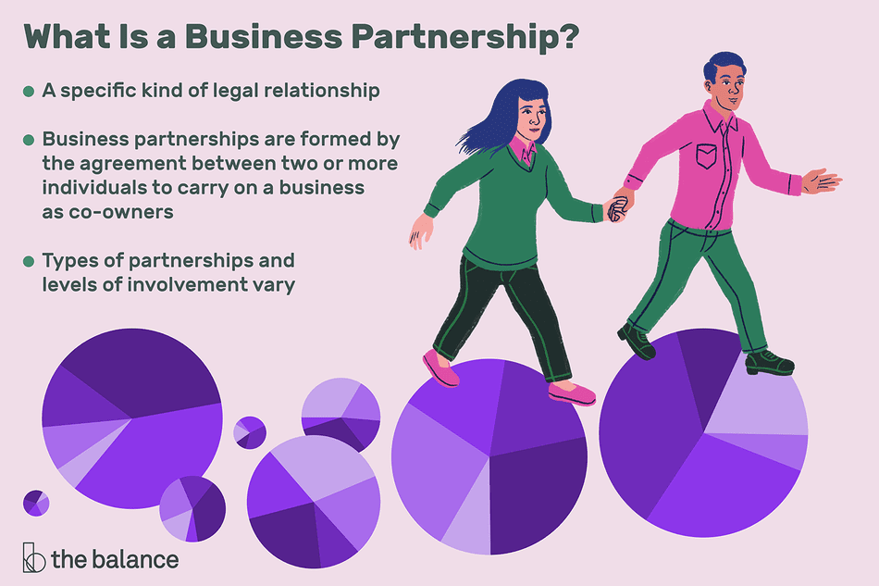
History of business

Slide 16
Musharka

Slide 17
PARTNERSHIP
CHARACTERISTICS
Agreement
Audit (Registered VS Unregistered)
Agent (An agent in commercial law (also referred to as a manager) is a person who is authorized to act on behalf of another (called the principal or client) to create a legal relationship with a third party.)
Business
Cooperation
Cont……….

Slide 18
PARTNERSHIP
CHARACTERISTICS
Dissolution
Legal Entity
Management
Number of Partners
Partnership Act 1932
Cont……….

Slide 19
PARTNERSHIP
CHARACTERISTICS
Payment of Tax
Profit and Loss Distribution
Share in Capital
Transfer of Rights
Unlimited Liability

Slide 20
ADVANTAGES OF PARTNERSHIP
Simplicity in Formation
Simplicity in Dissolution
Sufficient Capital
Skilled Workers
Sense of Responsibility
Cont……….

