Slide 1
Lecture 7
Instructor: Engr. Sajid Nawaz Khan

Slide 2
Transistor
A transistor is a device that is used to control current flow.
It is made of three layers of semiconductor material.
The construction is similar to the diode.
Transistors often take the place of mechanical switches and relays.
A transistor can be thought of as two diodes that share a common center layer.
A three lead semiconductor device that acts as;
an electrically controlled switch.
a current amplifier.

Slide 3
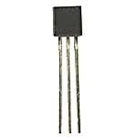
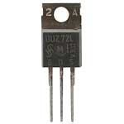
Transistor Types
Bipolar Junction Transistor (BJT),
NPN and PNP.
Junction Field Effect Transistor (JFET),
N-channel and P-channel.
Metal Oxide Semiconductor FET (MOSFET),
Depletion type (n- and p-channel) and enhancement type (n- and p-channel).
BJT
JFET
MOSFET

Slide 4
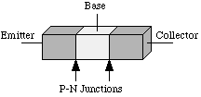
Bipolar Junction Transistor
BJT is bipolar because both holes (+) and electrons (-) will take part in the current flow through the device.
N-type regions contains free electrons (negative carriers).
P-type regions contains free holes (positive carriers).
A BJT is a three layer (npn or pnp) semiconductor device.
There are two pn junctions in the transistor.
The three layers are called the emitter, base and collector.

Slide 5
Bipolar Junction Transistor
The base is lightly doped and sandwiched between the collector and the emitter.
The collector is moderately doped and the emitter is heavily doped.
The base region is much thinner than the either the collector or emitter regions.
The collector region is usually thicker than the emitter as the largest amount of heat is dissipated in the collector.

Slide 6
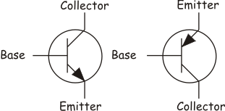
Bipolar Junction Transistor

Slide 7
Biasing the Transistor
The transistor operates in three modes depending on how the pn junctions in the device are biased.
Cutoff region; both junctions reverse biased.
Saturation region; both junctions forward biased.
Active region; base-emitter junction is forward biased and collector-base is reversed
biased.

Slide 8
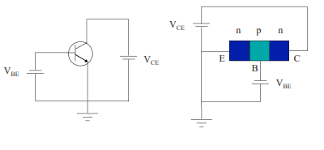
Biasing the Transistor
Cutoff;
Both junctions are reverse biased.
No current flows.

Slide 9
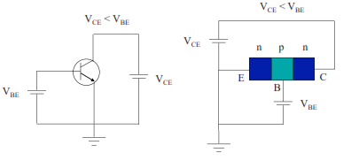
Biasing the Transistor
Saturation;
Both junctions are forward biased.
Maximum current flows.

Slide 10
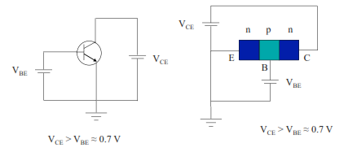
Biasing the Transistor
Active Region;
The BE junction is forward biased and the BC junction is reverse biased.
The base-emitter voltage is approximately 0.5 - 0.7 volts (the turn-on voltage of the junction).

Slide 11
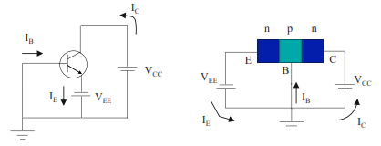
Biasing the Transistor
Active Region;
To make the biasing more obvious we can ground the base and use power supplies to bias the emitter and collector.
Notice that the BE junction is forward biased and the BC junction is reverse biased.

Slide 12
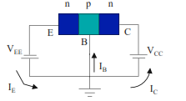
Active Operation
With the BE junction forward biased electrons diffuse across the junction into the base.
The base is very thin and lightly doped so there are relatively few holes in it compared with the electrons from the heavily doped emitter region.

Slide 13
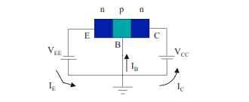
Active Operation
As there are few holes in the base for the electrons to combine with most of the electrons diffuse in to the reverse biased collector-base junction where the electric field in the depletion region sweeps them across into the collector.
Remember electrons are the minority carriers in the p material so they are swept across the depletion region.

Slide 14
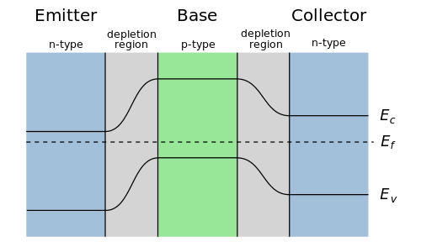
Active Operation
Unbiased;
A simplified electron energy diagram for the npn transistor

Slide 15
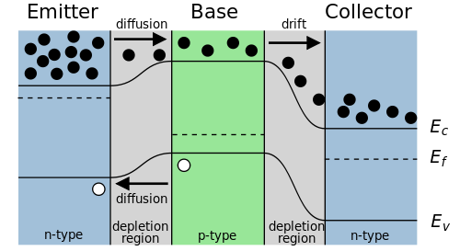
Active Operation
Biased;
A simplified electron energy diagram for the npn transistor

Slide 16
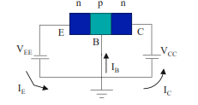
Active Operation
A small percentage of the electrons injected in to the base from the emitter do recombine with the holes in the base.
If left alone the base would slowly become more negative until the flow of electrons across the base stopped.
Electrons leave the base via the wire contact maintaining the small amount of holes in the base.
This flow of electrons is the small base current.

Slide 17
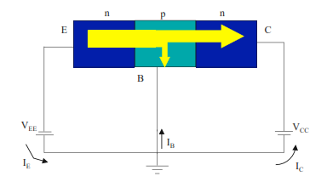
Active Operation
Electron flow through the transistor;

Slide 18
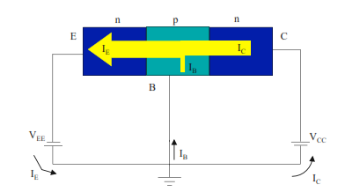
Active Operation
Conventional Current;

Slide 19
Active Operation
Kirchhoff's rule gives us;
The dc alpha is the ratio of collector to emitter current;
Typical transistors have values of a range from 0.95 to 0.995.

Slide 20
Active Operation
The ratio of the dc collector current to the dc base current is the dc beta rating of the transistor;
The dc beta can be related to the dc alpha;

Slide 21
Junction Field Effect Transistors (JFETs)

Slide 22
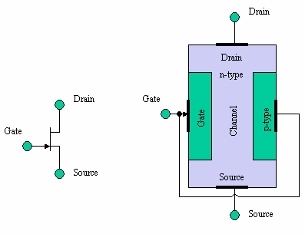
Junction Field Effect Transistors
Width of conducting channel is controlled by gate voltage;
Source emitter
Drain collector
Gate Base

Slide 23
JFETs vs. BJTs
JFETs have an extremely high input impedance for a given gain as compared to BJTs.
Smaller size.
Higher frequency response.
Voltage controlled rather than current controlled.

Slide 24
MOSFET
Metal Oxide Semiconductor FET.
Very low current devices.
Two types;
Enhancement.
Depletion.

Slide 25
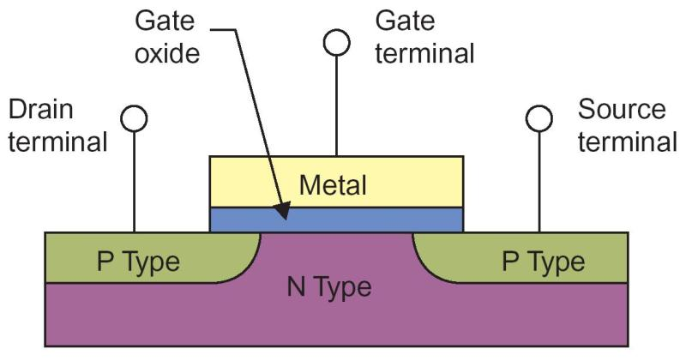
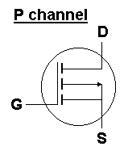
MOSFET
Enhancement;

Slide 26
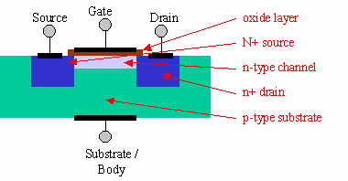
MOSFET
Depletion;

