Slide 1
Lesson 2 The Value Chain Model

Slide 2
The Value Chain Model
Michael Porter has proposed the value chain as a tool for identifying ways to create more customer value.
Understanding how your company creates value, and looking for ways to add more value, are critical elements in developing a competitive strategy. Michael Porter discussed this in his influential 1985 book "Competitive Advantage," in which he first introduced the concept of the value chain.
According to this model, every firm is a synthesis of activities performed to design, produce, market, deliver, and support its product.
The value chain identifies nine strategically relevant activities—five primary and four support activities—that create value and cost in a specific business.
A value chain is a set of activities that an organization carries out to create value for its customers. Porter proposed a general-purpose value chain that companies can use to examine all of their activities, and see how they're connected. The way in which value chain activities are performed determines costs and affects profits, so this tool can help you understand the sources of value for your organization.

Slide 3
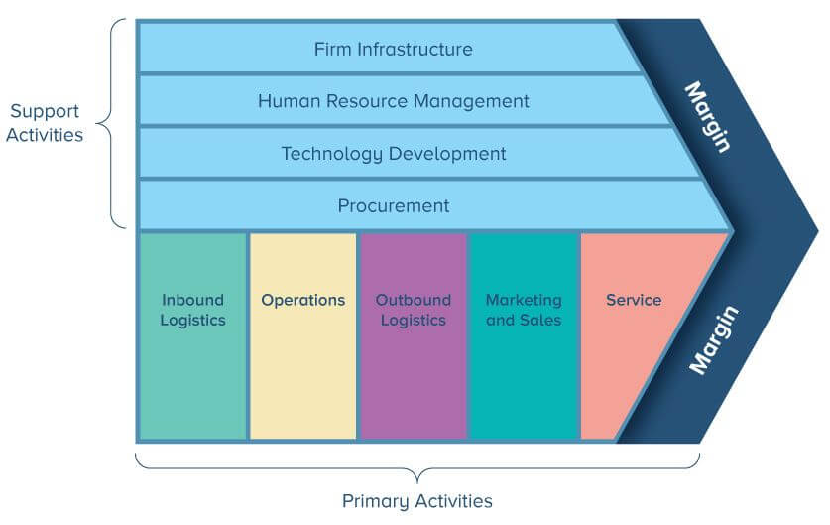
Porter’s Value Chain Model

Slide 4
The primary activities
(1) Inbound logistics, or bringing materials into the business;
(2) Operations, or converting materials into final products;
(3) Outbound logistics, or shipping out final products;
(4) Marketing, which includes sales;
(5) Service.
Secondary Activities:
(1) Procurement,
(2) Technology development,
(3) Human resource management,
(4) and firm infrastructure. (Infrastructure covers the costs of general management, planning, finance, accounting, legal, and government affairs)
The value that's created and captured by a company is the profit margin:
Value Created and Captured – Cost of Creating that Value = Margin

Slide 5
Primary activities
The first are primary activities which include the five main activities. All five activities are directly involved in the production and selling of the actual product.
They cover the physical creation of the product, its sales, transfer to the buyer as well as after sale assistance.
The five primary activities are
inbound logistics,
operations,
outbound logistics,
marketing & sales
and service.
Even though the importance of each category may vary from industry to industry, all of these activities will be present to some degree in each organization and play at least some role in competitive advantage.

Slide 6
Inbound Logistics
Inbound logistics is where purchased inputs suchs as raw materials are often taken care of. Because of this function, it is also in contact with external companies such as suppliers. The activities associated with inbound logistics are receiving, storing and disseminating inputs to the product. Examples: material handling, warehousing, inventory control, vehicle scheduling and returns to suppliers.
Operations
Once the required materials have been collected internally, operations can convert the inputs in the desired product. This phase is typically where the factory conveyor belts are being used. The activities associated with operations are therefore transforming inputs into the final product form. Examples: machining, packaging, assembly, equipment maintenance, testing, printing and facility operations.

Slide 7
Outbound Logistics
After the final product is finished it still needs to finds it way to the customer. Depending on how lean the company is, the product can be shipped right away or has to be stored for a while. The activities associated with outbound logistics are collecting, storing and physically distributing the product to buyers. Examples: finished goods warehousing, material handling, delivery vehicle operations, order processing and scheduling.
Marketing & Sales
The fact that products are produced doesn’t automatically mean that there are people willing to purchase them. This is where marketing and sales come into place. It is the job of marketeers and sales agents to make sure that potential customers are aware of the product and are seriously considering to purchase them. Activities associated with marketing and sales are therefore to provide a means by which buyers can purchase the product and induce them to do so. Examples: advertising, promotion, sales force, quoting, channel selection, channel relations and pricing. A good tool to structure the entire marketing process is the Marketing Funnel.

Slide 8
Service
In today’s economy, after-sales service is just as important as promotional activities. Complaints from unsatisfied customers are easily spread and shared due to the internet and the consequences on your company’s reputation might be vast. It is therefore important to have the right customer service practices in place. The activities associated with this part of the value chain are providing service to enhance or maintain the value of the product after it has been sold and delivered. Examples: installation, repair, training, parts supply and product adjustment.

Slide 9
Secondary/Support Activities
The second category is support activities. They go across the primary activities and aim to coordinate and support their functions as best as possible with each other by providing purchased inputs, technology, human resources and various firm wide managing functions.
The support activities can therefore be divided into procurement, technology development (R&D), human resource management and firm infrastructure.
The dotted lines reflect the fact that procurement, technology development and human resource management can be associated with specific primary activities as well as support the entire value chain.

Slide 10
Procurement
Procurement refers to the function of purchasing inputs used in the firm’s value chain, not the purchased inputs themselves. Purchased inputs are needed for every value activity, including support activities. Purchased inputs include raw materials, supplies and other consumable items as well as assets such as machinery, laboratory equipment, office equipment and buildings. Procurement is therefore needed to assist multiple value chain activities, not just inbound logistics.
Technology Development (R&D)
Every value activity embodies technology, be it know how, procedures or technology embodied in process equipment. The array of technology used in most companies is very broad. Technology development activities can be grouped into efforts to improve the product and the process. Examples are telecommunication technology, accounting automation software, product design research and customer servicing procedures. Typically, Research & Development departments can also be classified here.

Slide 11
Human Resource Management
HRM consists of activities involved in the recruiting, hiring (and firing), training, development and compensation of all types of personnel. HRM affects the competitive advantage in any firm through its role in determining the skills and motivation of employees and the cost of hiring and training them. Some companies (especially in the technological and advisory service industry) rely so much on talented employees, that they have devoted an entire Talent Management department within HRM to recruit and train the best of the best university graduates.

Slide 12
Firm Infrastructure
Firm infrastructure consists of a number of activities including general (strategic) management, planning, finance, accounting, legal, government affairs and quality management. Infrastructure usually supports the entire value chain, and not individual activities. In accounting, many firm infrastructure activities are often collectively indicated as ‘overhead’ costs. However, these activities shouldn’t be underestimated since they could be one of the most powerful sources of competitive advantage. After all, strategic management is often the starting point from which all smaller decisions in the firm are being based on. The wrong strategy will make it extra hard for people on the workfloor to perform well.

Slide 13
Core Competencies
Traditionally, companies owned and controlled most of the resources that entered their businesses—labor power, materials, machines, information, and energy—but many today outsource less-critical resources if they can obtain better quality or lower cost.
The key, then, is to own and nurture the resources and competencies that make up the essence of the business.
Many textile, chemical, and computer/electronic product firms do not manufacture their own products because offshore manufacturers are more competent in this task. Instead, they focus on product design and development and marketing, their core competencies.
Core competencies are special skills and capabilities of the firm that provides some competitive advantage in the marketplace. We are primarily interested in those skills and capabilities that allow the firm/brand to deliver superior customer value.
You should note that core competencies are skill sets that reside in the people and processes within the organization. They are ways that the organization operates, rather than the physical resources that the firm. You should use the words “expertise", “abilities", “skills", “know-how", “processes” and so on.
.

Slide 14
A core competency has three characteristics:
(1) It is a source of competitive advantage and makes a significant contribution to perceived customer benefits.
(2) It has applications in a wide variety of markets.
(3) It is difficult for competitors to imitate.
List of core competency examples
Innovation expertise
Speed and flexibility in the marketplace
Superior product development skills
Greater marketplace and customer understanding
Strong analysis and database skills
Industry/market knowledge and expertise
Experts in marketing communications
Fast or friendly customer service
Streamlined and efficient processes
Logistics expertise
Strategic/entrepreneurial insight
Skills in the early identification of trends/opportunities

Slide 15
PORTER’S GENERIC STRATEGIES
Michael Porter has proposed three generic strategies that provide a good starting point for strategic thinking: i.e. overall cost leadership, differentiation, and focus.
Overall cost leadership.
Firms work to achieve the lowest production and distribution costs so they can under price competitors and win market share. E.g Wal-Mart (Superior profit but lower cost)
2) Differentiation.
Creating a product or service that is perceived as being unique through out the industry. Differentiation can be based on product image or durability, after sales service, quality, additional features. E.g Oppo A9, Careem.
3) Focus.
Concentrating on the limited part of the market and with in the segment attempts to achieve either cost leadership or Differentiation. e.g. Pepsi Max, Cola Zero.

Slide 16
STRATEGIC ALLIANCES
Even giant companies—AT&T, Philips, and Nokia—often cannot achieve leadership, either nationally or globally, without forming alliances with domestic or multinational companies that complement or leverage their capabilities and resources.
Many strategic alliances take the form of marketing alliances. These fall into four major categories.

Slide 17
1) Product or service alliances
One company licenses another to produce its product, or two companies jointly market their complementary products or a new product. E.g Sony erricson.
2) Promotional alliances.
One company agrees to carry a promotion for another company’s product or service.
e.g. Shama cooking oil with Shaan masala.
3) Logistics alliances.
One company offers logistical services for another company’s product.
e.g Just in Time (JIT) concept, Dareworo, e.g TCS alliance with DHL.
4) Pricing collaborations.
One or more companies join in a special pricing collaboration. Hotel and rental car companies often offer mutual price discounts.

