Slide 1
Types of Foundations Structural Drawings
Civil Engineering Drawings & Graphics
Civil Engineering Department
Iqra National University

Slide 2
Foundation & Footing
FOUNDATION: Foundation is the lower portion of a building structure under columns and walls that transfers the building’s gravity load into the soil underneath foundation.
In other words, foundation is a structure that connects the superstructure with the ground and transfers the load from the superstructure to the ground. It provides support to the entire building.
FOOTING: Footing is a type of foundation which consists of concrete or brick, in square, rectangular or trapezoidal shape. Footing takes load from the column and transfers uniformly to soil to assure uneven settlement.

Slide 3
Foundation
Foundations and footings are installed under a building to provide stability for the building throughout its lifespan. Foundations are constructed, taking into consideration the soil conditions and environment around the construction site.
The function of a foundation is to re-distribute this load over a larger area
The load concentration becomes equal to the safe bearing capacity of the soil underneath (0.5 to 1.5 Tons/SFT.)
At the bottom of each foundation, lean concrete or a compacted mixture of brick-ballast with 25% sand is to be provided. Off set of this layer must be lesser than or equal to its depth (6” or 9”).

Slide 4
Types of Foundation
Generally, there are two broad categories of types of foundation.
Shallow Foundations (10’ depth)
A shallow foundation is a type of building foundation that transfers building loads to the earth very near to the surface, rather than to a subsurface layer or a range of depths as does a deep foundation.
Deep Foundations (66’ – 213’ depth)
A deep foundation is a type of foundation which transfers building loads to the earth farther down from the surface than a shallow foundation does, to a subsurface layer or a range of depths.

Slide 5
SHALLOW FOUNDATION OR SPREAD FOOTING:
The term "spread footing" is commonly used to refer to shallow foundations
A shallow foundation is used where the bearing soil layer is within 3m (10 feet) from the ground surface.
This type of foundation is mostly built for lightweight buildings where the condition of the soil is good with uniform layer and low water table
These should not be used on soils where there is any possibility of ground flow of water above bearing layer of soil which may result in liquefaction.
The wider base of this footing type spreads the weight from the building structure over more area and provides better stability.
Spread footing is also known as open foundation since the earth soil will be completely removed to construct the footing and later filled by backfilling.

Slide 6
Shallow Foundation
Types of shallow foundation:
Isolated footing
Combined footing
Strap footing
Strip or continuous footing
Mat footing or raft foundation

Slide 7
Isolated Footing
Isolated footings are one of the most economical types of footings. Sometimes, it is stepped to spread the load over a larger area.
They are used in the case of light column loads, when columns are not closely spaced and are spaced at relatively long distances
When footing is provided to support an individual column then isolated footing is used
Furthermore, they are used in the case of good homogeneous soil
Isolated or single footings are structural elements used to transmit and distribute loads of single columns to the soil without exceeding its bearing capacity, in addition to preventing excessive settlement and providing adequate safety against sliding and overturning.

Slide 8
Types of Isolated Footing
There are various types of isolated footings such as:
Flat footing
Slope footing
Step footing
It is circular, square or rectangular slab of uniform thickness.
Each type of footing is selected based on the soil condition and configuration of imposed loads.

Slide 9
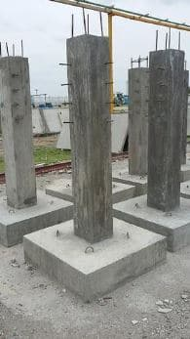
FLAT, PAD OR PLAIN FOOTING:
It is constructed under each column independently and is usually square, rectangular, or circular in shape. The thickness of flat isolated footing is uniform. It is provided so as to reduce the bending moments and shearing forces at their critical sections. It can be constructed from plain concrete or reinforced concrete to increase the ultimate load carrying capacity.

Slide 10
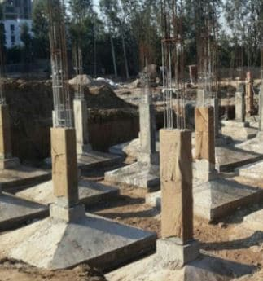
SLOPED FOOTING:
Sloped or trapezoidal footings are designed and executed with utmost attention to maintain a top slope of 45 degrees from all sides. The amount of reinforcement and concrete used in the sloped footing construction is less than that of plain isolated footing. Therefore, it decreases the utilization of concrete and reinforcement.

Slide 11
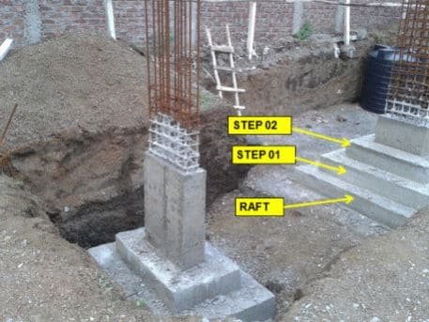
STEPPED FOOTING:
Previously, the construction of this type of isolated footing was popular, but its application has declined nowadays. It is generally used in the construction of residential buildings.

Slide 12
In stepped foundation, brick wall is expanded below ground level in different steps.
Three concrete cross-sections are stacked upon one another to create steps.
If detailed calculations of the loads is not possible, the number of steps are found out by dividing the wall thickness in inches by 4.5”
The increase in thickness of the wall in one step should be 2 ¼ inches on either side with a total of 4.5 inches.
The height of each step may vary but is generally 6” depending upon the required depth of foundation from the ground level.
2 ¼ Inch
6 Inch

Slide 13
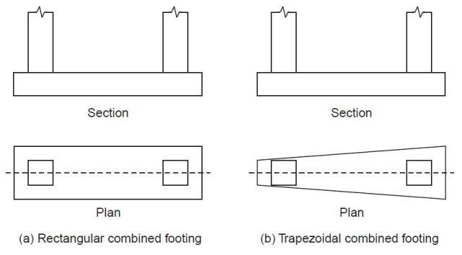
COMBINED FOOTING:
It supports two columns. It is used when the two columns are so close to each other that their individual footings would overlap where shuttering is not possible. A combined footing is also provided when the property line is so close to one column that a spread footing would be eccentrically loaded when kept entirely within the property line. By combining it with that of an interior column, the load is evenly distributed. A combine footing may be rectangular or trapezoidal in plan. Trapezoidal footing is provided when the load on one of the column is larger than the other column.

Slide 14
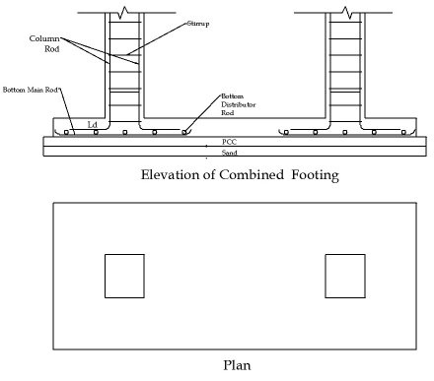

Slide 15
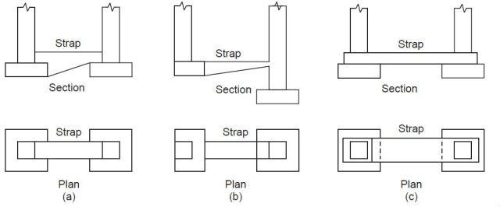
STRAP FOOTING
It consists of two isolated footings connected with a structural strap or a lever. The strap connects the footing such that they behave as one unit. The strap simply acts as a connecting beam.
A strap footing is more economical than a combined footing when the allowable soil pressure is relatively high and distance between the columns is large.

Slide 16
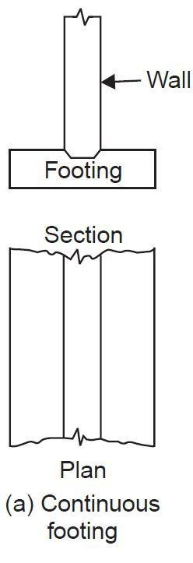
STRIP OR CONTINUOUS FOOTING
Strip foundations are continuous footing which is provided for a load bearing wall. A strip footing can also be provided for a row of columns which are so closely spaced that their spread footings overlap or nearly touch each other. In such cases, it is more economical to provide a strip footing than to provide a number of isolated footings in one line. A strip footing is also known as continuous footing. The footing will be constructed continually under the walls to support the load developed on the walls.
Strip foundation are used in support of a line of load, especially load bearing wall. While Isolated footing are used for sustaining concentrated loads from a single point load such as structural columns.

Slide 17
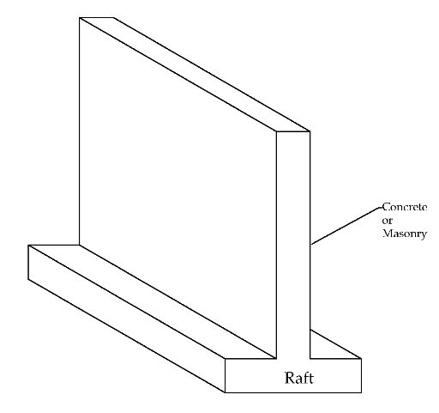

Slide 18
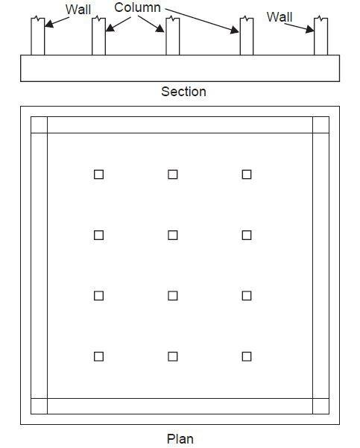
MAT OR RAFT FOOTING:
It is a large slab supporting a number of columns and walls under entire structure or a large part of the structure. A mat is required when the allowable soil pressure is low. Mat foundations are useful in reducing the differential settlements on non-homogeneous soils or where there is large variation in the loads on the individual columns.
You mostly see these type of foundation for High Residential Building construction where it has a basement.

Slide 19
Mat Footing
This type of foundation will be constructed under two situations,
Inconsistent Earth Soil Layer – The condition of the soil extremely differs in various places under the building layout where designer can’t able to calculate the load and design the foundation as we done in spread footings. So they come up with Mat or Raft Foundation where the total load of the building will be spread throughout the foundation
Cost Effective – Once the designer designs the foundation they analyse the cost of the foundation construction. If the foundation has a number of columns very adjacent to others, it will likely to increase the stuttering cost and concrete cost, Comparing these conditions the designer will design mat or Raft foundation where the construction will be easy and cost effective.

Slide 20
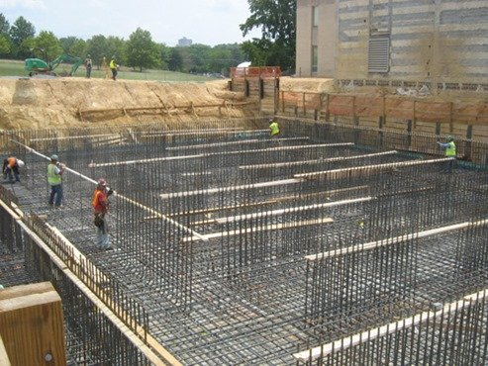

Slide 21
Deep Foundation
Deep foundation means as the name suggests the foundation will be penetrated through the weak soil layer at a great depth and supported on top of strong soil layer or on the rock.
The foundation shall be greater than the shallow foundation (>3m). Normally all deep foundations are referred us pile foundation. But there are other types,
Normally all deep foundations are referred us pile foundation. But there are some other types,

Slide 22
Deep Foundation
Types of Deep Foundation:
Pile Foundation
Caisson Foundation
Drilled Shaft Foundation

Slide 23
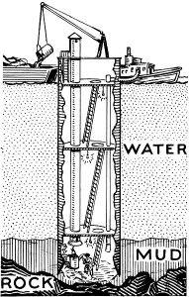
CAISSON FOUNDATION:
Caisson is a prefabricated hollow box or cylinder sunk into wet or unstable ground to some desired depth and then filled with concrete thus forming a foundation. Once the concrete hardens the shape will be removed from the hole or water
It is a watertight chamber, open at the bottom, from which the water is kept out by air pressure and in which construction work may be carried out under water.
It is often used as a bridge pier, in the construction of a concrete dam, or for the repair of ships; sometimes used in commercial construction.
Caisson foundations are often used in large construction under water bodies such as river, sea.

Slide 24
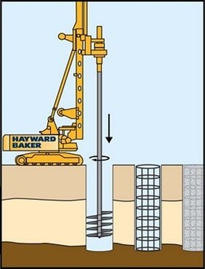
PIER FOUNDATION OR DRILLED CAISSONS:
These type of foundations are used in bridges and large structures such as metro train projects
Pier is typically dug out and cast in place using forms.
Step 1 – Drilling the shaft
Step 2 – Placing the cage
Step 3 – Pouring the concrete

Slide 25
Pier Foundation, also called as drilled caissons, is a type of deep foundation and has action similar to pile foundations, but are high capacity cast-in-situ foundations
The construction of drilled caissons are done using an Auger Drill Device.
It is used where depth of hard strata below ground level is locate within 10m to 100m (25 feet to 300 feet).
Drilled caisson is not suitable when deep deposits of soft clays and loose water-bearing granular soils exists. It is also not suitable for soils where caving formations are difficult to stabilize such as soils made up of boulders or artesian aquifer. An artesian aquifer is an underground layer which holds groundwater under pressure. This causes the water level in the well to rise

Slide 26
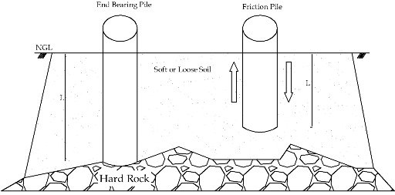
Pile Foundations
Pile means the vertical member or a column of material. which will be driven by a pile driver and penetrated through great depth.

Slide 27
PILE FOUNDATION:
Pile foundation is a type of deep foundation which is used to transfer heavy loads of structures through columns to a hard rock strata which is much deep below the ground level where shallow foundations such as spread footings and mat footings cannot be used.
This is also used to prevent uplift of structure due to lateral loads such as earthquake and wind forces.
Pile foundations are generally used for soils where soil conditions near the ground surface is not suitable for heavy loads.
The depth of hard rock strata may be 5m to 50m (15 feet to 150 feet) deep from the ground surface.
Use of pile foundations also prevents differential settlement of foundations.

Slide 28
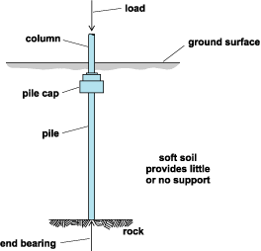

Slide 29
Differences
Difference between piling and footing
A structure need a foundation that supports it. If the structure is built on a soil that has bearing capacity which can withstand the weight of the whole structure, then you can design the foundation on footings alone. But if the soil is WEAK, you need piles to penetrate further the soil to have greater bearing strength.
Difference between Foundation & Footing
A Footing is the part of foundation or a foundation unit in brick work masonry or concrete under the base of walls or columns for the purpose of distributing the load over a large area.
A Footing is placed immediately below the lower part of super structure which transfers the load directly to the soil.
Foundation makes a base for the wall to sit on so that it doesn't push into the ground. This is usually, but not always, 3 times the width of the wall. Without it, the wall would act as a knife and with the weight of the structure, cut into the ground.

Slide 30
Differences
Difference between pile foundation and pier foundation
A pile is more slender than a pier. They are essentially the same thing. The pile is far better then pier because the total mass is divided equally between each pile used in pile foundation and the foundation is very much stable.
Difference between a pile foundation and an ordinary foundation
Pile foundations are typically much deeper than they are wide. This means that their ability to resist loads is mainly derived from the vertical friction of the side of the pile against the soil (skin friction). However it should be noted that a number of closely spaced piles will act as a group and as such can also have significant resistance to loads by end bearing.
Regular foundations rely on the bearing pressure between the soil and the underside of the foundation, they are cheaper and more common. Piles will be used when greater forces are needed to be transferred to the ground over a smaller area, such as with high rise buildings and those in densely built up areas where land comes at a premium and ground movements will affect neighboring buildings.

