Slide 1
Entrepreneurship
Robert D. Hisrich
Michael P. Peters
Dean A. Shepherd
Link: https://www.amazon.com/Entrepreneurship-Robert-Hisrich/dp/0073530328

Slide 2
Entrepreneurship
The process of creating something new with value by devoting the necessary time and effort: assuming the accompanying financial, psychic, and social risks and uncertainties: and receiving the resulting reward of monetary and personal satisfaction.

Slide 3
Nature and Development of Entrepreneurship
Entrepreneur – An individual who takes initiative to bundle resources in innovative ways and is willing to bear the risk and/or uncertainty to act.
Being an entrepreneur today:
Involves creation process.
Requires devotion of time and effort.
Involves rewards of being an entrepreneur.
Requires assumption of necessary risks.

Slide 4
Nature and Development of Entrepreneurship (cont.)
Entrepreneurial action –
Behavior in response to a judgmental decision under uncertainty about a possible opportunity for profit.

Slide 5
intrapreneur
an employee within a large company who takes direct responsibility for turning an idea into a profitable new product, service, business, etc.

Slide 6
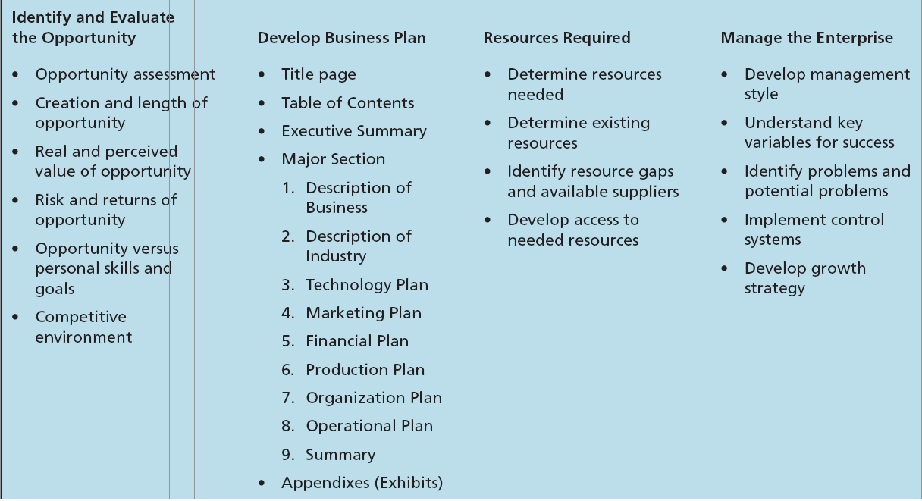
Aspects of the Entrepreneurial Process

Slide 7
The Entrepreneurial Process
Opportunity identification –
The process by which an entrepreneur comes up with the opportunity for a new venture.
Market size and the length of the window of opportunity are the primary bases for determining risks and rewards.
Window of opportunity –
The time period available for creating the new venture.
Business plan –
The description of the future direction of the business.

