Slide 1
Electrical Transmission System
In last lecture we have discussed about voltage regulation, transmission efficiency and performance of single phase short transmission line. In this lecture we will study about Three-Phase Short Transmission Lines, Effect of Load p.f. on Regulation and Efficiency.

Slide 2
(i) Three-Phase Short Transmission Lines
For reasons associated with economy, transmission of electric power is done by 3-phase system. This system may be regarded as consisting of three single phase units, each wire transmitting one-third of the total power. As a matter of convenience, we generally analyse 3-phase system by considering one phase only.

Slide 3
Therefore, expression for regulation, efficiency etc. derived for a single phase line can also be applied to a 3-phase system. Since only one phase is considered, phase values of 3-phase system should be taken. Thus, VS and VR are the phase voltages, whereas R and XL are the resistance and inductive reactance per phase respectively.
Fig. (i) shows a Y-connected generator supplying a balanced Y-connected load through a transmission line. Each conductor has a resistance of R Ω and inductive reactance of XL Ω. Fig. (ii) shows one phase separately. The calculations can now be made in the same way as for a single phase line.

Slide 4
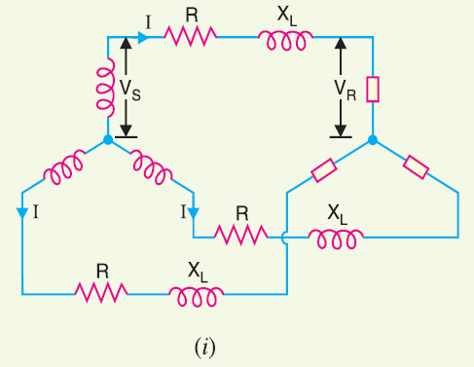

Slide 5
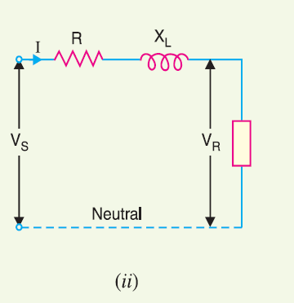

Slide 6
Effect of Load p.f. on Regulation and Efficiency
The regulation and efficiency of a transmission line depend to a considerable extent upon the power
factor of the load.
1. Effect on regulation. The expression for voltage regulation of a short transmission line is
given by :

Slide 8
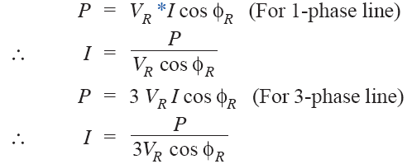
2. Effect on transmission efficiency. The power delivered to the load depends upon the
power factor.

Slide 9
It is clear that in each case, for a given amount of power to be transmitted (P) and receiving end voltage (VR), the load current I is inversely proportional to the load p.f. cos φR.
Consequently, with the decrease in load p.f., the load current and hence the line losses are increased. This leads to the conclusion that transmission efficiency of a line decreases with the decrease in load p.f. and vice-versa.

Slide 10
Example. A single phase overhead transmission line delivers 1100 kW at 33 kV at 0·8 p.f. lagging. The total resistance and inductive reactance of the line are 10 Ω and 15 Ω respectively.
Determine :
sending end voltage
sending end power factor and
transmission efficiency.

Slide 11
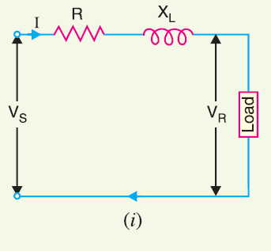

Slide 12
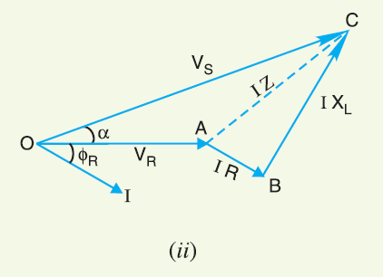

Slide 13
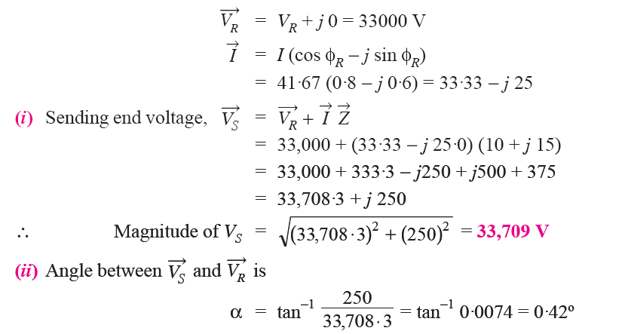
The equivalent circuit and phasor diagram of the line are shown in Figs. (i) and (ii) respectively. Taking receiving end voltage VR as the reference phasor,

Slide 14
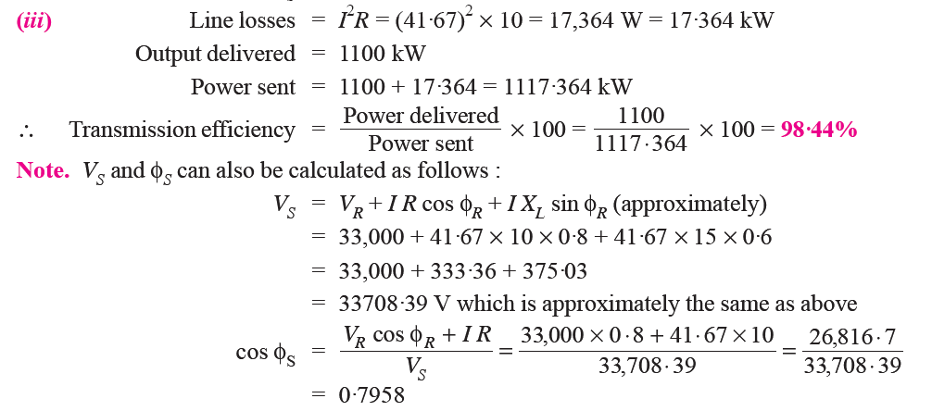

Slide 15
References
Principles of Power Systems by V.K Mehta

