Slide 1
Electrical Transmission System
In last lecture we have discussed about Skin Effect and Classification of Overhead transmission Lines. In this lecture we will study about voltage regulation, transmission efficiency and performance of single phase short transmission line.

Slide 2
(i) Voltage regulation.
When a transmission line is carrying current, there is a voltage drop in the line due to resistance and inductance of the line. The result is that receiving end voltage (VR) of the line is generally less than the sending end voltage (VS). This voltage drop (VS − VR) in the line is expressed as a percentage of receiving end voltage VR and is called voltage regulation.

Slide 3
The difference in voltage at the receiving end of a transmission line between conditions of no load and full load is called voltage regulation and is expressed as a percentage of the receiving end voltage.

Slide 4
Mathematically,
Obviously, it is desirable that the voltage regulation of a transmission line should be low i.e., the increase in load current should make very little difference in the receiving end voltage.

Slide 5
(ii) Transmission efficiency.
The power obtained at the receiving end of a transmission line is generally less than the sending end power due to losses in the line resistance.
The ratio of receiving end power to the sending end power of a transmission line is known as the transmission efficiency of the line i.e.

Slide 6
Performance of Single Phase Short Transmission Lines
As stated earlier, the effects of line capacitance are neglected for a short transmission line. Therefore, while studying the performance of such a line, only resistance and inductance of the line are taken
into account.
The equivalent circuit of a single phase short transmission line is shown in Fig. (i).
Here, the total line resistance and inductance are shown as concentrated or lumped instead of being distributed. The circuit is a simple a.c. series circuit.

Slide 8
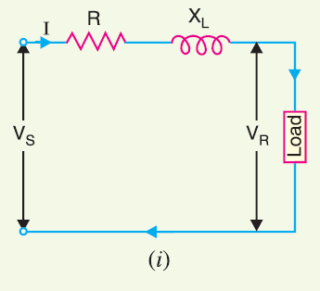

Slide 9
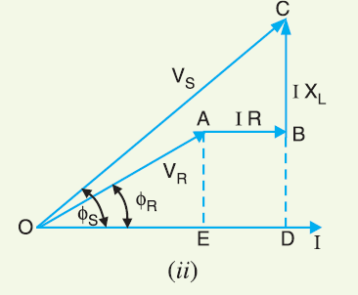

Slide 10
The phasor diagram of the line for lagging load power factor is shown in Fig. (ii). From the right angled traingle ODC, we get,

Slide 11
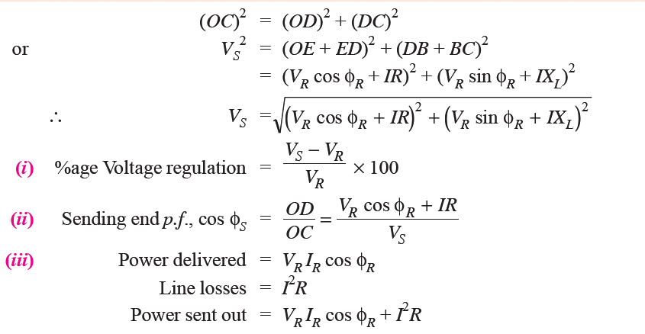

Slide 13
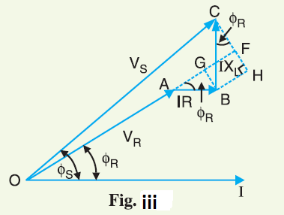
An approximate expression for the sending end voltage VS can be obtained as follows. Draw perpendicular from B and C on OA produced as shown in Fig.iii. Then OC is nearly equal to OF i.e.,

Slide 15
References
Principles of Power Systems by V.K Mehta

