Slide 2
Course
Project Management

Slide 3
Project integration Management
The processes and activities to identify, define, combine, unify, and
coordinate the various processes and project management activities within the Project Management Process Groups.

Slide 4
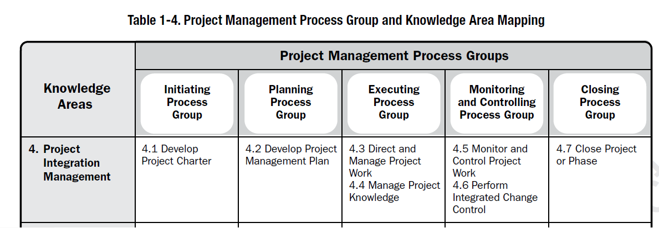
Project integration management

Slide 5
Project integration Management
Project Integration Management is specific to project managers.
The project manager is ultimately responsible for the project as a whole.
Characteristics of unification, consolidation, communication, and interrelationship.

Slide 6
Latest trends in Project integration Management
Use of automated tools
Use of visual management tools
Project knowledge management
Expanding the project manager’s responsibilities

Slide 7
Project Charter
Project Charter is the process of developing a document that formally authorizes the existence of a project and provides the project manager with the authority to apply organizational resources to project activities.

Slide 8
Project Charter
There is a direct link between the project and the strategic objectives of the organization, creates a formal record of the project, and shows the organizational commitment to the project

Slide 9
Project Charter
The project charter establishes a partnership between the performing and requesting organizations.
Internal agreements within an organization to ensure proper delivery under the contract.
Approved project charter formally initiates the project.

Slide 10
Project Charter
Project Charter is developed by the sponsor.
It provides the project manager with the authority to plan, execute, and control the project.

Slide 11
Project Charter
At a high level, the project charter ensures a common understanding by the stakeholders of the key deliverables, milestones, and the roles and responsibilities of everyone involved in the project.

Slide 12
Project Charter includes
Project purpose
Measurable project objectives
High-level requirements
High-level project description, boundaries, and key deliverables.
Overall project risk
Summary milestone schedule
Preapproved financial resources
Cont………

Slide 13
Project Charter includes
Key stakeholder list
Project approval requirements
Project exit criteria
Assigned project manager, responsibility, and authority level
Name and authority of the sponsor

Slide 15
quiz
List down the project constraints ?

Slide 16
Next Class
Bring project charter of your organization ?

Slide 17
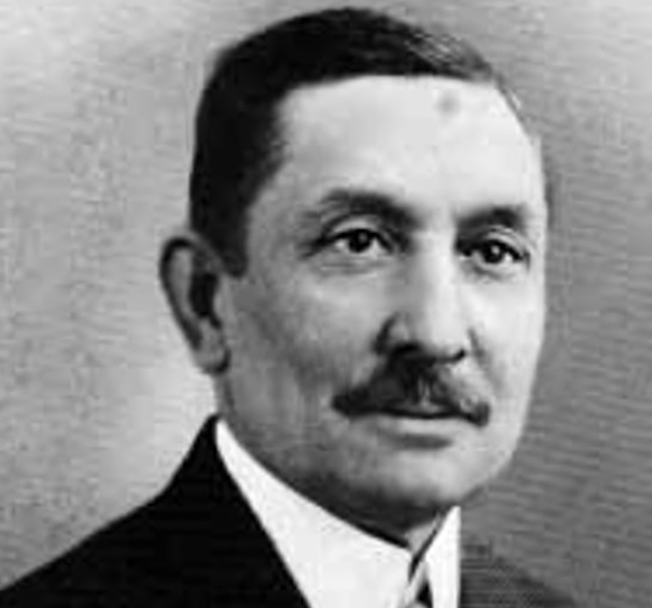
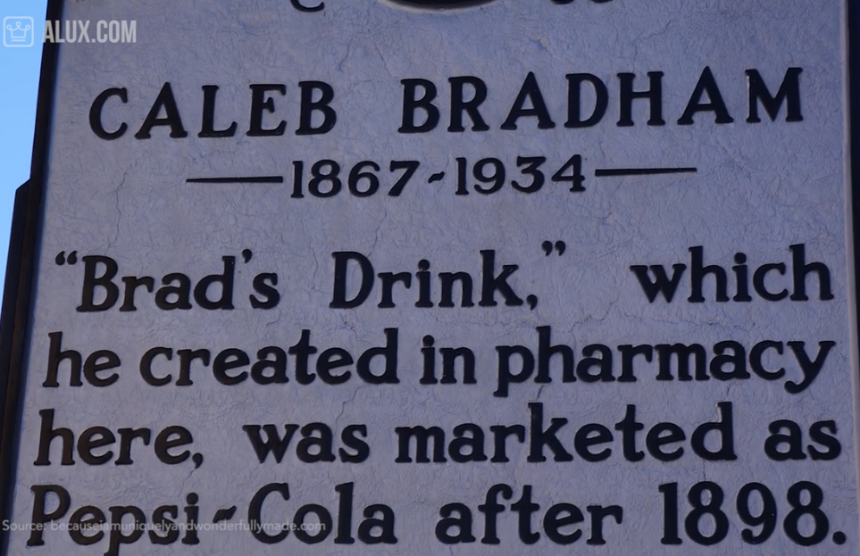
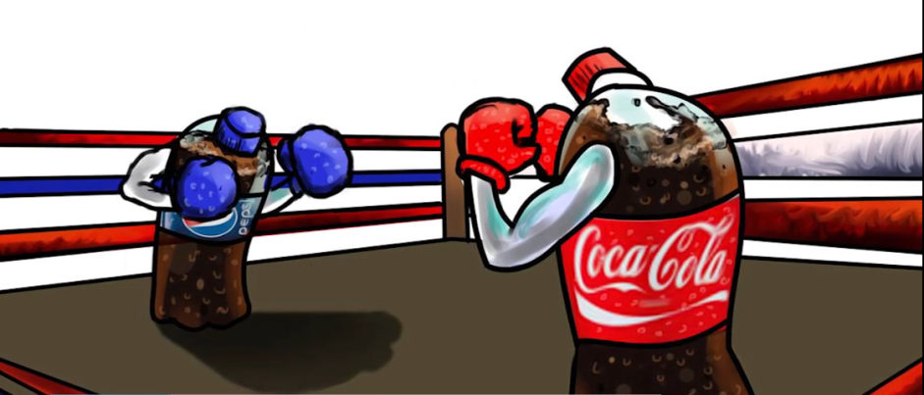
PEPSI
Started in 1893
Digestive enzyme Pepsin ( tonic for digestive)
Sip test Taste Campaign

Slide 18
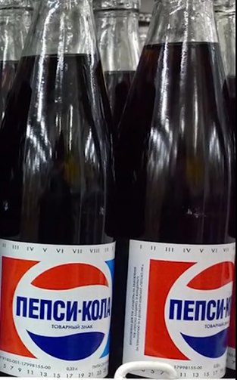
PEPSI
3 times PESPSI sale offer to COCACLOA in 1922-1933
PEPSI saved herself from bankruptcy by doubling the size of bottle
PEPSI ice cream in RUSSIA and PEPSI strawberry milk in JAPAN
Fists USA brand sold in RUSSIA, N KOREA, CUBA
1959 trade show PEPSI taste try
*** 08 Spoons of sugar in a regular can****
60% Calorie decline by 2025 which declined the sale
In USA

