Slide 1
Performance Appraisal:
Myth and Reality (part 2)

Slide 2
Potential Purpose: Driving Results
A performance management process intended to drive the achievement of key business results is typically designed to ensure that individual, group, and enterprise goals and expectations are clearly defined, focused on key priorities, and well connected to the drivers of results.
There are several characteristics of performance management processes that are intended to drive performance

Slide 3
There are multiple, formal channels for communicating performance expectations and goals and ensuring goal alignment across groups.
There is rigorous, formal performance measurement at several levels in the organization, with an appropriate balance among financial, operational, and customer-based metrics.
There are mechanisms and tools in place that help employees understand how they can affect the drivers of business success in their daily work.

Slide 4
Trap/Myth: The process needs to be streamlined; it’s too burdensome.
Response: The claim that the process is too burdensome—often about three hours per year per employee—is a red herring for a different problem: the perception that the process adds little value.
Key Message: The cost of doing this well is significant, but the cost of the opportunity missed is enormous!
Watch Out! Trap/Myth: The organization needs to change its performance management process to better weed out poor performers.
Response: Weeding out poor performers is a management responsibility that transcends the performance management process.
Key Message: Design the process to help people improve results, not walk the plank!

Slide 5
Potential Purpose: Building Capability
A performance management process intended to drive capability development is typically designed to help employees understand what they need to learn and how they need to learn it.
There are several characteristics of performance management processes that are intended to build capability:

Slide 6
Managers and employees are able and willing to engage in constructive conversations, establishing a culture of dialog that serves as the foundation to performance management.
The five types of conversation are:
Laying the groundwork for a relationship between an employee and a manager or coach/mentor.
Clarifying expectations and standards between a performer and a manager, coach, or project leader.
Providing performance information on an ongoing basis to ensure that the performer understands progress against goals/standards and can make course corrections if necessary.
Intervening in a problem where an employee must significantly improve his/her performance in one or more areas to remain a viable employee.
Creating development strategies and plans to address performance opportunities and needs based on feedback.

Slide 7
Performance feedback is used as a primary tool for development, with different types of feedback that can be delivered, depending on the situation.
Employees are expected to be in a constant growth and learning mode.
Coaching and mentoring programs and processes are used on a fairly formal basis to provide employees with ongoing support as they develop and apply new competencies.

Slide 8
Trap/Myth: More assessors are needed to diminish favoritism and distrust.
Response: While some degree of assessment is needed, objective performance information is often more helpful and positively received by the employee.
Key Message: Judgment is worthless; observation is priceless!

Slide 9
Potential Purpose: Carving up Consequences
A performance management process intended to carve up consequences is typically designed to yield a performance assessment that can easily be used to make decisions involving compensation, work assignments, career advancement, and/or recognition.

Slide 10
There are several characteristics of performance management processes that are intended to carve up consequences:
The way in which measures and goals are developed lends itself to differentiating individuals and/or groups.
The performance assessment process culminates in an overall numerical or text-based rating, reflecting a scale with multiple gradations.
There are formal guidelines for ensuring that performance ratings are well distributed, such as forced ranking or suggested distribution “audited” by HR.
There are formal processes in place for ranking employees based on an overall rating and supporting managerial input.

Slide 12
Strategies for Running the Gauntlet (to pass tough path)
Develop different purposes and approaches for different employee groups (if needed).

Slide 13
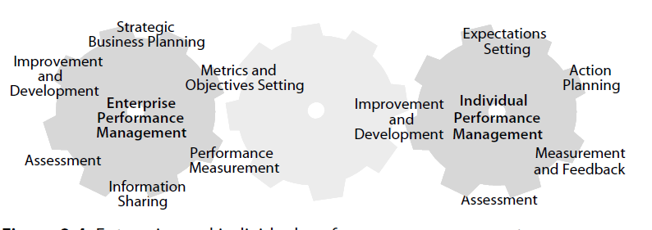
Integrate the enterprise with the individual.

Slide 15
Create a culture of conversation and performance information.
Invest more in process execution than program design.

Slide 16
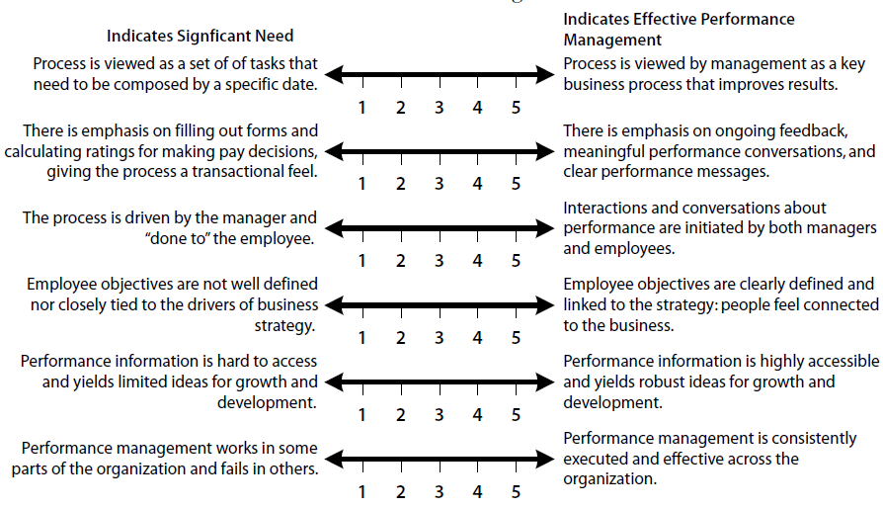
Determining the Need for Change
Why the need for change? Using a few formal indicators of the need for change can serve as the backbone of this diagnostic process

