Slide 1
Lecture 6
Instructor: Engr. Sajid Nawaz Khan

Slide 2
Electrical Properties of Solids
Conductors;
  e.g. copper or aluminum.
  having free electrons.
  If an electric field is applied electrons will flow causing an electric current.
Insulators;
  e.g. polythene.
  electrons are tightly bound to atoms so few can break free to conduct electricity.

Slide 3
Electrical Properties of Solids
Semiconductors;
  e.g. silicon, germanium and gallium arsenide.
  at very low temperatures these have the properties of insulators.
  as the material warms up some electrons break free and can move about and it takes the properties of a conductor.
  however, semiconductors have several properties that make them distinct from conductors and insulators.

Slide 4
Semiconductors
Pure semiconductors;
  thermal vibration results in some bonds being broken generating free electrons.
  these leave behind holes which accept electrons from adjacent atoms electrons are negative charge carriers.
  holes are positive charge carriers.
At room temperatures there are few charge carriers;
  pure semiconductors are poor conductors.
  this is intrinsic conduction.

Slide 5
Semiconductors
Doping;
  the addition of small amounts of impurities drastically affects its properties.
  some materials form an excess of electrons and produce an n-type semiconductor.
  some materials form an excess of holes and produce a p-type semiconductor.
  both n-type and p-type materials have much greater conductivity than pure semiconductors.
  this is extrinsic conduction.

Slide 6
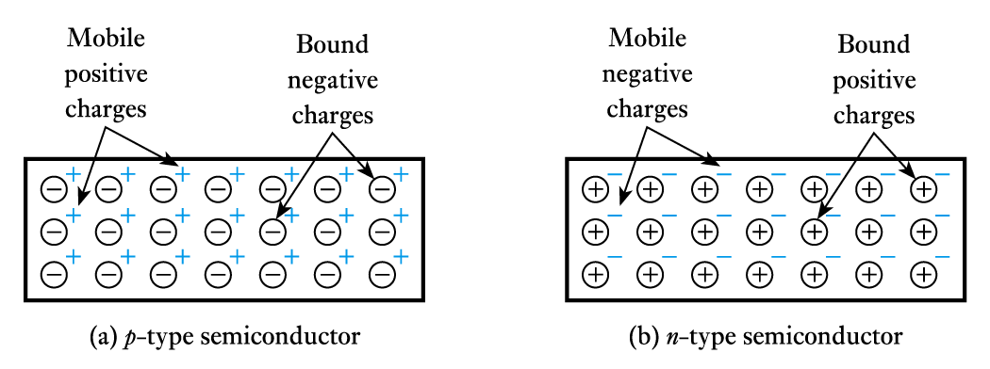
Semiconductors
The dominant charge carriers in a doped semiconductor (e.g. electrons in n-type
material) are called majority charge carriers.
Other type are minority charge carriers.
The overall doped material is electrically neutral.

Slide 7
Diode
A diode is an electronic component that;
  has two terminals,
  limits current to one direction.
Diodes have an anode and a cathode.
Positive current normally flows from the anode to the cathode.
Diodes are useful for protecting circuitry from harmful voltage or current.
Diodes are a basic building block of the charge-collecting element in many detectors.

Slide 8
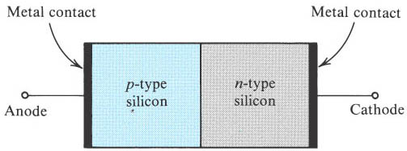
Physical Structure
The most important region, which is called pn junction, is the boundary between n-
type and p-type semiconductor.

Slide 9
Characteristics
Conducting in one direction and not in the other is the I-V characteristic of the diode.
The arrow like circuit symbol shows the direction of conducting current.
Forward biasing voltage makes it turn on.
Reverse biasing voltage makes it turn off.

Slide 10
Basic Semiconductor Concepts
Intrinsic Semiconductor.
Doped Semiconductor.
Carriers movement.

Slide 11
Intrinsic Semiconductor
A crystal of pure and regular lattice structure is called intrinsic semiconductor.
Materials;
  Silicon; today's IC technology is based entirely on silicon.
  Germanium; early used.
  Gallium arsenide; used for microwave circuits.

Slide 12
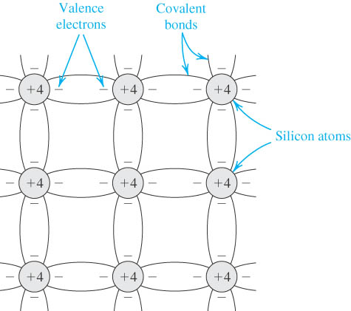
Intrinsic Semiconductor(cont’d)
Two-dimensional representation of the silicon crystal.
The circles represent the inner core of silicon atoms, with +4 indicating its positive charge of +4q, which is neutralized by the charge of the four valence electrons.
Observe how the covalent bonds are formed by sharing of the valence electrons. At 0 K, all bonds are intact and no free electrons are available for current conduction.

Slide 13
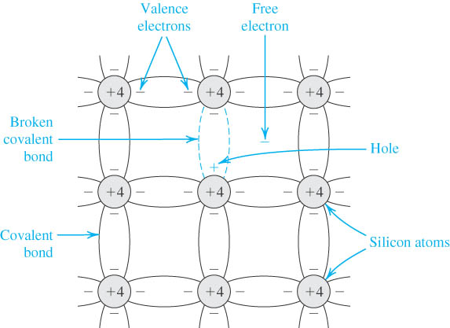
Intrinsic Semiconductor(cont’d)
At room temperature, some of the covalent bonds are broken by thermal ionization.
Each broken bond gives rise to a free electron and a hole, both of which become available for current conduction.

Slide 14
Intrinsic Semiconductor(cont’d)
Carriers;
    A free electron is negative charge and a hole is positive charge.
    Both of them can move in the crystal structure.
    They can conduct electric current.

Slide 15
Doped Semiconductor
Doped semiconductors are materials in which carriers of one kind predominate.
Only two types of doped semiconductors are available.
Conductivity of doped semiconductor is much greater than the one of intrinsic semiconductor.
The pn junction is formed by doped semiconductor.

Slide 16
Doped Semiconductor(cont’d)
n type semiconductor;
Concept;
  Doped silicon in which the majority of charge carriers are the negatively charged electrons is called n type semiconductor.
Terminology;
  Donor; impurity provides free electrons, usually entirely ionized.
  Positive bound charge; impurity atom donating electron gives rise to positive bound charge..
  carriers
    Free electron; majority, generated mostly by ionized and slightly by thermal ionization.
    Hole; minority, only generated by thermal ionization.

Slide 17
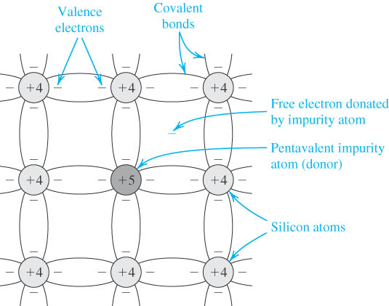
Doped Semiconductor(cont’d)
A silicon crystal doped by a pentavalent element.
Each dopant atom donates a free electron and is thus called a donor.
The doped semiconductor becomes n type.

Slide 18
Doped Semiconductor(cont’d)
p type semiconductor;
Concept;
  Doped silicon in which the majority of charge carriers are the positively charged holes is called p type semiconductor.
Terminology;
  Acceptor; impurity provides holes, usually entirely ionized.
  negatively bound charge; impurity atom accepting hole give rise to negative bound charge.
  Carriers;
    Hole; majority, generated mostly by ionized and slightly by thermal ionization.
    Free electron; minority, only generated by thermal ionization.

Slide 19
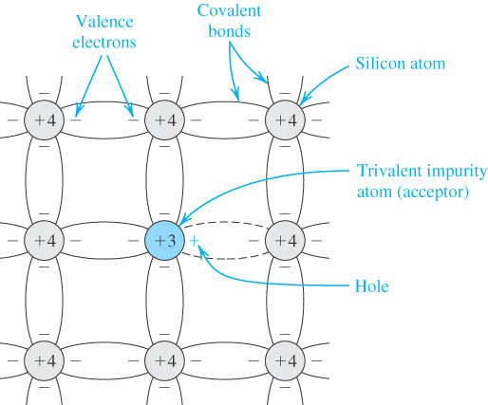
Doped Semiconductor(cont’d)
A silicon crystal doped with a trivalent impurity.
Each dopant atom gives rise to a hole and the semiconductor becomes p type.

Slide 20
Carriers Movement
There are two mechanisms by which holes and free electrons move through a silicon crystal;
    Drift;
      The carrier motion is generated by the electrical field across a piece of silicon.
      This motion will produce drift current.
    Diffusion;
      The carrier motion is generated by the different concentration of carrier in a piece of silicon.
      The diffused motion usually carriers diffuse from high concentration to low concentration will give rise to diffusion current.

Slide 21
pn Junction
The pn junction under open-circuit condition.
I-V characteristic of pn junction;
  Terminal characteristic of junction diode.
  Physical operation of diode.
Junction capacitance.

Slide 22
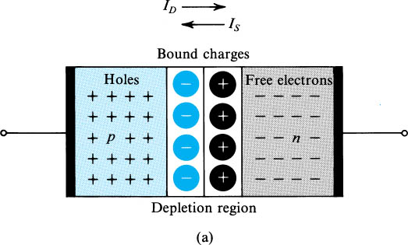
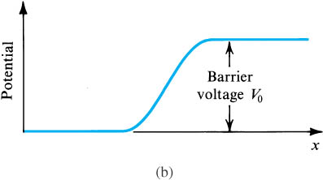
pn Junction Under Open-Circuit Condition
Usually the pn junction is asymmetric,
there are p⁺n and pn^{+.}
The superscript “+” denotes the region is
more heavily doped than the other region.
    Fig (a) shows the pn junction with no applied voltage (open-circuited terminals).
    Fig.(b) shows the potential distribution along an axis perpendicular to the junction.

Slide 23
Procedure of Forming pn Junction
The procedure of forming pn junction the dynamic equilibrium of drift and diffusion movements for carriers in the silicon.
In detail, there are 4 steps;
  Diffusion,
  Space charge region,
  Drift,
  Equilibrium.

Slide 24
Procedure of Forming pn Junction
Diffusion;
    Both the majority carriers diffuse across the boundary between p-type and n-type semiconductor.
    The direction of diffusion current is from p side to n side.

Slide 25
Procedure of Forming pn Junction
Space charge region;
  Majority carriers recombining with minority carriers results in the disappearance of majority carriers.
  Bound charges, which will no longer be neutralized by majority carriers are uncovered.
  There is a region close to the junction that is depleted of majority carriers and contains uncovered bound charges.
  This region is called carrier-depletion region or space charge region.

Slide 26
Procedure of Forming pn Junction
Drift;
  Electric field is established across the space charge region.
  Direction of electronic field is from n side to p side.
  It helps minority carriers drift through the junction.
  It acts as a barrier for majority carriers to diffusion.

Slide 27
Procedure of Forming pn Junction
Equilibrium;
  Two opposite currents across the junction is equal in magnitude.
  No net current flows across the pn junction.
  Equilibrium conduction is maintained by the barrier voltage.

Slide 28
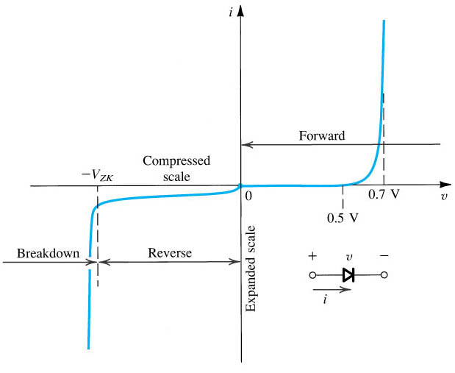
I-V Characteristics
The diode i–v relationship with some scales expanded and others compressed in order to reveal details.

Slide 29
I-V Characteristic Curve
Terminal Characteristic of Junction Diodes;
      The Forward-Bias Region, determined by
      The Reverse-Bias Region, determined by
      The Breakdown Region, determined by

Slide 30
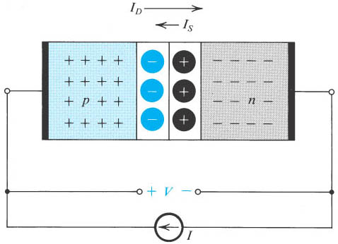
The pn Junction Under Forward-Bias Conditions
The pn junction excited by a constant-
current source supplying a current I in
the forward direction.
The depletion layer narrows and the
barrier voltage decreases by V volts,
which appears as an external voltage in
the forward direction.

Slide 31
The pn Junction Under Forward-Bias Conditions
Turn-on voltage;
    A conduction diode has approximately a constant voltage drop across it,
    It’s called turn-on voltage.
Diodes with different current rating will exhibit the turn-on voltage at different currents.
For silicon
For germanium

Slide 32
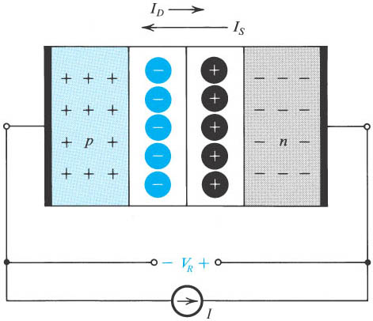
The pn Junction Under Reverse-Bias Conditions
The pn junction excited by a constant-
current source I in the reverse direction.
To avoid breakdown, I is kept smaller
than I_{S .}
Note that the depletion layer widens and
the barrier voltage increases by V_{R} volts,
which appears between the terminals as a
reverse voltage.

Slide 33
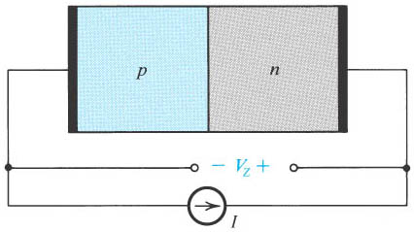
The pn Junction in the Breakdown Region
The pn junction excited by a reverse-current source I, where I > I_{S.}
The junction breaks down and a voltage V_{Z} , with the polarity indicated, develops across the junction.

Slide 34
The pn Junction In the Breakdown Region
Supposing , the current source will move holes from p to n through the
external circuit.
The free electrons move through opposite direction.
This result in the increase of barrier voltage and decrease almost zero of diffusion
current.
To achieved the equilibrium, a new mechanism sets in to supply the charge carriers
needed to support the current I .

Slide 35
Breakdown Mechanisms
Zener effect;
  Occurs in heavily doping semiconductor.
  Breakdown voltage is less than 5v.
  Carriers generated by electric field---field ionization.
Avalanche effect;
  Occurs in slightly doping semiconductor.
  Breakdown voltage is more than 7v.
  Carriers generated by collision.

Slide 36
Zener diode
The zener diode is a silicon pn junction devices that differs from normal diodes because it is designed for operation in the reverse-breakdown region.
The breakdown voltage of a zener diode is set by carefully controlling the level during manufacturing.
The basic function of zener diode is to maintain a specific voltage across it’s terminals within given limits of line or load change.
Typically it is used for providing a stable reference voltage for use in power supplies and other equipment.

Slide 37
Zener diode
The exception being is that it is placed in the circuit in reverse bias and operates in reverse breakdown.
This typical characteristic curve illustrates the operating range for a zener.
Note that it’s forward characteristics are just like a normal diode.

Slide 38
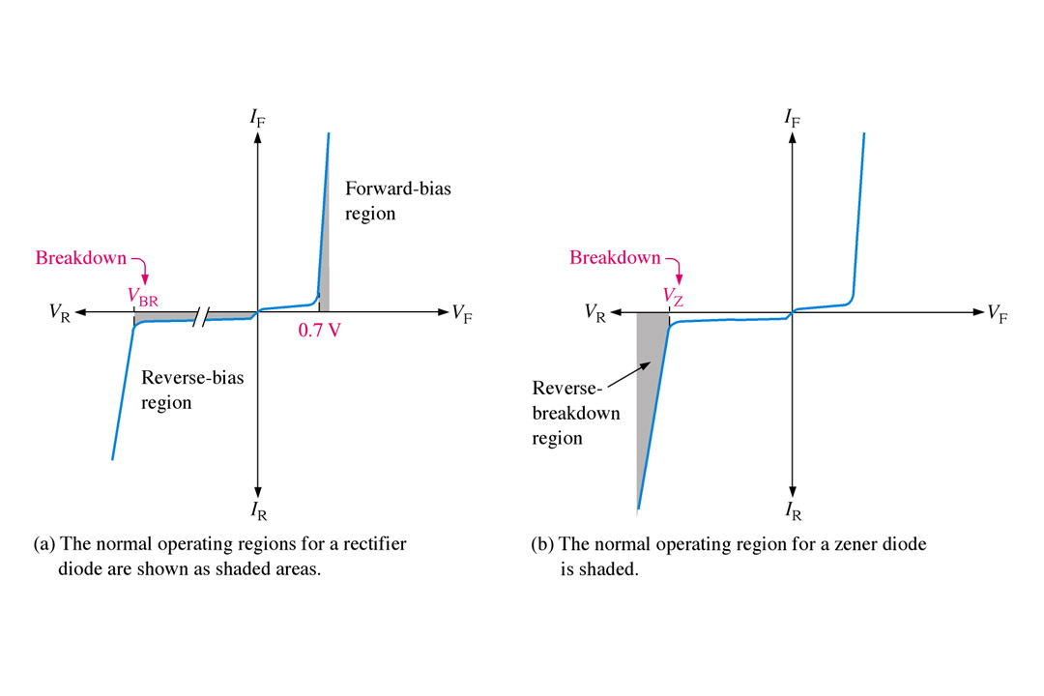
Zener diode
Volt-ampere characteristic is shown in this Figure with normal operating regions for rectifier diodes and for zener diodes shown as shaded areas.

Slide 39
Zener Breakdown
Zener diodes are designed to operate in reverse breakdown.
Two types of reverse breakdown in a zener diode are avalanche and zener.
The avalanche break down occurs in both rectifier and zener diodes at a sufficiently high reverse voltage.
Zener breakdown occurs in a zener diode at low reverse voltages.
A zener diode is heavily doped to reduced the breakdown voltage.
This causes a very thin depletion region.

Slide 40
Zener Breakdown
As a result, an intense electric field exists within the depletion region.
Near the zener breakdown voltage (V_{z}), the field is intense enough to pull electrons from their valence bands and create current.
The zener diodes breakdown characteristics are determined by the doping process.
Low voltage zeners less than 5V operate in the zener breakdown range.
Those designed to operate more than 5 V operate mostly in avalanche breakdown range.
Zeners are commercially available with voltage breakdowns of 1.8 V to 200 V.

Slide 41
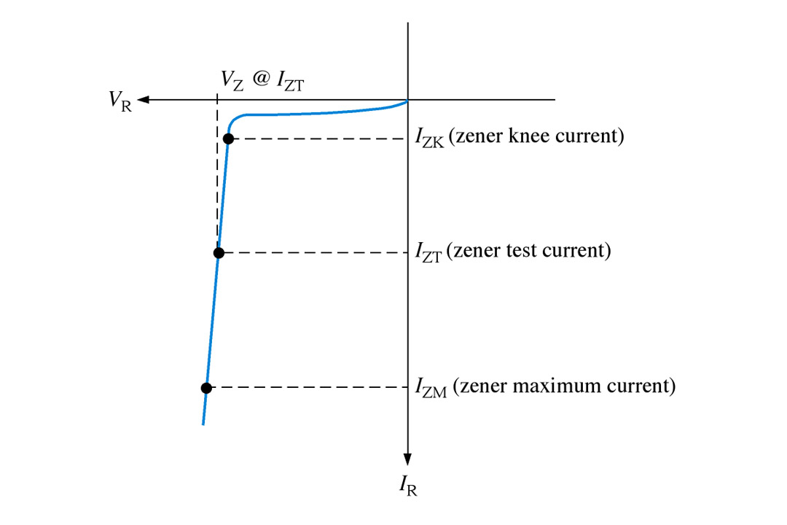
Breakdown Characteristics
Figure shows the reverse portion of a zener diode’s characteristic curve.
As the reverse voltage (V_{R}) is increased, the reverse current (I_{R}) remains extremely small up to the “knee” of the curve.
The reverse current is also called the zener current, I_{Z.}
At this point, the breakdown effect begins; the internal zener resistance, also called zener impedance (Z_{Z}), begins to decrease as reverse current increases rapidly.

Slide 42
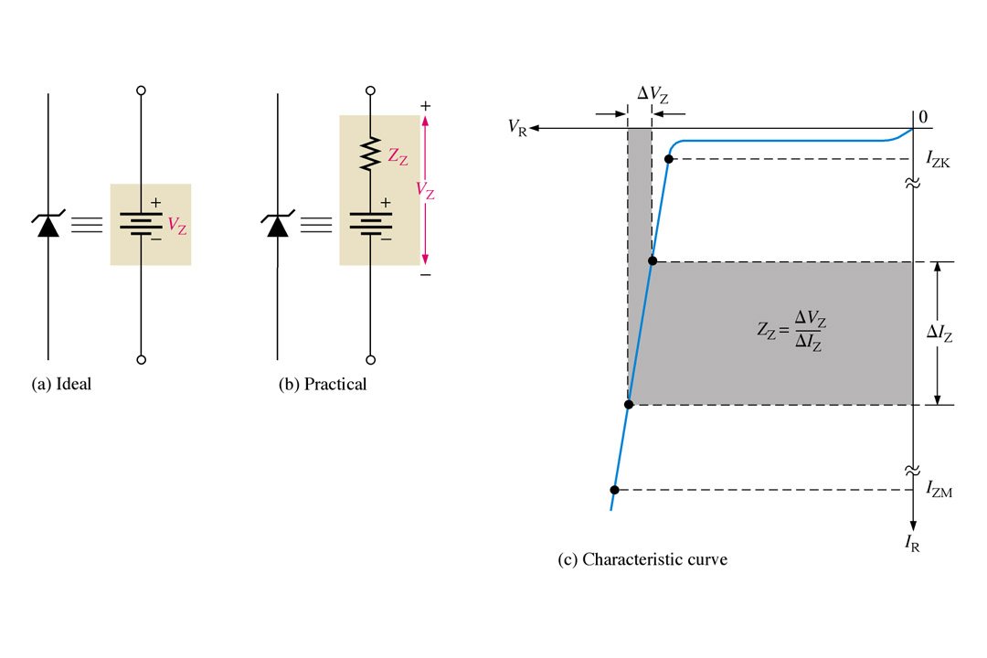
Zener Equivalent Circuit
Figure (b) represents the practical model of a zener diode, where the zener impedance (Z_{Z}) is included.
Since the actual voltage curve is not ideally vertical, a change in zener current (ΔI_{Z}) produces a small change in zener voltage (ΔV_{Z}), as illustrated in Figure (c).

Slide 43
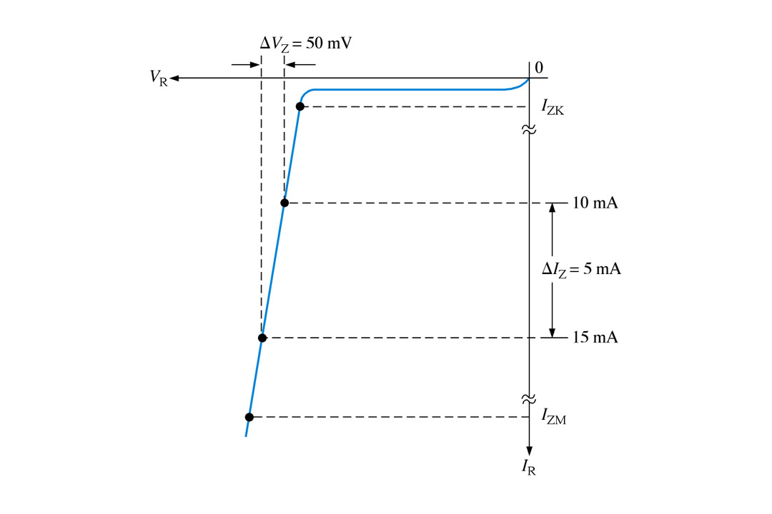
Example
A zener diode exhibits a certain change in V_{Z} for a certain change in I_{Z} on a portion of
the linear characteristic curve between I_{ZK} and I_{ZM} as illustrated in Figure. What is the
zener impedance?

Slide 44
Zener Diode Regulation Ranges
Zener zone
Diode zone
The zener diode’s breakdown characteristics are determined by the doping process.
Zeners are available with voltage breakdowns of 1.8 V to 200 V.
Avalanche
zone
5V.
This curve illustrates the minimum and maximum ranges of current operation that the zener can effectively maintain its voltage

Slide 45
Junction Capacitance
Diffusion Capacitance;
  Charge stored in bulk region changes with the change of voltage across pn junction gives rise to capacitive effect.
  Small-signal diffusion capacitance.
Depletion capacitance;
  Charge stored in depletion layer changes with the change of voltage across pn junction gives rise to capacitive effect.
  Small-signal depletion capacitance.

Slide 46
Application of Diode Circuits
Rectifier circuits;
  Half-wave rectifier,
  Full-wave rectifier,
    Transformer with a center-tapped secondary winding,
    Bridge rectifier.

Slide 47
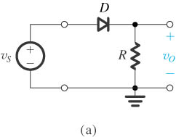
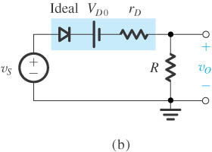
Half-Wave Rectifier
Half-wave rectifier.
Equivalent circuit of the half-wave
rectifier with the diode replaced with its
battery-plus-resistance model.

Slide 48
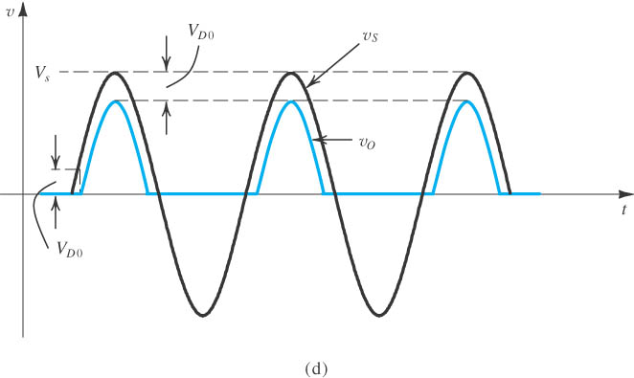
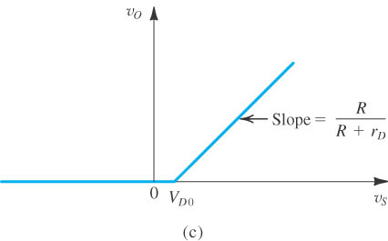
Half-Wave Rectifier
(c) Transfer characteristic of the rectifier circuit.
(d) Input and output waveforms, assuming that

Slide 49
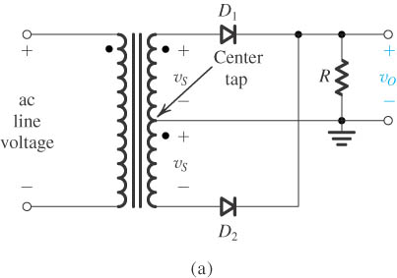
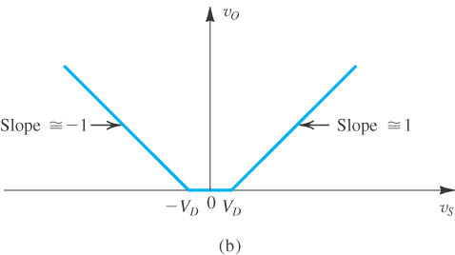
Full-Wave Rectifier
circuit,
transfer characteristic assuming a constant-voltage-drop model for the diodes.

Slide 50
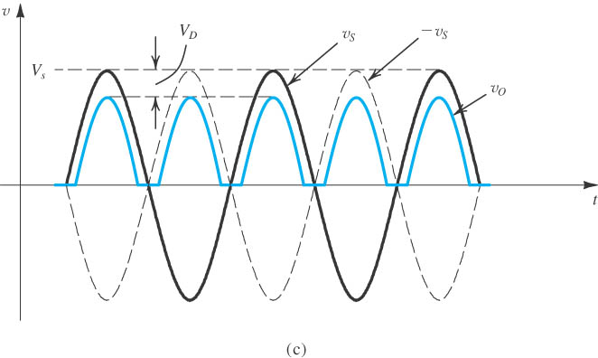
Full-Wave Rectifier
(c) input and output waveforms

Slide 51
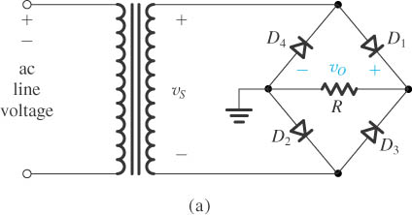
Bridge Rectifier
(a) circuit

Slide 52
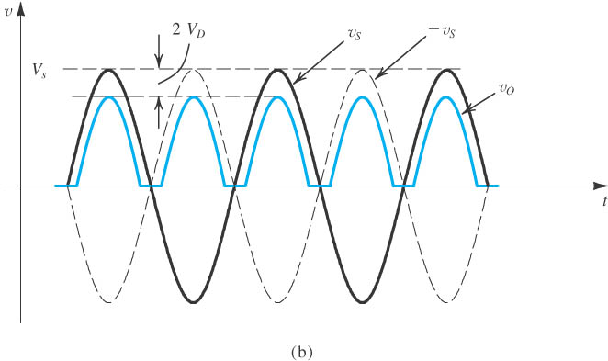
Bridge Rectifier
(b) input and output waveforms

Slide 53
Transformer Rectifier Units
A transformer rectifier unit (TRU) is used to convert AC into relatively smooth DC. An example of a simple TRU circuit is that which is used in a car battery charger, as shown below;

Slide 54
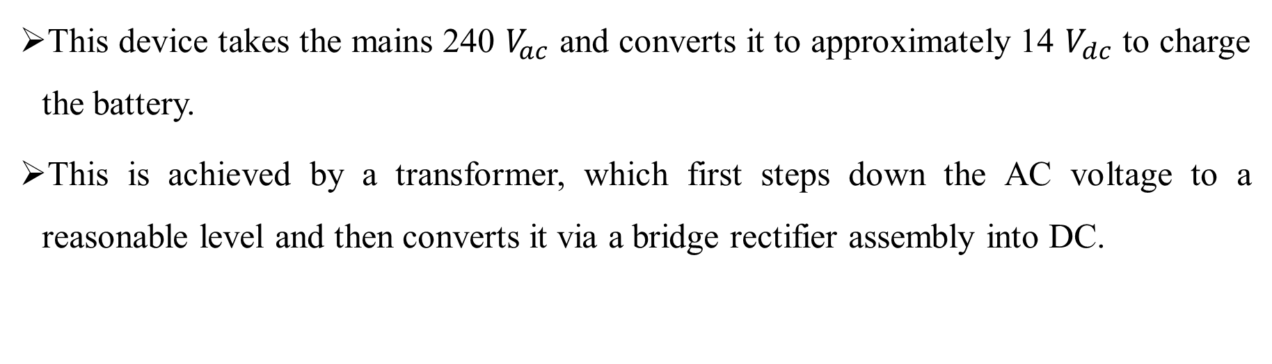
Transformer Rectifier Units
This device takes the mains 240 $V_{ac}$ and converts it to approximately 14 $V_{dc}$ to charge the battery.
This is achieved by a transformer, which first steps down the AC voltage to a reasonable level and then converts it via a bridge rectifier assembly into DC.

