Slide 2
Intro: Engr. Saleha Durrani B.Sc. Electrical Engineering from UET Pesh. Masters in Communications from UET Pesh.

Slide 3
Subject: Electronics II Lecture # 10.

Slide 4
2. Variations of Summing Amplifier
1. Averaging amplifier
2. Scaling amplifier

Slide 5
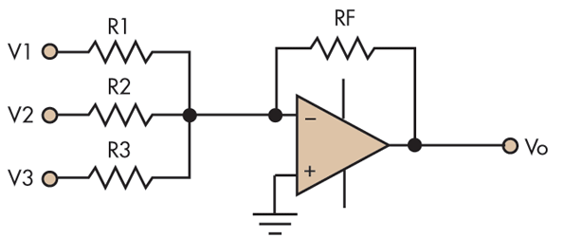
1. Averaging Amplifier
A summing amplifier can be made to produce the mathematical average of the input voltages. This is done by setting the ratio Rf/R equal to the reciprocal of the number of inputs(n)
Formula:
Rf/R= 1/n

Slide 6
Problem # 13.7
Show that the amplifier produces an output whose magnitude is the mathematical average of the input voltages.

Slide 7
2. Scaling Adder
In a scaling amplifier each input will be multiplied by a different factor and then summed together. Scaling amplifier is also called a weighted amplifier.
A different weight can be assigned to each input of a summing amplifier by simply adjusting the values of input resistors
Formula:
Vout=-[(Rf *Vin1 /R1) + (Rf*VIN2/R2) + (Rf*VIN2/R3) +…..+ (Rf*VINn/Rn)]

Slide 8
Integrator
An Opamp integrator simulates mathematical integration, which is basically a summing process that determines the total area under the curve of a function.
“In an ideal integrator the feedback element is capacitor that forms an RC circuit with the input resistor R.”
If the input signal is of a sine wave of varying frequency the Integrator Amplifier begins to behave like an active "Low Pass Filter",

Slide 9
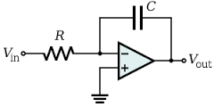
How Capacitor Charges
Q=Ic * t……………eq.1
Q= C*Vc…………eq.2
From eq.1 and eq.2 we can say that
=>Ic * t = C*Vc
Formula 1:
Vc=[Ic x t]
C
Vc=[Ic/C] x t
Formula 2:
Iin= Vin
Rin

Slide 10
Practical Op-amp Integrator

Slide 11
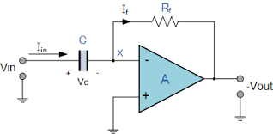
Differentiator
Differentiator simulates mathematical differentiations which is a process of determining the instantaneous rate of change of a function.
“It produces output that is proportional to the rate of change of the input voltage.”

Slide 12
Op-Amp Differentiator
Ideal Differentiator: Here the capacitor is the input element and the resistor is the feedback element.
A Differentiator produces an output that is proportional to the rate of change of input voltage.
Formula:
Ic=[Vc]* C
t

Slide 13
Practical Differentiator

Slide 14
Peak Detector
“Peak detector detects and holds the most positive value attained by the input signal prior to the time when switch is closed”
“It is used for detecting signal level peaks”.
In the given circuit,
Capacitor: A capacitor retains the peak voltage level of the signal.
Switch: A switch is used for resetting the detected level.

Slide 15
Mountain Peaks

Slide 16
Circuit Diagram

Slide 18
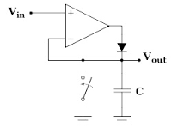
Operation of Op-Amp Peak Detector
The operation can be explained as follows, assume the switch is open and if
V_{out} < V_{in} (Inverting input <N. Inverting input) the op amp output V is positive so that
the diode conducts and the capacitor charges to
the input value at that instant as it forms a voltage follower circuit.

Slide 19
b) When V_{out} > V_{in}, (Inverting input >N. Inverting input) op amp output V’ is negative and the diode becomes reverse biased.
Thus the capacitor charges to the most positive value of input.

Slide 20
Hence the operation of opamp peak detector can be summarized as follows
V_{out} < V_{in}; Diode ON and C charges to peak value of input,
V_{out} < V_{in}; Diode OFF and C holds the peak value of input.

Slide 21
Rectifiers
Purpose: The purpose of the rectifier section is to convert the incoming ac signal from a transformer or other ac power source to some form of pulsating dc.

Slide 22
Half Wave Rectifier

Slide 23
Half wave rectifier
An easy way to convert ac, to pulsating dc, is to simply allow half of the ac cycle to pass, while blocking current to prevent it from flowing during the other half cycle.
They only work on half of the incoming ac wave.

Slide 24
Full Wave Rectifier

Slide 25
Full wave rectifiers
Full wave rectifiers manipulate the incoming ac wave so that both halves are used to cause output current to flow in the same direction.
The resulting waveform is shown to the right. Because these circuits operate on the entire incoming ac wave, they are known as full-wave rectifiers.

