Slide 1
Lecture 10
Instructor: Engr. Syed Ashraf Ali

Slide 3
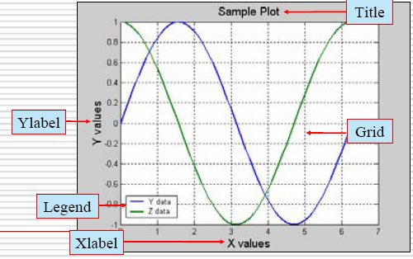
2D Plotting
Example: Plot sin(x) and cos(x) over [0,2π], on the same plot with different colours.
Method 1:
>> x = linspace(0,2*pi,1000);
>> y = sin(x);
>> z = cos(x);
>> hold on;
>> plot(x,y,‘b’);
>> plot(x,z,‘g’);
>> xlabel ‘X values’;
>> ylabel ‘Y values’;
>> title ‘Sample Plot’;
>> legend (‘Y data’,‘Z data’);
>> hold off;

Slide 4
2D Plotting
Method 2:
>> x = 0:0.01:2*pi;
>> y = sin(x);
>> z = cos(x);
>> figure
>> plot (x,y,x,z);
>> xlabel ‘X values’;
>> ylabel ‘Y values’;
>> title ‘Sample Plot’;
>> legend (‘Y data’,‘Z data’);
>> grid on;

Slide 5
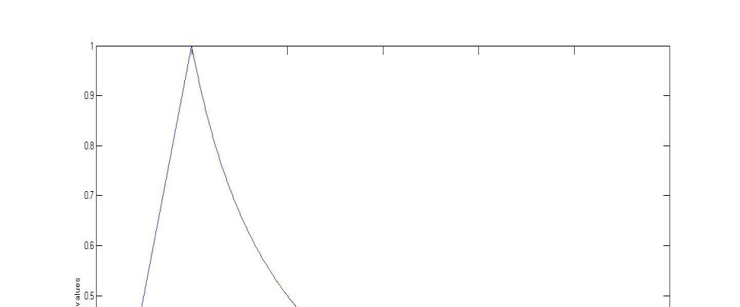
2D Plotting
Example:Plot the following function y$=\left\{\begin{aligned}t 0≤t≤1 \\ &\frac{1}{t} 1≤t≤6\end{aligned}\right.$
Method 1:
>> t1 = linspace(0,1,1000);
>> t2 = linspace(1,6,1000);
>> y1 = t1;
>> y2 = 1./ t2;
>> t = [t1,t2];
>> y = [y1,y2];
>> figure
>> plot(t,y);
>> xlabel ‘t values’, ylabel ‘y values’;

Slide 6
2D Plotting
Method 2:
>> t = linspace(0,6,1000);
>> y = zeros(1,1000);
>> y(t()<=1) = t(t()<=1);
>> y(t()>1) = 1./ t(t()>1);
>> figure
>> plot(t,y);
>> xlabel‘t values’;
>> ylabel‘y values’;

Slide 7
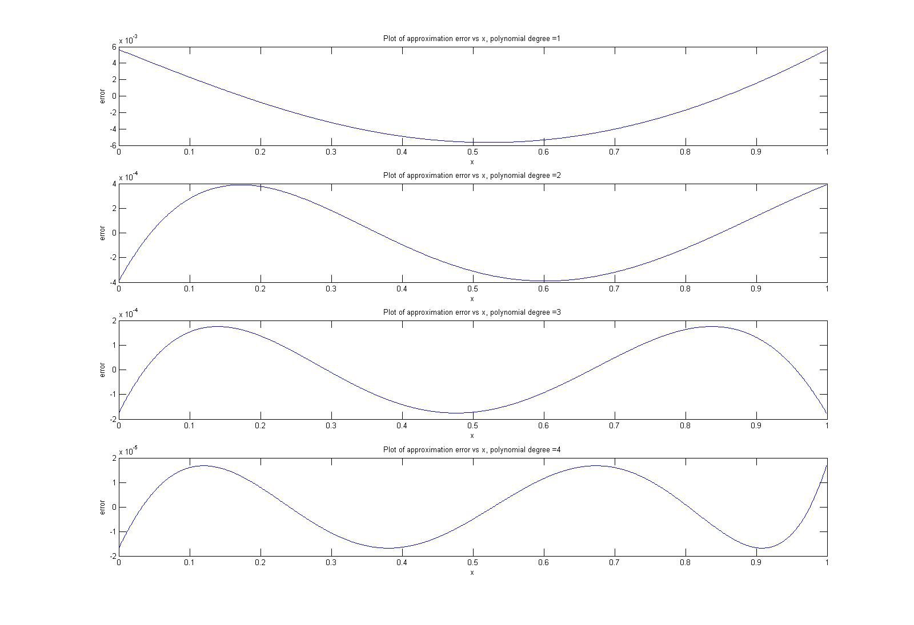
Subplots
Syntax: subplot (rows, columns, index)
>> subplot(4,1,1)
>> …
>> subplot(4,1,2)
>> …
>> subplot(4,1,3)
>> …
>> subplot(4,1,4)
>> …

Slide 8
Importing/Exporting Data
Load and Save:
Using load and save:
load filename: loads all variables from the file “filename”
load filename x: loads only the variable x from the file
load filename a*: loads all variables starting with ‘a’
For more information, type help load at command prompt
save filename: saves all workspace variables to a binary
.mat file named filename.mat
save filename x,y: saves variables x and y in filename.mat
For more information, type help save at command prompt

Slide 9
Import/Export from Excel sheet
Copy data from an excel sheet
>> x = xlsread(filename);
% if the file contains numeric values, text and raw data values, then
>> [numeric,txt,raw] = xlsread(filename);
Copy data to an excel sheet
>>x = xlswrite('c:\matlab\work\data.xls',A,'A2:C4')
% will write A to the workbook file, data.xls, and attempt to fit the elements of A into the rectangular worksheet region, A2:C4. On success, ‘x’ will contain ‘1’, while on failure, ‘x’ will contain ‘0’.
For more information, type help xlswrite at command prompt

Slide 10
Read/write from a text file
Writing onto a text file:
>> fid = fopen(‘filename.txt’,‘w’);
>> count = fwrite(fid,x);
>> fclose(fid);
% creates a file named ‘filename.txt’ in your workspace and stores the values of variable ‘x’ in the file. ‘count’ returns the number of values successfully stored. Do not forget to close the file at the end.
Read from a text file:
>> fid = fopen(‘filename.txt’,‘r’);
>> X = fscanf(fid,‘%5d’);
>> fclose(fid);
% opens the file ‘filename.txt’ which is in your workspace and loads the values in the format ‘%5d’ into the variable x.
Other useful commands: fread, fprintf

