Slide 1
Introduction
Zain Shaukat (MS-SE)
Research Areas:
Software Requirements
Software Risk Management
Datamining

Slide 2
Software Project Management
Evaluation Criteria | Percentage weightage
Assignment and Quiz | 10%
Semester Project | 10%
Mid term Exam | 30%
Final Exam | 50%

Slide 3
Week 1
Introduction & Fundamentals
What is Project Management?
What is Software Project Management?
What is a Project?
Goals of Project management
Project Characteristics
Four Project Dimensions
Product and Technology
SDLC
Task 1

Slide 4
Management?
Basically, the management involves the following activities:
Planning- deciding what is to be done
Organizing- making arrangements
Staffing- selecting the right people for the job
Directing- giving instructions
Monitoring- checking on progress
Controlling- taking action to remedy hold-ups
Innovating- coming up with new solutions
Representing- liaising with users, etc.

Slide 5
Project Management
Project Management is the art of maximizing the probability that a project delivers its goals on
Time,
Budget and at the required
Quality.
Project management is the
Application Of Knowledge,
Skills,
Tools,
Techniques
to project activities to meet project requirements

Slide 6
Project Management
Project management is accomplished through the use of the processes such as:
Initiating,
Planning,
Executing,
Controlling, And
Closing.

Slide 7
Project Management
Almost any human activity that involves carrying out a non- repetitive task can be a project.
So we are all project managers!
But there is a big difference between carrying out a very simple project involving one or two people and one involving a complex mix of
People,
Organizations and
Tasks.

Slide 8
Software Project Management
When the plan starts to involve different things happening at different times,
some of which are dependent on each other,
Resources required at different times and in different quantities and
Perhaps working at different rates,

Slide 9
Software Project Management
computer programs are not project management: they are tools for project managers to use.
Project management is all that mix of components of control, leadership, teamwork, resource management etc.
that goes into a successful project.

Slide 10
Project
A project is an activity with specific goals which takes place over a finite period of time.
“A temporary organization that is needed to produce a unique and pre-defined outcome or result at a pre-specified time using pre-determined resources”

Slide 11
Examples of projects include:
• Developing a new product or service.
• Effecting a change in structure, staffing, or style of an organization.
• Designing a new transportation vehicle.
• Developing or acquiring a new or modified information system.
• Constructing a building or facility.
• Building a water system for a community in a developing country.
• Running a campaign for political office.
• Implementing a new business procedure or process.

Slide 12
Goals of Project management
Project management is the discipline of defining and achieving a set of goals while optimizing the use of allocated resources (time, money, people, space, etc).
This includes planning, scheduling and maintaining progress of the activities that comprise the project.
Project management is normally reserved for
focused,
non-repetitive,
time-limited activities
with some degree of risk and that are beyond the usual scope of program (operational) activities for which the organization is responsible.

Slide 13
Goals of Project management
Project management software describes the tools to efficiently coordinate and automate the various project management component processes.
Project management software generally offers extensive reporting features, such as day to - day status updates of project
progress,
scheduling and dependency trees,
and
system-generated alerts
when schedules slip beyond pre-set tolerances.

Slide 14
Project Characteristics
Temporary
Temporary means that every project has a definite beginning and a definite end.
The end is reached when the project’s objectives have been achieved, or it becomes clear that the project objectives will not or cannot be met, or the need for the project no longer exists and the project is terminated.
Temporary does not necessarily mean short in duration; many projects last for several years. In every case, however, the duration of a project is finite; projects are not ongoing efforts.

Slide 15
Project Characteristics
Unique, Product Service or Result
Projects involve creating something that has not been done in exactly the same way before and which is, therefore, unique and distinct.
Projects create: A product or artifact that is produced, is quantifiable and can be either an end item in itself or
a component item A capability to perform a service, such as business functions supporting production or distribution.
A result, such as new knowledge.
For example, a research and development project develops knowledge that can be used to determine whether or not a trend is present or a new process will benefit society.

Slide 16
Project Characteristics
Aims/Tasks/Purpose
The projects are designed to achieve specific targets defined in terms of aims, tasks or a purpose.
The nature and size of the project depends upon complexity of the task, realization of the aims and scope of the purpose any organization wants to achieve.
In short project has to be aimed for achieving certain tasks in a given time frame.

Slide 17
Project Characteristics
Limited Time Scale
The projects are always designed considering time constraints.
Extension to the project completion dead lines are always discouraged as time overrun, costs extra and in some cases opportunity cost for not completing a project is too high.

Slide 18
Four Project Dimensions
Software project management is an umbrella activity within software engineering.
It begins before any technical activity is initiated and continues throughout the definition, development, and support of computer software.
Four P's have a substantial influence on software project management- people, product, process, and project.
People must be organized into effective teams, motivated to do high-quality software work, and coordinated to achieve effective communication.
The product requirements must be communicated from customer to developer, partitioned (decomposed) into their basic parts, and positioned for work by the software team.
The process must be adapted to the people and the problem.
A common process framework is selected, an appropriate software engineering paradigm is applied, and a set of work tasks is chosen to get the job done.
The project must be organized in a manner that enables the software team to succeed

Slide 19
Four P’s
People
The Players The software process (and every software project) is populated by players who can be categorized into one of five constituencies
Senior managers who define the business issues that often have significant influence on the project.
Project (technical) managers who must plan, motivate, organize, and control the practitioners who do software work.
Practitioners who deliver the technical skills that are necessary to engineer a product or application.
Customers who specify the requirements for the software to be engineered and other stakeholders who have a peripheral interest in the outcome.

Slide 20
Four P’s
People
End-users Who interact with the software once it is released for production use
Team Leaders Project management is a people-intensive activity, and for this reason,
competent practitioners often make poor team leaders.
They simply don’t have the right mix of people skills. And yet, as Edgemon states:
“unfortunately and all too frequently it seems, individuals just fall into a project manager role and become accidental project managers.”

Slide 21
Four P’s
Process
A software process provides the framework from which a comprehensive plan for software development can be established
A number of different task
sets-tasks,
milestones,
work products and;
quality assurance
points-enable the framework activities to be adapted to the characteristics of the software project and the requirements of the project team.

Slide 22
Product and Technology
The 80:20, rule was originated by Vilfredo Pareto, an Italian economist who studies the distribution of wealth in a variety of countries around 1900.
He discovered a common phenomenon: about 80% of the wealth in most countries was controlled by a consistent minority -- about 20% of the people.
Pareto called this a "predictable imbalance." His observation eventually became known as either the "80:20 rule" or "Pareto's Principle."

Slide 23
80 : 20 Rule
The credit for adapting Pareto's economic observations to business goes to the "Father of Total Quality Management," service quality consultant Joseph M. Juran.
In 1950, he published "The Quality Control Handbook," which first recognized the applicability of the Pareto principle in the context of inventory management, e.g.
20% of the repair parts normally account for 80% of the total inventory
80% of production volume usually comes from 20% of the producers

Slide 24
80 : 20 Rule
Some Sample 80/20 Rule Applications
80% of process defects arise from 20% of the process issues.
20% of your sales force produces 80% of your company revenues.
80% of delays in schedule arise from 20% of the possible causes of the delays.
80% of customer complaints arise from 20% of your products or services.

Slide 26
SDLC
This view of software development is referred to as the software development life cycle.
A project has five phases. Here's a brief summary of each:
⇒ Initiation Articulate your vision for the project, establish goals, assemble your team, and define expectations and the scope of your project.
⇒ Planning Refine the scope, identify specific tasks and activities to be completed, and develop a schedule and budget.
⇒ Executing Accomplish your goals by leading your team, solving problems, and building your project. Value of products Value of services Financial cost Personal value Psychical cost Image value Time cost Real value to the customer Total value Total costs Energy cost
⇒ Controlling Monitor changes to the project make corrections, adjust your schedule to respond to problems, or adjust your expectations and goals.
⇒ Closing Deliver your project to your audience, acknowledge results, and assess its success. Take the time to compose a written evaluation of the project and the development effort.

Slide 27
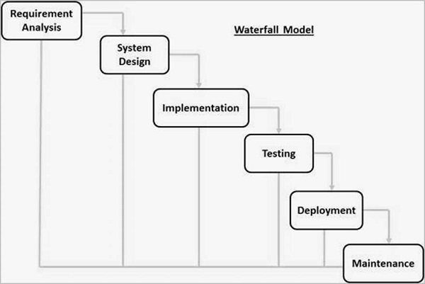
What Happens Next ??

Slide 28
Work Breakdown Structure
A work-breakdown structure (WBS) in project management and systems engineering, is a deliverable-oriented breakdown of a project into smaller components.
A work breakdown structure is a key project deliverable that organizes the team’s work into manageable sections.

Slide 29
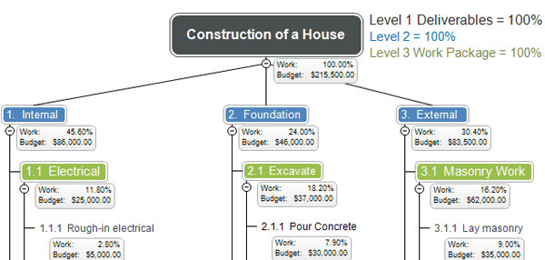
Work Breakdown Structure

Slide 30
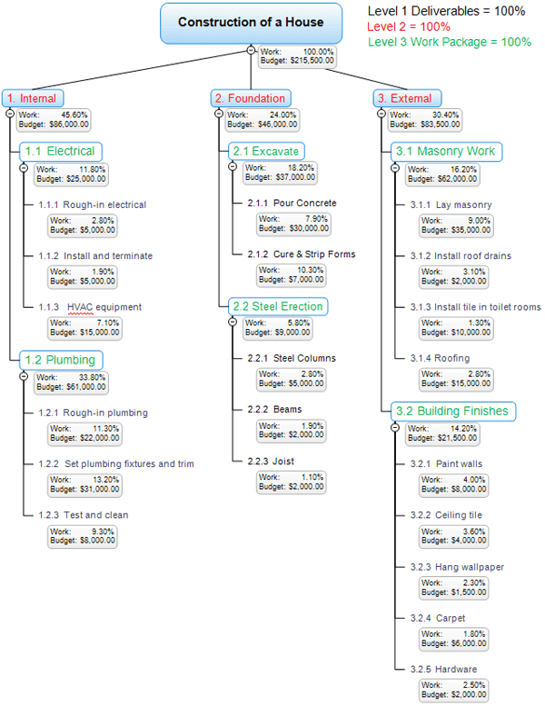

Slide 31
Gantt Chart
A Gantt chart is a type of bar chart that illustrates a project schedule.
This chart lists the tasks to be performed on the vertical axis, and time intervals on the horizontal axis.
The width of the horizontal bars in the graph shows the duration of each activity.

Slide 32
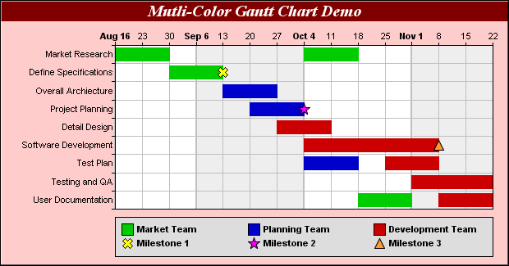
Gant Chart

Slide 33
Task 1
Draw
Work breakdown structure
&
Gantt Chart
Any scenario ! (IT Project Preferable)

