Slide 1
Electrical Transmission System
In last lecture we have discussed Sag in overhead transmission line, Conductor sag and tension, calculation of sag, and Effect of wind and ice loading in detail. In this lecture we will study about numerical related to Sag in overhead transmission line.

Slide 2
Numerical 01. A 132 kV transmission line has the following data :
Wt. of conductor = 680 kg/km ;
Length of span = 260 m
Ultimate strength = 3100 kg ;
Safety factor = 2
Calculate the height above ground at which the conductor should be supported.
Ground clearance required is 10 meters.

Slide 3
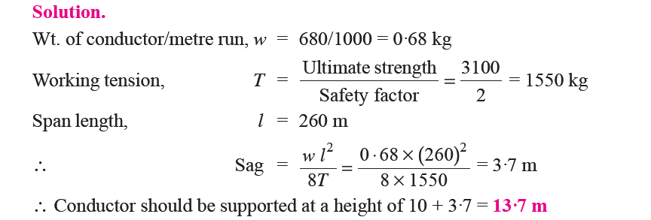

Slide 4
Numerical 02. A transmission line has a span of 150 m between level supports. The conductor has a cross-sectional area of 2 cm2. The tension in the conductor is 2000 kg. If the specific gravity of the conductor material is 9·9 gm/cm3 and wind pressure is 1·5 kg/m length.
Calculate the sag and vertical sag?

Slide 6
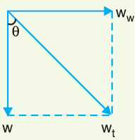
This is the value of slant sag in a direction making an angle θ with the vertical.
Referring to Figure, the value of θ is given by ;

Slide 7
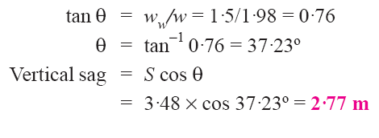

Slide 8
Numerical 03. A transmission line has a span of 200 meters between level supports. The conductor has a cross-sectional area of 1·29 cm2, weighs 1170 kg/km and has a breaking stress of 4218 kg/cm2. Calculate the sag for a safety factor of 5, allowing a wind pressure of 122 kg per square meter of projected area. What is the vertical sag?

Slide 12
Numerical 04. A transmission line has a span of 214 meters between level supports. The conductors have a cross-sectional area of 3·225 cm2. Calculate the factor of safety under the following conditions :
Vertical sag = 2·35 m ;
Wind pressure = 1·5 kg/m run
Breaking stress = 2540 kg/cm2 ;
Wt. of conductor = 1·125 kg/m run

Slide 15
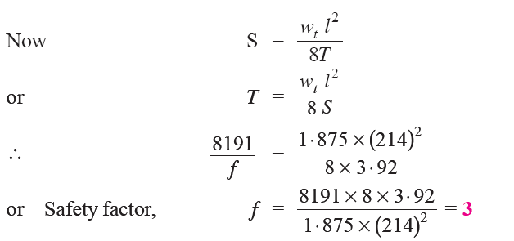

Slide 16
Numerical 05. An overhead line has a span of 150 m between level supports. The conductor has a cross-sectional area of 2 cm2. The ultimate strength is 5000 kg/cm2 and safety factor is 5. The specific gravity of the material is 8·9 gm/cc. The wind pressure is 1·5 kg/m.
Calculate the height of the conductor above the ground level at which it should be supported if a minimum clearance of 7 m is to be left between the ground and the conductor.

Slide 20
References
Principles of Power Systems by V.K Mehta

