Slide 1
Electrical Transmission System
In last lecture we have discussed the Corona in transmission lines, factor affecting corona and its pros and cons in detail. In this lecture we will study about Sag in overhead transmission line, Conductor sag and tension, calculation of sag, and Effect of wind and ice loading.

Slide 2
Sag in Overhead Lines
The difference in level between points of supports and the lowest point on the conductor is called sag.

Slide 3
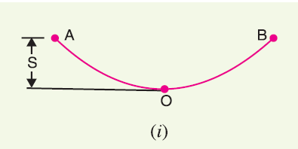
Fig. (i) shows a conductor suspended between two equilevel supports A and B. The conductor is not fully stretched but is allowed to have a dip. The lowest point on the conductor is O and the sag is S.

Slide 4
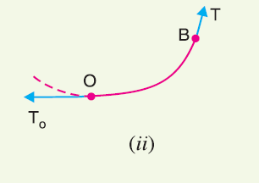
The following points may be noted :
When the conductor is suspended between two supports at the same level, it takes the shape of catenary. However, if the sag is very small compared with the span, then sag-span curve is like a parabola.
The tension at any point on the conductor acts tangentially. Thus tension TO at the lowest point O acts horizontally as shown in Fig. (ii).

Slide 5
The horizontal component of tension is constant throughout the length of the wire.
The tension at supports is approximately equal to the horizontal tension acting at any point on the wire. Thus if T is the tension at the support B, then T = TO.

Slide 6
Conductor Sag and Tension
This is an important consideration in the mechanical design of overhead lines.
The conductor sag should be kept to a minimum in order to reduce the conductor material required and to avoid extra pole height for sufficient clearance above ground level.

Slide 7
It is also desirable that tension in the conductor should be low to avoid the mechanical failure of conductor and to permit the use of less strong supports.
However, low conductor tension and minimum sag are not possible. It is because low sag means a tight wire and high tension, whereas a low tension means a loose wire and increased sag.
Therefore, in actual practice, a compromise in made between the two.

Slide 8
Calculation of Sag
In an overhead line, the sag should be so adjusted that tension in the conductors is within safe limits.
The tension is governed by conductor weight, effects of wind, ice loading and temperature variations.
It is a standard practice to keep conductor tension less than 50% of its ultimate tensile strength i.e., minimum factor of safety in respect of conductor tension should be 2.

Slide 9
We shall now calculate sag and tension of a conductor when
(i) supports are at equal levels
(ii) supports are at unequal levels.

Slide 10
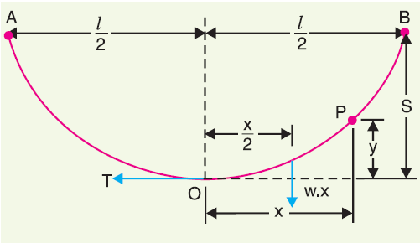
When supports are at equal levels.
Consider a conductor between two equilevel supports A and B with O as the lowest point as shown in Figure. It can be proved that lowest point will be at the mid-span.

Slide 11
l = Length of span
w = Weight per unit length of conductor
T = Tension in the conductor.
Consider a point P on the conductor. Taking the lowest point O as the origin, let the co-ordinates of point P be x and y.
Assuming that the curvature is so small that curved length is equal to its horizontal projection (i.e., OP = x), the two forces acting on the portion OP of the conductor are :
(a) The weight wx of conductor acting at a distance x/2 from O.
(b) The tension T acting at O.

Slide 12
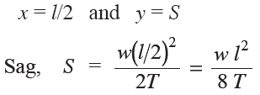
Equating the moments of above two forces about point O, we get,
The maximum dip (sag) is represented by the value of y at either of the supports A and B.
At support A,

Slide 13
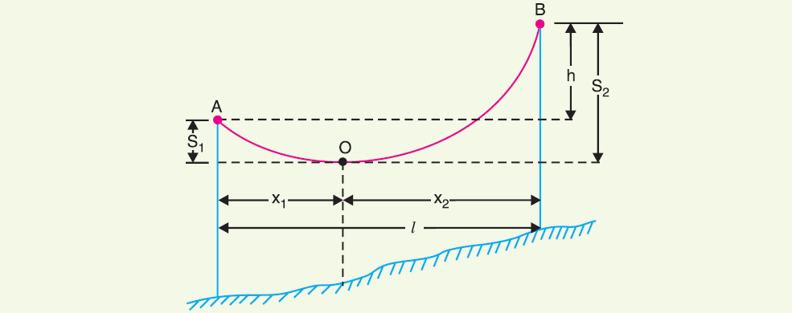
When supports are at unequal levels.
In hilly areas, we generally come across conductors suspended between supports at unequal levels.
Figure shows a conductor suspended between two supports A and B which are at different levels. The lowest point on the conductor is O.

Slide 14
Let
l = Span length
h = Difference in levels between two supports
x1 = Distance of support at lower level (i.e., A) from O
x2 = Distance of support at higher level (i.e. B) from O
T = Tension in the conductor

Slide 15
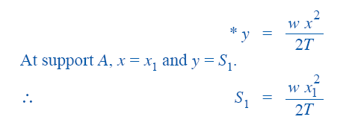
If w is the weight per unit length of the conductor, then,

Slide 17
Having found x1 and x2, values of S1 and S2 can be easily calculated.

Slide 18
Effect of wind and ice loading
The above formulae for sag are true only in still air and at normal temperature when the conductor is acted by its weight only.
However, in actual practice, a conductor may have ice coating and simultaneously subjected to wind pressure.

Slide 19
The weight of ice acts vertically downwards i.e., in the same direction as the weight of conductor. The force due to the wind is assumed to act horizontally i.e., at right angle to the projected surface of the conductor.

Slide 20
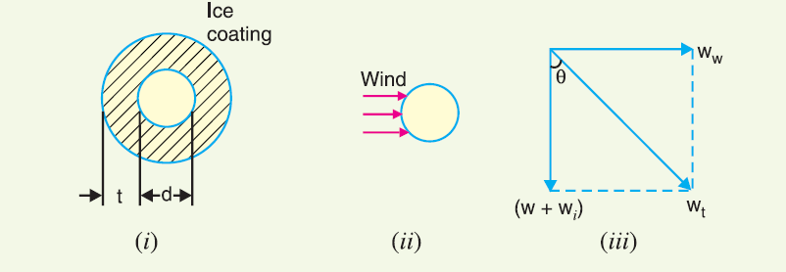
Hence, the total force on the conductor is the vector sum of horizontal and vertical forces as shown in Figure.

Slide 22
When the conductor has wind and ice loading also, the following points may be noted :
The conductor sets itself in a plane at an angle θ to the vertical where

Slide 23
(ii) The sag in the conductor is given by :
Hence S represents the slant sag in a direction making an angle θ to the vertical. If no specific mention is made in the problem, then slant slag is calculated by using the above formula.
(iii) The vertical sag = S cos θ

Slide 24
References
Principles of Power Systems by V.K Mehta

