Slide 1
Software Requirement and Specification
Muhammad Waqas
14 May 2018
1400-1700Hrs

Slide 2
Review
Analysis Modeling
Structured analysis
Object oriented analysis
Object Oriented Analysis
Scenario Based Modeling (Use Cases, Swim lane Diagrams, Activity Diagrams)

Slide 3
Elements of the Analysis Model
Object-oriented Analysis
Structured Analysis
Scenario-based
modeling
Flow-oriented
modeling
Use case text
Use case diagrams
Activity diagrams
Swim lane diagrams
Data structure diagrams
Data flow diagrams
Control-flow diagrams
Processing narratives
Class-based
modeling
Behavioral
modeling
Class diagrams
Analysis packages
CRC models
Collaboration diagrams
State diagrams
Sequence diagrams
Notes:
Structed: Flow:
Model the flow of data through the system… Input in HR system is attendance, leave, salary. Output>> Late, Leave, salary calculation
1Data structure diagram (DSD) is a diagram of the conceptual data model which documents the entities and their relationships, as well as the constraints that connect to them
2DFD model data inside the system
Scenario Based

Slide 4
Analysis Modeling Approaches
Structured analysis
Considers data and the processes that transform the data as separate entities
Data is modeled in terms of only attributes and relationships (but no operations)
Processes are modeled to show the 1) input data, 2) the transformation that occurs on that data, and 3) the resulting output data
Object-oriented analysis
Focuses on the definition of classes and the manner in which they collaborate with one another to fulfill customer requirements
Notes:
1: Focus on data and how they are transforming as separate entities. Concern with flow of data…Must do structure analysis as every system have input data and output data
2: division into classes and how they are collaborating with each other

Slide 5
Elements of the Analysis Model
Scenario-based elements
Describe the system from the user's point of view using scenarios that are depicted in use cases and activity diagrams
Class-based elements
Identify the domain classes for the objects manipulated by the actors, the attributes of these classes, and how they interact with one another; they utilize class diagrams to do this
Behavioral elements
Use state diagrams to represent the state of the system, the events that cause the system to change state, and the actions that are taken as a result of a particular event; can also be applied to each class in the system
Flow-oriented elements
Use data flow diagrams to show the input data that comes into a system, what functions are applied to that data to do transformations, and what resulting output data are produced
Notes:
Describe system through user point of view… what action will be performed by whom.
Class, attributes Object, attributes identification… and interaction within classes.
Used states diagram for showing stated (idle…active, waiting working)
Flow Oriented: Used DFD to show in out of system

Slide 6
Class-based Modeling
Notes:
Classes identification and their interaction

Slide 7
What are classes?
A class describes a group of objects with
similar properties (attributes),
common behavior (operations),
common relationships to other objects,
and common meaning (“semantics”).
Examples
Employee: has a name, employee# and department; an employee is hired, and fired; an employee works in one or more projects
Employee
Name (mandatory)
Attributes
(optional)
name
employee#
department
hire()
fire()
assignproject()
Operations
(optional)
7

Slide 8
The full notation…
Attribute
type
Name of the class
Attribute
name
Student
+ name: string [1] = “Anon” {readOnly}
+ registeredIn: Course [*]
+ register (c: Course)
+ isRegistered (c: Course) : Boolean
Other Properties
Visibility:
+, -, #
Default value
Multiplicity
Function/Operation
name
Return value
Parameters
8
Notes:
+ public: everywhere
private: within the class
# protected: accessible to child class
8

Slide 9
Objects vs. Classes
The instances of a class are called objects.
Objects are represented as:
The relation between an Object and its Class is called “Instantiation”
Two different objects may have identical attribute values (like two people with identical name and address)
Note: Make sure attributes are associated with the right class
Fred_Bloggs:Employee
name: Fred Bloggs
Employee #: 234609234
Department: Marketing
9
Notes:
Car: Honda, Toyota
Class specification like color object has value for color like whitep

Slide 10
Relationships
Objects do not exist in isolation from one another
A relationship represents a connection among things.
E.g. Fred_Bloggs:employee is associated with the KillerApp:project object
Class diagrams show classes and their relationships
In UML, there are different types of relationships:
Association
Aggregation and Composition
Generalization
Realization
10
Notes:
Student: no interaction then faida kiaaa?

Slide 11
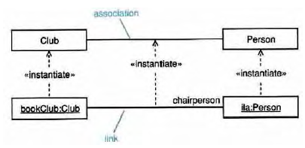
Association
Associations are semantic connections between classes.
If there is a link between two objects, there must be an association between the classes of those objects.
Association
Link
11

Slide 12
Association
Associations may optionally have the following:
Association name
may be prefixed or postfixed with a small black arrowhead to indicate the direction in which the name should be read;
should be a verb or verb phrase;
Role names
on one or both association ends;
should be a noun or noun phrase describing the semantics of the role;
Multiplicity
The number of objects that can participate in an instantiated relation
Navigability
Association name
navigability
role name
navigability
*
*
multiplicity
multiplicity
12

Slide 13
Association Multiplicity
Ask questions about the associations:
Can a company exist without any employee?
If yes, then the association is optional at the Employee end - zero or more (0..*)
If no, then it is not optional - one or more (1..*)
If it must have only one employee - exactly one (1)
What about the other end of the association?
Can an employee work for more than one company?
No. So the correct multiplicity is one.
Some examples of specifying multiplicity:
Optional (0 or 1) 0..1
Exactly one 1 = 1..1
Zero or more 0..* = *
One or more 1..*
A range of values 2..6
Company
1
0 .. *
Employee
13

Slide 14
Class associations
Multiplicity
A client has exactly one staffmember
as a contact person
Multiplicity
A staff member has zero or more clients on
His/her clientList
Name of the
association
:Client
:StaffMember
companyAddress
companyEmail
companyFax
companyName
companyTelephone
staffName
staff#
staffStartDate
1
liaises with
0..*
contact
person
ClientList
Direction
The “liaises with”
association should be
read in this direction
Role
The staffmember’s role in this association is as a contact person
Role
The clients’ role in this association is as a clientList
14

Slide 15
Navigability / Visibility
Order
+ dateReceived: Date [0..1]
+ isPrepaid: Boolean [1]
+ lineItems: OrderLine [*] {ordered}
Date
0..1
*
Order
1
Boolean
+dateReceived
+isPrepaid
1
*
+lineItems {ordered}
OrderLine
15

Slide 16
Bidirectional Associations
Person
0..1
*
Car
How implement it?
Person
+ carsOwned: Car [*]
Car
+ Owner: Person [0..1]
Implementation Complexities !
16
Notes:
Reference is shared on both sides

Slide 17
Generalization
Generalization is a relationship between a more general thing and a more specific thing:
the more specific thing is consistent in every way with the more general thing.
the substitutability principle states that you can substitute the more specific thing anywhere the more general thing is expected.
Notes:
Bike: Yamaha Bike, Honda Bike

Slide 18
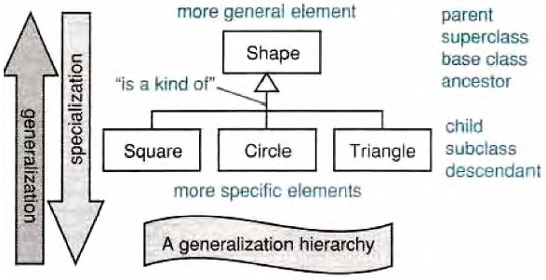
Generalization/Specialization
Generalization hierarchies may be created by generalizing from specific things or by specializing from general things.
More general element
Parent
Superclass
Ancestor
Base Class
“is a kind of”
Child
Subclass
Descendant
Leaf
More specific element

Slide 19
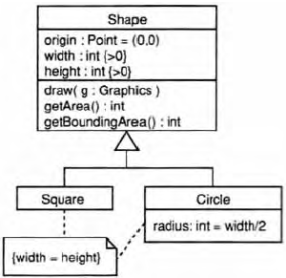
Inheritance
Class inheritance is implicit in a generalization relationship between classes.
Subclasses inherit attributes, associations, & operations from the superclass
Notes:
You can comment for better understandibility

Slide 20
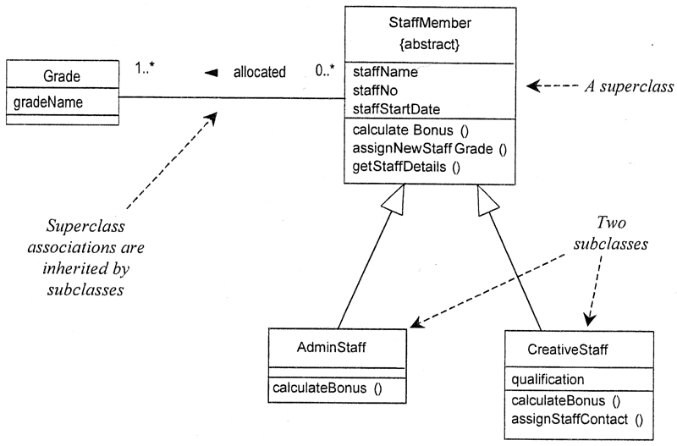
Inheritance
Notes:
A subclass may override an inherited aspect
e.g. AdminStaff & CreativeStaff have different methods for calculating bonuses
A Subclass may add new features
qualification is a new attribute in CreativeStaff
Superclasses may be declared {abstract}, meaning they have no instances
Implies that the subclasses cover all possibilities
e.g. there are no other staff than AdminStaff and CreativeStaff
Notes:
Object of staffmember is not allowed because of abstract. You can have object of adminstaff or creativestaff.

Slide 21
Aggregation and Composition
Aggregation
This is the “Has-a” or “Whole/part” relationship
aggregation
Club
Member
*
*
:Car
:Train
0..1
:Person
0..1
0..*
driver
1
passengers
aggregation
21
Notes:
Aggregation: idependant
Composition: Dependantss

Slide 22
Aggregation and Composition
Aggregation
This is the “Has-a” or “Whole/part” relationship
Composition
Strong form of aggregation that implies ownership:
if the whole is removed from the model, so is the part.
the whole is responsible for the disposition of its parts
Note: Parts can be removed from the composite (where allowed) before the composite is deleted
22
22

Slide 23
Aggregation and Composition
1
:Engine
composition
:Locomotive
1..*
1
0..1
:Car
:Train
0..1
:Person
0..1
0..*
driver
1
passengers
aggregation
23

Slide 24
Annotation
Comments
-- can be used to add comments within a class description
Notes
Constraint Rules
Any further constraints {in curly braces}
e.g. {time limit: length must not be more than three months}
Date Range
Start: Date
End: Date
/length: integer
{length = start - end}
24

Slide 25
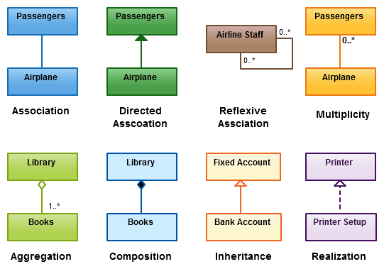

Slide 26
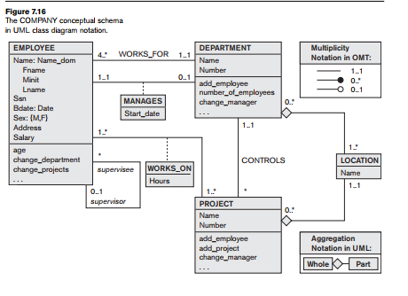

Slide 27
What UML class diagrams can show
Division of Responsibility
Operations that objects are responsible for providing
Subclassing
Inheritance, generalization
Navigability / Visibility
When objects need to know about other objects to call their operations
Aggregation / Composition
When objects are part of other objects
Dependencies
When changing the design of a class will affect other classes
Interfaces
Used to reduce coupling between objects
27

Slide 28
Assignment (Individual)
Prepare written assignment about UML in your own words from the link given below.
https://www.ibm.com/developerworks/rational/library/769.html
Dead line: 21/05/2018

Slide 29
Assignment (Group)
Prepare class diagram of your proposed project in STARUML.
Dead line: 21/05/2018

