Slide 1
Mobile Computing
Cloud Computing

Slide 2
What is Cloud Computing?
NIST.GOV (Natl. Institute of Standards and Technology):
“Cloud computing is a model for enabling available, convenient, on-demand network access to a shared pool of configurable computing resources (e.g., networks, servers, storage, applications, services) that can be rapidly provisioned and released with minimal management effort or service provider interaction.”
This is a user-centric view and highlights:
Access method = availability, convenience, on-demand, via network
Computing method = shared pools, configurable virtualized resources, including application, storage, and print
Setup = rapid provisioning/release, dynamic scalability, minimal management and service-provider interaction
“Pay-per-use” where relevant (differs from “hosted” environments, where model is “pay for maximum capacity”)
Not a technology but a means for using technology
Treats IT more as a utility than as a capital expense that must be managed and upgraded

Slide 3
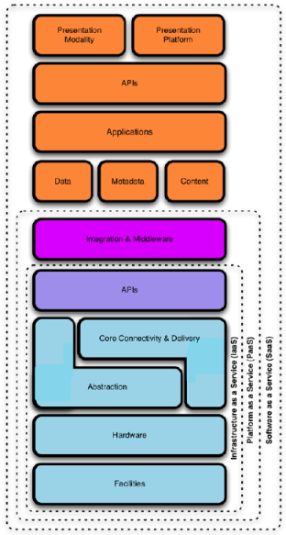
Cloud Computing Delivery Models
Software-as-a-Service (SaaS): an application environment is provided
Platform-as-a-Service (PaaS): an application development platform is provided
Infrastructure-as-a-Service (IaaS): infrastructure capabilities (such as storage or a bare operating system) are provided
Dimension of ownership:
Public (someone else owns it outside of the enterprise)
Can be either a consumer or enterprise market model
Private (the enterprise has sole ownership)
Focus is enterprise, not consumer market
Many dimensions to private, the “enterprise” can potentially include groups of enterprises, special interest groups, etc.

Slide 4
The Range of Mobile Devices
Smart Phones
Laptops, “Net-books”, iPads
Sensors
Embedded Systems (e.g., RFID Readers, Biometric Readers, OnStar)
Vehicles, UAVs
Satellites

Slide 5
Mobile Apps & Cloud Computing
“Information at your fingertips anywhere and anytime”
Mobile Cloud Computing (MCC)
Infrastructure where both the data storage and data processing happen outside of the mobile device

Slide 6
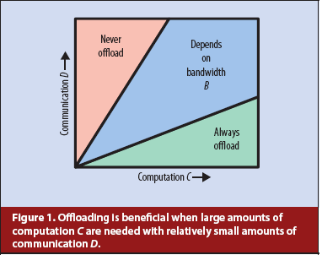
Mobile Cloud Computing – Why?
Limited mobile resources
Battery, storage, processing, network, …
Consider tradeoffs!
Permanent storage
Backup (reliability), long-term storage, anywhere access (availability)
Data sharing
Social media, sensor data, collaboration, producer-consumer, …

Slide 7
Mobile Cloud Computing
Mobile cloud applications move the computing power and data storage away from the mobile devices and into powerful and centralized computing platforms located in clouds, which are then accessed over the wireless connection based on a thin native client
MOBILE CLOUD COMPUTING =
MOBILE COMPUTING + CLOUD COMPUTING

Slide 8
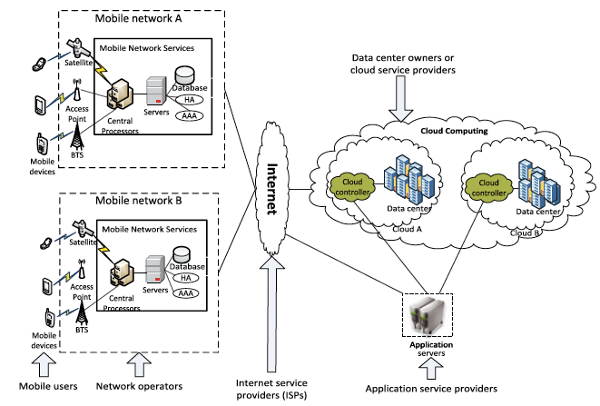
Mobile Cloud Computing

Slide 9
Mobile Cloud Computing
More resources
Reliability and availability
Sharing of data & information
Control access of data
MCC allows for dynamic provisioning
Resources always available; no need for reservation
Mobile applications can be scaled to meet user demands
Services can be added and expanded easily
Multiple services can be integrated through cloud
New/additional services possible (or easier)
Mobile payment
Push notifications
Advertising
Analysis tools
Social network integration
User management tools

Slide 10
“Backend”
No clear definition of backend
Frontend – mobile device user interface
Backend - data, server, programs the user does not interact with directly
Backend as a Service (Baas)
Sometimes MBaaS (M for mobile)

Slide 11
Definition of MBaaS
Provide web and mobile app developers with a way to connect their applications to backend cloud storage and processing while also providing common features such as user management, push notifications, social networking integration, and other features that mobile users demand from their apps these days
Rule Platform
Seamless Integration
Offline & Server Side rules to establish standard operating procedures as well as ensure compliance
BaaS helps reduce time-to-market. Implement with 50% less effort
Technology
App Security
Low Memory footprint based platforms to support truly asynchronous operations with significant flexibility
mBaaS features, ensures application and data security
mBaaS
Notifications
Data Synchronization
Multi Channel notifications through push, SMS, email across devices and platforms.
mBaaS provides End – to – End data sync framework, this ensures user always has latest data available on mobile Application
Enhanced Semantics
Ready Made Apps
Identity federation through Oauth to extract data from external platforms for augmented information
Kick start your customer mobility journey using ready made apps.

Slide 12
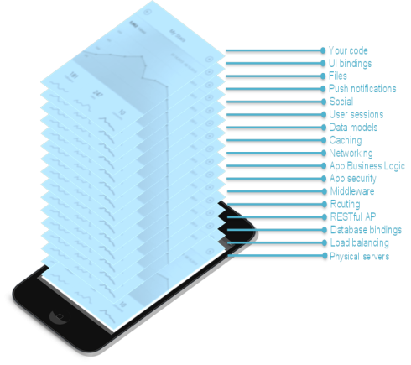
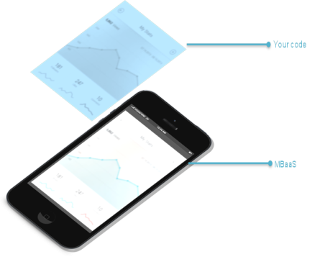
MBaaS – Focus on Frontend!

Slide 13
Advantages for Developer
Efficiency gains: reducing the development cost, development time and maintenance cost
Faster Time To Market: reduce obstacles from idea to production and operations overhead.
Optimized for Mobile and Tablets: optimization of data and network for mobile apps, and lower fragmentation problems across multiple platforms and devices.
Secure & Scalable: bundled infrastructure that deals with scalability, security, performance and other operational headaches.
Handle App Growth & Maintenance: brings common and essential 3rd party API resources into a single stack, preventing developers from having to go gather them separately.

Slide 14
MBaaS Providers

Slide 15
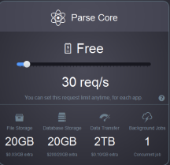
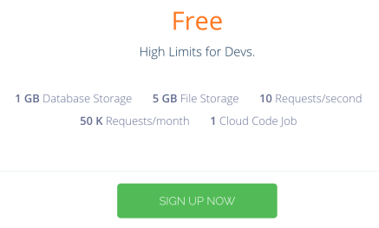
Example: back4app (parse.com)
Founded in 2011
Acquired by Facebook in 2013
More than 500,000 apps in 2014
Shut down January 2017
Made code open-source
Many replacements, including self-hosted
Back4app.com

Slide 16
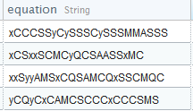
Parse/Back4app Dashboard

Slide 17
More Parse/Back4app
Includes capability to do local data store
Save objects on device, save to cloud later
Abstracts away a lot of the details
Store/fetch objects in background if possible:
Make sure to keep app consistent
Provide progress feedback for user
Parse objects are meant to be "small”
Less than 128Kb
Parse files for large pieces of data

Slide 18
Firebase
Yet another Backend as a Service (BaaS):
Firebase is a real-time cloud data service. Firebase database is stored as JSON and synchronized in real time to every connected client. When you build cross-platform apps with our Android, iOS, and JavaScript SDKs, all of your clients share one Firebase database and automatically receive updates with the newest data
Designed for web and mobile
Founded in 2011
Initial product was backend so websites could easily host chat as part of site
Discovered developers were sending non chat data (such as game state) via the tool

Slide 19
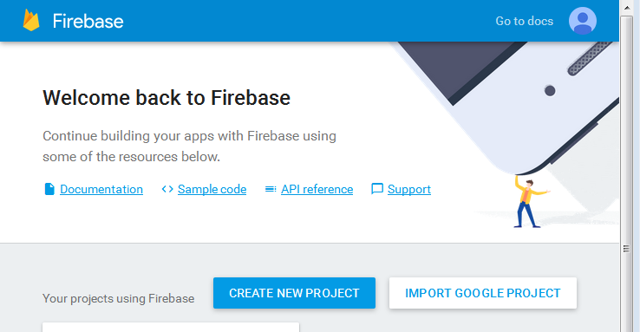
Firebase
Create Firebase project in console
Just needs name and country

Slide 20
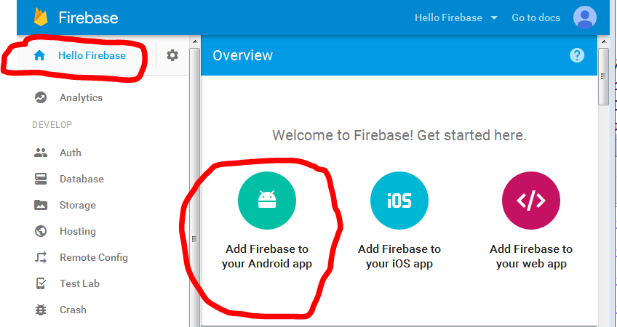
Firebase
After creating project, overview page:

Slide 21
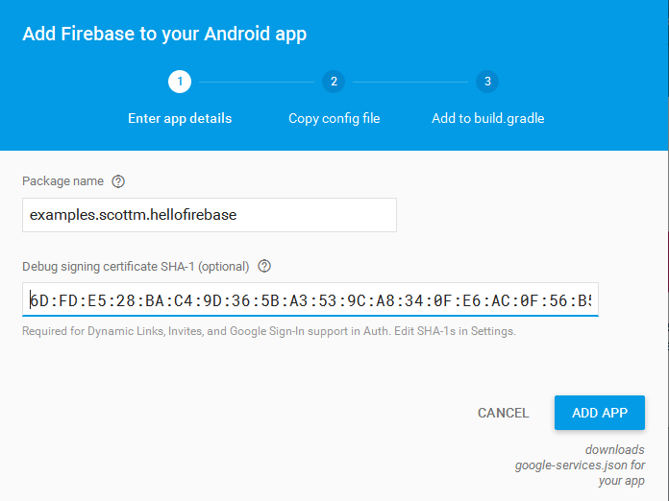
Firebase

Slide 22
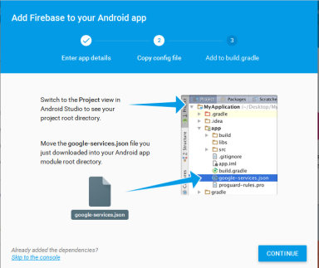
Firebase
After providing package name and SHA-1 fingerprint ...
Firebase generates a JSON file named google-services.json specific for this project
multiple projects / apps -> repeat steps
Download and add file to project
Update gradle file

Slide 23
Firebase
Documentation:
https://firebase.google.com/docs/?authuser=0
Capabilities:
User authorization
Database storage
Storage for larger files
Cloud messaging
Push notifications
Analytics
Hosting of web content
…

Slide 24
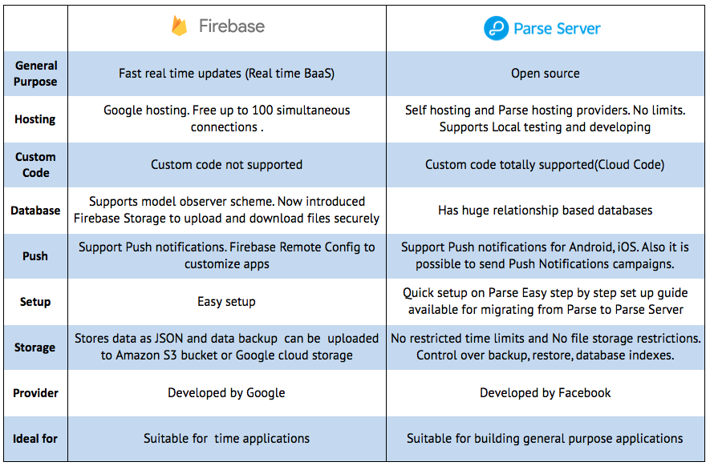

Slide 25
Alternatives
https://github.com/relatedcode/ParseAlternatives

Slide 26
Choosing a MBaaS
Ease of Use (Parse, Back4app)
Automated updates (Firebase)
Analytics (User data, Crashes)
Authentication (including social media integration)
App/Database management
Push notifications
Cloud code, background jobs
System emails (password reset, verification)
Variety of APIs (iOS, Android, REST)

