Slide 1
Functional Modeling
Lecture9

Slide 2
Functional Modeling
Functional Modeling is used to describe:
Business processes
Interaction of the system with the environment
Activity Diagram
Use Case Diagram

Slide 3
Activity Diagrams
Can be used for any type of process-modeling activity.
It shows how the process operates.
They illustrate:
Activities that are performed
How object move among them
Can be used for modeling both:
As-is systems
To-be systems
Notes:
No Flow in UCDWhen actor will encounter different action (if this then that) then we will develop AD…

Slide 4
Use case Diagrams
A formal way of representing how the system interacts with the environment.
Shows an external view rather than an internal view
Who the users are?
How user interacts with the system
Can be used for modeling both:
As-is systems
To-be systems

Slide 5
Steps in preparing these models
First collect requirements
Model the overall business process using activity diagram
Identity use cases that occur in the system
Prepare use case descriptions and use-case diagrams

Slide 6
Activity Diagrams in detail
Model the behavior in a business process independent of objects.
Can be used to model any type of process

Slide 7
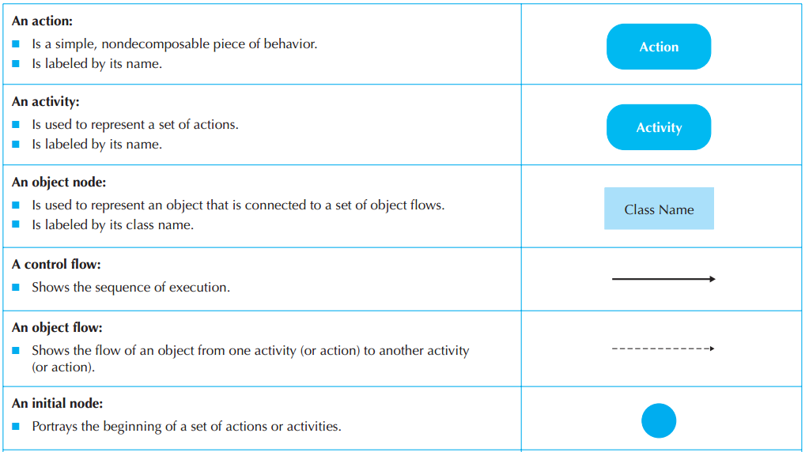

Slide 8
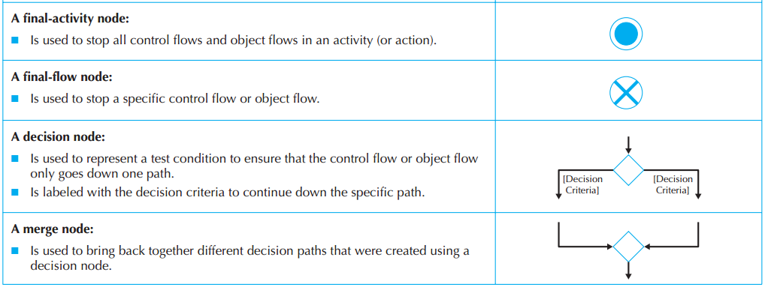

Slide 9
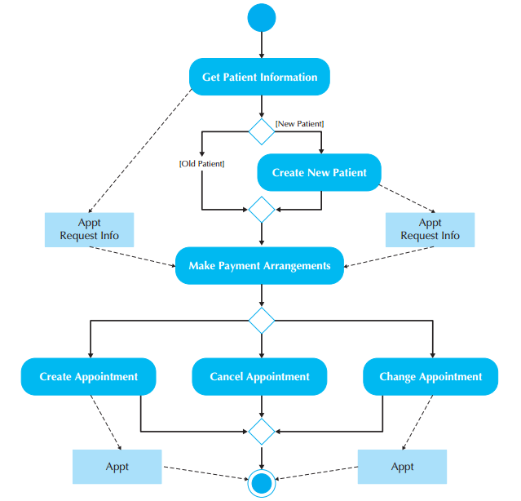

Slide 10
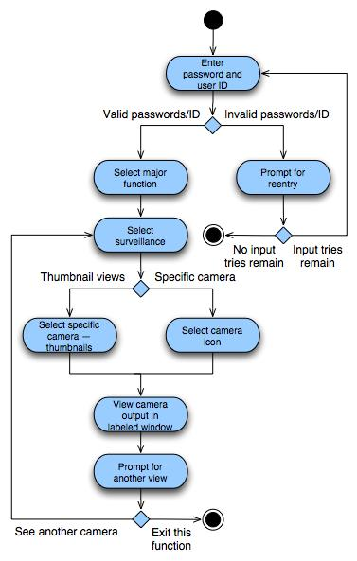

Slide 11
Guidelines for creating Activity Diagrams
Scope the activity
Give the diagram a title
Identify actions, control flows and object flows
Identify decisions
Identify parallelism in the process
Draw the diagram

Slide 12
Any Question?

Slide 13
Now your turn!!!
Create an activity diagram of any process in your FYP.

