Slide 1
Lecture 3
Chapter 2: Utilization of Network Computing
Technologies

Slide 2
Utilization of Network Computing Technologies
In less than 20 years, parallel and distributed computing infrastructures have experienced three profound revolutions: clusters, grids and clouds.
Each of these technologies is more or less adapted to certain types of use.
In this chapter we present the applications of distributed computing and their classification.
The objective is to highlight factors that should guide the user when choosing one or other type of infrastructure and the network or protocol designer when choosing this or that technical approach.

Slide 3
Distributed Computing Applications
Digital Simulation
Digital simulation and complex analyses of large quantities of data are examples of applications that can benefit from a high-performance distributed computing environment.
Digitally simulating a physical system (a car, plane, nuclear power plant, etc.) consists of solving equations that model the system’s behavior in space.
Typically, the problem is broken down into a spatial mesh divided into several parts.
As an example, the digital model of the plane or that of the space in which it will evolve can be considered as being divided into several pieces.
Next, piece by piece, the interactions between these different systems are calculated.
Then, to simulate the system’s behavior in time, these equation sets are resolved iteratively.

Slide 4
Distributed Computing Applications
Stochastic or optimization
The problem is split up into independent parts, or several instances of the same problem are calculated independently in parallel.
Therefore, these applications often use parallel-computing techniques to accelerate the resolution of a problem that can be very large in size and can sometimes require several days of computing on a simple processor.
When the job is distributed, each part or instance of the problem is calculated by a different computer.
When the distributed tasks work in parallel, they sometimes have data or intermediate results to exchange.
For example, in Figure 2.1, the program is broken down into six tasks (P1 to P6), also sometimes called processes or jobs.
P1, P2 and P3 are executed in parallel and are synchronized at the level of task P4. P4 then distributes the job so that P5 and P6 can be executed in parallel.

Slide 5
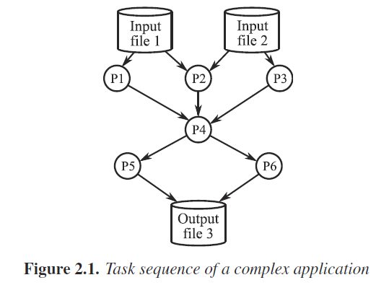
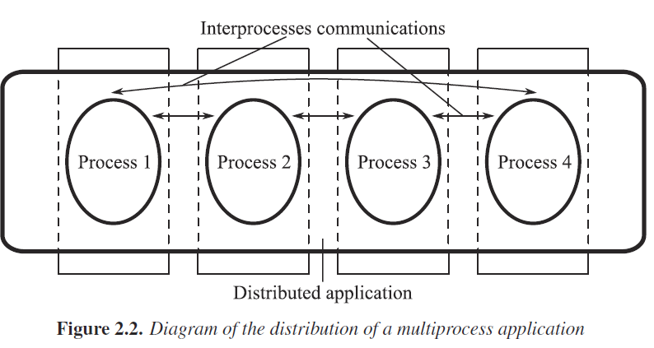
Distributed Computing Applications
Stochastic or optimization
The input data of this program are File 1 and File 2. The result is returned at the end of the program in File 3.
Figure 2.2 shows how the different tasks of the
application above can be distributed
(or mapped) over desktop computers.

Slide 6
Parallelization and distribution of an algorithm
The nature and intensity of communications between tasks greatly influence computing time and therefore the choice of distributed infrastructure.
Exchanges between blocks are very quick on a parallel machine because they are done directly through shared memory.
In a cluster, messages pass through the interconnection network.
On a computing grid if the network latency is greater than a millisecond, coupling between tasks or computing blocks will be more relaxed than when it is run on a cluster or a parallel computer.
Applications are often classified according to how often their subtasks need to synchronize or communicate with each other.
An application exhibits fine-grained parallelism if its subtasks must communicate many times per second.
it exhibits coarse-grained parallelism if they do not communicate many times per second.

Slide 7
Parallelization and distribution of an algorithm
And it is embarrassingly parallel if they rarely or never have to communicate.
Embarrassingly parallel applications are considered the easiest to parallelize.

Slide 8
Parallelization and distribution of an algorithm
Embarrassingly parallel applications
In some applications, data domains can be completely divided in advance and the data distributed upon initialization.
These applications are said to be embarrassingly parallel.
The distribution of initial data on different computers corresponds to the preprocessing phase (stage-in).
In general, a process, called the master process, is in charge of data distribution and activation of processes called workers.
Each process works on its own data on an independent computer.
In the end, the results are collected to be stored or displayed.
This is the post-processing phase (stage-out).
The programming model “MapReduce” for processing masses of data on a large number of computers is a very popular, for embarrassingly parallel application.

Slide 9
Parallelization and distribution of an algorithm
Embarrassingly parallel applications
Processing can be carried out on data stored in a file system (unstructured) or in a database (structured).
This framework corresponds to a large number of data-mining applications, e.g. searches for web pages containing a key word (search engine).
In the Map stage, a master node takes the mass of input data and cuts it up finely into sub-problems, which it distributes to worker nodes.
A worker node can in turn re-do some cutting, which leads to a multilevel tree structure.
In the Reduce stage, the master node takes the answers for all of the sub-problems and combines them in such a way as to get the answer to the problems submitted.
The advantage of MapReduce is that it enables all the operations to be processed in a distributed and theoretically parallel way.

Slide 10
Parallelization and distribution of an algorithm
Embarrassingly parallel applications
Today MapReduce can be used on a large-sized server cluster to sort a petabyte of data in only a few hours.
Parallelism also offers the possibility of supporting server or storage breakdowns during the operation: if a mapper or a reducer fails, the job can be transferred to another processor.

Slide 11
Parallelization and distribution of an algorithm
Fine-grained parallelism
In the parallelization phase of an application, data split-up cannot be completely clear and a non-empty intersection remains between the subdomains.
Intermediate data must be communicated from one computer to another.
These exchanges take place during the processing phase, at each iteration step for example, called inter-process communication (IPC).
Parallel applications that communicate during computing phases are said to exhibit fine-grained parallelism.
Some applications can show a hybrid structure or be even more complex.
For example, the family of physical simulation applications – which includes applications for structural mechanics, fluid dynamics, molecular dynamics, electromagnetics, chemistry, materials science, seismology, reservoirs, meteorology, virtual reality, etc. – are often heterogeneous and consume large volumes of data.

Slide 12
Parallelization and distribution of an algorithm
Fine-grained parallelism
They often have distributed and asynchronous control and are constructed in layers and by composition.
In these applications, a large number of proprietary components are found.
Each component implements a part or a stage of the simulation that can be implemented in parallel with, for example, the Message Passing Interface or MPI library, threads or even vector processing.

Slide 13
Modeling parallel applications
Parallel applications are generally modeled in the form of graphs representing the logical progression of the processing.
Some complex applications are expressed using workflows; others are carried out in batch sequential processing via batch queues on computers with varied architecture.
Workflows used for describing complex applications are graphs indicating the modules to execute and the existing relations or data dependencies between the modules.
Figure 2.3 represents a workflow of an application for processing medical images.
To run such applications on computing grids, specific tools capable of analyzing and executing a workflow description file were developed.
Figure 2.4 represents a distribution of the tasks of this medical application.
For fine-grained applications, the dependences between elementary tasks are generally represented by a graph of tasks or directed acyclic graph (DAG).

Slide 14
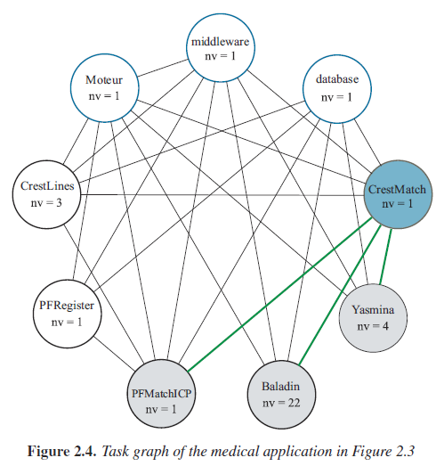
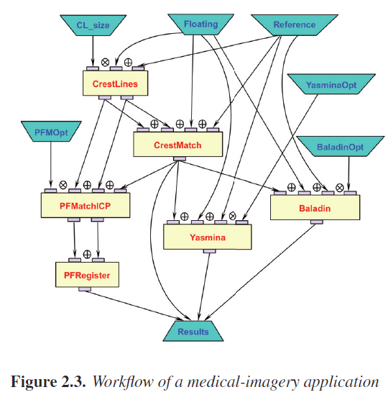
Modeling parallel applications

Slide 15
Example of a grid application
One of the great challenges of modern physics is to answer the fundamental question: why do particles have a mass?
For this, we must explore the physical world in a state similar to that at the time of the Big Bang.
Such a study requires very costly machines (similar to large microscopes) and work programs that can last more than 20 years.
This is the reason why the community of high-energy physicians became equipped with a 17 km ring constructed at the European Organization for Nuclear Research or CERN in Switzerland.
It forms a global instrument shared by 2,000 physicians belonging to 150 universities distributed in 34 countries and is called the Large Hadron Collider or LHC.
The energy level required by these experiments is seven times greater than that required by traditional instruments used by physicians and the rate of data generated is 40 times greater.

Slide 16
Example of a grid application
In this ring, 150 million sensors acquire petabytes of data per second.
These raw data are filtered and coded and generate 15 petabytes of data each year.
These data require immense storage space and about 100,000 processors for processing them.
These enormous data collections are shared by a very large number of users, each with unforeseeable data-access patterns.
Therefore, instead of creating a gigantic and extremely difficult to maintain computing center, the community preferred to equip the LHC with a worldwide computing grid.
The Large Collider Grid or LCG is the operating infrastructure for data generated by the CERN’s LHC.
The model adopted in order to store and process data is highly hierarchical, as shown in Figure 2.5.

Slide 17
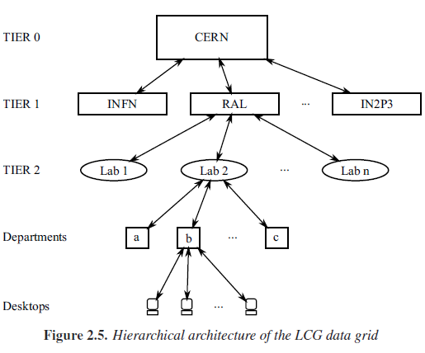
Example of a grid application

Slide 18
Example of a grid application
CERN is at the top of this hierarchical data tree (level-0 tier).
About 10 big computing centers (level-1 tiers) are distributed throughout the continents.
These centers replicate, store and process all the data.
Below this, there are level-2 and level-3 tiers that are available to researchers in their respective regions.
In this grid, the wide-area network (WAN) plays a central role.
It is a private optical network that links CERN’s site with the first-level (tier 1) sites in a star topology and then the second-level (tier 2) sites in series; see Figure 2.5.
This network is based on virtual private network services at 1 or 10 Gbit/s supplied by national and international research networks, for example GEANT in Europe.

