Slide 1
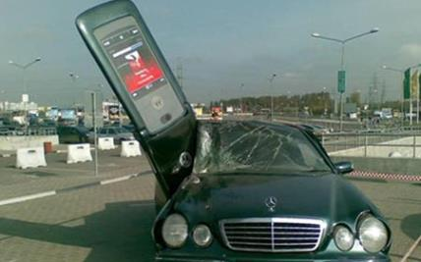
Mobile Computing
SMART HOMES

Slide 2
Introduction
  By the year 2035, one third of the American and European population will be more than 65 years old.
  A Canadian study on 2000 elderly living in nursing homes showed that 4% of subjects have been victims of violence.
  In France, almost 3,000 people ages 65 and older committed suicide in 1998.

Slide 3
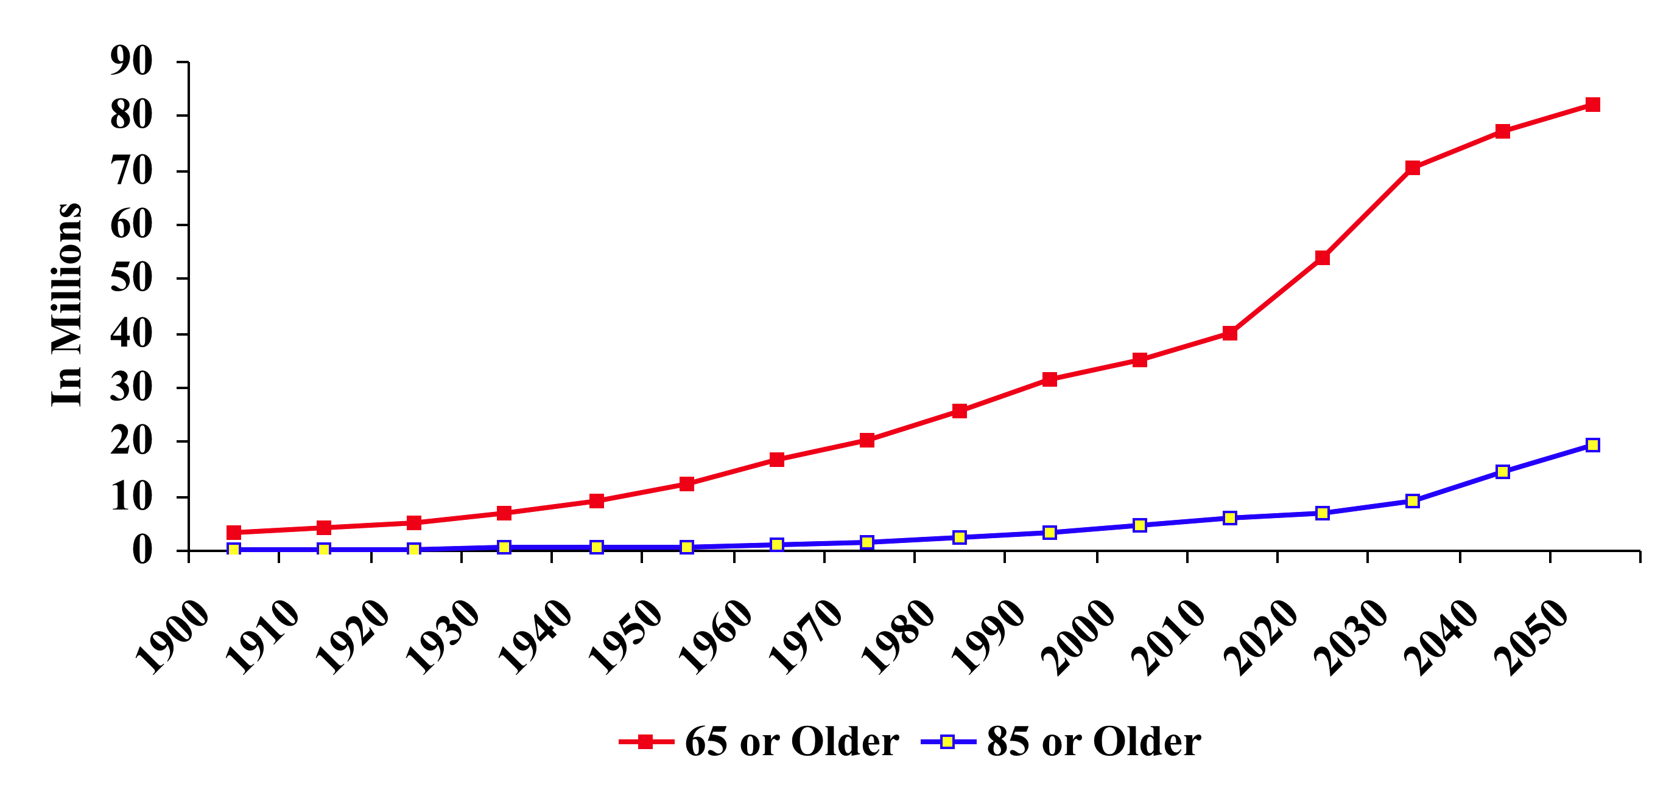
Smart Homes for Aging Population
Number of Persons Age 65 or Older

Slide 4
Independence Is Important
A primary goal of many older individuals is to maintain an independent lifestyle in their own home (Willis, 1996)
Aging successfully will be difficult in homes not designed to meet changing needs and without access to appropriate technologies (Coughlin, 1999)

Slide 5
Concept
The concept of Smart Home or Medical Home aims at giving an autonomous life, in their own home, to people who would normally be placed in institutions: patients suffering from a chronic disease, handicapped people, and fragile elderly.

Slide 6
Reasons
Economical
  Earlier detection/treatment leads to lower cost
  Can be achieved by constant monitoring
Medical
  Fall detection
  Detection of poor adherence or problems with regimens
  Changes in sleep patterns, physiological parameters, cognitive abilities, etc.
Personal
  Allow for independent living, avoid depression, etc.

Slide 7
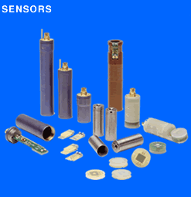
Sensing
Data acquisition from elderly without the awareness of the person.
The detectors will be placed in the house in many different places, and the person will continue her (his) regular life without wearing anything special on her (him) self (except of a wrist watch).

Slide 8
Sensor: Smart Floors
Fall detections
  Falls are the second leading cause of unintentional-injury death for people of all ages and the leading cause of death for elders 79 years and older.
  Studies have shown that the medical outcome of a fall is largely dependent upon the response and rescue time.
Smart Floor
  Measure the pressure signals on the floor’s cell via piezoelectric sensor.
Mobility Assessment

Slide 9
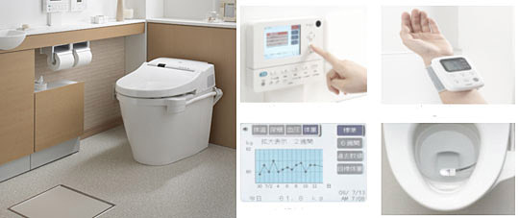
Sensor: Smart Toilet
Analyze of urinary salts and sends the results to a computer through LAN.
How many times during the night did a person go to the bathroom?
Analyze blood sugar levels, body weight, and fat percentage; can even have a blood pressure cuff.

Slide 10
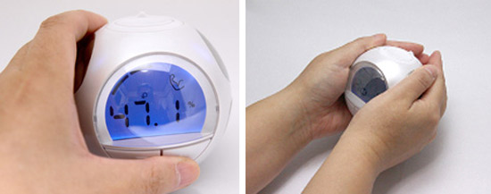
Sensor: Ball Body Check
It sends a weak current through your body, measuring body fat, bone density, and percentage of muscle.

Slide 11
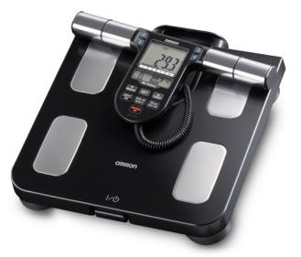
Sensor: Full Body Sensor
Compute weight, body fat, BMI, visceral fat, skeletal muscle, resting metabolism, and physical age.

Slide 12
Sensor: ECG Chair
ECG waveforms can be obtained using electrodes fixed on a chair or in the bed, and measurements obtained without direct contact with the skin.
The signal will be sent to the home central computer via Bluetooth signals.

Slide 13
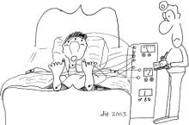
Sensor: Sleeping Disorders
Recording of an EEG, EMG, measurements of brain waves, and muscles activities. Electrodes can assess the sleep quality, but their attachment to the patient’s body affects sleep.
Sleep disorders measurements can be obtained via analysis of physiological characteristics such as body temperature, movement in bed, breathing rate, heart rate, and snoring analysis.

Slide 14
Sensor: Sleeping Disorders
Piezoelectric transducer provides information about heart rate and breathing rate.
Temperature sensors attached to the mattress measure the temperature changes of the person.
Pressure sensors detect movements of the person while sleeping and when out of bed.
Sound recorder for the detection of snoring.
Detection of bacterial infection developed in bed sores.
All the sensors above allow the subject to sleep comfortably without having to wear electrodes or be hooked up to a machine.

Slide 15
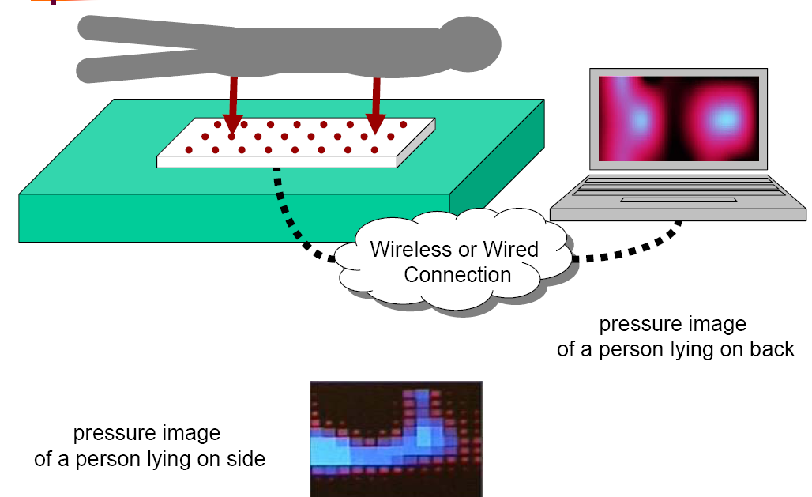
Sleep Studies

Slide 16

Medication Reminder
Patients with chronic diseases often do not follow their physicians’ medication and lifestyle regimens, and 9 out of 10 make mistakes when taking their medications.
The #1 problem in treating illness today is patients’ failure to take prescription medications correctly, regardless of patient age.
Smart pillbox: count and record medications taken
Computer can alert patient to take medication or warn patient if mistake has been made.

Slide 17
But Not Just For The Elderly
According to research by anthropologists watching people live, it is predicted that key areas for innovation will relate to:
  Child care
  Cooking
  Group entertaining
  Family coordination
  Learning
  Home management
But also:
  Personal Health
  Home security
  Entertainment
  All boring stuff
Houses are part of a bigger picture
  Part of the local neighborhood and community
  Part of the local environment

Slide 18
What Are Smart Homes Good For?
Value proposition: safety for you and your family
Safety from intruders already well-established
Sensor-based systems enable new areas:
  “Is the gas leaking?”
  “What’s in the water?”
  “Is the oven off?”

Slide 19

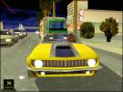
What Are Smart Homes Good For?
Value proposition: great fun
Again, well-established market
  Smart toys, home theaters, video games
New twists:
  How about make it easier to find neighbors and compete?
  Games where you learn something “useful”?

Slide 20
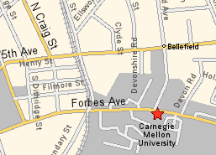
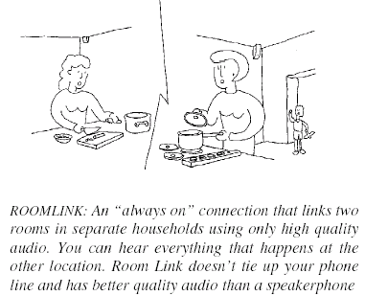
What Are Smart Homes Good For?
Value proposition: stay in touch, know your neighbors
Carpooling
Always on connection with close friends
Wi-Fi NeighborNode
“How much is our community recycling?”
I’m leaving now

Slide 21
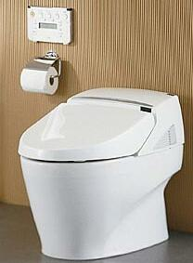

What Are Smart Homes Good For?
Value proposition: stay in better health
Suite of mobile and fixed wireless devices
“Great weather outside, how about walking today?”
Intel Research Seattle – Group coordination
Smart toilets

Slide 22
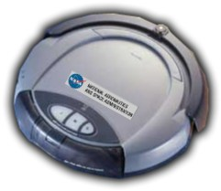
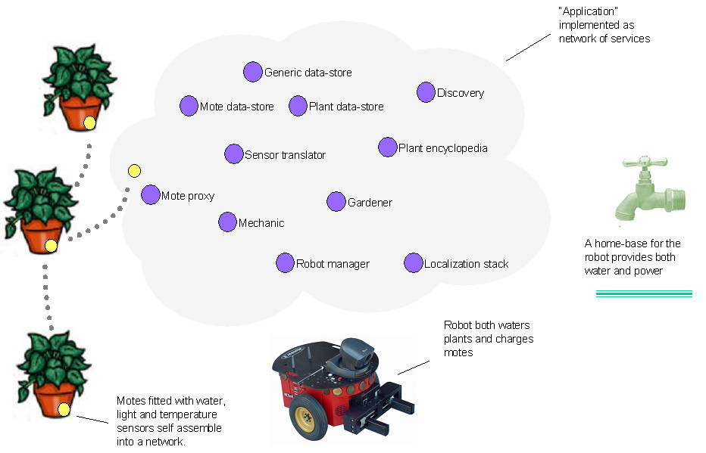
What Are Smart Homes Good For?
Value proposition: We’ll warn you before it’s too late
“Are ants/termites/roaches invading?”
“Are my sewer pipes okay?”
“Your plants need water…”

Slide 23
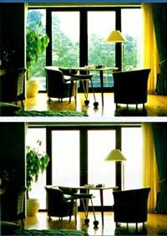
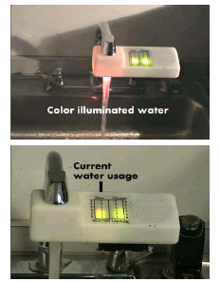
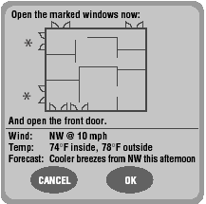
What Are Smart Homes Good For?
Value proposition: save energy and money
Add “smarts” that also encourage sustainable behavior
  “Are my windows leaking warm air in winter?”
  “Did you know you can save water if…”
  “Opening up the windows could increase sunlight.”

Slide 24


Research Issues with Smart Homes
Computer Security
Problem:
  Few people can make their home Wi-Fi networks secure
  Security will only get worse as more devices and homes are wirelessly networked
Some ideas:
  Better user interfaces for configuration
  Simpler and understandable security models
    E.g., physically limited channels
Prognostication:
  Will remain very messy for a long time
  Huge risks in accidentally sabotaging the market

Slide 25

Research Issues with Smart Homes
Unified Interaction Experience
Problem:
  #1 – “How do I get my home to…”
    Some houses so complex, have to hire someone to set temperature
  #2 – “Why did my house do that?”
    Complexity, emergent behavior, e.g., temperature oscillates
Some ideas:
  Design patterns for the home, e.g., power cycle
  Simplicity: tech-heavy features favored by engineers, again focus on key activities
Prognostication:
  De facto standards (Microsoft, Sony, Krupps, etc,)
  Will remain ugly for a long time as contenders fight

Slide 26
Research Issues with Smart Homes
Deployability
Problem:
  How to move from research concept to real homes?
Some ideas:
  Incremental deployment, can add new toaster, just works
  Managing power, can’t replace hundreds of batteries a day
  Maintenance, needs to just work
  Marketing
    People don’t want to be green, they want to save money
Prognostication:
  Insurance companies will advocate (e.g., Lojack)
  Bundled with entertainment (XBox) and media (Apple)

