Slide 1
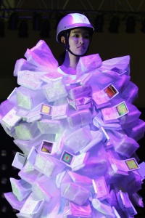
Mobile Computing
WEARABLE COMPUTING Part 2

Slide 2
Applications
Mediated Reality
Experiencing the world through the computer
Allows computer to process the sensory cues before reaching the user
E.g. block commercial billboards
Augmented Reality
Overlaying virtual information on the real world
E.g. allow architects to build virtual houses
E.g. the AR Quake or AR Pacman game
Both realities can enhance your senses

Slide 3
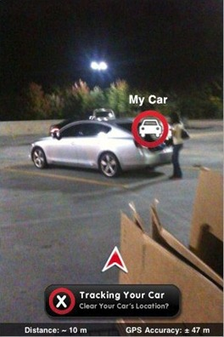
Applications – Augmented Memory
Trivial example, finding your way
”Where did I park my car?”
Camera on your body records the way
Replay helps you find your way back
Only key events need to be recorded
Example: Intersections at a car park

Slide 4
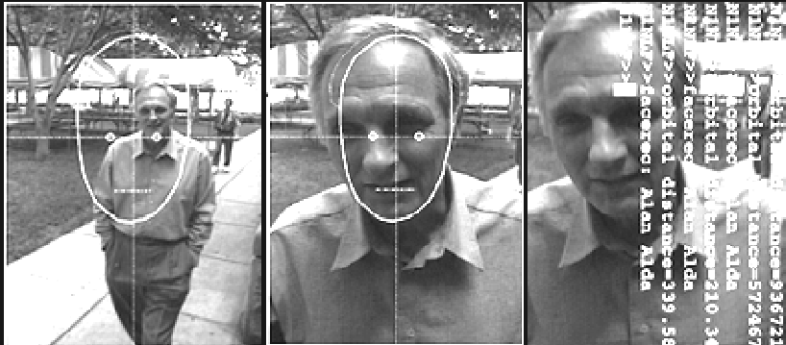
Applications – Augmented Memory
Elderly or people with poor memory
Remember name and face of people
Image processing can recognize a face and map it to the person’s name and affiliation
How should it be presented?

Slide 5
Applications – Annotated Reality

Slide 6
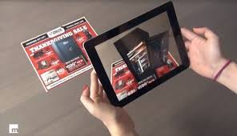
Applications - Advertising

Slide 7
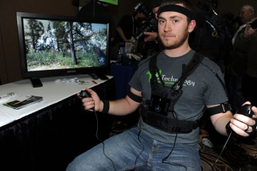
Applications - Entertainment
PrioVR gaming

Slide 8
Applications – Aiding the Visually Disabled
Some forms of low vision can not be alleviated by use of ordinary glasses
User wears non-transparent glasses with integrated displays, experiences the world through a camera
Computer processed video stream
Enhance contrast
Adjust colors
Night vision
Enlarged view

Slide 9
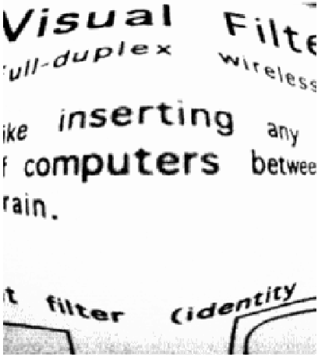
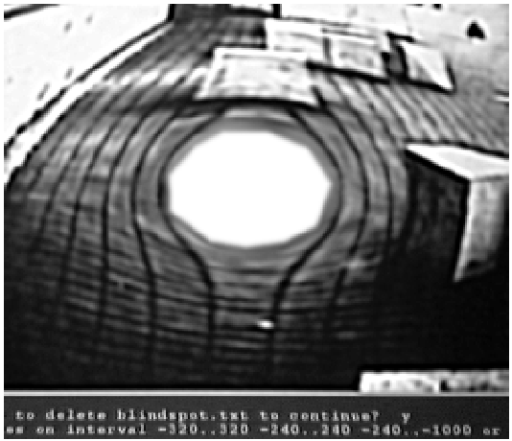
Applications – Aiding the Visually Disabled
Fisheye lense for reading text.
Remapping around blind spots.

Slide 10
Applications – Additional Vision Tricks
”Edgertonian” eyes
Freeze-frame effect, fast shutter
Reading text on a tire of a speeding car
Clearly seeing the rotor blades of a helicopter
Counting the number of bolts holding an airplane rotor together in mid-air
Plus lots of other interesting effects
https://www.youtube.com/watch?v=yr3ngmRuGUc

Slide 11
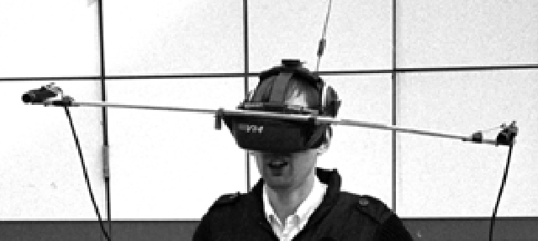
Applications – Additional Vision Tricks
Giant’s eyes
Enhances depth perception of distant objects

Slide 12
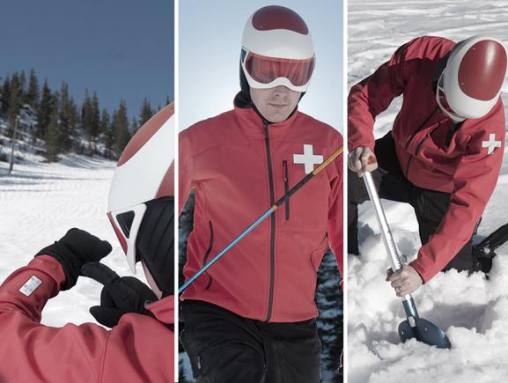
Applications – First Response

Slide 13
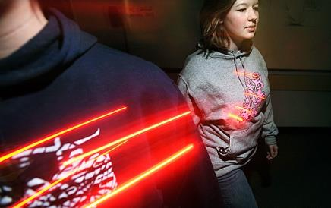
Applications – Social software
Usually designed for urban settings. Interface to groups or individuals.
Safety net
Heart rate, perspiration, breath rate
Alert friends in case of abnormal values
Friend finder

Slide 14
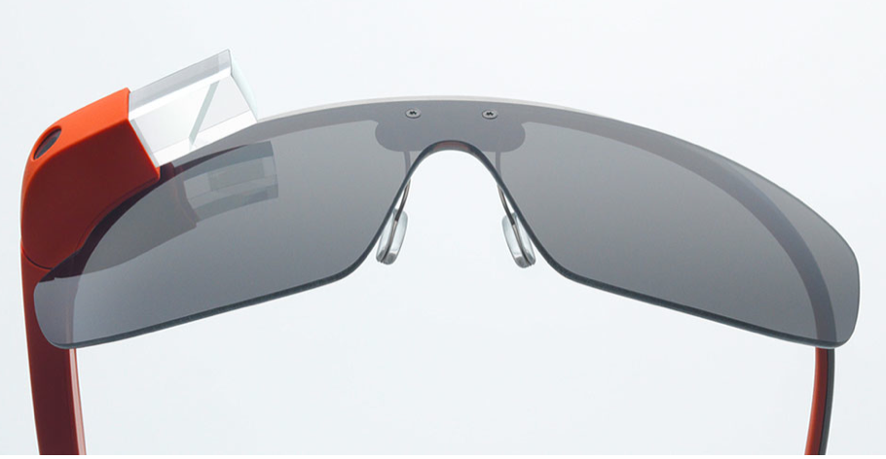
Google Glass
Create a closer relationship with technology.
Move away from technology that competes with real life
Ex: Take pictures and record videos as you experience them. Allows you to capture the experience and remain in the moment.
There when you want it, gone when you don’t.
Ex: Glass is not in field of vision. Remain connected to what you doing.
By bringing technology closer, we can get it more out of the way.

Slide 15
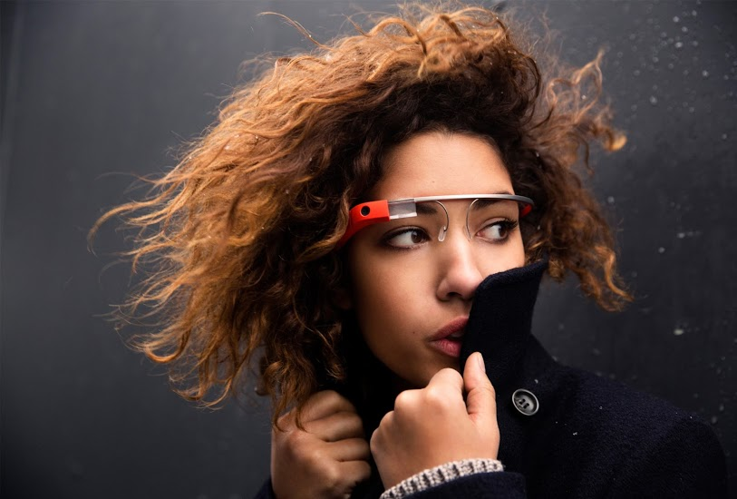
How it worked
Glass
Location: Sits above the line of sight
Wi-Fi/ Bluetooth
Location: Inside the right arm of Glass
Control: Look up to activate/ Look down to activate sleep mode
Control: Links to Wi-Fi or devices with Bluetooth.

Slide 16
How it worked
Touchpad
Location: Right arm of Glass
Control: By swiping and tapping touchpad
Speaker
Location: Right arm of Glass just behind the ear
Control: Automatic voice commands

Slide 17
Voice Commands
Glass Feature | Voice Command | Explanation
Take Picture | “Ok Glass” take a picture | Hands free and quick
Take Videos | “Ok Glass” take a video | In the moment recording
Video Chat | “Ok Glass” video chat [Person] | Lets others see what your seeing
Send Texts | “Ok Glass” send a text [Person] | Hand free texting like Siri
Translate | “Ok Glass” translates [Word/Phrase] | Translates and recites back with proper pronunciation
Directions | “Ok Glass” give direction to [Place] | Turn by turn directions
Weather | “Ok Glass” what is the weather | Temperature, Chance of Rain and if it is currently sunny or cloudy
Google Hangout | “Ok Glass” hangout [Group Name] | Group interactions with selected friends

Slide 18
Medical Wearables
Wearable Belts
Sensor Insoles
Smart Clothing
Headsets
Patches
Respiratory Biofeedback and Body Sensor Networks
Sensors in Sheets

Slide 19
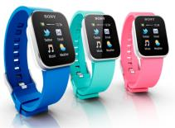
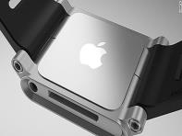
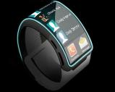
Smart Watches
Sony SmartWatch, Apple iWatch, Galaxy Gear …
Uses NFC, Bluetooth, and RF technology for communication
Pros & Cons
Pro: More integration, gateway to Internet of Things (IoT)
Con: Distraction on the road, battery life, smaller screens

Slide 20
Challenges
Privacy
Price
Health risks
Accidents

Slide 21
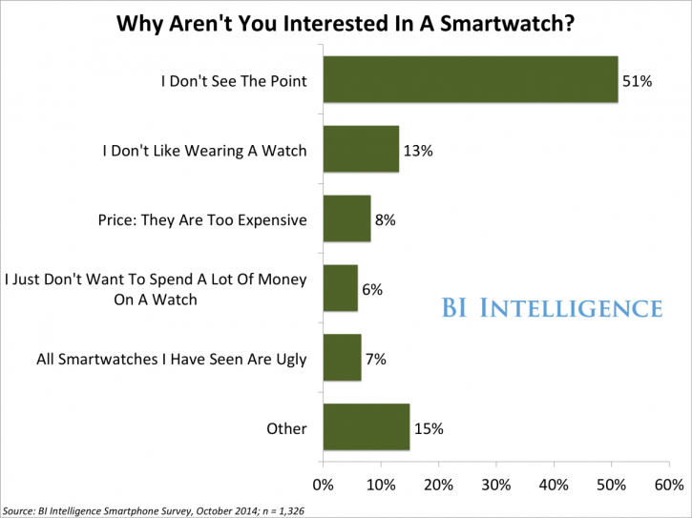

Slide 22
Wearable Computing & the Market
Growth in wearable Computing
35% growth by 2019
Smartwatch will be leading product
Will rise by 41%
Apple Watch market share
Account for 40% market share in 2015
Fitness bands, smart eyewear, etc.
36% percent market share this year

