Slide 1
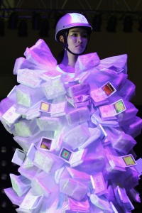
Mobile Computing
WEARABLE COMPUTING Part 1

Slide 2
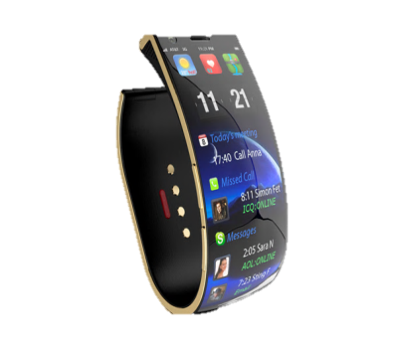
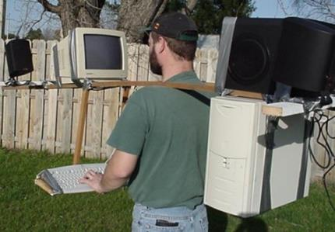
The Past – The Present

Slide 3
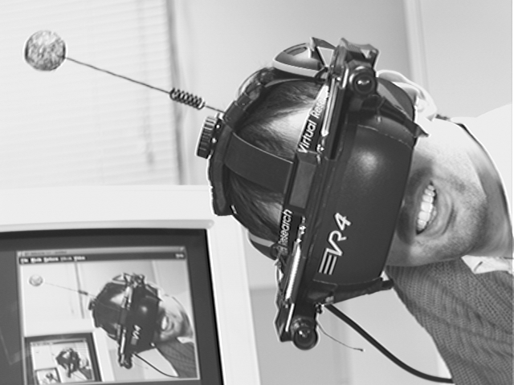
Steve Mann
1970s, pre-laptop, early computer era.
Building computers he could wear.
Inventor of wearable computing.

Slide 4
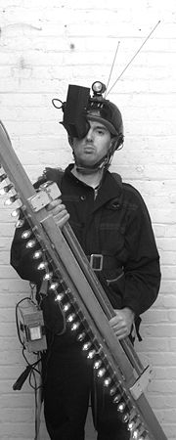
Steve Mann
1991: Started the ”Wearable Computing Project” at MIT.
1995: World’s first covert wearable computer – camera and display concealed in ordinary eyeglasses.
1997: PhD from MIT in the field he himself had invented.
Today: Works at University of Toronto.

Slide 5
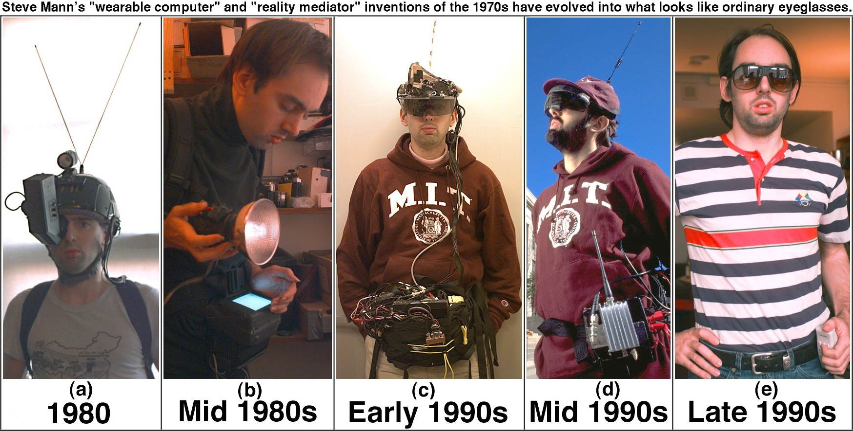
Steve Mann

Slide 6
What is Wearable Computing?
Mann
“A wearable computer is a computer that is subsumed into the personal space of the user, controlled by the user, and has both operational and interactional constancy, i.e. is always on and always accessible. Most notably, it is a device that is always with the user, and into which the user can always enter commands and execute a set of such entered commands, and in which the user can do so while walking around or doing other activities”

Slide 7
What is Wearable Computing?
Seven attributes of wearable computing [Steve Mann, 1998]:
Unmonopolizing of the user’s attention. User can attend to other events.
Unrestrictive to the user. Allows interaction while user carries out normal functions.
Observable by the user. As the system is being worn, there is no reason why the wearer cannot be aware of it continuously… but this contrasts with 1!
Better phrasing: User can identify computational and non-computational components of their clothing.
Controllable by the user. User can take control at any time.
Attentive to the environment. Can enhance the user’s environment and situational awareness.
Communicative to others. Can be used as a communications medium.
Shares the same physical and situational context as the user.

Slide 8
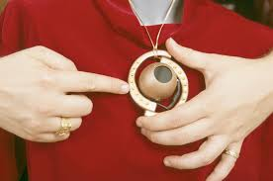
Purpose: Mediate Interactions
Wearable computers will help provide a consistent interface to computationally augmented objects in the physical world.
Example: Gesture Pendant
One gesture could provide an intuitive command for many devices

Slide 9
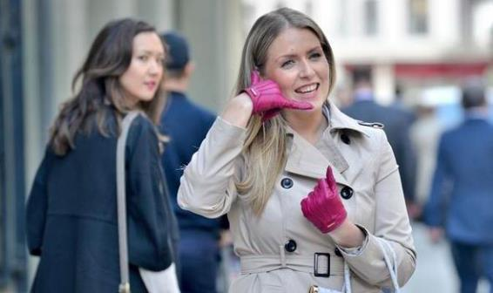
Purpose: Aid Communication
The wearable can also assist in human-to-human communication.
Wearable computers can also help manage interruption in the user’s daily life.

Slide 10
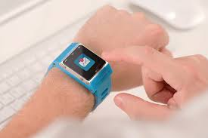
Purpose: Provide Context-Sensitive Reminders
Instead of simply acting as a virtual secretary, the wearable could be proactive and intimate, listening to the wearer’s conversations and providing reminders as appropriate

Slide 11
Purpose: Augmented Reality
Augmented reality overlays information-rich virtual realities onto the physical world.
In a sense, augmented reality is a combination of the application domains described previously.
https://www.youtube.com/watch?v=vDNzTasuYEw

Slide 12
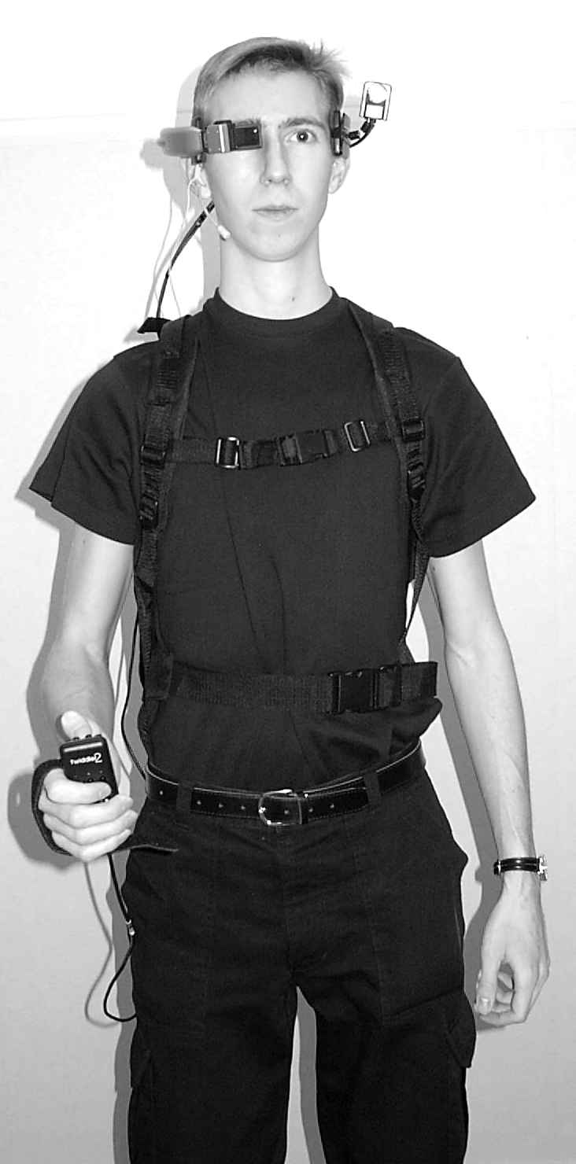
Components of a Wearable Device

Slide 13
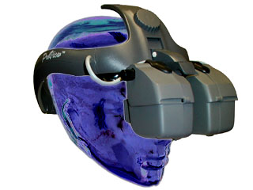
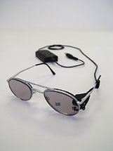
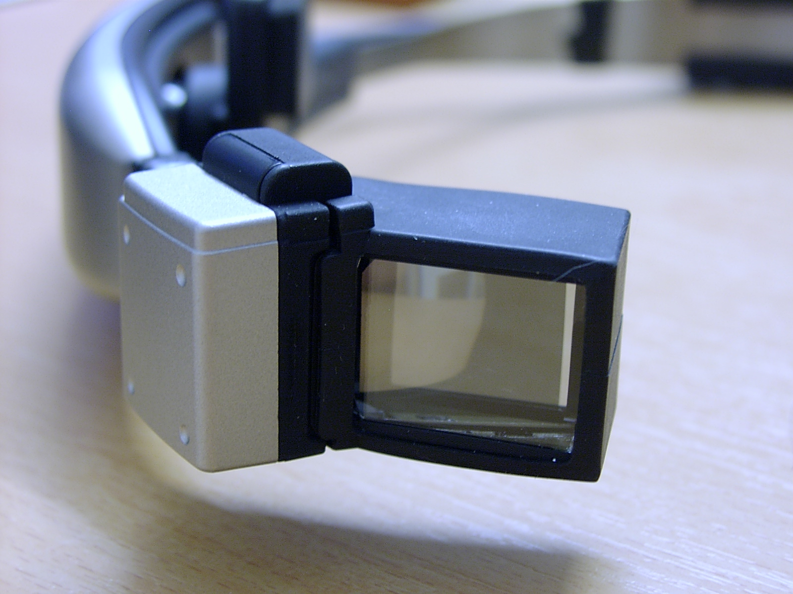
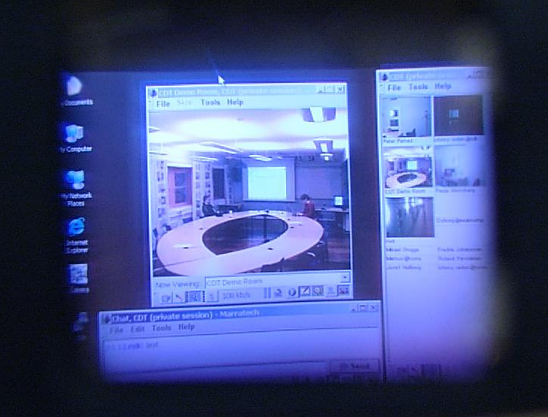
Head-Mounted Display (HMD)
Small screen, typically covering one of your eyes.
Works like an ordinary monitor, providing an image floating in the air in front of you.
Transparent vs opaque.

Slide 14
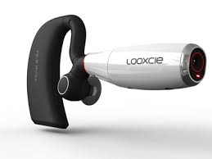
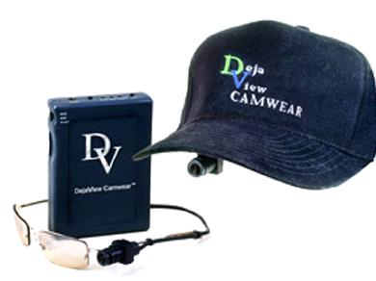
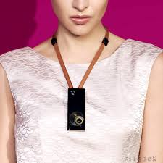
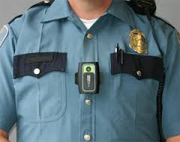
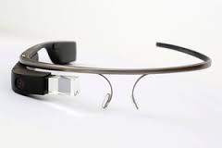
Camera (& Sensors)
Suitable placement
Head, follows user’s gaze.
Shoulder, more stable.

Slide 15
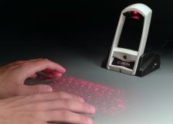
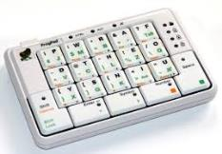
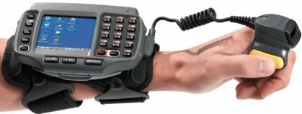
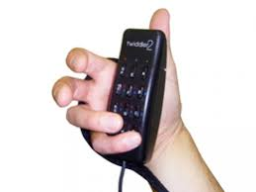
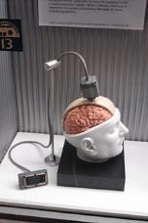
Input Device
Keyboard
Canesta’s IR keyboard.
Arm-strapped keyboard.
FrogPad
Twiddler chording keyboard
Mouse
Twiddler, again.
BrainGate

Slide 16
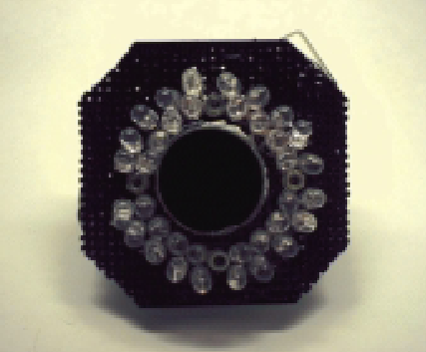
Input Device
Gestures
Gesture Pendant (controlling smart homes)
Voice recognition
Siri
Multi-modal interfaces
Something new?

Slide 17
Output device
Sight – Visual output
HMD, wristwatch...
Hearing – Audio/sound/speech/music
Speakers, earplug/headset...
Touch – Tactile feedback
Taste and smell

Slide 18
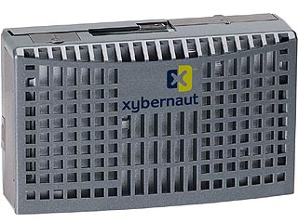
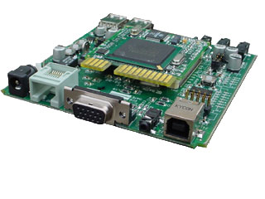
The Computer Itself
Anything small, but powerful enough
Smartphones
Smartwatches
Embedded computers

Slide 19
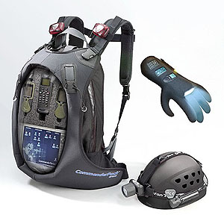
Network Connection
Benefits of having a network
Access to the Internet
Communication
Localization
Wireless network connection
WLAN
3G, 4G, LTE
Bluetooth, ZigBee
InfraRed

Slide 20
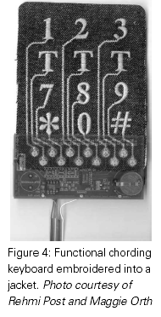
Other Challenges
Connecting all pieces
Wires (embedded into clothing?), wireless (security?), body as conduit
Power supply
Batteries (rechargeable; solar power)
Human powered devices
Body heat, 0.6 – 4.8W (wetsuit clothes)
Breath, 0.4 – 2.5W (pressure mask)
Blood pressure, 0.2W
Limb motion, 0.3 – 1.5W
Finger motion, 0.019W (keyboard typing)
Walking, 5 – 8W (shoe generator)
Heat dissipation

Slide 21
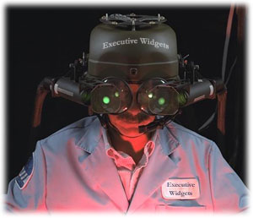
Examples
Technicians
Blueprints, etc.
Field workers
Access to information given by remote experts.
Military personnel
Soldiers, monitoring health, equipment, etc.
Maps and terrain.
Infrastructure (sewers, roads) in urban areas.
Researchers

Slide 22
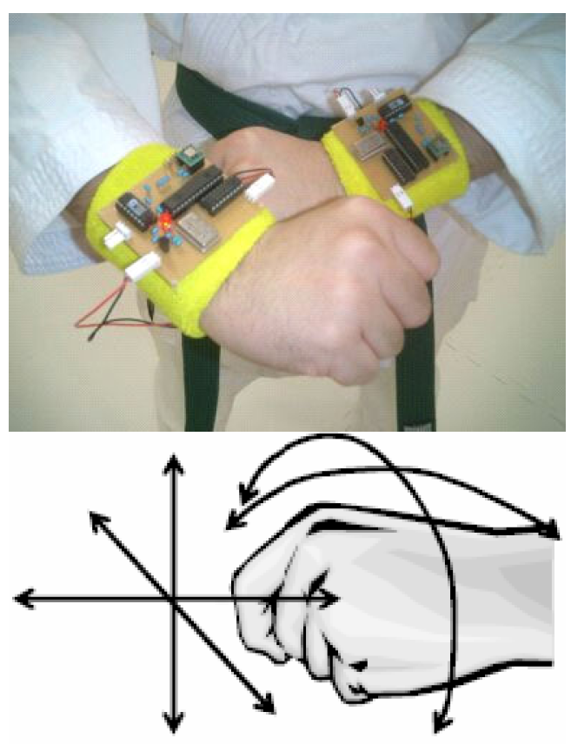
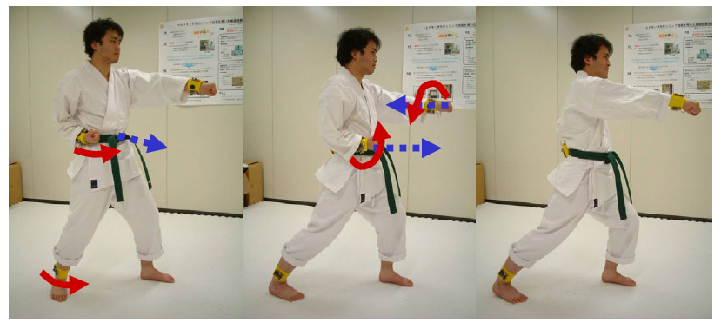
Examples
Wearables for sports training
Karate trainees are instrumented with acceleration sensors.
Sensor data is translated directly into sound output.
Trainees can now ‘hear’, as well as see instructor’s movements.
Trainees can also hear themselves: attempt to match own sound to sound of instructor.
Martial arts training is about reproducing patterns over time, not just matching static poses; therefore, sound is a useful sensory stimuli to introduce to training.
Result: Trainees with system tended to learn faster than trainees without system.

Slide 23
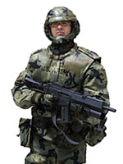
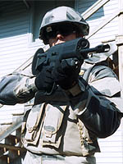
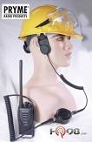
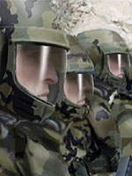
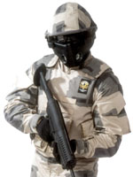
Examples
Wearables for the military: Future Force Warrior (FFW)
Onboard physiological/medical sensor suite to accelerate casualty care
Netted communications to maximize robustness and integration of small teams
Embedded training (similar to martial arts example?)
Enhanced situational awareness (heads-up display?)
Synchronized firing of weapons from team.
Bone conduction technology: “talking and speaking without sound or hearing”

Slide 24
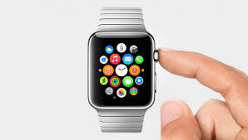
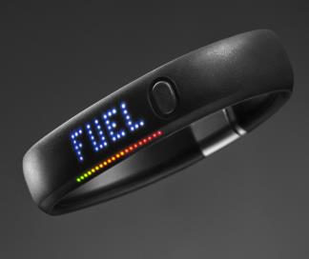
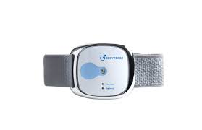
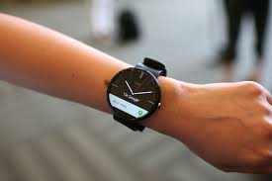
Examples: Smartphone Extensions & Fitness Trackers

