Slide 1
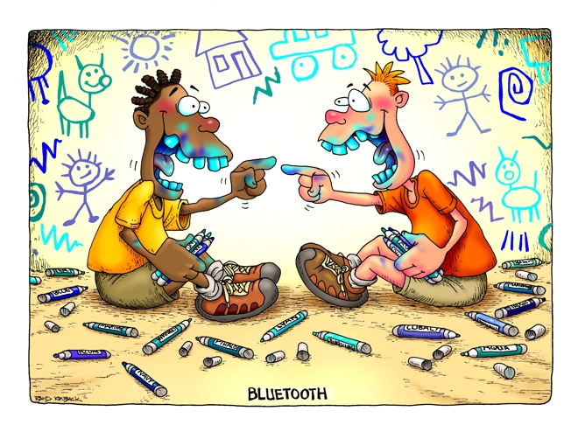
Mobile Computing
BlueTooth and ZigBEE

Slide 2
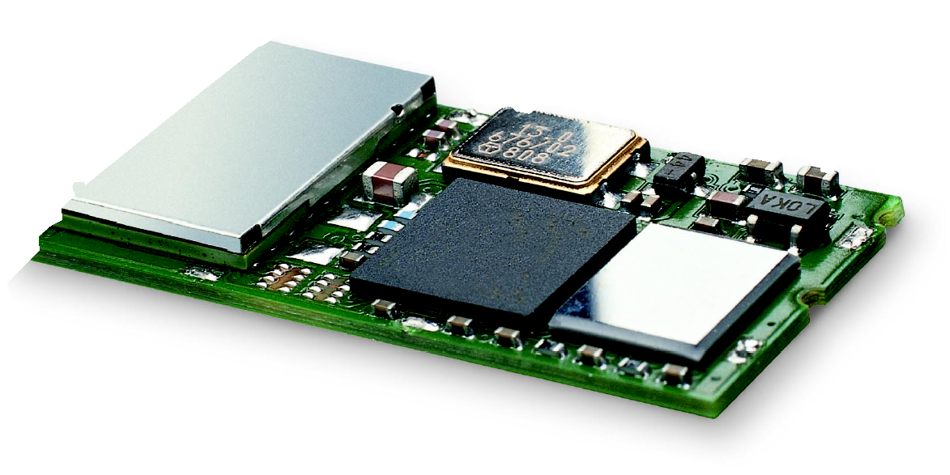
Bluetooth
Basic idea
  Universal radio interface for ad-hoc wireless connectivity
  Interconnecting computer and peripherals, handheld devices, PDAs, cell phones – replacement of IrDA
  Embedded in other devices, very cheap
  License-free ISM (Industrial Science and Medical) 2.45GHz
  Relatively short range, low power, low data rate
  Voice and data transmission
One of the first modules (Ericsson).

Slide 3

Bluetooth
History
  1994: Ericsson (Mattison/Haartsen), “MC-link” project
  Renaming of the project: Bluetooth according to Harald “Blåtand” Gormsen [son of Gorm], King of Denmark in the 10th century
  1998: foundation of Bluetooth SIG, www.bluetooth.org
  2001: first consumer products for mass market, spec. version 1.1 released
  2005: 5 million chips/week
Special Interest Group
  Original founding members: Ericsson, Intel, IBM, Nokia, Toshiba
  Added promoters: 3Com, Agere (was: Lucent), Microsoft, Motorola
  > 10000 members
  Common specification and certification of products

Slide 4
Characteristics
2.4 GHz ISM band, 79 RF channels, 1 MHz carrier spacing
  Channel 0: 2402 MHz … channel 78: 2480 MHz
  GFSK modulation, 1-100 mW transmit power
FHSS and TDD
  Frequency hopping (spread spectrum) with 1600 hops/s
  Hopping sequence in a pseudo random fashion, determined by a master
  Time division duplex for send/receive separation
Voice link – SCO (Synchronous Connection Oriented)
  FEC (forward error correction), no retransmission, 64 kbit/s duplex, point-to-point, circuit switched
Data link – ACL (Asynchronous Connection Less)
  Asynchronous, acknowledgments, point-to-multipoint, up to 433.9 kbit/s symmetric or 723.2/57.6 kbit/s asymmetric, packet switched
Topology
  Overlapping piconets (stars) forming a scatternet

Slide 5
Piconet
Collection of devices connected in an ad hoc fashion
One unit acts as master and the others as slaves for the lifetime of the piconet
Master determines hopping pattern, slaves have to synchronize
Each piconet has a unique hopping pattern
Participation in a piconet = synchronization to hopping sequence
Each piconet has one master and up to 7 simultaneous slaves (> 200 could be parked)
P
S
S
M
P
SB
S
P
SB
M=Master
S=Slave
P=Parked
SB=Standby

Slide 6
Forming a Piconet
All devices in a piconet hop together
  Master gives slaves its clock and device ID
    Hopping pattern: determined by device ID (48 bit, unique worldwide)
    Phase in hopping pattern determined by clock
Addressing
  Active Member Address (AMA, 3 bit)
  Parked Member Address (PMA, 8 bit)


P
•
S


SB
SB
S



M
P
SB




SB
SB
SB
S




SB
SB
P
SB


SB
SB

Slide 7
Scatternet
Linking of multiple co-located piconets through the sharing of common master or slave devices
  Devices can be slave in one piconet and master of another
Communication between piconets
  Devices jumping back and forth between the piconets
Piconets
(each with a
capacity of
720 kbit/s)
P
S
S
S
P
P
M
M
SB
S
M=Master
S=Slave
P=Parked
SB=Standby
P
SB
SB
S

Slide 8
Bluetooth Versions
Bluetooth 1.1
  also IEEE Standard 802.15.1-2002
  initial stable commercial standard
Bluetooth 1.2
  also IEEE Standard 802.15.1-2005
  eSCO (extended SCO): higher, variable bitrates, retransmission for SCO
  AFH (adaptive frequency hopping) to avoid interference
Bluetooth 2.0 + EDR (2004, no more IEEE)
  EDR (enhanced date rate) of 3.0 Mbit/s for ACL and eSCO
  lower power consumption due to shorter duty cycle
Bluetooth 2.1 + EDR (2007)
  better pairing support, e.g., using NFC
  improved security

Slide 9
Bluetooth Versions
Bluetooth 3.0 + HS (2009)
  speeds up to 24Mbps (using co-located Wi-Fi link!)
Bluetooth 4.0
  Classic Bluetooth
  Bluetooth High Speed
  Bluetooth Low Energy
Bluetooth Low Energy (BLE):
  Marketed as Smart Bluetooth
  Lower power, lower cost
  Use in healthcare, fitness, security, entertainment devices
  40 channels
Bluetooth Profiles (different types of applications)

Slide 10
Energy Consumption in Classic BT
Traditional Bluetooth is connection oriented. When a device is connected, a link is maintained, even if there is no data flowing
Sniff modes allow devices to sleep, reducing power consumption to give months of battery life (e.g., wake up every 100ms)
Peak transmit current is typically around 25mA
Even though it has been independently shown to be lower power than other radio standards, it is still not low enough for coin cells and energy harvesting applications

Slide 11
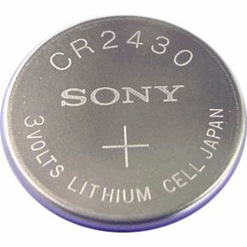
Bluetooth Low Energy (BLE)
Bluetooth low energy is a new, open, short range radio technology
  Blank sheet of paper design
  Different to Bluetooth classic (BR/EDR)
  Optimized for ultra low power
  Enable coin cell battery use cases
    < 20mA peak current
    < 5uA average current

Slide 12
BLE Fact Sheet
Data Throughput
  For Bluetooth low energy, data throughput is not a meaningful parameter. It does not support streaming
  It has a data rate of 1Mbps, but is not optimized for file transfer
  It is designed for sending small chunks of data (exposing state)

Slide 13
“Exposing State”
23.2˚C
60.5 km/h
12:23 pm
Gate 10 BOARDING
3.2 kWh
PLAY >>
Network Available
It’s good at small, discrete data transfers
Data can triggered by local events
Data can be read at any time by a client
Interface model is very simple (GATT)

Slide 14
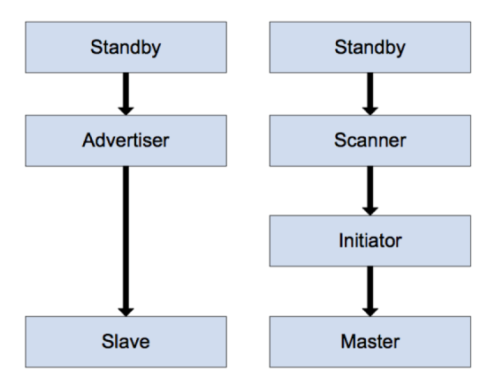
BLE Link Layer

Slide 15
BLE Link Layer
Possible states:
  Standby: not transmitting or receiving any data, and is not connected to any other device
  Advertiser: periodically broadcasting advertisements
  Scanner: actively looking for advertisers
  Initiator: actively trying to initiate a connection with another device
  Master: connected to another device as a master
  Slave: connected to another device as a slave

Slide 16
BLE Advertising
Four types of advertisements:
  Connectable undirected: any scanner device can initiate a connection with this advertiser
  Connectable directed: only one specific device can initiate a connection with this advertiser
  Non-connectable undirected: no devices can initiate a connection with this advertiser; primarily used for general broadcast of data (up to 31 bytes of payload)
  Discoverable undirected: any scanner device can request more information from the advertising device, but no devices can initiate a connection with it

Slide 17
BLE Use Cases
Proximity
Time
Emergency
Network availability
Personal User Interface
Simple remote control
Browse over Bluetooth
Temperature Sensor
Humidity Sensor
HVAC
Generic I/O (automation)
Battery status
Heart rate monitor
Physical activity monitor
Blood glucose monitor
Cycling sensors
Pulse oximeter
Body thermometer

Slide 18
BLE Use Cases
It can enable proximity detection
  I’m in the car
  I’m in the office
  I’m in the meeting room
  I’m in the movie theater
It can enable presence detection
  Turn the lights on when I walk around the house
  Automatically locks the door when I leave home
  Turn the alarm off if I’m already awake

Slide 19
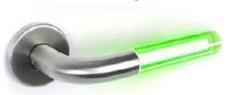
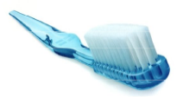
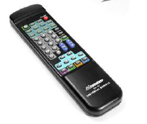
BLE and Internet-of-Things
My pulse is …
My blood glucose is …
My temperature is …

Slide 20

ZigBee
IEEE 802.15.4 (similar to Bluetooth and IEEE 802.15.1)
Pushed by Chipcon (now TI), Ember, Freescale (Motorola), Honeywell, Mitsubishi, Motorola, Philips, Samsung…
More than 260 members
  about 15 promoters, 133 participants, 111 adopters
  must be member to commercially use ZigBee spec
ZigBee platforms comprise
  IEEE 802.15.4 for layers 1 and 2
  ZigBee protocol stack up to the applications

Slide 21
ZigBee
Design goal
  Low power consumption
  Simple Design
  Few costs
History
  ZigBee-style networks began ~1998
  IEEE 802.15.4 was first completed in 2003
  ZigBee Alliance was established in 2002

Slide 22
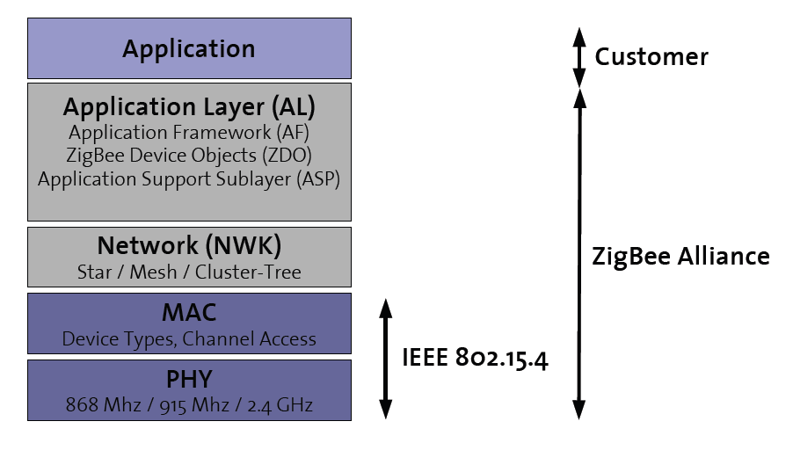
ZigBee Protocol Stack

Slide 23
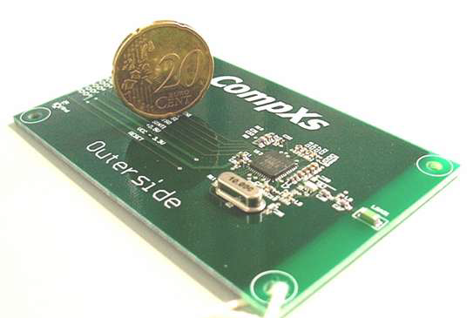
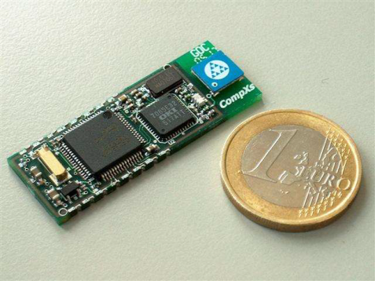
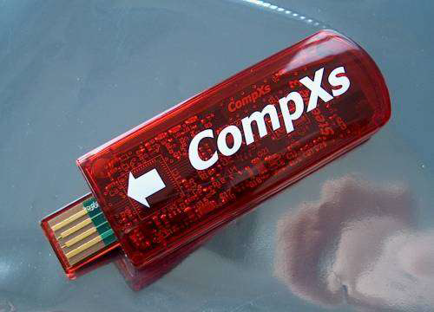
Device Type
Full Function Device (FFD)
  Network router function
  Any Topology
Reduced Function Device (RFD)
  Easy and cheap to implement
  Limited to star topology
Personal Area Network (PAN) Coordinator
  Maintains overall network knowledge
  Needs most memory and computing power

Slide 24
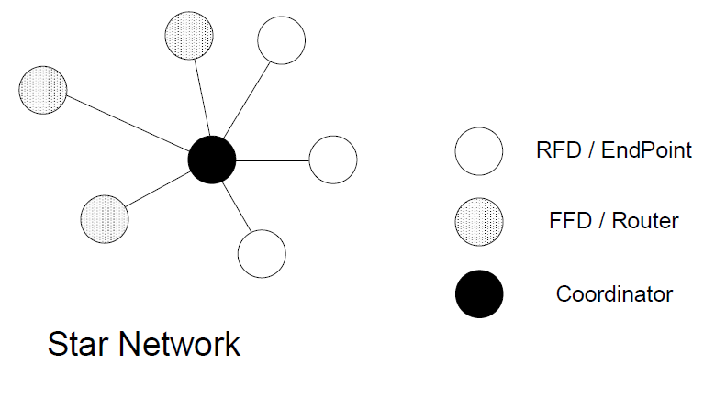
Basic Topology

Slide 25
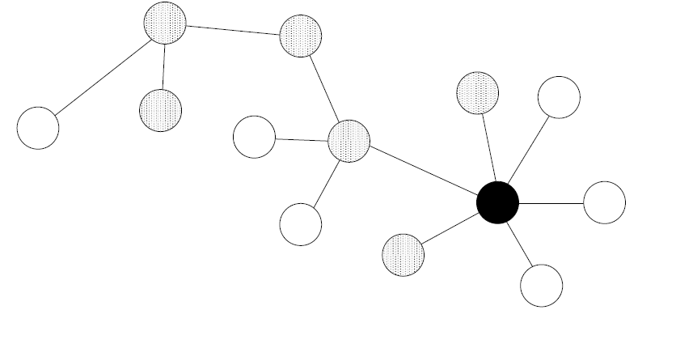
Cluster Tree Network

Slide 26
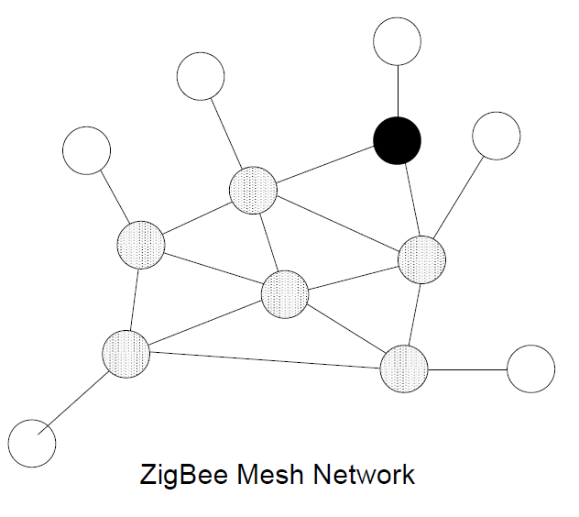
ZigBee PRO: Mesh Network

Slide 27
Bluetooth vs. ZigBee
 | Bluetooth (v1) | ZigBee
Protocol Stack | 250 kb | < 32 kb (4kb)
Range | 10 - 100 meters | 30 - 100 meters
Link Rate | 1 Mbps | 250 kbps
Battery | rechargeable | non-rechargeable
Devices | 8 | 2^16
Air Interface | FHSS | DSSS
Usage | frequently | infrequently
Network Join Time | long | short
Extendibility | no | yes
Security | PIN, 64 bit, 128 Bit | 128 bit, AES

