Slide 1
Mobile Computing
Context

Slide 2
System Structure
explicit
input
System
explicit
output

Slide 3
Context as Implicit Input
explicit
input
Context-Aware
System
explicit
output
Context:
state of the user
state of the physical environment
state of the computing system
history of user-computer interaction
...

Slide 4
What is Context?

Slide 5
Examples of Context
Identity (user, others, objects)
Location
Date/Time
Environment
Emotional state
Focus of attention
Orientation
User preferences
Calendar (events)
Browsing history
Behavioral patterns
Relationships (phonebook, call history)
… the elements of the user’s environment that the computer knows about…

Slide 6
Relevance of Context Information
Trying to arrange lunch meeting
Going to a job interview
Going home after work and making evening plans
Shopping
Tourist
...

Slide 7
Scene 1

Slide 8
Scene 1

Slide 9
Scene 2

Slide 10
Scene 2

Slide 11
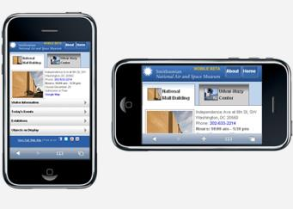
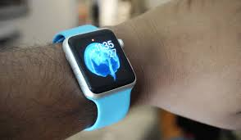
Examples
Smartphone adjusts the screen to the orientation of the device
Apple Watch turns on display if arm lifted/rotated
Orientation is determined by using both a gyroscope and an accelerometer.

Slide 12
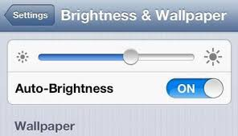
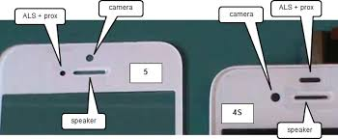
Examples
Phone display adjusts the brightness of the display based on the surrounding area
Uses a light sensor

Slide 13
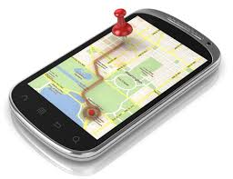
Examples
Device displays user’s location, shows route to a desired destination, find nearby stores, geotag images on social media, etc.
Uses location sensor

Slide 14
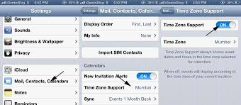
Examples
The time is displayed on the phone.
Time zone change
Daylight savings time

Slide 15
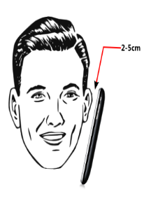
Examples
Device disables touch screen when the user speaks on the phone
Uses a proximity sensor (infrared signal travel time)

Slide 16
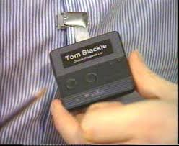
Examples
Active Badge location system
One of the first context-aware applications
Context = location
Call-forwarding system
Issues
Private call forwarding to a public room
Call is forwarded to important meeting

Slide 17
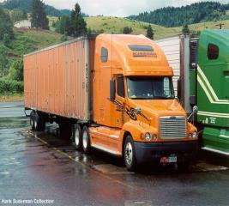
Examples
Schneider trucking trackers
Uses GPS to track loads
Sends a notification when a load nears its destination
Sends emergency notifications when certain conditions are met

Slide 18
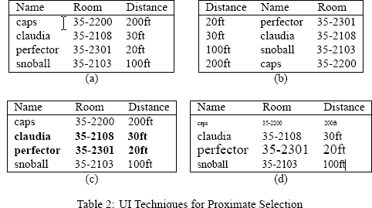
Proximate Selection/Contextual Information

Slide 19
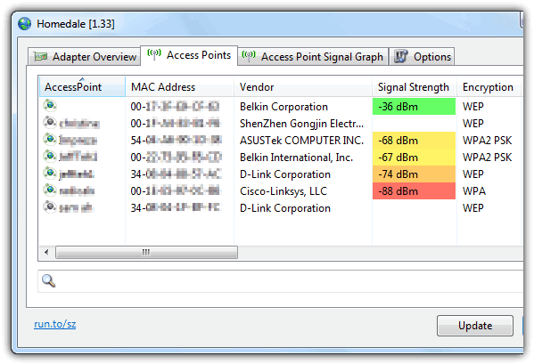
Proximate Selection/Contextual Information

Slide 20
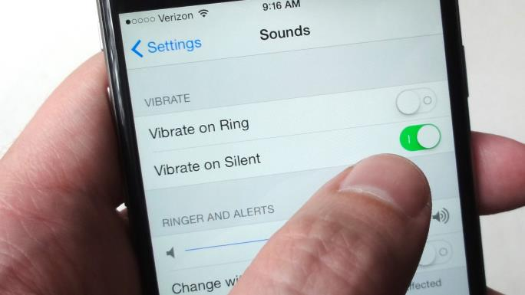
Automatic Contextual Reconfiguration
Add, remove, or alter components based on context
Smart notifications on phone (ring, vibrate, autoresponse)

Slide 21
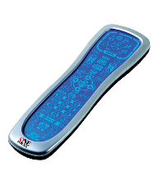
Contextual Commands
Users can parameterize commands with context-filtered values; execution changes based on context
Example: universal remote control

Slide 22
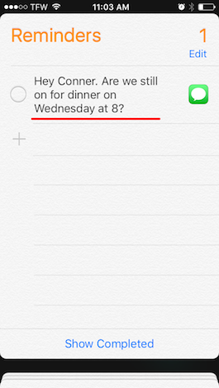
Context-Triggered Actions
Simple if-then condition-action rules, automatically invoked
Reminder: if I step into the car on weekday morning and don’t have suitcase with me, remind me to get it

Slide 23
Why Use Context?
Reduce cognitive load of user
Proactivity
Set up environment according to user’s preferences/history
Auto-completion of forms (location, time in timetable)
Reminders
Search and filter information according to user’s needs
Avoid interrupting the user in inappropriate situations
Smart environments
Turn devices on/off, start applications, … depending on location, time, situation (lecture, meeting, home cinema, …)
Discover and use nearby interaction devices

Slide 24
Types of Context: Train Booking App
Customer provides customer# and booking details (explicit input)
Location, time are required and can be automatically derived from context information (implicit input)
Additional information: current temperature, number of people around you, what you wear, heart rate, …

Slide 25
Types of Context
Time Context (current time, day of week, etc.)
Physical Context (location, temperature, etc.)
User Context (characteristics, habits, history, etc.)
Computational Context (user input, customer history from database, network status, etc.)

Slide 26
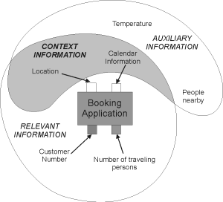
Definitions of Context
“Context is any information that can be used to characterize the situation of an entity. An entity is a person, place, or object that is considered relevant to the interaction between a user and an application, including the user and applications themselves” [Dey et al. 2001]
Auxiliary: not essential
Relevant: can actually be used

Slide 27
Classification
External (physical)
Context that can be measured by hardware sensors
Examples: location, light, sound, movement, touch, temperature, air pressure, etc.
Internal (logical)
Mostly specified by the user or captured monitoring the user’s interaction
Examples: the user’s goal, tasks, work context, business processes, the user’s emotional state, etc.

Slide 28
Challenges
Self-Awareness:
Context-awareness helps technology to “get it right”
But context is hard to sense (quantity, subtleness)
Computers are not self-aware like humans
When the system does the wrong thing
auto-locking car doors
screen saver during presentation
microphone amplifying a whisper

Slide 29
Challenges
Intelligence
Context data must be coupled with the ability to interpret it, but computers are bad at “common sense”.
More rules ≠ intelligence
More rules = more complexity, harder to understand
Keep “Human in the Loop”?
computers can detect, aggregate, portray information
allow human users to interpret and act on it
is this a good strategy for all context-aware systems?

Slide 30
Challenges
Programming:
Developers have little experience with devices that gather the data (e.g., gyroscopes).
Data gathered from a sensor must be interpreted correctly in order for it to be useful.
Context comes from various sources and in order for this data to be useful it must be combined correctly (i.e., the gyroscope and accelerometer working together to determine orientation).
The context changes constantly in real time.

Slide 31
Challenges
Usability vs. control?
Automation reduces the amount of work that users have to do
Users like the idea of a device that completes tasks on their behalf
However, when users use these devices they feel a loss of control if a device has a high level of automation

Slide 32
Challenges
Privacy
Should law enforcement be able to access the history of a user?
Correctness
Errors fusing data
Detection errors
Interpretation errors
Complexity
Difficult to develop, maintain, understand
Reduces accuracy of the application

Slide 33
Challenges
User preferences
May not match what the device does!
Everyone is different!
What is your idea of “nighttime”?
What is your idea of “warm”? Or “loud”?
Information overload
Can overwhelm the user

Slide 34
Solutions
Keep an appropriate level of automation (avoid uncertainty)
The more automation we have, the less control we have over what is happening.
What happens if we give all control to machines?
Would you trust your phone to give you a dose of medicine?
Keep a balance between uncertainty and automation.

Slide 35
Solutions
Avoid unnecessary interruptions
Phone flashes a notification every 30 seconds
Eventually the user will ignore it!
Avoid information overload
Too much information can overwhelm the user, and bog down the device
Example: Walking down a busy street a user’s device is bombarded with suggestions of places to shop

Slide 36
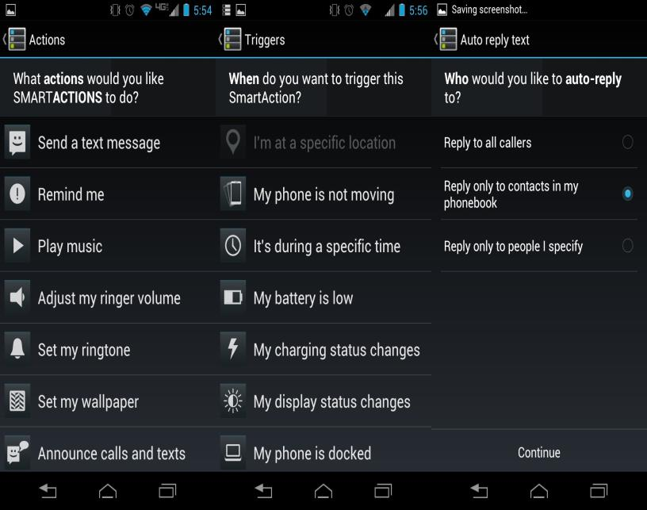

Slide 37
Solutions
Keep an appropriate level of system status visibility
Allow the user to see what action the device is taking
Be sure the user understands why the device is performing the action
Account for the impact of Social Context
A loud alert is not ideal for all situations
Allow for the personalization of individual needs
Allow user to change location names (set a location name to “home” for example)

Slide 38
Solutions
Secure the user’s privacy
Selling information to advertisers…is this right?
Giving information to the police, when does this cross the line?
Sharing context information with others—Facebook location

