Slide 1
Software Requirement and Specification
Waqas Swati
Requirements Engineering: Processes and Techniques Gerald Kotonya and Ian Sommerville
Software Requirements Karl Wiegers and Joy Beatty

Slide 2
Requirements Validation and Negotiation

Slide 3
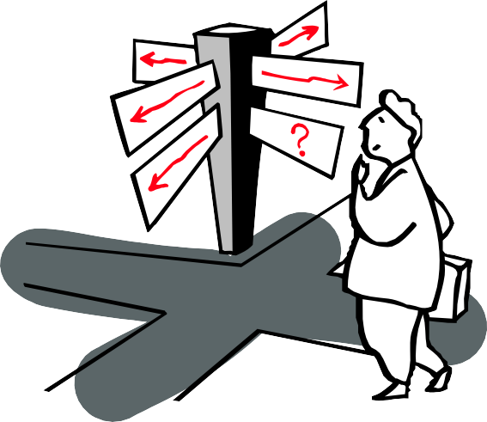
AGENDA
Fundamentals of Requirements Validation
Fundamentals of Requirements Negotiation
Quality Aspects of Requirements
Principles of Requirements Validation
Requirements Validation Techniques
Requirements Negotiation
2

Slide 4
REQUIREMENTS VALIDATION AND NEGOTIATION
Fundamentals of Requirements Validation
3

Slide 5
Purpose of Requirements Validation
Reviewing requirements in order to discover errors or quality problems
Early assurance that (documented) requirements:
represent the actual needs and expectations of the stakeholders
have the necessary level of quality
can be approved for further development activities
Design, implementation, test, …
Especially important in client–contractor relationships
Remember: the later an error is found, the more expensive it is to correct
4

Slide 6
REQUIREMENTS VALIDATION AND NEGOTIATION
Fundamentals of Requirements Negotiation
5

Slide 7
Purpose of Requirements Negotiation
Unresolved conflicts reduce system acceptance
E.g., when only one of the contradictory requirements is implemented, the other party is demotivated
Overall goal of negotiation
Gain a common and agreed-upon understanding of the requirements among all stakeholders
Resolving contradictory requirements of different stakeholders
“Shut down in case of failure” vs. “Restart in case of failure”
Negotiation needs to be done throughout the entire requirements engineering process (not as a single step at the end!)
6

Slide 8
REQUIREMENTS VALIDATION AND NEGOTIATION
Quality Aspects of Requirements
7

Slide 9
Relevant Quality Aspects for Validation
Content
Have all relevant requirements been elicited and documented at the appropriate level of detail?
Documentation
Do all documented requirements respect the predetermined guidelines for documentation and specification?
Agreement
Do all stakeholders concur with the documented requirements and have all known conflicts been resolved?
Approval for further development activities should only be given if all three aspects are being fulfilled
8

Slide 10
Quality Aspect: Content
Content errors are present when the quality criteria for requirements are violated
Fulfilled if no shortcoming have been detected with regard to:
completeness (set of all requirements)
traceability
9

Slide 11
Quality Aspect: Documentation (1/2)
Documentation errors are present when specification guidelines have been violated
Risks of documentation errors
Impairment of development activities
Format not usable for processing
Misunderstanding
Requirements consumers do not understand the notation properly
Incompleteness
Used format does not allow representing all information
Overlooking requirements
Requirements consumers do not find information where expected
10

Slide 12
Quality Aspect: Documentation (2/2)
Fulfilled if no shortcoming have been detected with regard to:
conformity to documentation format (e.g., template, notation)
conformity to documentations structure (e.g., correct section)
understandability (e.g., defined terminology)
unambiguity (e.g., only one possible interpretation)
conformity to documentation rules (e.g., correct use of notation syntax)
11

Slide 13
Quality Aspect: Agreement
Agreement errors are present when the set of requirements does not or no longer represent the stakeholders’ actual needs and expectations
Fulfilled if no shortcoming have been detected with regard to:
agreement (all requirements agreed upon by the stakeholders)
agreement after changes
conflict resolution
12

Slide 14
REQUIREMENTS VALIDATION AND NEGOTIATION
Principles of Requirements Validation
13

Slide 15
Essential Validation Principles
Involvement of correct stakeholders
Separation of the identification and correction of errors
Validation from different views
Adequate change of document type
Construction of development artifacts
Repeated validation
14

Slide 16
Principle 1: Involvement of Correct Stakeholders
Which stakeholder is “correct” depends on the goal of the validation
Validation should never be carried out by the author of a requirement / requirements document
External vs. internal validation
External: validators from outside the development team or even the organization (e.g., experts from Fraunhofer)
More independent and neutral view
Higher effort and costs
Internal: validators from inside the development team or the organization
More influence from prior knowledge
Easy to coordinate
15

Slide 17
Principle 2: Separation of the Identification and Correction of Errors
The principle of separating error identification from error correction is well-established in today‘s software development practice
Applied to requirements validation, this separation:
enables validators to concentrate on identification
enables authors to concentrate on correcting / fixing
16

Slide 18
Principle 3: Validation from Different Views
Requirements should always be validated by several people who take the perspectives of different roles, e.g.:
the customer (who pays for the system)
the user (who uses the system)
the tester (who tests the system)
the developer (who develops the system)
the architect (who designs the system)
…
Taking into account multiple perspectives increases finding more and different errors and reduces finding duplicate errors
17

Slide 19
Principle 4: Adequate Change of Documentation Type
Validation uses the strengths of each documentation type (e.g., natural language, graphical models) in order to compensate for their weaknesses
Transcribing a requirements from one documentation format into another allows for easier validation of this requirement
E.g., written text on a process flow can be validated easier if a corresponding model is drawn
18

Slide 20
Principle 5: Construction of Development Artifacts
Requirements are used as the basis for further development artifacts
It makes sense to directly derive these artifacts (e.g., test cases, design sketches) during validation
Developing artifacts allows for checking whether a requirement is really a suitable basis for development (beyond the assumption that it is)
19

Slide 21
Principle 6: Repeated Validation
Validation should therefore be repeated multiple times, because stakeholders gain additional knowledge during a project
A validated requirement may not be valid at a later point in time
Typical situations in which validation is crucial
(Many) Innovative ideas
Significant gain of knowledge during requirements engineering
Long-lasting projects
First validation was conducted very early
Unknown domain
Reuse of requirements
20

Slide 22
REQUIREMENTS VALIDATION AND NEGOTIATION
Requirements Validation Techniques
21

Slide 23
Techniques Overview
Core techniques (review techniques)
Commenting
Inspections
Walkthroughs
Supporting techniques
Prototyping
Validation checklists
Each technique requires upfront preparation (e.g., identification and involvement of correct stakeholders)
22

Slide 24
Commenting / Ad Hoc Review (One Reviewer)
Receiving opinions on the quality of the requirements
Process
The author hands out the document to an expert.
The expert checks for errors and ambiguities
The flaws are marked and briefly explained
Advantages
Easy to apply
Low costs
Disadvantages
Unsystematic; results depend on expert’s knowledge
23

Slide 25
Inspection
Finding errors in a systematic way
Advantages
Very effective and efficient
Structured process
Disadvantages
Costly
Learning effort
24

Slide 26
Inspection Process (1/2)
Planning
Determining the goal of the validation, the work results that are validated, and which roles and participants are included
Six roles
Author → explains the requirements, implements corrections
Validators (inspectors) → search for errors, communicate findings
Organizer → plans and supervises
Moderator → leads the session, follows the inspection process
Reader → guides the inspectors through the requirements
Minute-taker → reports on the results of the inspection
25

Slide 27
Inspection Process (2/2)
Overview
The author explains the requirements to the validators
Error detection
Validators (inspectors) search through the requirements for errors and document their findings
Recommendation: alternate between collaborative and individual work
Error collection and consolidation (technical review)
Discussing the findings, detecting false positives
An error list contains the consolidated errors and correcting measures
Correction
The author corrects the detected errors
26

Slide 28
Walkthrough
Gaining a shared understanding and identifying quality flaws
Process
The author hands out requirements to validators prior a workshop
Validators discuss the requirements to be validated one by one
Advantages
Stakeholders gain a better understanding
Active discussions among stakeholders
Disadvantages
No formal process
Risk of the author presenting the requirements too positively
27

Slide 29
Checklists
Supporting technique, to be applied in conjunction with review techniques
Ideal for complex environments in which no aspect may be omitted
Precise questions ease the detection of errors, according to the:
three quality aspects (content, documentation, agreement)
principles of validation
quality criteria for requirements documents
quality criteria for (single) requirements
experiences from prior projects
error statistics from prior projects
The checklist should not be longer than one page
28

Slide 30
Prototypes
Supporting technique for requirements validation
Enables stakeholders to experience what they will get
Are considered the most effective means for validation
Degree of detail
High-fidelity
Low-fidelity
Prototype lifetime
Evolutionary
Throw-away
31

Slide 31
Using Prototypes
Prototypes are useful if:
stakeholders do not have any experience regarding the system to be built or do not know in detail what they really need
“I know it when I see it” (IKIWISI) phenomenon
a risk for misunderstandings exists, because:
stakeholders are not able to describe their requirements properly
requirements engineers do not understand the stakeholders correctly
a similar product did not exist so far (feasibility unclear)
the system is interactive
32

Slide 32
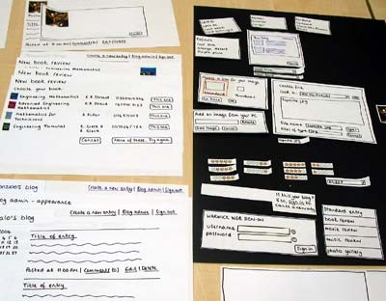
Low-Fidelity Prototypes
Usually first sketches on paper
Intentionally not similar to the final product
Advantages
Easy to create
Supports communication
Change requests can be “implemented” directly
Disadvantages
No prototyping of functionality
Throw-away prototype
No assurance that every concept is technically feasible
33

Slide 33
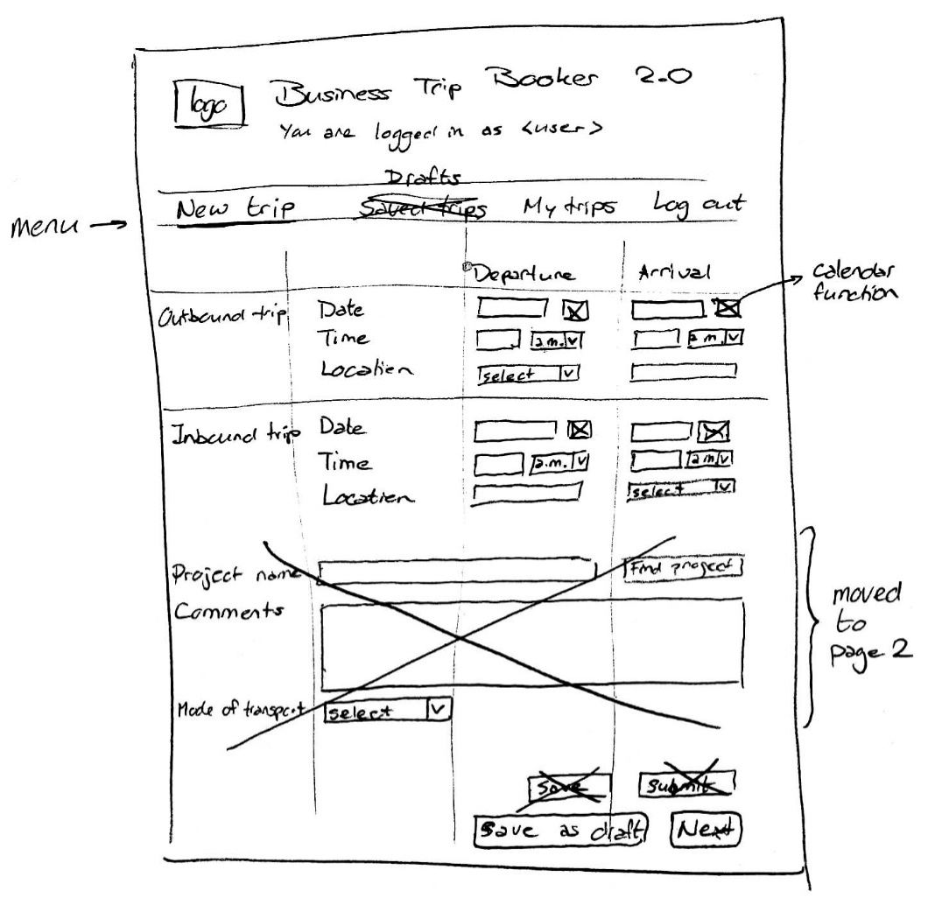
Example: Lo-Fi BTB Prototype with Changes
34

Slide 34
High-Fidelity Prototype
Usually realistic screens developed using software
High similarity to the final system
Advantages
Functionality can be validated as well
Users can get a feel what the final system is like
Disadvantages
Costly development
Change requests cannot be incorporated directly
Stakeholders may get the impression that the system is already there
35

Slide 35
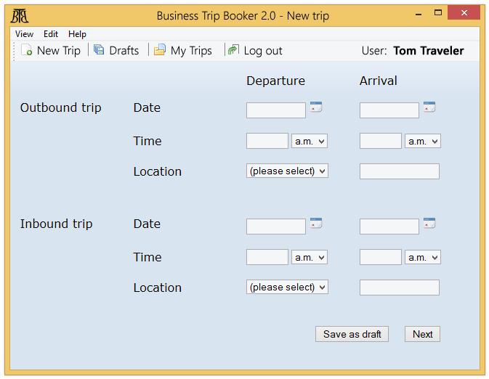
Example: Hi-Fi BTB Prototype
36

Slide 36
Validation Process with Prototypes
Selection of requirements that should be validated through prototypes
Selection of a suitable class of prototypes
Development of the prototype
Preparation of a manual or set of instructions for the users, a prototyping scenario, and a checklist of validation criteria
Performing the validation with stakeholders
Documentation of the validation results (i.e., own observations and statements of the stakeholders)
Analysis of the results and decision about adaptation
(Repetition)
37

Slide 37
REQUIREMENTS VALIDATION AND NEGOTIATION
Requirements Negotiation
38

Slide 38
Performing Requirements Negotiation
Negotiation requires systematic conflict management, which includes:
conflict identification
conflict analysis
conflict resolution
documentation of the resolution
39

Slide 39
Conflict Identification
Conflicts are often not obvious at first glance
Conflicts need to identified systematically by:
directly analyzing elicited requirements
analyzing the requirements while documenting them
reviewing the requirements explicitly during validation
40

Slide 40
Conflict Analysis (1/3)
To resolve contradicting requirements, the underlying reason for the conflict must be understood
Main conflict types
Subject conflict
Conflict of interest
Conflict of value
Relationship conflict
Structural conflict
Note: In practice, most contradictions have multiple underlying reasons (hybrid conflicts). The above classification helps to analyze these reasons.
41

Slide 41
Conflict Analysis (2/3)
Subject conflict
Stakeholders have different interpretation of the consequences
E.g., “Is a response time of 1 second fast enough?”
Conflict of interest
Stakeholders have different goals
E.g., “Should the requirements on integrating the system with the central human resources system be rejected due to its implementation costs?”
Conflict of value
Stakeholders have different cultural and personal preferences
E.g., “Should the BTB system be developed using open source or commercial components?”
42

Slide 42
Conflict Analysis (3/3)
Relationship conflict
Negative interpersonal behavior between stakeholders of the same organizational rank (→ “power & politics”)
E.g., “Should the requirement of the Payroll Director be replaced by the requirement the Human Resources Director?”
Structural conflict
Similar to relationship conflict, but between stakeholders on different levels of the hierarchy
E.g., “Does the Human Resources Director agrees with the requirements of Tina Travelmanager?”
43

Slide 43
Conflict Resolution and Documentation
Conflict resolution is a success factor for a project
It can motivate or demotivate stakeholders to cooperate further
It is essential to involve all relevant stakeholders in conflict resolution
Otherwise: some opinions or viewpoints will be neglected
Conflicts and their resolution must be documented, otherwise:
the same conflicts may arise again and need to be handled anew
the rationale for the requirement is lost and one group of stakeholders will complain when the system is later in place
44

Slide 44
Conflict Resolution Techniques
Agreement → one party convinces the other party and both parties agree on the initial requirement
Compromise → The parties find a compromise between the contradicting, alternative requirements or create a new requirement to which all parties agree
Voting → all stakeholder vote for one of the contradicting requirement, and the requirement with most votes is selected
Variants → the conflicting requirements are not resolved, but the system is developed in different variants (or configurations)
Overruling → a party with a higher organizational rank selects one of the conflicting requirements (only if all other techniques have failed)
…and some more, e.g., decision matrix, plus-minus-interesting, and consider-all-facts
45

Slide 45
Summary
Validation assures the quality of elicited and documented requirements
Quality aspects: content, documentation, agreement
Validation techniques
Main techniques: commenting, inspections, walkthroughs
Supporting: perspective-based reading, prototypes, checklists
Negotiation of requirement conflicts
Identification, analysis, resolution, documentation
46

