Slide 1
Mobile Computing
Location Based Services

Slide 2
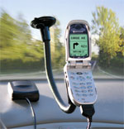
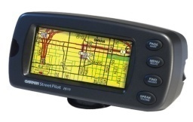
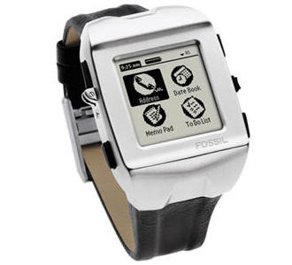
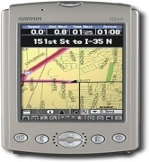
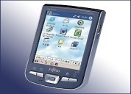
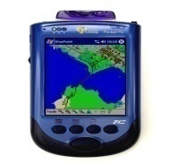
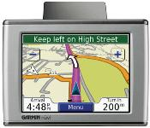
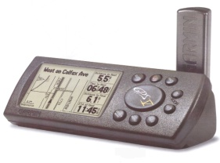
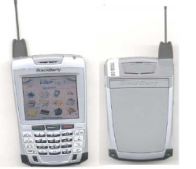
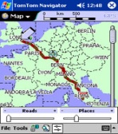
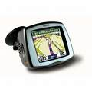
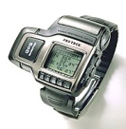
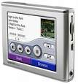
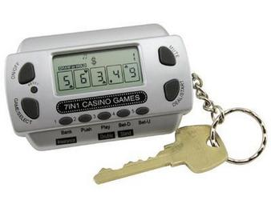
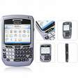
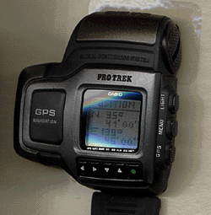
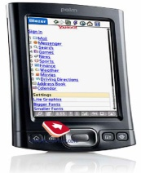
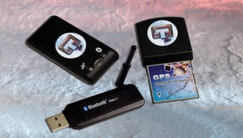
Location-based Services: Definition
LBS: A certain service that is offered to the users based on their locations.

Slide 3
Convergence of Technologies
GIS/ Spatial Database
Web GIS
Mobile GIS
LBS
Mobile Devices
Internet
Mobile Internet

Slide 4
History
The main origin of Location-Based Services (LBS) was the E911 (Enhanced 911) mandate, which the U.S. government passed in 1996.
The mandate was for mobile-network operators to locate emergency callers with prescribed accuracy, so that the operators could deliver a caller’s location to Public Safety Answering Points.
Cellular technology couldn’t fulfill these accuracy demands back then, so operators started enormous efforts to introduce advanced positioning methods.

Slide 5
History
E911 Phase 1: Wireless network operators must identify the phone number and cell phone tower used by callers, within six minutes of a request by a PSAP (public safety answering point).
E911 Phase 2:
95% of a network operator’s in-service phones must be E911 compliant (“location capable”) by December 31, 2005.
Wireless network operators must provide the latitude and longitude of callers within 300 meters, within six minutes of a request by a PSAP.

Slide 6
History
To gain returns on the E911 investments, operators launched a series of commercial LBSs.
In most cases, these consisted of finder services that, on request, delivered to users a list of nearby points of interest, such as restaurants or gas stations.
However, most users weren’t interested in this kind of LBS, so many operators quickly phased out their LBS offerings and stopped related development efforts.

Slide 7
History
The emergence of GPS-capable mobile devices, the advent of the Web 2.0 paradigm, and the introduction of 3G broadband wireless services were among the enabling developments.
A timeline of the most significant developments and landmark events in the short history of LBS is depicted in the next figure.

Slide 8
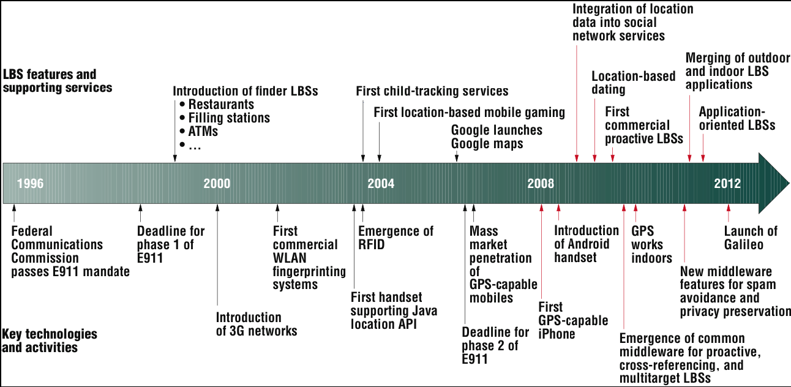
History

Slide 9
Evolution
Early LBSs were reactive, requiring user initiation of service requests.
They were also self-referencing and single-targeted, meaning concerned only with one mobile user location.
They were mainly content-oriented, providing only information based on current location.
Early LBSs were “operator” centered and owned.

Slide 10
Evolution
In 2004, operators and other providers started offering services for fleet management and for tracking children and pets—these were the first examples of cross-referencing LBSs.
Initial versions of these services were based on cell-ID positioning using triangulation techniques, which suffered from low accuracy and were soon replaced by GPS.
An overlay of geo-location technologies consisting of cellular and Wi-Fi triangulations, in addition to low-power GPS receivers (e.g., assisted GPS), made it possible for location information to be available most of the time and with variable accuracies.

Slide 11
Maps
Interactive digital maps; used in many applications, with many map features (location, navigation, nearby sites, traffic overlay, …)
The world of digital navigable maps can be traced back to NAVTEQ, the most dominant company in geographic information systems and electronic maps.
The majority of portable GPS navigation devices , many web based map applications (Yahoo! Maps, MapQuest and Bing Maps), as well as mobile maps (Nokia Maps, Bing Mobile Maps for Windows Phone and Maps for iOS) used NAVTEQ.
Even Google started off using NAVTEQ maps in 2004 (a service then called Google Local) before it switched, and later on generated its own map assets.

Slide 12
Maps
Interactive digital maps; used in many applications, with many map features (location, navigation, nearby sites, traffic overlay, …)
The world of digital navigable maps can be traced back to NAVTEQ, the most dominant company in geographic information systems and electronic maps.
Indoor maps, e.g., major airports, shopping malls, stadiums, resorts and other complex architectural spaces; seamlessly embedded and laid over outdoor maps, which requires no switching actions by the users - only zooming is required to see the details of an indoor map.

Slide 13
Smartphone LBS
iOS:
Core Location framework for accessing user location and getting notifications of location changes.
Map Kit framework for accessing and manipulating maps (street view, satellite view, etc.).
“Maps” application for map viewing and browsing.
Features such as verifying device capabilities, current location, significant change in location (low-power), region monitoring, etc.
Android:
Location Manager Service
Google Map View (Google API)

