Slide 1
Programming Fundamentals
Lecture – 1
Sumaiya Fazal Dad

Slide 2
Introduction
A computer program, from one perspective, is a sequence of instructions that dictate the flow of electrical impulses within a computer system.
These impulses affect the computer’s memory and interact with the display screen, keyboard, mouse, and perhaps even other computers across a network

Slide 3
Cont..
at the lower, more concrete level electrical impulses alter the internal state of the computer, while
at the higher, more abstract level computer users accomplish real-world work or derive actual pleasure

Slide 4
Cont..
The higher-level language code is called source code. The compiled machine language code is called the target code. The compiler translates the source code into the target machine language.
same C++ source code can be compiled to different target platforms

Slide 5
Tools
Editors. An editor allows the user to enter the program source code and save it to files.
Most programming editors increase programmer productivity by using colors to highlight language features.
The syntax of a language refers to the way pieces of the language are arranged to make well-formed sentences.

Slide 6
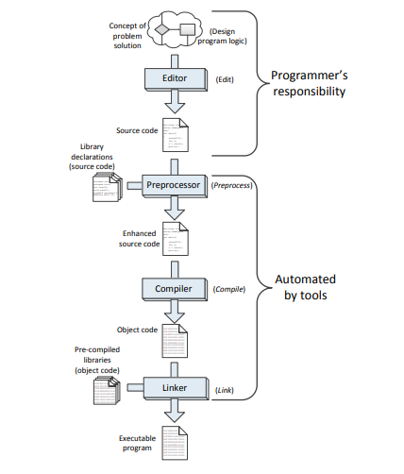
Source Code to Target Code Sequence

Slide 7
Tools Cont..
Compilers. A compiler translates the source code to target code.
The target code may be the machine language for a particular platform or embedded device.
The target code could be another source language; for example, the earliest C++ compiler translated C++ into C, another higher-level language.

Slide 8
Tools Cont..
The complete set of build tools for C++ includes a preprocessor, compiler, and linker:
Preprocessor—adds to or modifies the contents of the source file before the compiler begins processing the code. We use the services of the preprocessor mainly to #include information about library routines our programs use.

Slide 9
Tools Cont..
Compiler—translates C++ source code to machine code
Linker—combines the compiler-generated machine code with precompiled library code or compiled code from other sources to make a complete executable program.
Most compiled C++ code is incapable of running by itself and needs some additional machine code to make a complete executable program.
The missing machine code has been precompiled and stored in a repository of code called a library. A program called a linker combines the programmer’s compiled code and the library code to make a complete program.

Slide 10
Tools Cont..
Debuggers
A debugger allows a programmer to more easily trace a program’s execution in order to locate and correct errors in the program’s implementation.
With a debugger, a developer can simultaneously run a program and see which line in the source code is responsible for the program’s current actions.
The programmer can watch the values of variables and other program elements to see if their values change as expected. Debuggers are valuable for locating errors (also called bugs) and repairing programs that contain errors.

Slide 11
Tools Cont..
Profilers.
A profiler collects statistics about a program’s execution allowing developers to tune appropriate parts of the program to improve its overall performance.
A profiler indicates how many times a portion of a program is executed during a particular run, and how long that portion takes to execute.
Profilers also can be used for testing purposes to ensure all the code in a program is actually being used somewhere during testing. This is known as coverage.
It is common for software to fail after its release because users exercise some part of the program that was not executed anytime during testing. The main purpose of profiling is to find the parts of a program that can be improved to make the program run faster.

Slide 12
Building Blocks of C++ Program
Numeric values
Variables
Declarations
Assignment
Identifiers
Reserved words

Slide 13
Integer Values
#include <iostream>
using namespace std;
int main()
{
std::cout << 4 << '\n';
}
Output:
4

Slide 14
Cont..
In published C++ code you sometimes will see a statement such as the following:
std::cout << 4 << std::endl;
This statement on the surface behaves exactly like the following statement:
std::cout << 4 << '\n';
Programs that do significant printing may execute faster if they terminate their output lines with '\n' instead of std::endl.

Slide 15
Variables and Assignments
#include<iostream>
int main()
{
int x;
x = 10;
std::cout << x << '\n';
}
Output:
?

Slide 16
int x;
• int x;
This is a declaration statement.
All variables in a C++ program must be declared.
A declaration specifies the type of a variable.
The word int indicates that the variable is an integer.
The name of the integer variable is x.

Slide 17
X=10;
x = 10;
This is an assignment statement.
An assignment statement associates a value with a variable.
The key to an assignment statement is the symbol = which is known as the assignment operator.
Here the value 10 is being assigned to the variable x.

Slide 18
Cont..
Note that the lack of quotation marks here is very important.
If x has the value 10, the statement
std::cout << x << '\n';
prints 10, the value of the variable x, but the statement
std::cout << "x" << '\n';
prints x, the message containing the single letter x

Slide 19
Multiple Assignment
#include <iostream>
int main()
{
int x;
x = 10;
std::cout << x << '\n';
x = 20;
std::cout << x << '\n';
x = 30;
std::cout << x << '\n';
}

Slide 20
Cont..
Multiple variables of the same type can be declared and, if desired, initialized in a single statement.
The following statements declare three variables in one declaration statement:
int x, y, z;
The following statement declares three integer variables and initializes two of them:
int x = 0, y, z = 5;
Here y’s value is undefined. The declarations may be split up into multiple declaration statements:

Slide 21
Cont..
int x = 0;
int y;
int z = 5;
In the case of multiple declaration statements the type name (here int) must appear in each statement.
The compiler maps a variable to a location in the computer’s memory.

Slide 22
Identifiers
A variable name is one example of an identifier.
Identifiers have the following form:
Identifiers must contain at least one character.
The first character must be an alphabetic letter (upper or lower case) or the underscore ABCDEFGHIJKLMNOPQRSTUVWXYZabcdefghijklmnopqrstuvwxyz_

Slide 23
Cont..
The remaining characters (if any) may be alphabetic characters (upper or lower case), the underscore or a digit.
ABCDEFGHIJKLMNOPQRSTUVWXYZabcdefghijklmnopqrstuvwxyz_0123456789
No other characters (including spaces) are permitted in identifiers.

Slide 24
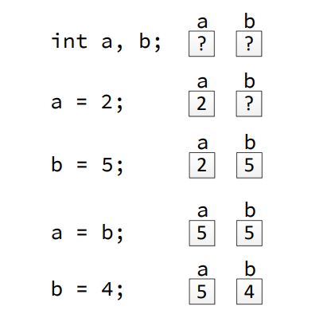
How memory changes during variable?

Slide 25
Additional Integer Types
The type short int, which may be written as just short, represents integers that may occupy fewer bytes of memory than the int type.
If the short type occupies less memory, it necessarily must represent a smaller range of integer values than the int type.
The C++ standard does not require the short type to be smaller than the int type; in fact, they may represent the same set of integer values.

Slide 26
Cont..
The long int type, which may be written as just long, may occupy more storage than the int type and thus be able to represent a larger range of values
short int ≤ int ≤ long int ≤ long long int

Slide 27
Cont..
Within the source code, any unadorned numerical literal without a decimal point is interpreted as an int literal;
for example, in the statement
int x = 4456;
the literal value 4456 is an int.
In order to represent 4456 as an long, append an L, as in
long x = 4456L;
C++ also permits the lower-case l (elle), as in
long x = 4456l;

Slide 28
Floating-point Types
The types float and double represent different types of floating-point numbers.
The type double is used more often, since it stands for “double-precision floating-point,” and it can represent a wider range of values with more digits of precision.
The float type represents single-precision floating-point values that are less precise.

Slide 29
Code
#include
int main()
{
double pi = 3.14159;
std::cout << "Pi = " << pi << '\n';
std::cout << "or " << 3.14 << " for short" << '\n';
}

Slide 30
Cont..
The first line declares a variable named pi and assigns it a value.
The second line prints the value of the variable pi, and the third line prints a literal value.
Any literal numeric value with a decimal point in a C++ program automatically has the type double, so
3.14
has type double. To make a literal floating-point value a float, you must append an f or F to the number, as in
3.14f

Slide 31
Constants
Constants are declared like variables with the addition of the const keyword:
const double PI = 3.14159;
Once declared and initialized, a constant can be used like a variable in all but one way—a constant may not be reassigned.
It is illegal for a constant to appear on the left side of the assignment operator (=) outside its declaration statement. A subsequent statement like

Slide 32
Cont..
PI = 2.5;
would cause the compiler to issue an error message:
error C3892: ’PI’ : you cannot assign to a variable that is const

Slide 33
Characters
The char data type is used to represent single characters:
letters of the alphabet (both upper and lower case), digits, punctuation, and control characters (like newline and tab characters).
Most systems support the American Standard Code for Information Interchange (ASCII) character set.
Standard ASCII can represent 128 different characters.
In C++ source code, characters are enclosed by single quotes ('), as in char
ch = 'A';

Slide 34
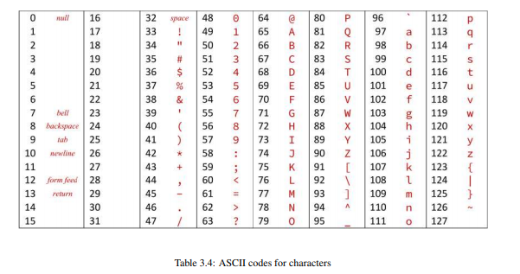
ASCII Code

Slide 35
Code
#include <iostream>
int main()
{
char ch1, ch2;
ch1 = 65;
ch2 = 'A';
std::cout << ch1 << ", " << ch2 << ", " << 'A' << '\n';
}

Slide 36
Cont..
Some characters are non-printable characters.
The ASCII chart lists several common non-printable characters:
• '\n'—the newline character
• '\b'—the backspace character
• '\a'—the “alert” character (causes a “beep” sound or other tone on some systems)
• '\t'—the tab character

Slide 37
Enumerated Types
enum Color
{
Red, Orange, Yellow, Green, Blue, Violet
};

Slide 38
Quiz:
1. Will the following lines of code print the same thing?
Explain why or why not.
std::cout << 6 << '\n';
std::cout << "6" << '\n';
2. Will the following lines of code print the same thing? Explain why or why not.
std::cout << x << '\n';
std::cout << "x" << '\n';

Slide 39
Cont..
3. What is wrong with the following statement that attempts to assign the value ten to variable x?
10 = x;
4. In the declaration do a and b represent the same memory location?
int a;
int b;
5. What is printed by the following code fragment?
int x;
x = 'A';
std::cout << x << '\n';

Slide 40
Cont..
6. Difference between debugger and profiler?
7. Difference between compiler and interpreter?
8. Difference between declaration and identifier?

