Slide 1
E- Commerce and Management
Lecture-1

Slide 2
E-Commerce definition
Electronic commerce is an emerging concept that describes the process of buying and selling or exchanging of products, services and information via computer networks including the internet

Slide 3
E-commerce classification
A common classification of EC is by the nature of transaction: Business-to-Business (B2B): electronic market transactions that take place between organizations
Business-to-Consumer (B2C): retailing transactions with individual shoppers – typical shopper at Amazon.com is a consumer
Consumer-to-Consumer (C2C): consumer sells directly to consumers, examples -individuals selling in classified ads, auction sites allowing individuals to put up items for auction – e.g, e-bay

Slide 4
E-commerce classification
Consumer-to-Business (C2B): individuals who sell products or services to organizations and those who seek sellers and conclude a transaction.
Intra Business (organizational) EC: all internal organizational activities involving exchange of goods, services or information, selling corporate products to employees, online training and cost reduction activities
Non-Business EC: academic institutions, not-for-profit organizations, religious/social organizations and government agencies using EC to improve their operations, customer service and reduce expense

Slide 5
Basic Definitions
Web client- machine that initiates internet request
Web server – machine that services internet request
Browser - software at the client side to interact with web data
Intranet – an internal network of computers confined to a single place
Extranet – when two or more intranets are connected with each other, they form an Extranet – e.g, Virtual Private Network
Internet – a global network of networks is defined as internet

Slide 6
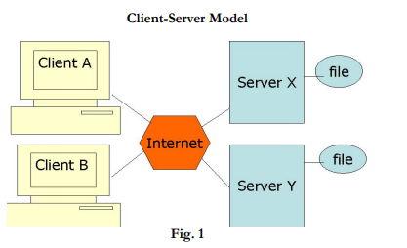
Client –server Model

Slide 7
What is the WEB?
The Web is a protocol that uses the internet as the communication structure. It links documents stored in computers that communicate on the internet. It is based on Hypertext Transfer Protocol (HTTP) - native protocol of WWW designed for making web page requests.

Slide 8
HTTP is a four step process per transaction
Client
Makes an HTTP request for a web page
Makes a TCP/IP connection
2. Sever accepts request Sends page as HTTP
1. Client downloads the page
2. Server breaks the connection
3. HTTP is stateless because in the fourth step the server breaks the connection. We can say, therefore:
Each operation or transaction makes a new connection
Each operation is unaware of any other connection
Each click is a new connection

Slide 9
Side Effect of HTTP Transfers
A record is left of all web transaction in a file that resides at the server called common log file. Good news is that some user data (record of his visits to the web sites) is recorded in a particular format in the log files. Bad news is that user privacy is not maintained.

Slide 10
What can you do with this data?
Rearrange your site by knowing which portions of your web site are popularly accessed and which are ignored by the users
Change your marketing strategy – e.g., you can introduce some promotional scheme for boosting the sale of ignored items
Make a mailing list – you can trace the location from where customers are visiting and prepare a mailing list for marketing purposes

Slide 11
WHAT IS A NETWORK
A network can be anything from a simple collection of computers at one location connected through a connectivity media to the internet (a global network of networks). Local Area Network (LAN) is a serverbased network confined to a particular area/place. Most LANs consist of many clients and a few servers. Fig. 1 below shows a simple LAN setup:

Slide 12
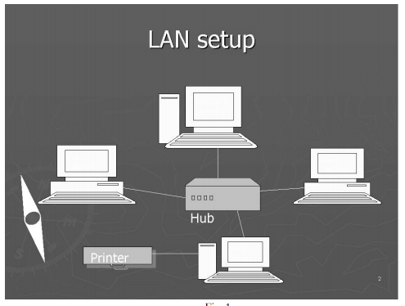

Slide 13
Why networking your computer
We network our computers to share resources and communicate. We can do networking for:
File sharing
Hardware sharing – printer sharing, for example
Program sharing
User communication through a machine called e-mail server

Slide 14
Network protocol
Network protocols are those standard rules using which computers on a network communicate and exchange data with each other. A group of protocols that prepare the data for communication on the network is called the Protocol stack.

Slide 15
International organization for standard’s (ISO) model
In 1970’s came ISO’s OSI model – a conceptual model for network communications. OSI stands for Open System Interconnection Reference Model and it proposes a 7 layer architecture. Each layer (except physical layer) at the sending machine sends instructions through its header to the receiving machine as to how the accompanying data be interpreted or treated by the receiving machine. Header is a piece of which is attached to the data at its beginning by each layer except the physical layer. The process of moving the data down the OSI Protocol stack at the sending machine is called Encapsulation, and the process of moving the data up the OSI stack at the receiving side is called De-encapsulation. Fig. 2 below shows names of the 7 layers of the OSI model which are numbered from bottom up.

Slide 16
ISO OSI Model

Slide 17
OSI Layers
Application layer
It sits at top of the OSI model. Requests related to file transfer and database queries are handled by this layer. Two very important protocols, namely, HTTP and FTP (file transfer protocol) operate at this layer.
Presentation layer
It is the translator of the OSI model. It provides instructions through its header that how the accompanying data should be formatted by the receiving machine. MIME-multipurpose internet mail extensions protocol operates at this layer to define file formats and data types

Slide 18
OSI Layers
Session layer
It provides instructions about the nature of communication link between the sending and receiving machine during a session. A combination of protocols called Session Protocol Data Units work at this layer. Three modes of communication are simplex, half-duplex and full-duplex. Simplex means communication in one direction only. Half-duplex means communication in two directions but one party can send data at a time. Full-duplex means communication in two directions while both parties are able to send data simultaneously. It also places special checkpoints on data packets to trace any lost packets.

Slide 19
OSI Layers
Transport layer
TCP (Transmission Control Protocol) or UDP (User Datagram Protocol) operate at this layer. It has two functions. It converts the data into data packets. Secondly, it is responsible for flow control of data. TCP is more reliable as it is acknowledgment based as opposed to UDP which does not use any system of acknowledgment for the delivery of data packets.
Network layer
It is responsible for providing IP addresses on data packets using IP protocol. Routing Information Protocol (RIP) also operates here which enables routers to build their routing table. Another protocol, Address Resolution Protocol (ARP) is also designed to operate at network layer.

Slide 20
OSI Layers
Data link layer
It places data packets into data frames. Network Interface Card Drivers/Protocols operate at this layer. It is used to identify MAC or hardware address of computer machines. A mathematical calculation, Cyclical Redundancy Check (CRC), takes place here to confirm integrity of data frames.
Physical layer
It has got no header. All information including the header information is converted into binary data at this layer. It results into the generation of electric signals as 1s and 0s are queued up and travel along the connectivity media to the receiving side.

Slide 21
Internet layers- TCP/IP stack
Internet communication model (TCP/IP Stack) proposes a 4 layer architecture. Following are the names of internet layers that map with the OSI model’s layers:
Application layer is equivalent to OSI model’s Application, Presentation and Session layers
Host-to-Host Layer is equivalent to OSI model’s Transport layer
Internet layer is equivalent to OSI model’s
Network layer Network Access layer is equivalent to OSI model’s data link layer

Slide 24
IP addressing
It is the logical addressing scheme used to identify computer machines on the internet. Each computer has a unique IP address provided by IP protocol for a given session. It is represented by four decimal numbers separated by a period e.g, 140.57.220.200 (see Fig. 5 below). Computers see this information as a stream of 32 bits.

Slide 25
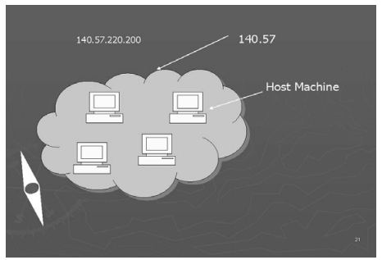

Slide 26
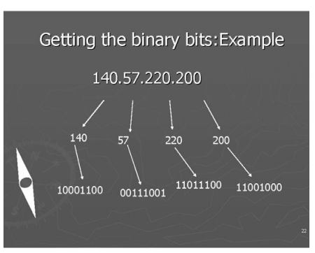

Slide 29
Classes of IP address
There are five classes of IP addresses, namely, A, B, C, D and E. Classes A, B and C are for general public use, whereas Classes D and E are used by people belonging to certain special groups. To find which class a particular IP address belongs to, the rule is to look at the number in the first byte. If this number falls within the calculated range of a specific class, then we can say that this IP address belongs to such particular class.

