Slide 1
Lecture 4
Design Evaluation

Slide 2
Review
Any question from previous lecture?

Slide 3
Where Are We?
We talked to users and understand their problems
We are now designing our prototypes
Low-Fidelity →Hi Fidelity
We need to know which idea is good and which is bad
Many ways for that

Slide 5
Heuristic Evaluation
Notes:
Heuristic Evaluation (originally proposed by Nielsen and Molich, 1990) is a method for quick, cheap, and easy evaluation of the user interface.
The process requires that a small set of testers (or “evaluators”) examine the interface, and judge its compliance with recognised usability principles (the “heuristics”). The goal is the identification of any usability issues so that they can be addressed as part of an iterative design process.

Slide 6
Notes:
The simplicity of heuristic evaluation is beneficial at the early stages of design. This usability inspection method does not require user testing which can be burdensome due to the need for users, a place to test them and a payment for their time. Heuristic evaluation requires only one expert, reducing the complexity and expended time for evaluation. Most heuristic evaluations can be accomplished in a matter of days. The time required varies with the size of the artifact, its complexity, the purpose of the review, the nature of the usability issues that arise in the review, and the competence of the reviewers. Using heuristic evaluation prior to user testing will reduce the number and severity of design errors discovered by users.

Slide 10
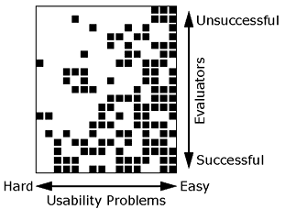
Why Multiple Evaluators?
Notes:
Illustration showing which evaluators found which usability problems in a heuristic evaluation of a banking system. Each row represents one of the 19 evaluators and each column represents one of the 16 usability problems. Each square shows whether the evaluator represented by the row found the usability problem represented by the column: The square is black if this is the case and white if the evaluator did not find the problem. The rows have been sorted in such a way that the most successful evaluators are at the bottom and the least successful are at the top. The columns have been sorted in such a way that the usability problems that are the easiest to find are to the right and the usability problems that are the most difficult to find are to the left.

Slide 11
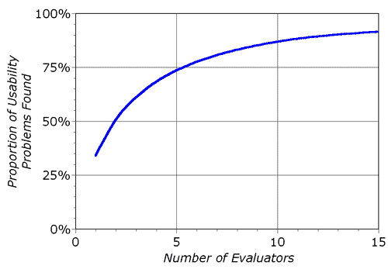
Why not A lot of Evaluators -Decreasing Returns
Notes:
Curve showing the proportion of usability problems in an interface found by heuristic evaluation using various numbers of evaluators. The curve represents the average of six case studies of heuristic evaluation.
In principle, individual evaluators can perform a heuristic evaluation of a user interface on their own, but the experience from several projects indicates that fairly poor results are achieved when relying on single evaluators. Averaged over six of my projects, single evaluators found only 35 percent of the usability problems in the interfaces. However, since different evaluators tend to find different problems, it is possible to achieve substantially better performance by aggregating the evaluations from several evaluators. Figure 2 shows the proportion of usability problems found as more and more evaluators are added. The figure clearly shows that there is a nice payoff from using more than one evaluator. It would seem reasonable to recommend the use of about five evaluators, but certainly at least three. The exact number of evaluators to use would depend on a cost-benefit analysis. More evaluators should obviously be used in cases where usability is critical or when large payoffs can be expected due to extensive or mission-critical use of a system.

Slide 12
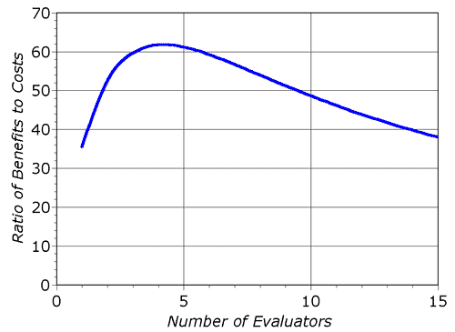
Why not A lot of Evaluators -Decreasing Returns
Notes:
Figure shows the varying ratio of the benefits to the costs for various numbers of evaluators in the sample project. The curve shows that the optimal number of evaluators in this example is four, confirming the general observation that heuristic evaluation seems to work best with three to five evaluators. In the example, a heuristic evaluation with four evaluators would cost $6,400 and would find usability problems worth $395,000.

Slide 15
Notes:
Severity ratings can be used to allocate the most resources to fix the most serious problems and can also provide a rough estimate of the need for additional usability efforts. If the severity ratings indicate that several disastrous usability problems remain in an interface, it will probably be unadvisable to release it. But one might decide to go ahead with the release of a system with several usability problems if they are all judged as being cosmetic in nature.
The severity of a usability problem is a combination of three factors:
The frequency with which the problem occurs: Is it common or rare?
The impact of the problem if it occurs: Will it be easy or difficult for the users to overcome?
The persistence of the problem: Is it a one-time problem that users can overcome once they know about it or will users repeatedly be bothered by the problem?

Slide 16
Notes:
Even though severity has several components, it is common to combine all aspects of severity in a single severity rating as an overall assessment of each usability problem in order to facilitate prioritizing and decision-making.
The following 0 to 4 rating scale can be used to rate the severity of usability problems:
0 = I don't agree that this is a usability problem at all 1 = Cosmetic problem only: need not be fixed unless extra time is available on project 2 = Minor usability problem: fixing this should be given low priority 3 = Major usability problem: important to fix, so should be given high priority 4 = Usability catastrophe: imperative to fix this before product can be released

Slide 17
Further Reading on Severity Rating
http://www.nngroup.com/articles/how-to-rate-the-severity-of-usability-problems/

Slide 19
The heuristics

Slide 21
Notes:
The system should always keep users informed about what is going on, through appropriate feedback within reasonable time.

Slide 25
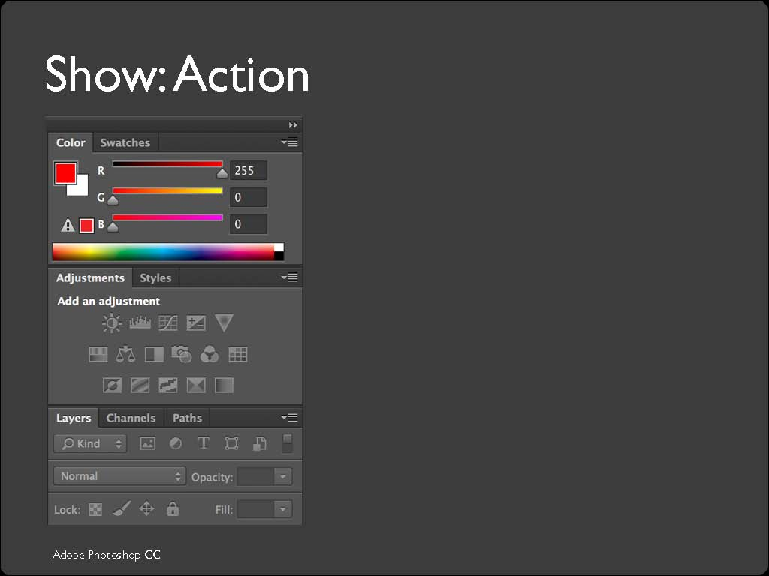

Slide 27
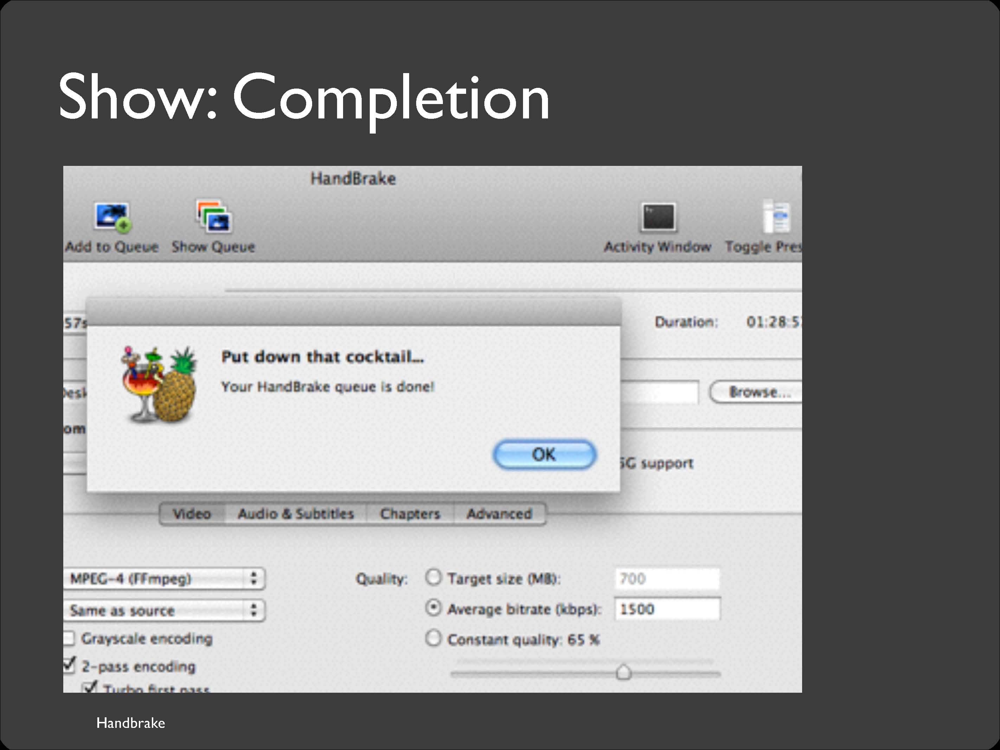

Slide 28
Notes:
The system should speak the users' language, with words, phrases and concepts familiar to the user, rather than system-oriented terms. Follow real-world conventions, making information appear in a natural and logical order.

Slide 30
Notes:
Electronic Correspondence and Electronic Bill presentation are terms that are not familiar to a normal users. It is better to use simple terms like “email” and “bill by email”

Slide 31
Notes:
A lot of people living in California would not be sure if they live in North or South California as they are no official demarcation.

Slide 32
Notes:
What is UTF -8 and no BOM??
What is ISO Latin 1 encoding
Would any of you be sure if you should cancel and save??

Slide 33
Notes:
Uers often choose system functions by mistake and will need a clearly marked "emergency exit" to leave the unwanted state without having to go through an extended dialogue. Support undo and redo.

Slide 34
Notes:
Cannot go back here

Slide 35
Notes:
This flight search interface satisfies this heuristic as user can explore flights on other dates as well

Slide 36
Notes:
Users should not have to wonder whether different words, situations, or actions mean the same thing. Follow platform conventions.

Slide 37
Notes:
Samsung mobile but with different order of buttons

Slide 38
Notes:
The subtopic names are not according what the user expects

Slide 39
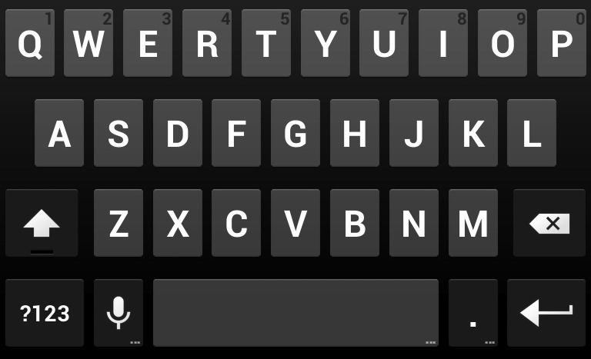
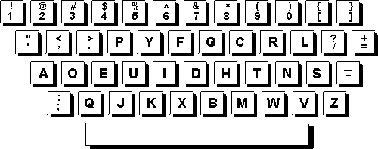
The Keyboards Example
Notes:
DVORAK keyboard is a scientifically better keyboard
Designs that are seriously inconsistent but provide only a tiny improvement in performance will probably fail. The Dvorak keyboard, for example, is slightly faster than the standard QWERTY keyboard, but not enough to overcome the power of an entrenched standard.

Slide 40
Notes:
Make it easier to understand what is going to happen with each butt on press

Slide 41
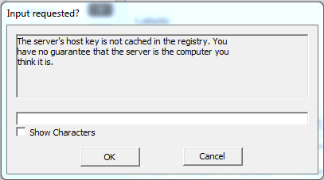
Example of Unclear Choices
Notes:
What should I press? Not clear
What is the textbox for?

Slide 42
Notes:
Even better than good error messages is a careful design which prevents a problem from occurring in the first place. Either eliminate error-prone conditions or check for them and present users with a confirmation option before they commit to the action.

Slide 45
Notes:
It is always better to ask the user to select a date rather than type it as many problems can be avoided. Some example of possible problem cn be :
Wrong day month sequence
Wrong date e.g 31 02 2013 ( there is no 31 febuary)

Slide 46
Notes:
On this publisher site, the user has to enter the author name as well a catalog. This can lead to errors as users might enter the wrong catalog. A simple user might not be sure which catalog to select in the first place. Better to remove catalog and show results from all catalog. The user will probably recognize the correct author name from the title of the book etc

Slide 47
Notes:
Any information needed by a task should be visible or otherwise accessible in the interface for that task. The interface shouldn’t depend on users to remember the email address they want to send mail to, or the product code for the product they want to buy.
Minimize the user's memory load by making objects, actions, and options visible. The user should not have to remember information from one part of the dialogue to another. Instructions for use of the system should be visible or easily retrievable whenever appropriate.

Slide 48
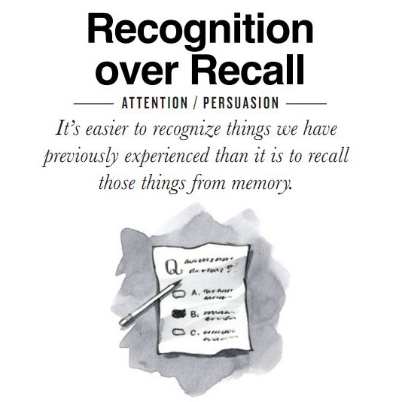
Minimize the user's memory load by making objects, actions, and options visible.

Slide 49
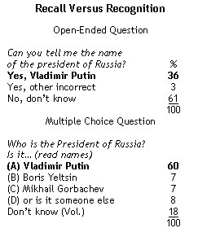

Slide 51
Notes:
No preview: difficult for user to select the right one

Slide 52
Notes:
Preview: easier for the user

Slide 53
An Interface where a lot of Recall if Required
Notes:
This dialog box is a great example of overreliance on the user’s memory. It’s a modal dialog box, so the user can’t start following its instructions until after clicking OK. But then the instructions vanish from the screen, and the user is left to struggle to remember them. An obvious solution to this problem would be a button that simply executes the instructions directly! This message is clearly a last-minute patch for a usability problem.

Slide 54
Notes:
Accelerators -- unseen by the novice user -- may often speed up the interaction for the expert user such that the system can cater to both inexperienced and experienced users. Allow users to tailor frequent actions.

Slide 61
Notes:
Dialogues should not contain information which is irrelevant or rarely needed. Every extra unit of information in a dialogue competes with the relevant units of information and diminishes their relative visibility.

Slide 62
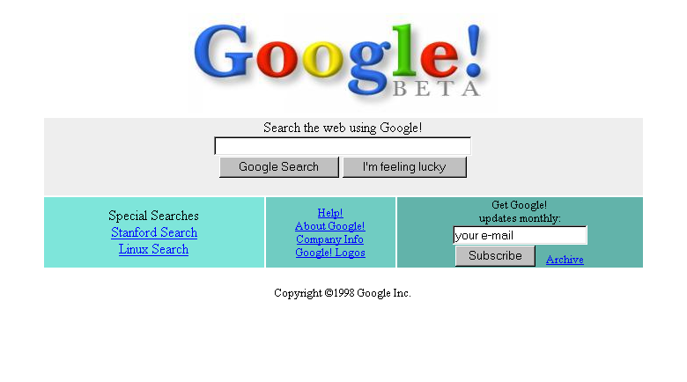

Slide 63
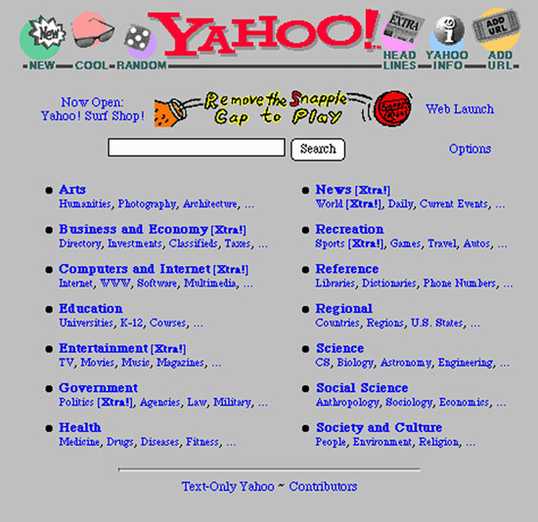

Slide 64
Notes:
Above the fold is the upper half of the front page of a newspaper where an important news story or photograph is often located. Papers are often displayed to customers folded so that only the top half of the front page is visible. Thus, an item that is "above the fold" may be one that the editors feel will entice people to buy the paper.
In websites above the fold means the portion of the webpage that is visible to the user without scrolling down. In the above example the page is about weather in San Francisco but that information is not there. Bad practice

Slide 66
Notes:
The borders is a lot of nose.

Slide 68
Notes:
Error messages should be expressed in plain language (no codes), precisely indicate the problem, and constructively suggest a solution.

Slide 72
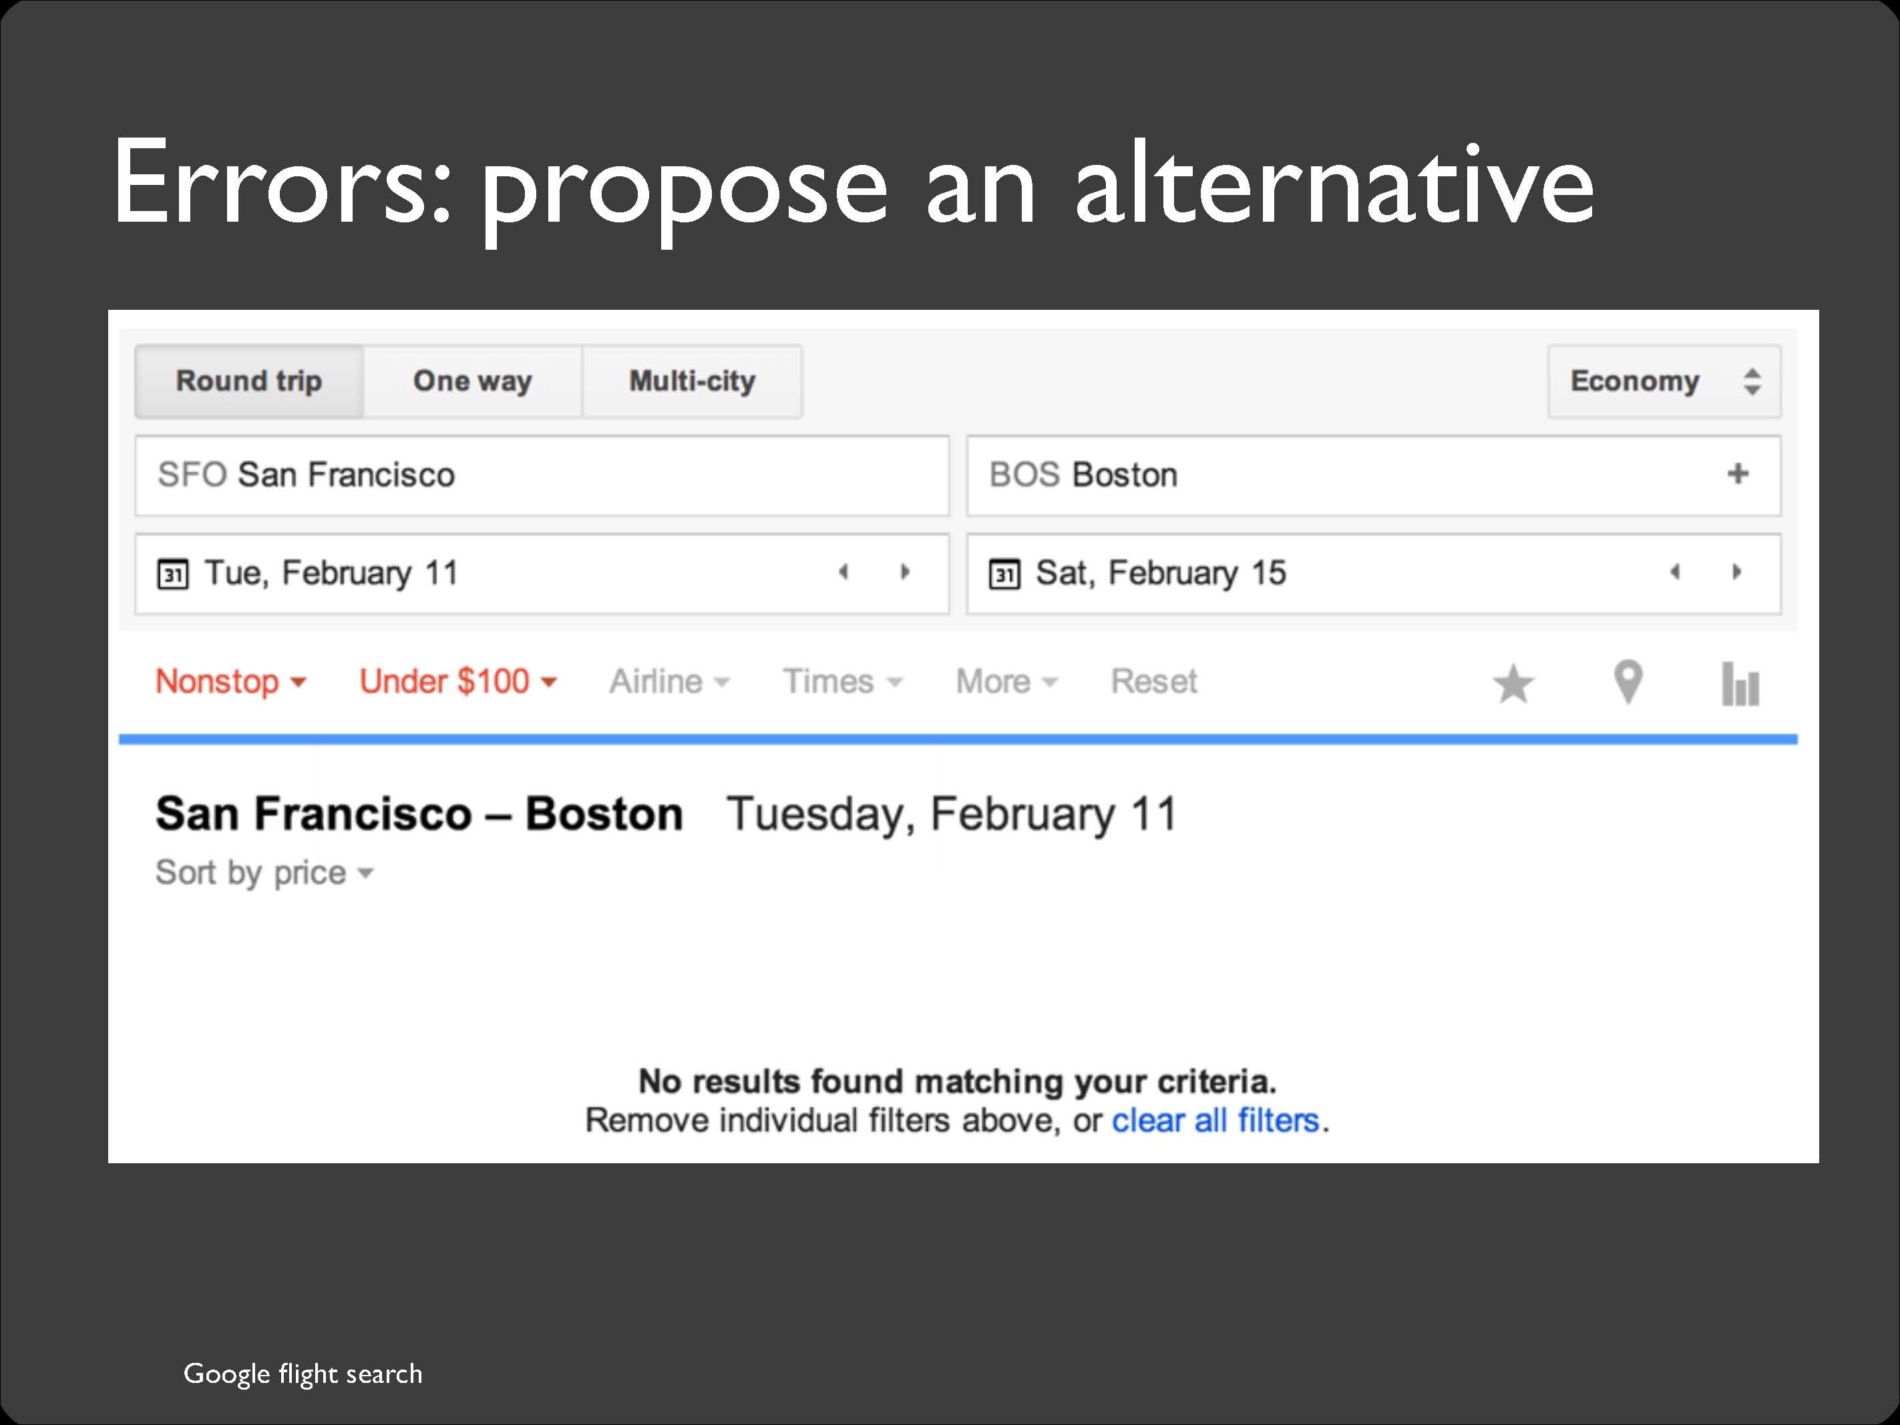

Slide 74
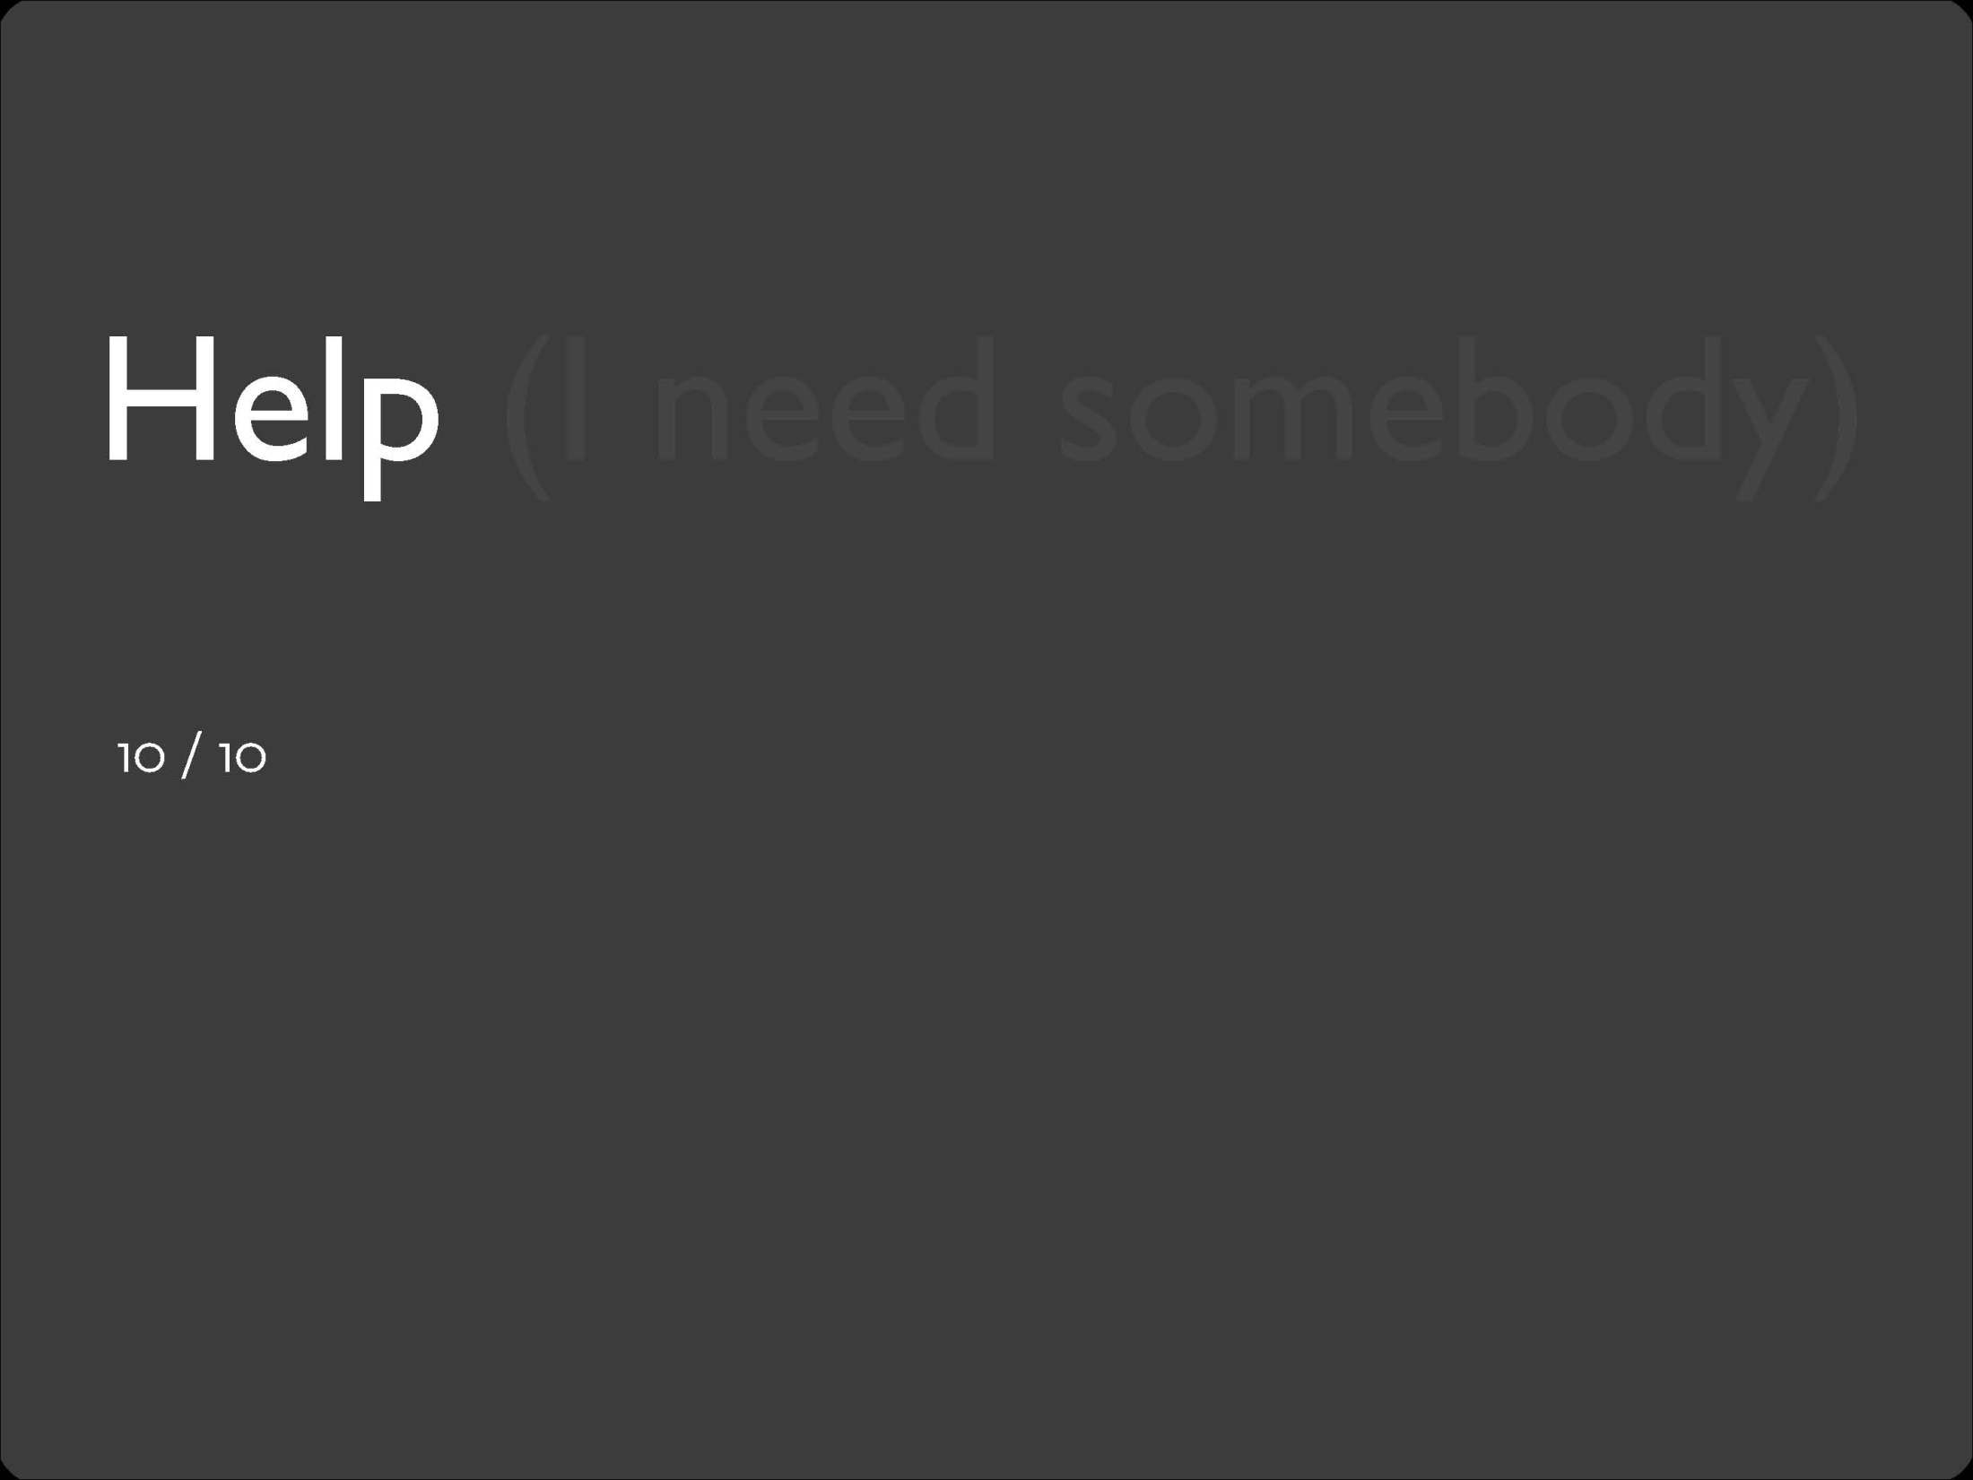
Notes:
Even though it is better if the system can be used without documentation, it may be necessary to provide help and documentation. Any such information should be easy to search, focused on the user's task, list concrete steps to be carried out, and not be too large.

Slide 75
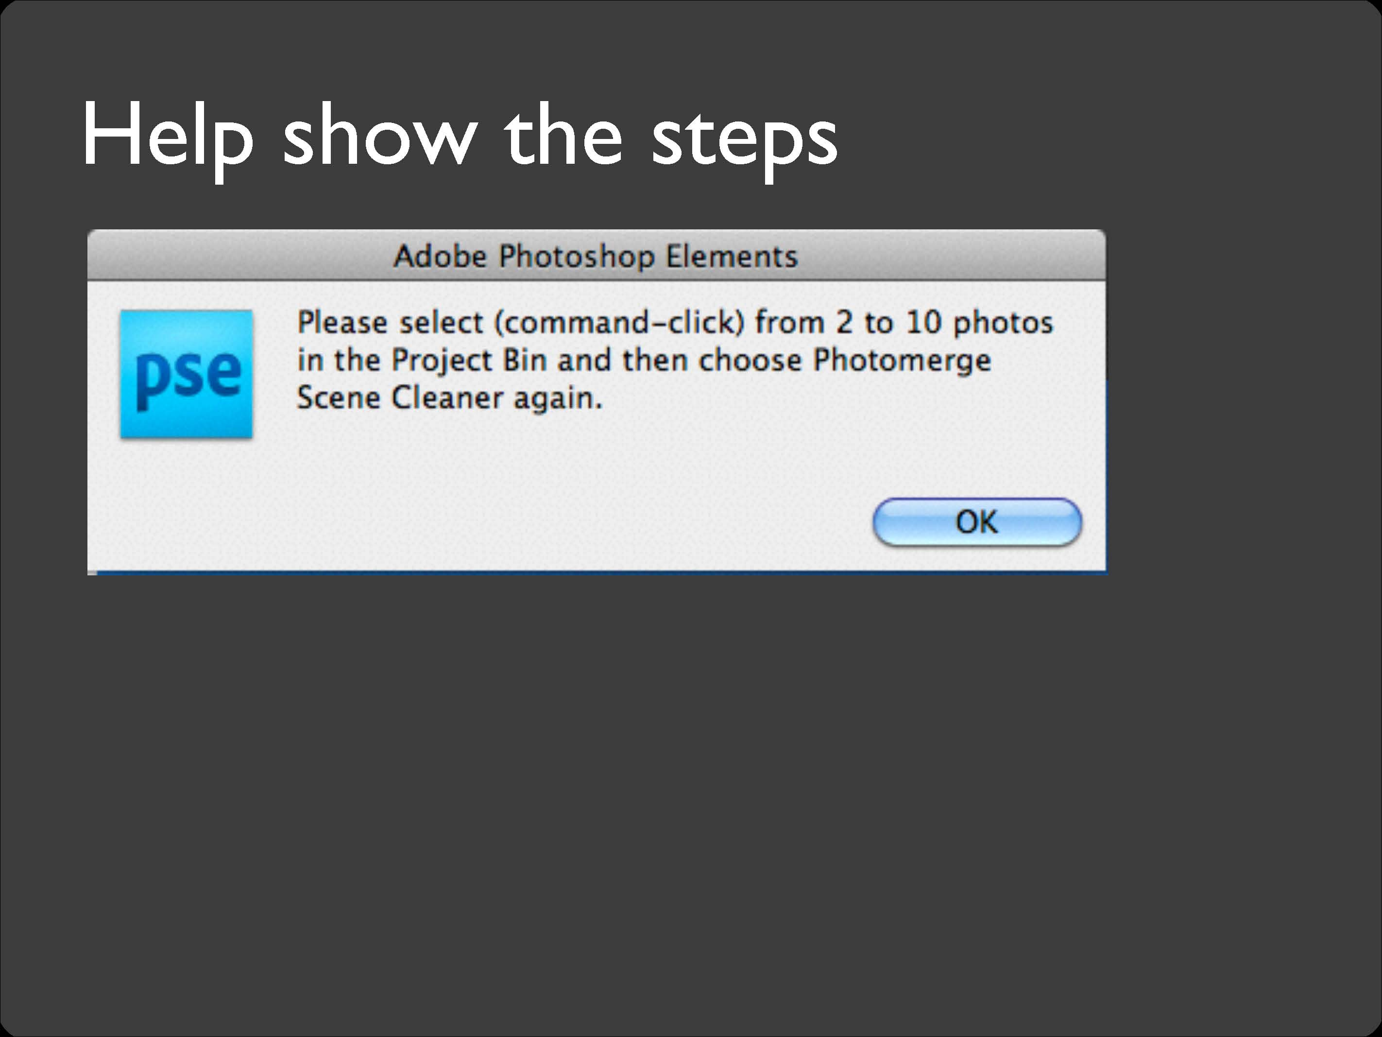

Slide 78
Further Reading
Jacob Neilsen webpage on Heuristic Evaluation
http://www.nngroup.com/articles/ten-usability-heuristics/
http://www.nngroup.com/articles/how-to-conduct-a-heuristic-evaluation/
Examples of the 10 heuristics in websites
http://designingwebinterfaces.com/6-tips-for-a-great-flex-ux-part-5

Slide 79
Quiz#1
Write properties of sketches. (Min. 08)

