Slide 1
Object Oriented Programming (OOP)
Iqra National University Peshawar

Slide 2
Inheritance In General
The features, behaviors and properties shared from parents to children is called inheritance
For Example, in humans we observe
hair, eye color, height, sound pitch, style etc. (in features)
Loyalty, Sincerity, Simplicity, and Passion etc. (in behaviors, virtual properties)
Bank balance, money, house, car and land etc. (in physical properties)

Slide 3
Inheritance in OOP
Inheritance is among the most important features of OOP
The code of existing classes is used in new classes
Inheritance provides us a mechanism of software reusability which is one of the most important principles of software engineering

Slide 4
Inheritance in OOP
Existing classes are called base classes
New classes are called derived classes
Derived class can use data and functions of the base class
In addition, derived class can have its own data and functions as well (like usual inheritance)

Slide 5
Inheritance diagram
Base Class
Base Class
Feature 1
Feature 11
Feature 1
Feature 11
Own Feature of Base Class
Derived Class (inherited from base class)
Feature 1
Feature 11
Feature 111
Feature of Base Class Accessible to Derived Class Because of inheritance
Own Feature defined in Derived Class

Slide 6
Syntax for Inheritance
class base_name //parent class
{ body of the base class};
class derived_name : specifier base_name
// inherited class
{body of the derived class};
main ()
{
Main body
}

Slide 7
Inheritance Example
#include<iostream.h>
#include<conio.h>
class c1
{
public:
long a,b,c;
void get(void)
{
cout<<"Enter the value of a, b and c"<<endl;
cin>>a>>b>>c;}};
class ihc2: public c1
{ public:
sho(void){
cout<<"The values of a, b and c are: "<<a<<"\t"<<b<<"\tand\t"<<c;}};
void main(void)
{ clrscr();
ihc2 obj2;
obj2.get();
obj2.sho();
getch();
}

Slide 8
Access Specifier in Inheritance
Access | Public | Protected | Private
Same class | Yes | Yes | Yes
Derived classes | Yes | Yes | No
Outside classes | Yes | No | No

Slide 9
Multi-level Inheritance
Multi level inheritance is from base class to derived classes derived from derived class (first, second, third and so on derived classes)
The format (syntax) of multi level inheritance is same as normal inheritance
Class A
Class B
Class C

Slide 10
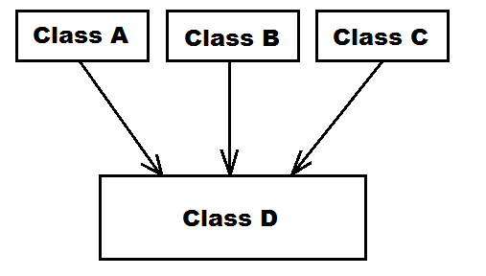
Multiple Inheritance
In multiple inheritance, a class is derived from more one classes
class c1
{body of c1}
class c2
{body of c2}
class c3
{body of c3}
class c4 : spc c1, spc c2, spc c3

Slide 11
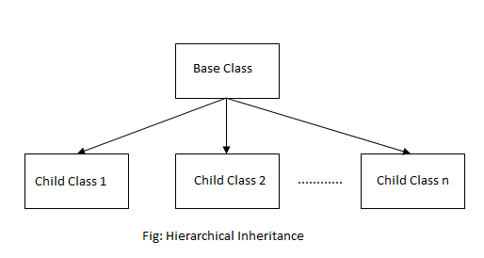
Hierarchical Inheritance
In hierarchical inheritance, more than one classes can be derived form a class

Slide 12
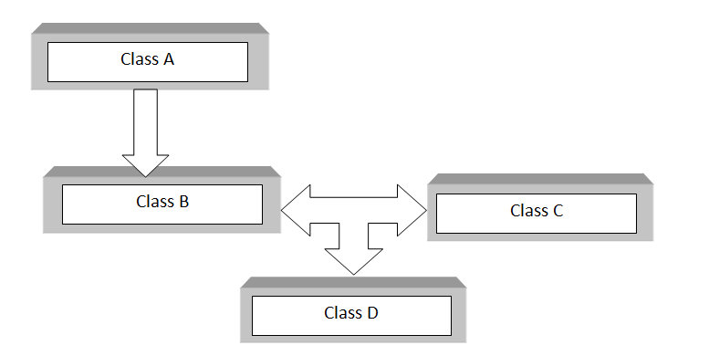
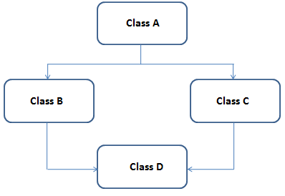
Hybrid inheritance
In hybrid inheritance, more than one type of inheritance is used

Slide 13
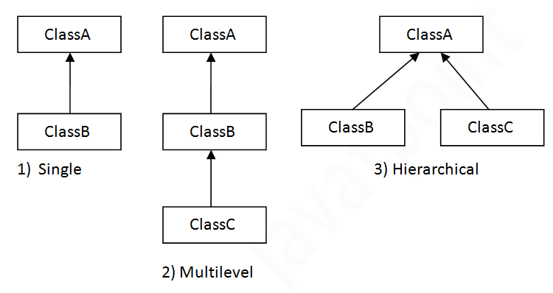
Single vs Multi level vs multiple vs hierarchical
4) Multiple

Slide 14
Constructors in derived classes and multiple inheritance
In single inheritance, the constructor of base as well as derived class is executed automatically when an object of the derived class is created
Similarly, in multiple inheritance, the constructors of all base classes as well as all derived classes are executed when an object of last derived class is created
Syntax and rules of constructors are same as already studied in detail (constructors Section)

Slide 15
Lab Tasks
Write a program having at least two classes and try to call their functions through different/cross objects after calling through own objects
Try to change, calling the functions after changing access specifier and using protected specifier
Inherit one class from another and now call the function of base class through object of derived class
Change access specifiers using inheritance and see its effects

