Slide 1
Object Oriented classes implementation in UML

Slide 2
Outline
What is UML?
Why Use UML?
UML Diagrams
Resources

Slide 3
What is UML?
UML → “Unified Modeling Language”
Unified: UML has become a world standard
Modeling :Describing a software system at a high level of abstraction
Language: More comprehensible, ready-to-use, expressive, and visualing.

Slide 4
What is UML?
Goals of UML:
Provide extensibility and specialization mechanisms to extend the core concepts
Be independent of particular programming languages and development processes
Provide a formal basis for understanding the modeling language
Encourage the growth of the OO tools market.
Support higher-level development concepts such as collaborations, frameworks, patterns and components.

Slide 5
What is UML?
History of UML
Object-Oriented modeling languages began to appear between mid-1970 and the late 1980s ;
Identified modeling languages: < 10 → > 50 (1989-1994 )
Necessity and development

Slide 6
What is UML?
Year Version
2003: UML 2.0
2001: UML 1.4
1999: UML 1.3
1997: UML 1.0, 1.1
1996: UML 0.9 & 0.91
1995: Unified Method 0.8
Booch ‘93
OMT - 2
Other methods
Booch ‘91
OMT - 1
began in late 1994(unifying the Booch and OMT (Object Modeling Technique) methods )

Slide 7
UML Diagrams
Each UML diagram is designed to let developers and customers view a software system from a different perspective and in varying degrees of abstraction
Use Case Diagram
Class Diagram
Interaction Diagrams (Sequence Diagram / Collaboration Diagram )
State Diagram
Activity Diagram
…

Slide 8
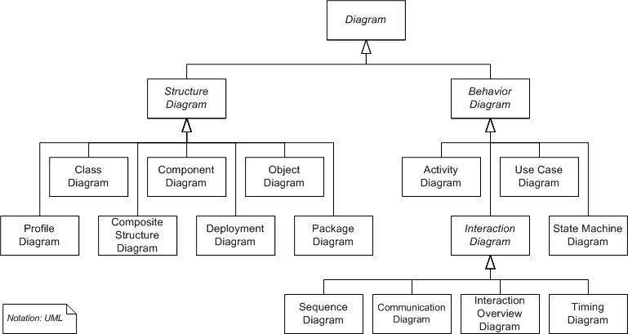

Slide 9
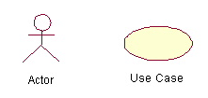
Use-Case Diagrams
Relationship between actors and use cases; capturing user requirements.
Actors: An actor is represents a user or another system that will interact with the system you are modeling
Use cases: an external view of the system that represents some actions the user might perform in order to complete a task

Slide 10
Use-Case Diagrams
When to use:
Use cases are used in almost every project.
How to Draw
Simplest

Slide 11
Use-Case Diagrams: Example
A user placing an order with a sales company might follow these steps :
Browse catalog and select items.
Call sales representative.
Supply shipping information.
Supply payment information.
Receive conformation number from salesperson.

Slide 12
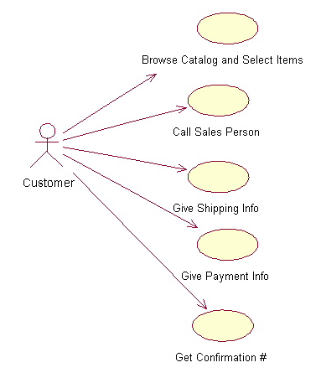
Use-Case Diagrams: Example
The salesperson could also be included in this use case diagram because the salesperson is also interacting with the ordering system.
Notes:
From this simple diagram the requirements of the ordering system can easily be derived. The system will need to be able to perform actions for all of the use cases listed. As the project progresses other use cases might appear. The customer might have a need to add an item to an order that has already been placed. This diagram can easily be expanded until a complete description of the ordering system is derived capturing all of the requirements that the system will need to perform.

Slide 13
Use-Case Diagrams
Relationships in Use Cases
Include: a use case includes the functionality described in another use case. (directed arrow having a dotted shaft, labeled <<include>> )
<<include>>

Slide 14
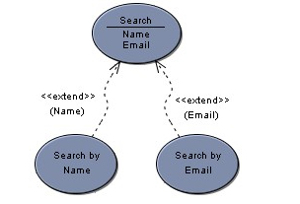
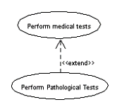
Use-Case Diagrams
Extend: the child use case, the parents use case. <<extend>>
The "Perform Pathological Tests" use case is a specialized version of the generic "Perform medical tests" use case.

Slide 15
Class diagram
Class diagrams are widely used to describe the types of objects in a system and their relationships
Each class is represented by a rectangle subdivided into three compartments
Name
Attributes
Operations
Notes:
Class diagrams describe three different perspectives when designing a system, conceptual, specification, and implementation.1 These perspectives become evident as the diagram is created and help solidify the design.

Slide 16
Class diagram
Modifiers are used to indicate visibility of attributes and operations.
‘+’ is used to denote Public visibility (everyone)
‘#’ is used to denote Protected visibility (friends and derived)
‘-’ is used to denote Private visibility (no one)
Account_Name
Name
- Customer_Name
- Balance
Attributes
+addFunds( )
+withDraw( )
+transfer( )
Operations
Notes:
By default, attributes are hidden and operations are visible.

Slide 17
Class diagram
There are two kinds of Relationships
Generalization{Inheritance} (parent-child relationship)
Association{delegation} (student enrolls in course)
Associations can be further classified as
Aggregation
Composition

Slide 18
Generalization
Supertype
Example:
Customer
Subtype1
Subtype2
Regular
Customer
Loyalty
Customer
-Inheritance is a required feature of object orientation
-Generalization expresses a parent/child relationship among related classes.
Used for abstracting details in several layers
Notes:
the class Honda would have a generalization relationship with the class car

Slide 19
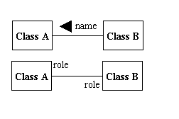
Association
Associations represent static relationships between classes.
(association names ← filled arrow )
(Place roles near the end of an association)
Notes:
Place association names above, on, or below the association line. Use a filled arrow to indicate the direction of the relationship. Place roles near the end of an association. Roles represent the way the two classes see each other.

Slide 20
Association: Multiplicity and Roles
student
1
*
University
Person
0..1
*
employer
teacher
Multiplicity
Symbol Meaning
1 One and only one
0..1 Zero or one
M..N From M to N (natural language)
* From zero to any positive integer
0..* From zero to any positive integer
1..* From one to any positive integer
Role
Role
“A given university groups many people; some act as students, others as teachers. A given student belongs to a single university; a given teacher may or may not be working for the university at a particular time.”
Notes:
asterisk

Slide 21
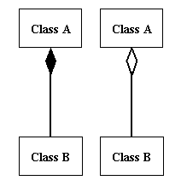
Association: Composition and Aggregation
Association: Models the part–whole relationship
Composition : (filled diamond) “Every part may belong to only one whole, and If the whole is deleted, so are the parts”
Aggregation : (hollow diamond). “It is a specific kind of Container-Containee relationship”

Slide 22
Aggregation vs. Composition
Composition is really a strong form of association
components have only one owner
components cannot exist independent of their owner
components live or die with their owner
e.g. Each car has an engine that can not be shared with other cars.
Aggregations
may form "part of" the association, but may not be essential to it. They may also exist independent of the aggregate. e.g. Employees may exist independent of the team.

Slide 23
Aggregation vs. Composition
//Composition
public class Person
{
private final Name name;
public Person (String fName, String lName)
{
name = new Name(fName, lName);
}
//...
}
//Aggregation
public class Person
{
private Address address;
public Person(Address address)
{
this.address = address;
}
. . .
}

Slide 24
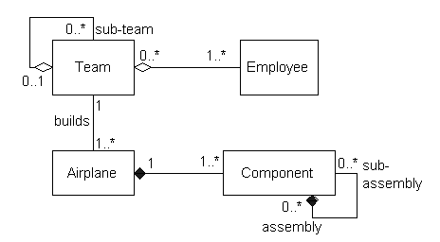
Association: Composition and Aggregation
Composition : (filled diamond) Aggregation : (hollow diamond).
Notes:
farfetched

Slide 25
Interaction Diagrams
Interaction diagrams are used when you want to model the behavior of several objects in a use case
UML supports two types of interaction diagrams
Sequence diagrams Sequence diagrams generally show the sequence of events that occur
Collaboration diagrams Collaboration diagrams demonstrate how objects are statically connected.

Slide 26
Sequence Diagram:Object interaction
A
B
Self-Call: A message that an
Object sends to itself.
Condition: indicates when a message is sent. The message is sent only if the condition is true.
Synchronous
Asynchronous
Transmission delayed
Condition
[condition] remove()
Iteration
*[for each] remove()
Self-Call
Notes:
Messages

Slide 27
Sequence Diagram(make a phone call)
Caller
Phone
Recipient
Picks up
Dial tone
Dial
Ring notification
Ring
Picks up
Hello
Notes:
Sequence diagrams generally show the sequence of events that occur

Slide 28
Sequence Diagrams – Object Life Spans
Creation
Create message
Object life starts at that point
Activation
Symbolized by rectangular stripes
Place on the lifeline where object is activated.
Rectangle also denotes when object is deactivated.
Deletion
Placing an ‘X’ on lifeline
Object’s life ends at that point
A
Create
B
Activation bar
X
Return
Deletion
Lifeline

Slide 29
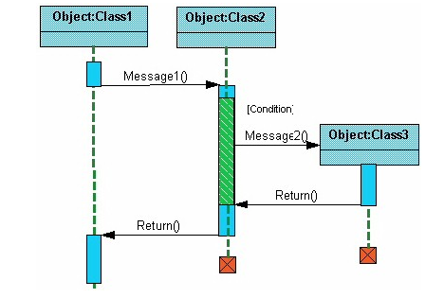
Sequence Diagrams – Object Life Spans
Notes:
The light blue vertical rectangles the objects activation while the green vertical dashed lines represent the life of the object. The green vertical rectangles represent when a particular object has control. The orange rectangles represents when the object is destroyed. This diagrams also shows conditions for messages to be sent to other object. The condition is listed between brackets next to the message. For example, a [condition] has to be met before the object of class 2 can send a message() to the object of class 3.

Slide 30
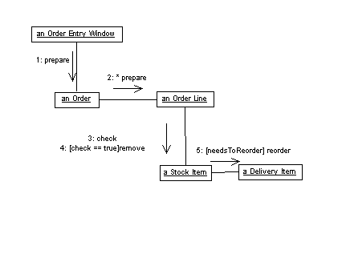
Interaction Diagrams: Collaboration diagrams
Collaboration diagrams are equivalent to sequence diagrams. All the features of sequence diagrams are equally applicable to collaboration diagrams
Use a sequence diagram when the transfer of information is the focus of attention
Use a collaboration diagram when concentrating on the classes
Notes:
Collaboration diagrams are also relatively easy to draw.

Slide 31
State Diagrams (Billing Example)
State Diagrams show the sequences of states an object goes through during its life cycle in response to stimuli, together with its responses and actions;
an abstraction of all possible behaviors.
Start
End
Unpaid
Paid
Invoice created
paying
Invoice destroying
Notes:
State diagrams describe all of the possible states of an object as events occur. Each diagram usually represents objects of a single class and track the different states of its objects through the system.
Rounded Box represents the state of the object and arrows indicting the transition to the next state

Slide 32
State Diagrams (Traffic light example)
Traffic Light
Start
State
Red
Transition
Yellow timer expires
Car trips sensor
Yellow
Green timer expires
Green
Event

Slide 33
Activity Diagrams
Activity diagrams describe the workflow behavior of a system.
similar to state diagrams because activities are the state of doing something
Activity diagrams can show activities that are conditional or parallel.

Slide 34
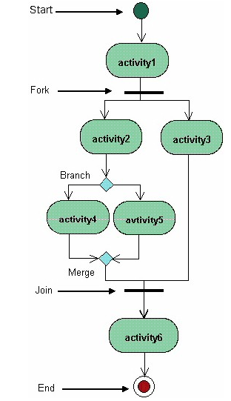
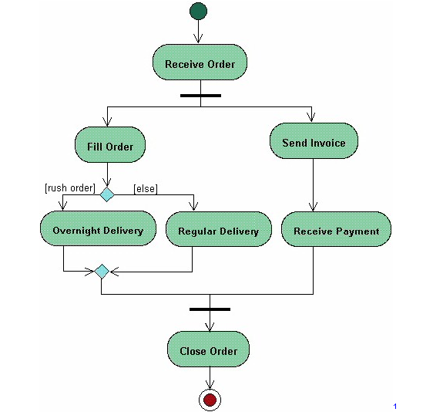
Activity Diagrams
Notes:
Activity diagrams show the flow of activities through the system. Diagrams are read from top to bottom and have branches and forks to describe conditions and parallel activities. A fork is used when multiple activities are occurring at the same time.

Slide 35
UML Resources
Books
Martin Fowler, Kendall Scott: UML Distilled, Addison-Wesley 2000
Grady Booch, et al: The Unified Modeling Language User Guide, Addison-Wesley
James Rumbaugh, et al: The Unified Modeling Language Reference Manual, Addison-Wesley Ivar Jacobson, et al: Unified Software Development Process, Addison-Wesley
Online UML Resources
Rational Software – UML Resource Center (http://www.rational.com/uml/index.jsp), UML Quick Reference (http://www.rational.com/uml/resources/quick/index.jsp), UML Whitepapers (http://www.rational.com/uml/resources/whitepapers/index.jsp) Recommended Books (http://www.rational.com/uml/reading/index.jsp) UML Cafe (http://cafe.rational.com/HyperNews/get/hn/umlcafe.html)

Slide 36
Thank you…..

