Slide 1
Preprocessing Data
Zain Shaukat
MS SE
CUSIT

Slide 2
Contents
Data
Data Preprocessing
Normalization
Other techniques
WEKA Demo
References

Slide 3
Know Your Data
Independent Variables
Dépendent Variables
Data Types

Slide 4
Independent & Dépendent
When a study involves a possible cause and effect relationship,
At least two variables are specified.
One being the variable that the researcher manipulates, independent variable.
The other is potentially influenced or caused by this variable, the dependent variable
Let’s look at the equation
y = 4x – 3

Slide 5
Data types
Nominal
Ordinal
Interval/Ratio

Slide 6
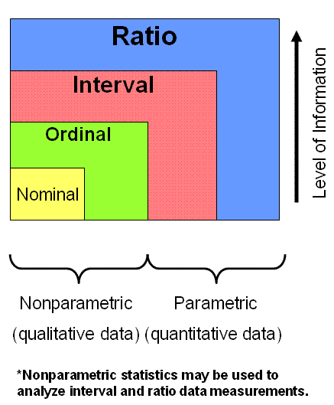
GDP
USA
$16,768,100,000,000
Rank: 1
Percentile: 100th
CYPRUS
$22,767,000,000
Ranks: 102
Percentile: 46th
http://www.six-sigma-material.com/Data-Classification.html

Slide 7
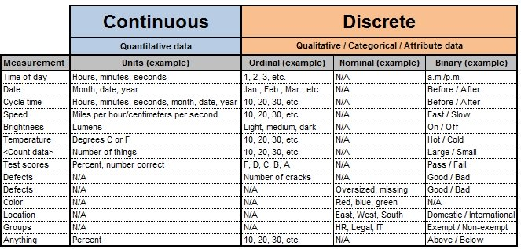
http://www.six-sigma-material.com/Data-Classification.html

Slide 8
Dirty Data…!
Incomplete
occupation=“ ”
Noisy
Salary=“-10”
Inconsistent:
Age=“42” Birthday=“03/07/1997”
Was rating “1,2,3”, now rating “A, B, C”
Discrepancy between duplicate records

Slide 9
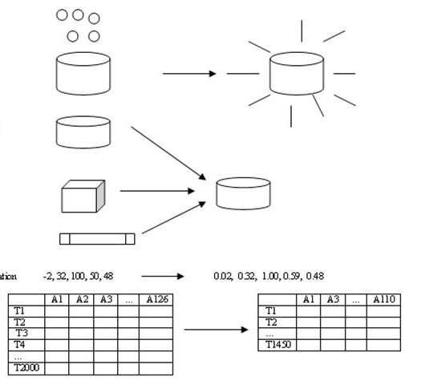
Forms of data pre-processing
Data cleaning
Fill in missing values, smooth noisy data,
identify or remove outliers, and resolve inconsistencies
Data integration
Integration of multiple databases, data cubes, or files
Data transformation
Normalization
Data reduction
Obtains reduced representation in volume but
produces the same or similar analytical results
Data discretization
Part of data reduction but with particular importance,
especially for numerical data

Slide 10
Data Transformation
Normalization: scaled to fall within a small, specified range
min-max normalization
z-score normalization
Other Techniques
Notes:
Aggregation is also called a “Has-a” relationship
Generalization uses a “is-a” relationship

Slide 11
Why Normalization
More Understandability
Better Results
Data Size ?

Slide 12
Some machine learning algorithms require the input data to be normalized in order to converge to a good result.
Let's take an example
a data set where samples represent apartments and the features are the number of rooms and the surface area.
The number of rooms would be in the range 1-10, and the surface area 200 - 2000 square feet.

Slide 13
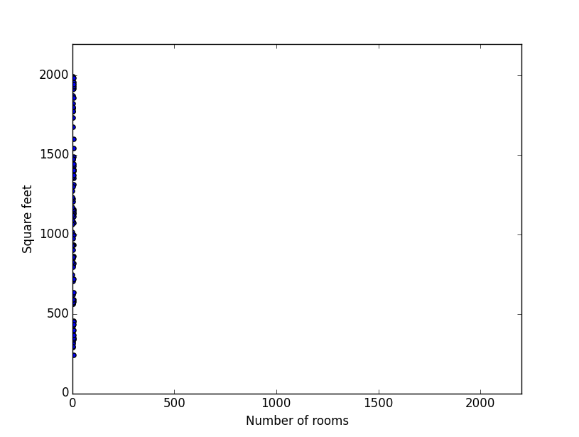
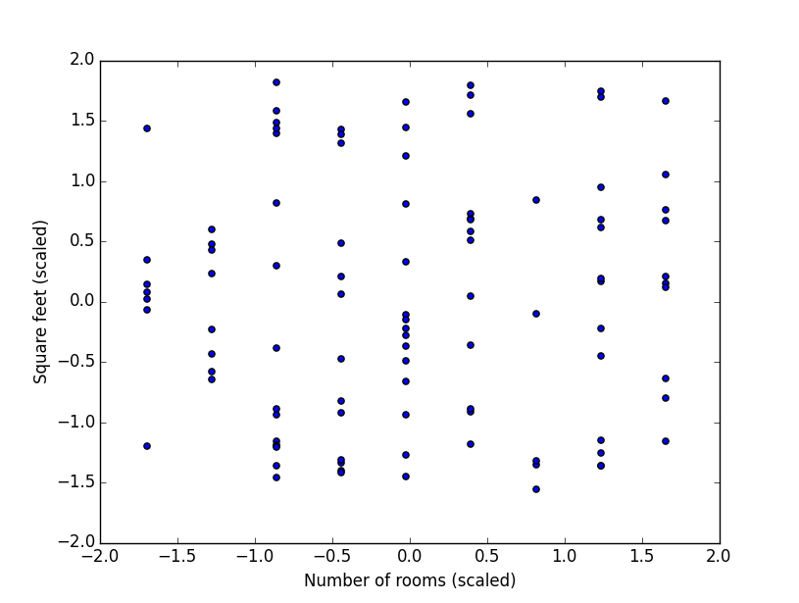
Before and After Normalization
http://www.six-sigma-material.com/Data-Classification.html

Slide 14
COMMON Techniques
1. Rescaling data to have values between 0 and 1.
This is usually called feature scaling. One possible formula to achieve this is:
2. Transforming data using a z-score. This is usually called standardization.
x_{i} is a data point (x₁, x₂…x_{n}).
x̄ is the sample mean.
s is the sample standard deviation.

Slide 15
Normalization Mathematically
A Set of Values {8,10,15,20}
Min=8
Max=20
V1=8, v2=10, v3=15, v4=20
New_Min=1
New_Max=0

Slide 16
Take v=8,
MINMAX=((v-Min)/(Max-Min))*(New_ Max – New_ Min)+New_ Min
MINMAX= ((8-8)/(20-8)) * (1 - 0) + 0
= 0/12 *1
v1= 0
v2= 0.16
V3 = 0.58
V4 = 1
OLD | NEW
8 | 0
10 | 0.16
15 | 0.58
20 | 1

Slide 17
Standardization
V1=8, v2=10, v3=15, v4=20
NEWVALUES= (V-MEAN)/STDDEV
MEAN= (8+10+15+20)/4
MEAN=13.25
STDDEV=
=SQRT(1/4((8-13.25)+(10-13.25)+(15-13.25)+(20-13.25)))
=SQRT(0.25)
=5.37
V1_New= -0.976
V2_New= -0.604
V3_New= 0.325
V4_New= 1.25

Slide 18
Normalized Vs Standardized Values
Original | Normalized | Standardize
8 | 0 | -0.976
10 | 0.16 | -0.604
15 | 0.58 | 0.325
20 | 1 | 1.25

Slide 19
Normalization vs Standardization
STANDARDIZING attribute data assumes a Gaussian distribution of input features
It Takes Mean As 0 and StdDev as 1.
This works better with linear regression, logistic regression and linear discriminate analysis.
NORMALIZING attribute data is used to rescale components of a feature vector to have the complete vector length of 1.
This pre-processing rescaling method is useful for sparse attribute features and algorithms using distance to learn such as KNN.

Slide 20
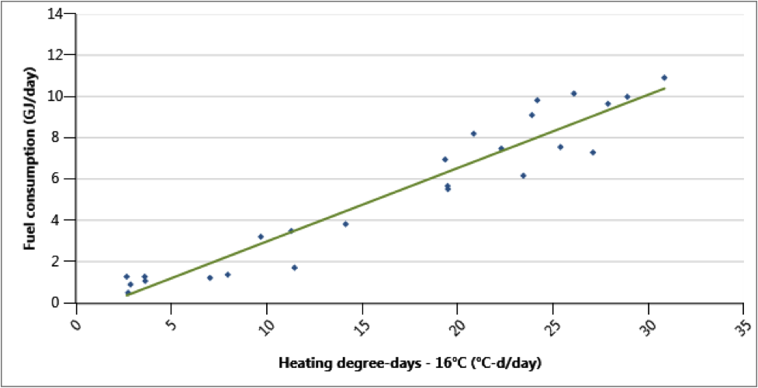
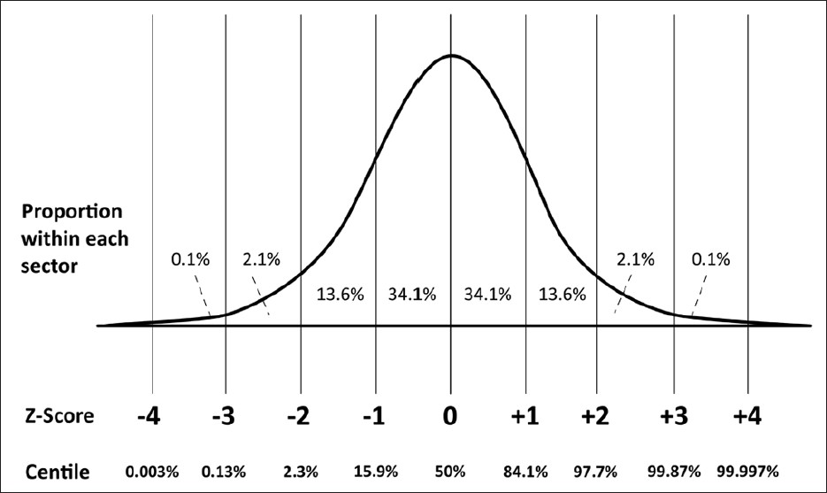
Normalization https://blog.heatspring.com/free-retscreen-tutorial/ Standardization http://access-excel.tips/probability-range-z-score/

Slide 21
Other Techniques
Normalize by mean
[E] / Avg([E])
Normalize by percentile
[E] / Percentile([E], P)
Normalization by log ratio
Log10( [E] / [A] )
Normalize by standard deviation
[E] / StdDev([E])
Subtract the mean
[E] – Avg([E])
Subtract the median
[E] – Median([E])

Slide 22
WEKA

Slide 23
References
Data Mining: Concepts and Techniques (Han, Kamber, Pei)
Data Mining: Practical Machine Learning Tools and Techniques (Ch. 5, Degregori, Witten)
https://www.techwalla.com/articles/how-to-find-the-z-score-using-microsoft-excel
https://machinelearningmastery.com/normalize-standardize-machine-learning-data-weka/

