Slide 1
WIRELESS COMMUNICATION
CELLULAR CONCEPTS
Engr. Latif Jan
IQRA NATIONAL UNIVERSITY

Slide 2
What is GSM?
Global system for mobile communication is a set of ETSI standards specifying the infrastructure for a digital cellular services.
GSM networks are structured hierarchically it consist of one administrative region which is assigned to a MSC.
Each administrative region is made up of at least one location area (LA). LA is also called the visited area.
An LA consists of several cell groups.
Each cell group is assigned to a base station controller (BSC)

Slide 3
GSM system hierarchy?
GSM NETWORK
MSC REGION
MSC REGION
LOCATION AREA (LA)
LA
BS CONTROLLER
BS CONTROLLER
BS CONTR-OLLER
CELL
CELL
LA
MSC REGION

Slide 4
OPENED VIEW OF GSM ARCHITECHTURE?
NSS
NMS
HLR
VLR
AUC
ISDN
EIR
MSC
PSTN
BSC
OTHER NETWORKS
BSS
Mobile station

Slide 5
Mobile station?
Consist of two main elements.
1. The mobile equipment
2. Subscriber identity module(SIM).

Slide 6
The Base Station Subsystem?
BSS = BSC + BTS
CENTRAL N/W ELEMENT OF BSS
CALL ESTABLISHMENT
MOBILITY MGMT
STATISTICAL RAW DATA COLLECTION
SPEECH PROCESSING
MODULATION/DEMODULATION
TRANSCODER
MINIMIZE TRANSMISSION PROBLEM
AIR INTERFACE MANAGEMENT
RADIO PATH CONTROL
AIR INTERFACE SIGNALLING

Slide 7
THE N/W SWITCHING SUBSYSTEM?
NSS = MSC + HLR + VLR + AUC + EIR
MANAGE
COMMUNICATION
B/W USERS
INCLUDE
DATABASE TO STORE INFORMATION OF USER
CALL CONTROL
MOBILITY
MGMT
SUBSCRIBER
DATA HANDLING
CHECK IDENTITY OF USER
PERMANENT STORAGE OF USER INFORMATION
STORE A COPY OF HLR
CHECK ROAMING
PROVIDE AUTHENTICATION
SECURITY
CHECK IMEI NUMBER OF MOBILE

Slide 8
N/W MANAGEMENT SUBSYSTEM?
1. MONITORING
MANAGE
OPERATION
4. MAINTANENCE
NMS

Slide 9
GSM TECHNOLOGY ?
USE TDMA + FDMA
MODULATION USED = GMSK(Gaussian minimum shift keying)
UPLINK FREQUENCY = 890 – 915 MHZ
DOWNLINK FREQUENCY = 935 – 960 MHZ

Slide 10
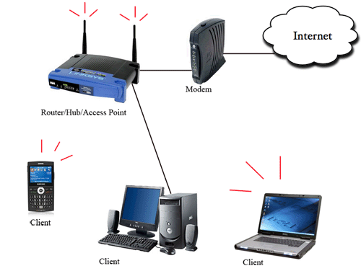
Wireless local area network(WLAN)
WLAN connect local computers
Range (100 m) confined region
Break data into packets
Channel access is shared
Backbone internet provides best service
Poor performance in some application like videos
Low mobility

Slide 11
Satellite system ?
Global coverage
Different orbit height
Optimized for good transmission
Expensive base stations.
Voice and data transmission
Telecommunication application
GPS , global telephone connection
TV broadcasting , military , whether broadcasting

Slide 12
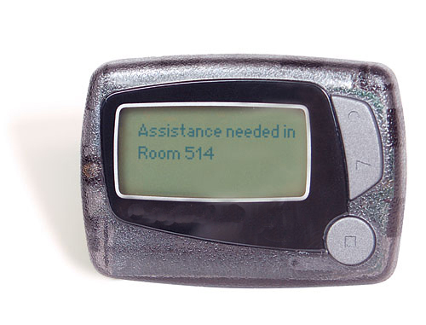
Paging system ?
Broad coverage for short messages
Message broadcast from all base stations
Simple terminals
Optimized for one way transmission
Answer back hard
Overtaken by cellular
Pager system

Slide 13
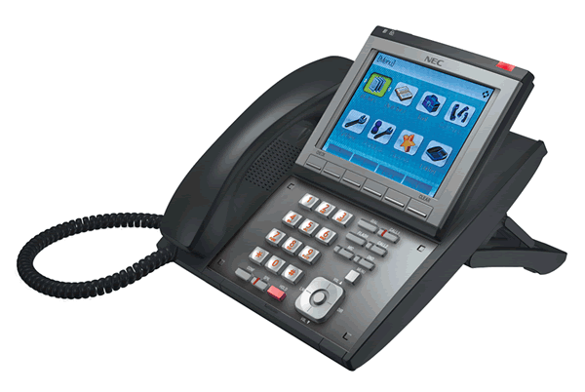
Wide area paging system ?
Base station
City 1
Terrestrial link
Paging terminal
Base station
City 2
Paging terminal
Terrestrial link
Paging control center
PSTN
Base station
City N
Paging terminal
Satellite link

Slide 14
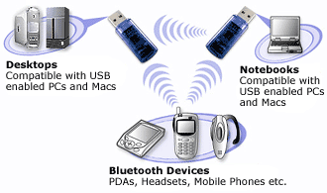
Personal area network ?
Bluetooth
Cable replacement RF technology
Short range(10m)
2.4 GHz band
TDD duplex scheme
1 Mbps data rate shared b/w 7 devices
Polling based multiple access
Work on frequency hopping spread spectrum technology

Slide 15
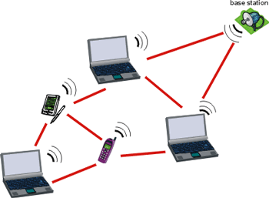
Ad-hoc network ?
Peer to peer communication
No backbone infrastructure
Routing can be multihop
Topology is dynamic
Fully connected with different link SINRs.

Slide 16
Ad-hoc network contd….
Ad-hoc network provides a flexible network infrastructure for many emerging applications.
The capacity of such networks is generally unknown.
Transmission , access and routing strategies for these networks are generally ad-hoc.
Cross layer design is very critical and challenging.
Energy constraints impose interesting design for trade offs communication and networking.

Slide 17
END of Slides….

