Slide 1
Information Visualization 2
Waqas Swati

Slide 2
Recent Examples of Visualization

Slide 4
Notes:
It’s worth at this point reviewing our discussion of visual variables from last time. An
information visualization uses some or all of these variables to display data attributes. We had
two important properties of variables (whether visual or data): their type (N, O, or Q) and their
length (number of distinct values). Which visual variables were used in the Napoleon march
display?

Slide 5
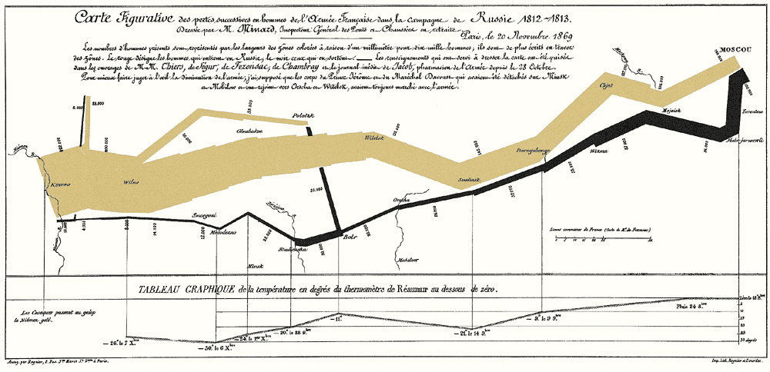
Which Visual Variables are used? Why?

Slide 6
Use of Position
Position is the most important visual variable in information visualization
Why
Most selective
Recall selective visual variables pops out more strongly
Because it is obvious where you move the spotlight of your attention. (Instant look up)
Notes:
Position is the primal visual variable in infovizualization. It’s the most versatile (in length and type), it
pops out most strongly, and it’s the most selective (since the spotlight of your attention is easy to
move around your visual field). So it’s often the scarcest resource as well. Infoviz often
involves figuring out how to pack as much information into the available pixels as you can.
Sometimes the most appropriate use of position is simply a direct mapping of real space, as in
the maps on the left. If the data items have spatial coordinates, and physical location is actually
relevant to the thinking or communicating task the user is trying to do, then this works.
When location is not relevant, however, we have to turn to abstract mappings – using x and y
positions to represent other variables (as in the scatterplot on the top right), or simply using them
to pack related information near each other (as in the treemap on the bottom right, which we’ll
say more about in a moment).

Slide 7
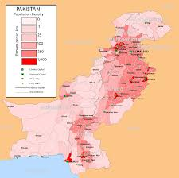
Use of Position: Mapping With Reality
What purpose is position and value used for?

Slide 8
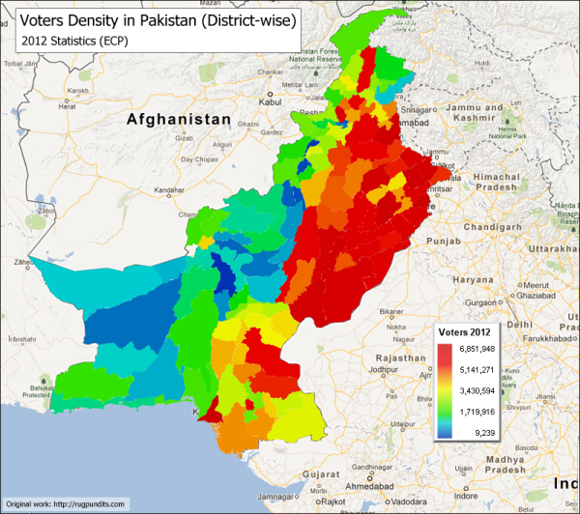
What is wrong with this One?

Slide 9
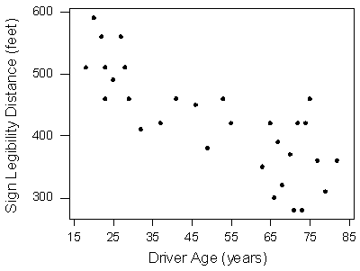
When Location is not relevant
Abstract mapping of position
Example
Scatter plot on right
Plots about 20 people sign legibility against their age
What does it show?
Telling a rough estimate between age of drivers and distance of sign they can see.

Slide 10
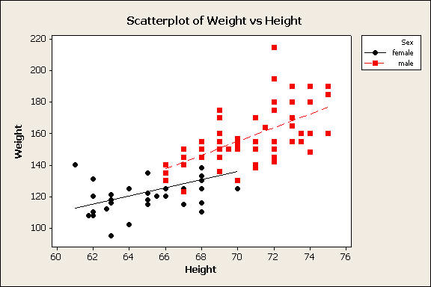
Scatter Plot: Other Visual Variables
The (x,y) location of a dot is determined by the quantitative or ordered data
Other information can be mapped into hue, value, texture , size etc

Slide 11
Hierarchical Data

Slide 12
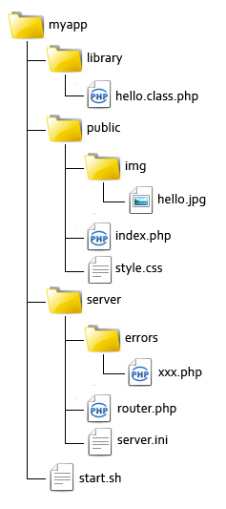
Hierarchical Data: Where?
Hierarchical Data is everywhere
Folder and Files on HD
Animal Species
Tell me one more example??

Slide 13
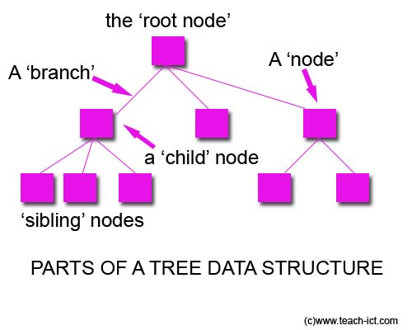
Visualization of Hierarchical Data: Trees
The image on the previous slide is also a tree , it is just drawn differently

Slide 14
Problem with Tree
Imagine your C drive is full and your computer is running slow
You delete all big files, uninstall unnecessary programs but the free space available is still not sufficient
You want to visualize the data of your harddisk to understand where the space is being consumed
Why is trees not a good method ?.. Think and tell me

Slide 15
Some Reasons
Difficult to fit in all information on one screen
Shows me files and folders not their sizes

Slide 16
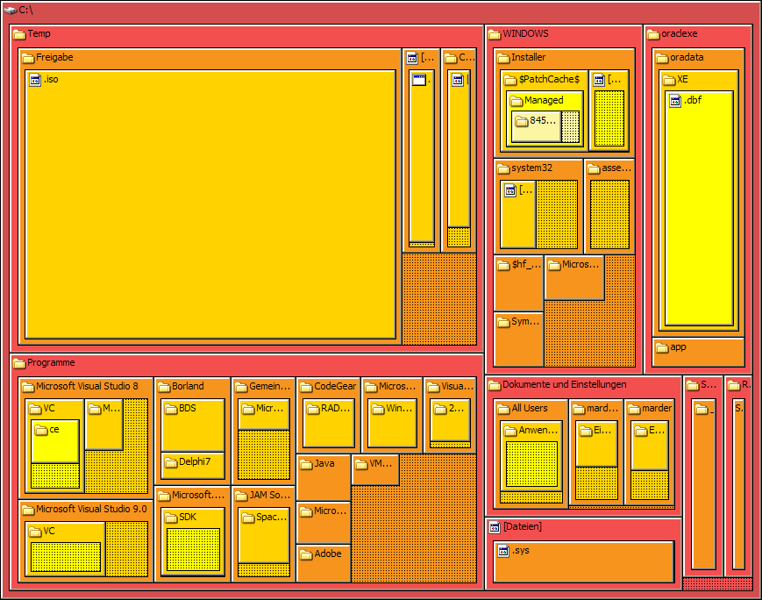
A Solution: TreeMap

Slide 17
Tree Map
Treemaps display hierarchical (tree-structured) data as a set of nested rectangles.
Size of a rectangle represents information of primary interest
Other visual variables can also be used if needed
Do not waste space and can display information about thousands of items
Notes:
Treemaps display hierarchical (tree-structured) data as a set of nested rectangles. Each branch of the tree is given a rectangle, which is then tiled with smaller rectangles representing sub-branches. A leaf node's rectangle has an area proportional to a specified field of data. Often the leaf nodes are colored to show a separate dimension of the data.
When the color and size dimensions are correlated in some way with the tree structure, one can often easily see patterns that would be difficult to spot in other ways, such as if a certain color is particularly relevant. A second advantage of treemaps is that, by construction, they make efficient use of space. As a result, they can legibly display thousands of items on the screen simultaneously

Slide 18
Tabular Data

Slide 19
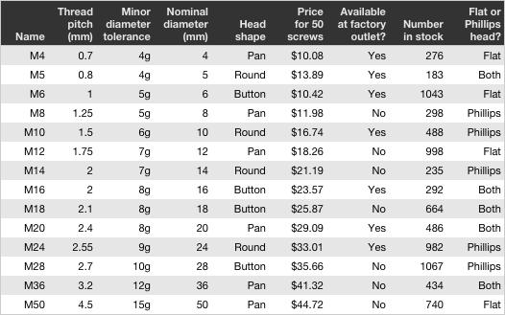

Slide 20
Tabular Data
There is a lot of tabular data in the world
Excel sheets
Database tables
When we know which variable(s) we are interested in then we can visualize it easily
But what can we do if we are looking for interesting cases and usual patterns and observations?

Slide 21
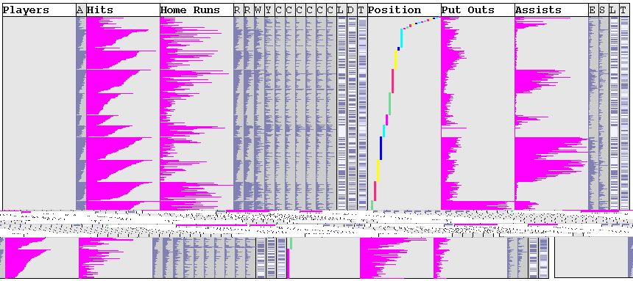
Table Lens

Slide 22
Table Lens
Displays all data in scaled pictorial form
Packing all data on screen can pop out interesting patterns
100 times more than a table
User can focus on interesting areas
Focus +context technique
For a demo and information see
http://www.ncomva.se/guide/?chapter=Visualizations&section=Table%20Lens#_General

Slide 23
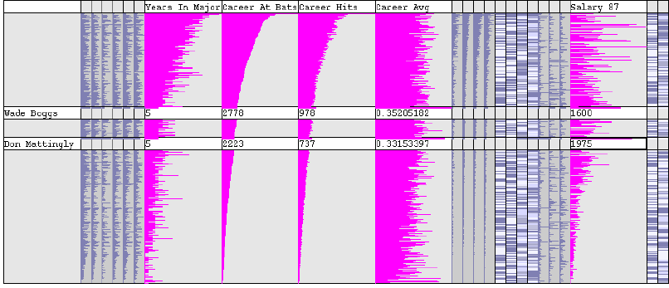
Example of Table Lens in Use

Slide 24
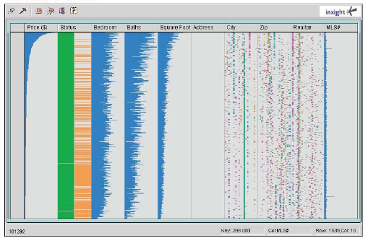
Table Lens in Use

Slide 25
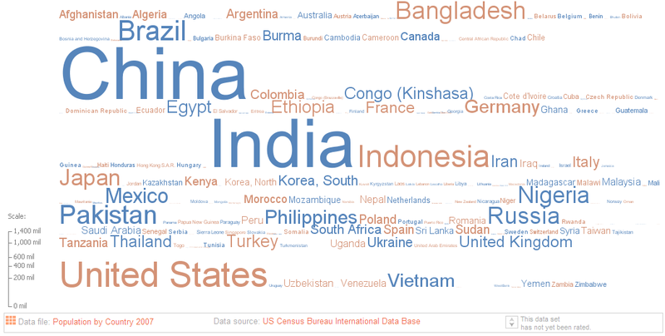
Tag Cloud
Notes:
Country and population

Slide 26
Wordle
A tag cloud that tightly packs words from left to right or top to bottom alignment
Readers more used to this alignment
Packs information as tightly as possible
You can create your own wordles here
http://www.wordle.net/.
The next example shows a wordle created from the frequency of words in the US constituion

Slide 27
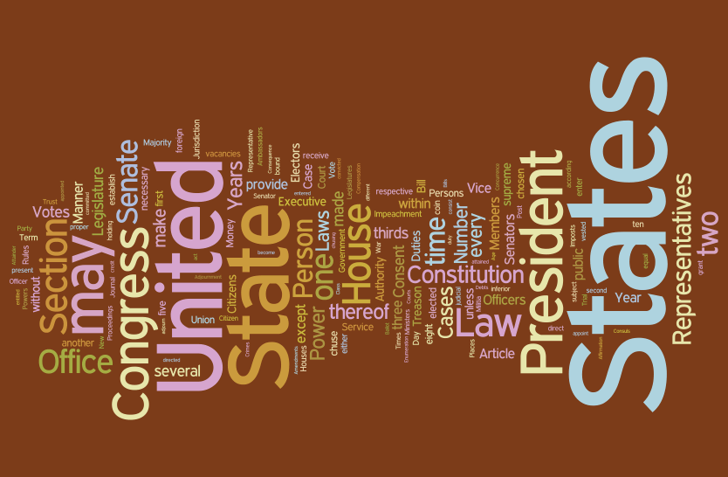
Wordle Example

Slide 28
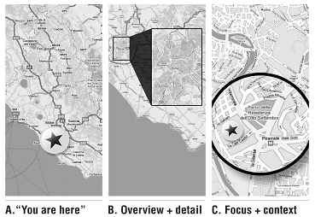
How it works?
Table Lens also has it!!

Slide 29
Necessary Things for UI with Visualization

Slide 30
WhatsOnWeb

Slide 31
Web Clustering Search Engines
It is sometimes hard to find relevant result using a traditional search engine
Size of web
One word have multiple meaning like say bat
To Bat: bat in cricket
To Bat: in baseball
Bat: the animal
Bat: the sports equipment

Slide 32
Web Clustering Search Engines
They work in the following fashion:
Receive query from user
Pass query to a search engine and receive results
Organize the received results in multiple clusters, i.e groups
Each cluster has results that are semantically related to each other
Clusters are hierarchical

Slide 33
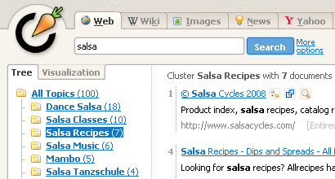
Example: carrotsearch

Slide 34
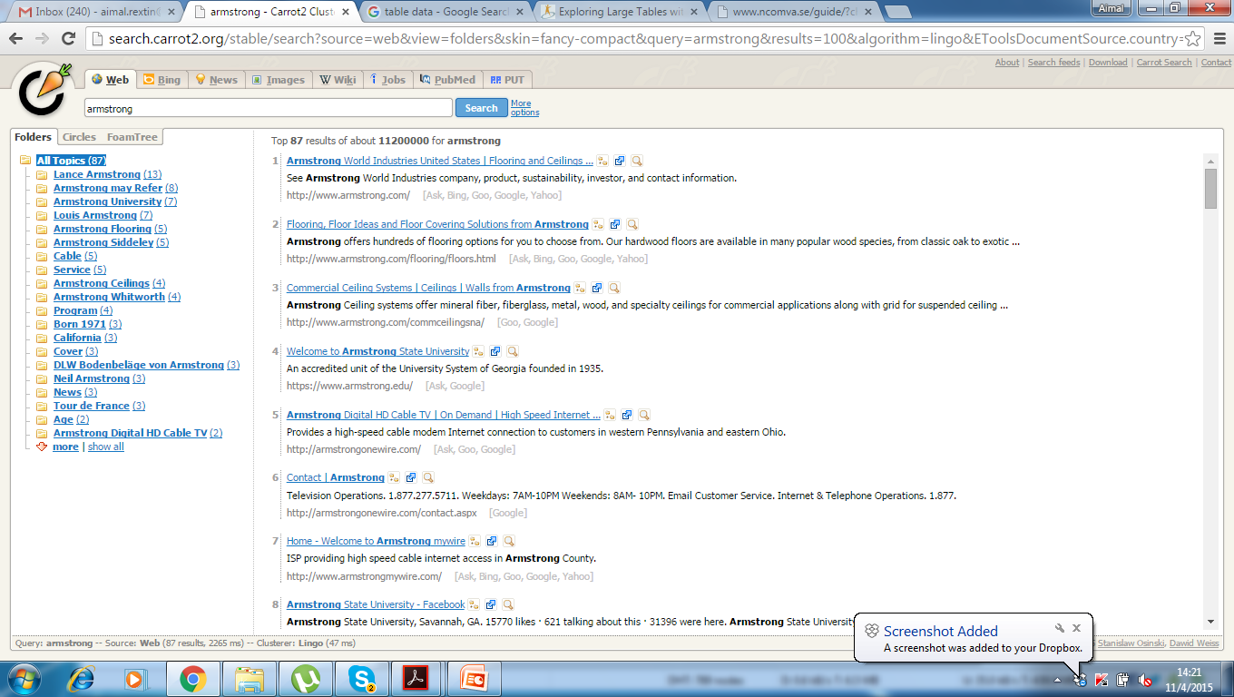

Slide 35
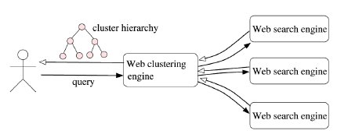
Schematic Diagram

Slide 36
WhatsOnWeb
A visualization based interface for clustering search engines
Draws a graph/network
nodes represents concepts
edges represents relationships between them

Slide 37
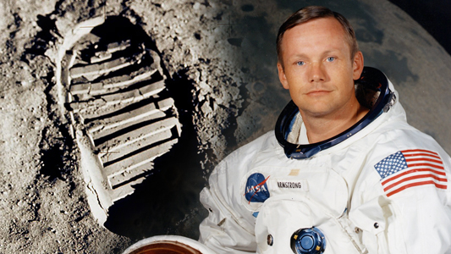
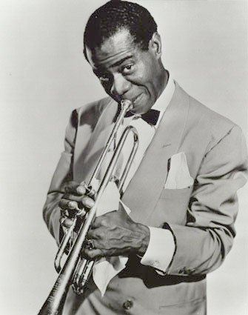
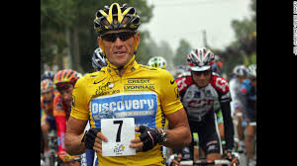
Working Example: Armstrong
Neil Armstrong
Louis Armstrong
Lance Armstrong

