Slide 1
Requirement Engineering Lecture 08

Slide 2
Recap
Flow Based Modeling
DFDs
CFDs
Processing narratives
Class-based Model
How to select classes?
How to find attributes and operations of a class?
CRC modeling

Slide 3
Outline
Elaboration
Behavioral Modeling
Negotiation
Specification
Validation
Requirements management

Slide 4
Behavioral Modeling

Slide 5
Creating a Behavioral Model
Identify events found within the use cases and implied by the attributes in the class diagrams
Build a state diagram for each class, and if useful, for the whole software system
Notes:
Implied by attribute (means if the attribute has Boolean value, true or false, so if true then one event and if false then other event)

Slide 6
Identifying Events in Use Cases
An event occurs whenever an actor and the system exchange information
An event is NOT the information that is exchanged, but rather the fact that information has been exchanged
Some events have an explicit impact on the flow of control, while others do not
An example is the reading of a data item from the user versus comparing the data item to some possible value
Notes:
an explicit impact (if the users enters a password it has direct impact on the system which changes the state, while on the other hand the comparing of password with the correct one has not the direct impact)

Slide 7
Building a State Diagram
A state is represented by a rounded rectangle
A transition (i.e., event) is represented by a labeled arrow leading from one state to another
The active state of an object indicates the current overall status of the object as is goes through transformation or processing
A state name represents one of the possible active states of an object
The passive state of an object is the current value of all of an object's attributes
A guard in a transition may contain the checking of the passive state of an object

Slide 8
Identifying Events
A use-case is examined for points of information exchange.
The homeowner uses the keypad to key in a four-digit password. The password is compared with the valid password stored in the system. If the password in incorrect, the control panel will beep once and reset itself for additional input. If the password is correct, the control panel awaits further action.

Slide 9
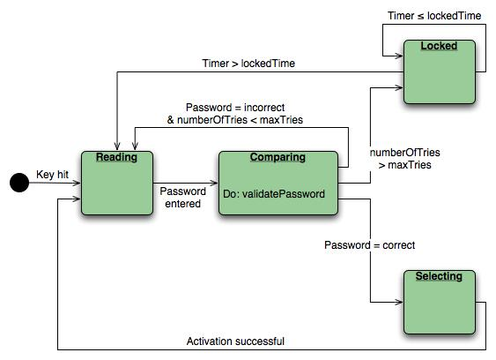
State Diagram
State diagram for the ControlPanel class

Slide 10
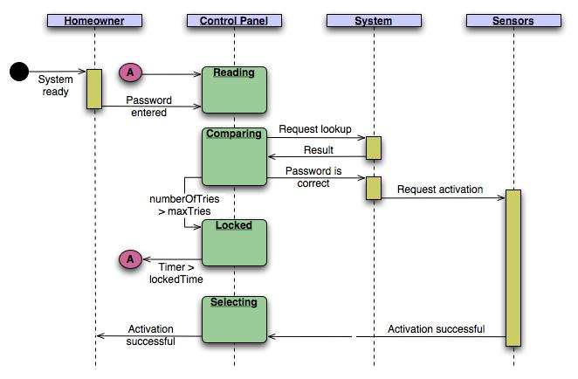
Sequence Diagram
Sequence diagram (partial) for the SafeHome security function

Slide 11
Inception
Elicitation
Elaboration
Negotiation
Specification
Validation
Requirements
Management

Slide 12
Negotiation Task
During negotiation, the software engineer reconciles the conflicts between what the customer wants and what can be achieved given limited business resources
Requirements are ranked (i.e., prioritized) by the customers, users, and other stakeholders
Risks associated with each requirement are identified and analyzed
Rough guesses of development effort are made and used to assess the impact of each requirement on project cost and delivery time
Using an iterative approach, requirements are eliminated, combined and/or modified so that each party achieves some measure of satisfaction

Slide 13
The Art of Negotiation
Recognize that it is not competition
Map out a strategy
Listen actively
Focus on the other party’s interests
Don’t let it get personal
Be creative
Be ready to commit

Slide 14
Inception
Elicitation
Elaboration
Negotiation
Specification
Validation
Requirements
Management

Slide 15
Specification Task
A specification is the final work product produced by the requirements engineer
It is normally in the form of a software requirements specification
It serves as the foundation for subsequent software engineering activities
It describes the function and performance of a computer-based system and the constraints that will govern its development
It formalizes the informational, functional, and behavioral requirements of the proposed software in both a graphical and textual format

Slide 16
Typical Contents of a Software Requirements Specification
Requirements
Required states and modes
Software requirements grouped by capabilities (i.e., functions, objects)
Software external interface requirements
Software internal interface and data requirements
Other software requirements (safety, security, privacy, environment, hardware, software, communications, quality, personnel, training, etc.)
Design and implementation constraints
Qualification provisions to ensure each requirement has been met
Requirements traceability
Trace back to the system or subsystem where each requirement applies

Slide 17
Software Requirements Specification (SRS) template
TABLE OF CONTENTS 1.0 Introduction
1.1 Purpose 1.2 Scope 1.3 Definitions, Acronyms, and Abbreviations 1.4 References 1.5 Overview
2.0 General Description
2.1 Product Perspective 2.2 Product Functions 2.3 User Characteristics 2.4 General Constraints 2.5 Assumptions and Dependencies

Slide 18
SRS template
3.0 Specific Requirements
3.1 Functional Requirements
3.1.1 Unit Registration 3.1.2 Retrieving and Displaying Unit Information 3.1.3 Report Generation 3.1.4 Data Entry
3.2 Design Constraints
3.3 Non-Functional Requirements
3.3.1 Security
Appendix A

Slide 19
Inception
Elicitation
Elaboration
Negotiation
Specification
Validation
Requirements
Management

Slide 20
Validation Task
During validation, the work products produced as a result of requirements engineering are assessed for quality
The specification is examined to ensure that
all software requirements have been stated unambiguously
inconsistencies, omissions, and errors have been detected and corrected
the work products conform to the standards established for the process, the project, and the product
The formal technical review serves as the primary requirements validation mechanism
Members include software engineers, customers, users, and other stakeholders

Slide 21
Questions to ask when Validating Requirements
Is each requirement consistent with the overall objective for the system/product?
Have all requirements been specified at the proper level of abstraction? That is, do some requirements provide a level of technical detail that is inappropriate at this stage?
Is the requirement really necessary or does it represent an add-on feature that may not be essential to the objective of the system?
Is each requirement bounded and unambiguous?
Does each requirement have attribution? That is, is a source (generally, a specific individual) noted for each requirement?
(more on next slide)

Slide 22
Questions to ask when Validating Requirements (continued)
Is each requirement achievable in the technical environment that will house the system or product?
Is each requirement testable, once implemented?
Does the requirements model properly reflect the information, function, and behavior of the system to be built?
Has the requirements model been “partitioned” in a way that exposes progressively more detailed information about the system?

Slide 23
Inception
Elicitation
Elaboration
Negotiation
Specification
Validation
Requirements
Management

Slide 24
Requirements Management Task
During requirements management, the project team performs a set of activities to identify, control, and track requirements and changes to the requirements at any time as the project proceeds
Each requirement is assigned a unique identifier
The requirements are then placed into one or more traceability tables
A requirements traceability table is also placed at the end of the software requirements specification

Slide 25
Requirement Traceability

Slide 26
Summary
Inception
Elicitation
Elaboration
Negotiation
Specification
Validation
Requirements
Management
☺

