Slide 1
Lecture 03
Computer Communication
&
Networks

Slide 2
Last Lecture
OSI Reference Model

Slide 3
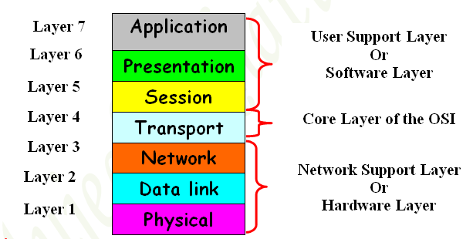
Overview of OSI Reference Model

Slide 4
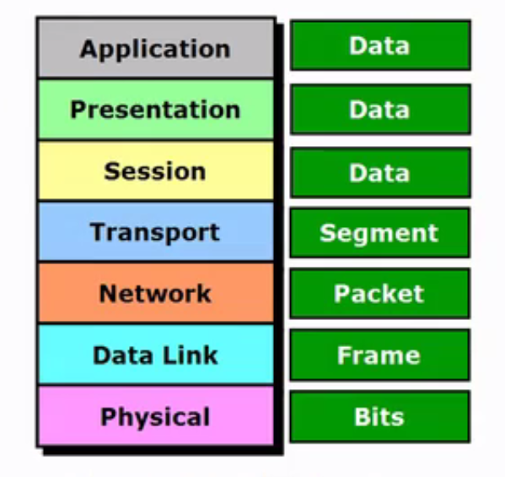
OSI Reference Model

Slide 5
Today Lecture
TCP/IP Model

Slide 6
TCP/IP Model (Transmission Control Protocol / Internet Protocol)
TCP/IP is a standard language like English used by computers and network devices for communication.
TCP/IP is a universal standard and can make communication possible among all operating systems.
The Transmission Control Protocol/ Internet Protocol (TCP/IP) suit was created by the Department Of Defense (DOD).
It has four Layers

Slide 7
TCP/IP Model
The DOD Model:
The Process / Application Layer
The Host-to-Host Layer
The Internet Layer
The Network access Layer

Slide 8
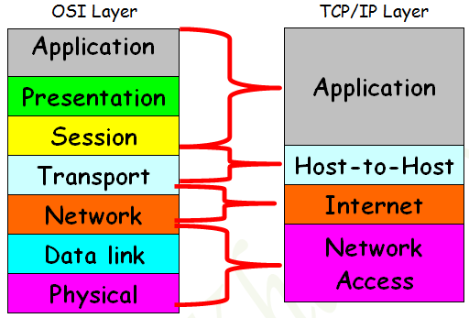
Comparing OSI & TCP/IP Model

Slide 9
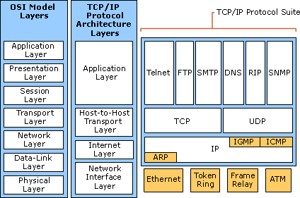
TCP/IP Model

Slide 10
Process/Application Layer
The Process/Application Layer defines protocols for process to process application communication and also controls user interface specification.
Examples for the Layer are:- Telnet, FTP, TFTP SMTP, SNMP, DNS, DHCP etc.

Slide 11
Application Layer Cont…
Telnet:-
Telnet is used for terminal Emulation.
It allows a user sitting on a remote machine to access the resources of another machine.
FTP (File Transfer Protocol);-
It allows you to transfer file from one machine to another.
It allows access to both directories and files.
It uses TCP Port no 21 for data transfer
It is slow but reliable.

Slide 12
Application Layer Cont…
TFTP (Trivial File Transfer Protocol);-
This has no directory browsing abilities.
It can only send and receive files.
It uses UDP for data transfer and hence fast but not reliable.
SNMP (Simple Network Management Protocol);-
SNMP enables a central management of Network.
Using SNMP administrator can watch the entire network.
SNMP works with TCP/IP.
It uses UDP port no 161 for transportation of data.

Slide 13
Application Layer Cont…
DNS ( Domain Name System):-
DNS resolves FQDN(Full Qualified Domain Name) into IP address
Example: www.yahoo.com ---------> 60.70.90.3
FQDN IP Address
It maintains a database for IP.
DHCP (Dynamic Host Configuration Protocol):-
DHCP Server dynamically assigns IP addresses to hosts.
It uses UDP Prot no 67 & 68 for transportation of data.

Slide 14
Host-to-Host Layer:

Slide 15
The Internet Layer Protocols:-
Internet Protocol (IP).
Internet Control Message Protocol (ICMP).
Address Resolution Protocol (ARP).
Reverse Address Resolution Protocol (RARP).

Slide 16
Internet Protocol (IP)
Provides Connectionless, Best efforts delivery routing of data-grams (Packets).
IP is not concerned with the contents of datagram’s.
It looks for a way to move the datagram’s (Packets to their destination).

Slide 17
Internet Control Message Protocol(ICMP):-
ICMP messages are carried in IP datagram’s and used to send error and control messages.
Following are some Common events and messages that ICMP relates to.
Destination Unreachable
Ping
Trace route

Slide 18
ICMP Cont…
Ping (Packet Internet Groper):-
Ping is a utility used to test a device on Network. Whether it is reachable or unreachable. Ping Uses ICMP Protocol.
Trace Route:-
Its utility used to discover a path packets traverses.
In Microsoft windows its tracert
C:\tracert www.google.com

Slide 19
ARP & RARP
Address Resolution Protocol (ARP):-
ARP works at Internet Layer of DOD Model.
It is used to resolve MAC address with the help of a known IP address
Reverse Address Resolution Protocol(RARP):-
This is also works at Internet Layer
It works exactly opposite of ARP.
It resolves an IP address with the help of a known MAC Address.
DHCP is the example of an RARP implementation.

Slide 20
Network Access Layer
Responsible for Hardware Addressing
It Contains two sub layers
Define physical transmission of data and medium of data transfer
Protocols of Network access layer includes: Ethernet, Token Ring, FDDI

Slide 21
Network Access Layer
Ethernet—A very popular LAN architecture, using the CSMA/CD network-access method.
Token ring—A LAN architecture featuring a ring topology and a token-passing network access method
FDDI(Fiber Distributed Data Interface)—A token passing network architecture using fiber-optic cable.

Slide 22
IP Addressing
The unique number ID assigned to one host or interface in a network.
IP Address is Logical Address
It is a Network Layer address (Layer 3)
IP is an identifier used to route packets to and from devices in a network.
Two Versions of IP:
IP version 4 is a 32 bit address
IP version 6 is a 128 bit address

Slide 23
IP Version 4
Total IP Address Range of IPv4 is 0.0.0.0 to 255.255.255.255
The address is made up of 32 binary bits, which can be divisible into a network portion and host portion with the help of a subnet mask
The 32 binary bits are broken into four octets (1 octet = 8 bits)
Each octet is converted to decimal and separated by a period (dot).

Slide 24
IP Version 4
Here is a sample octet conversion when not all of the bits are set to 1.
0 1 0 0 0 0 0 1
0 64 0 0 0 0 0 1 (0+64+0+0+0+0+0+1=65)
And this sample shows an IP address represented in both binary and decimal.
10. 1. 23. 19 (decimal)
00001010 . 00000001 . 00010111 . 00010011 (binary)

Slide 25
IP Version 4
IP Addresses are divided into 5 Classes
Class A
Class B
Class C
Class D
Class E

Slide 26
IP Version 4
Class A, B & C are commercially Available Classes. They are used for data communication. We purchase it from Name Assigning Authority (IANA)
Class D is reserved for multicasting. Routing protocols use multicast IP Addresses from Class D
Class E It is reserved for Research and Experimental Purposes

Slide 27
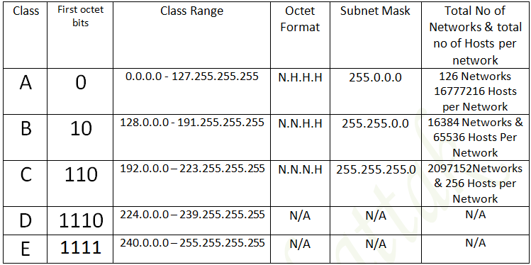
IP Version 4 Table

Slide 28
Private & Public IP Address
Public IP Addresses:-
Public IP Addresses are also called Inside Global Addresses
They are registered IP Addresses
They are globally Unique
Internet Routers can route these IP Addresses

Slide 29
Private IP Address
Private IP Addresses are also called Inside Local IP Addresses
They are used for Private purpose
They are not registered IP Addresses
The internet routers cannot route these IP Addresses
There are certain Addresses in each class of IP Addresses that are reserved for Private Networks
These Addresses are called Private IP Addresses
Class A 10.0.0.0 to 10.255.255.255
Class B 172.16.0.0 to 172.31.255.255
Class C 192.168.0.0 to 192.168.255.255

Slide 30
Subnet Mask
It is an address used to identify the Network and Host Portion of the IP Address
It tells you that in a given IP Address how many bits are for Network Portion and How many bits are for Host Portion
It is also called Prefix Length.

Slide 31
Subnet Mask
Network Address Or Network Id:-
Network-Id is the identification of a Network when all the host bits in the given IP Address are “0s”. It is called
Broadcast Address or Broadcast ID:-
Broadcast address is used to send a message to all the computers on a Network.
When all the Host bits in the given IP Address are all “1s”. It is called Broadcast-ID.
Eg:- 192.168.1.255
11000000.10101000.00000001.11111111
Network-Bits Host-Bits

Slide 32
Cont…
Default Gateway: -
It is an entry and exit point of Network. Eg. The IP Address of the Router Ethernet or Fast Ethernet or Giga Ethernet interface.
Valid IP Address Or Valid Host-ID:-
When all the Host bits in the given IP Address are neither all “0s” not all “1s” but the combination of “0s” and “1s”.
We assign this to computer NIC Card Router interface and switch interface.
We can’t assign Network Address or Broadcast IP address to Computer, Router, and switch.

