Slide 1
Lecture 02
Computer Communication
&
Networks

Slide 2
LAYERED TASKS
We use the concept of layers in our daily life. As an example, let us consider two friends who communicate through postal mail. The process of sending a letter to a friend would be complex if there were no services available from the post office.

Slide 3
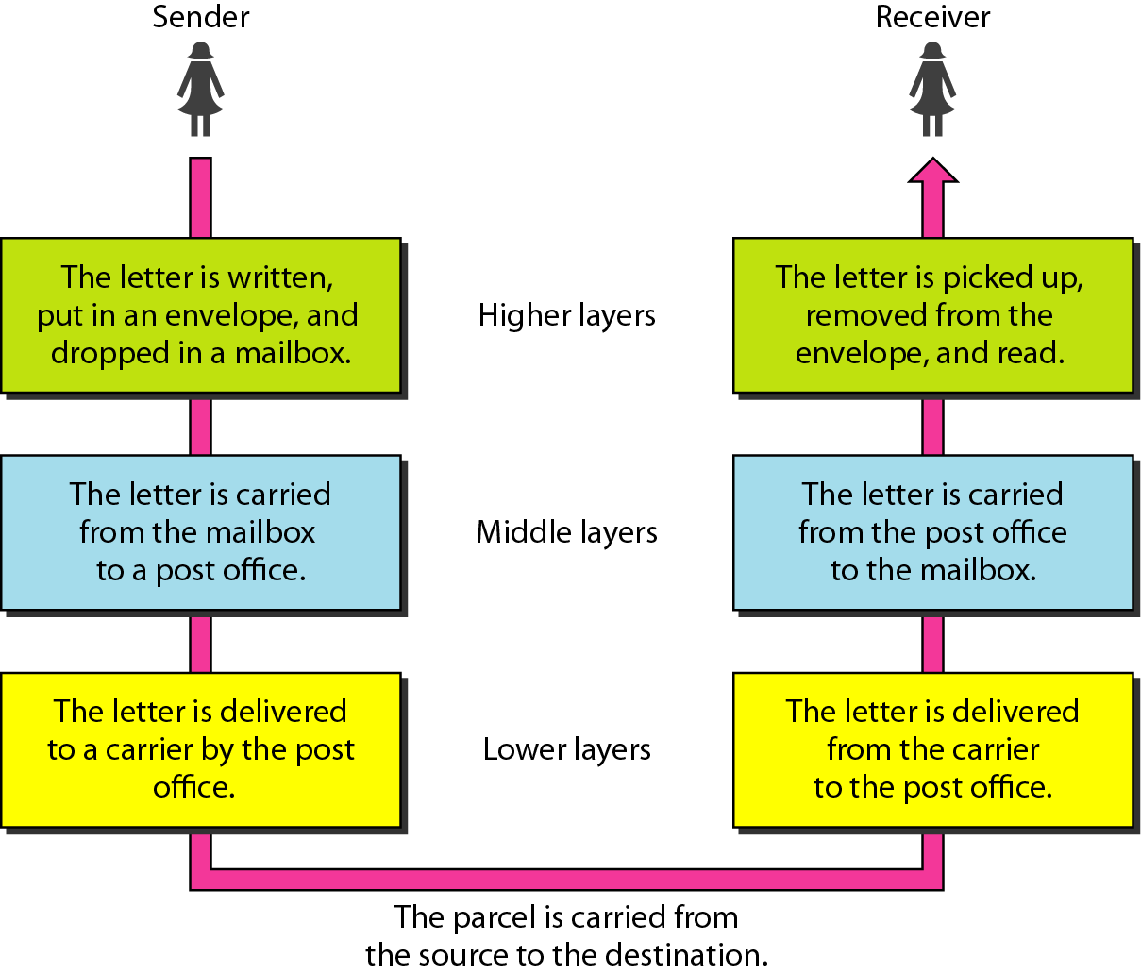
Tasks Involved in Sending Letter

Slide 4
OSI Reference Model
OSI was developed by the International Organization for Standardization (ISO) and introduced in 1984.
It is a layered architecture (consists of seven layers).
Each layer defines a set of functions in data communication.
It is open model. It can support every vendor.
It is non tangible model. You can’t touch it. Its just conceptual and theoretical model.
ISO introduced this model so that data communication which is a complex process becomes easy and understandable for every one.

Slide 5
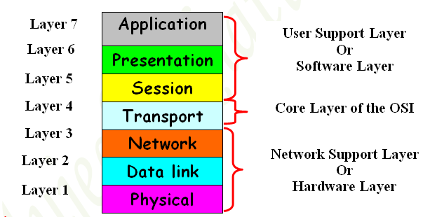

Slide 6
Application Layer
Application Layer is responsible for providing an interface for the users to interact with
It initiates the application
Application services or Networking Services.
Ex: Web browser etc.

Slide 7
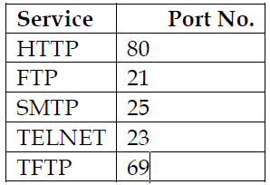
Application Layer Cont…
Identification of Services is done using Port Numbers.
Port is a logical communication Channel
Port number is a 16 bit identifier.
Total No. Ports 0 – 65535
Server Ports 1 - 1023
Client Ports 1024 – 65535

Slide 8
Presentation Layer
Presentation Layer Is responsible for defining a standard format to the data.
It deals with data presentation.
Presentation layer acts as a translator for the data.
It converts the data into machine readable format like binary or machine language (100011000).
There are different dictionaries available at presentation layer.
Conversion of data into bits is completed on presentation layer.
Notes:
Note: there are different types of data which we want to exchange over the network at application layer. Like our data can be simple Text. It can be video or audio or images or graphics etc. So for each data type there are dictionaries available at presentation layer.

Slide 9
Presentation Layer Cont…
Major functions of presentation layer are…
Encoding – Decoding:
Ex: ASCII and EBCDIC (it converts text data into binary language.)
JPEG,GIF,TIFF (it converts picture or graphics data into binary language.)
MIDI,WAV (it converts voice or audio data into binary language.)
MPEG,DAT,AVI (it converts video data like movies into binary language.)
Encryption - Decryption :
Ex:DES,3-DES,AES,PLAY-FAIR
Compression – Decompression:
Ex: Predictor, Stacker, MPPC. (Compression means like winrar, winzip, it reduce load on link. Mean convert 10GB file into 10 MB.

Slide 10
Session Layer
It deals with sessions or Interactions between the applications.
It is responsible for establishing, maintaining and terminating the sessions based on port numbers.
Session layer organizes communication through simplex, half-duplex and full-duplex
Notes:
Session layer checks the availability of other side machine. if u type address of some Website like www.yahoo.com.than some time u see
that webpage can’t be displayed. It means that the destination server or machine is not available or may be the server is down due to some reason or may be server is off. than u can’t exchange data with Server. Session layer fails to create virtual session with the destination machine.
If the other side machine is available, it means session is established; now u can exchange data with the server (destination machine.).
If u has opened different web pages, like yahoo, Google, Facebook.
These like u have Created different sessions. now session layer differentiates among these different Sessions(web pages)by assigning Session ID to each one. Ex: RPC,SQL,NFS.

Slide 11
Transport Layer
The transport layer is responsible for end to end delivery of the entire message from source to destination
Two main protocols works on this layer is TCP & UDP
It is the Core layer of OSI
The major functions described at this layer are…
Identifying Service
Segmentation
Sequencing & Reassembling
Flow control & Error Control
Windowing
Multiplexing & De-multiplexing

Slide 12
Identifying a Service
Services are identified at this layer with the help of Port No’s.
The major protocols which takes care of Data Transportation at Transport layer are…TCP, UDP

Slide 13
Segmentation
Segmentation means dividing data into segments.
The advantage of segmentation is speed increases and error chance minimizes.
At the receiver side segments are reassembled in sequence.

Slide 14
Sequencing & Reassembling
It is the addition of some extra bits with data sending to the receiver.
On the receiver side data(segments) can be reassembled using this sequence.

Slide 15
Flow Control & Error Control
Flow Control means either to decrease the speed of a sender or to increase the speed of a receiver to overcome the overflow of data.
Our data will be not wasted in this way.
Ex: you are in Pakistan are using P-1 computer and your friend is in Mauritius she is using P-4 computer.
P-1 processing power and storage (buffer will be less than P-4.so during communication data overflow can occurs to avoid
Overflow of data transport layer do flow control.

Slide 16
Network Layer
It is responsible for end to end transportation of data across multiple networks.
Logical addressing and path determination (Routing) are described at this layer.
The protocols works at Network Layer are:
Routing Protocol
Routed Protocol

Slide 17
Routing Protocol
For the best path selection u has routing protocols
Routing protocols perform path determination (Routing)
Routing protocols are based on intelligent algorithms
Ex: RIP, IGRP, EIGRP, OSPF, BGP

Slide 18
Routed Protocols
To carry data on the selected path u have routed protocols
Routed protocols acts as a data carrier and defines logical addressing
Ex: IP, IPX, Apple Talk etc
Note: Devices works at Network Layer are Router, Multilayer Switch (MLS)

Slide 19
Data Link Layer
It is responsible for end to end delivery of data between devices on a Network Segment.
Data link layer comprises of two sub layers.
MAC(Media Access Control)
LLC(Logical Link Control)

Slide 20
MAC (Media Access Control)
It deals with hardware addresses (Mac address.)
Mac address is 12 digit hexa-decimal identifier used to uniquely identify the device on network segment

Slide 21
LLC (Logical Link Control)
It deals with Network layer.
Your driver for your NIC card is the LLC.
Note: devices work at this layer are layer2 Switch, Bridge, NIC card, access point(wireless)

Slide 22
Physical Layer
It deals with physical transmission of Binary data on the given media (copper, Fiber, wireless)
The major functions described at this layer are:
Encoding/decoding: It is the process of converting the binary data into signals based on the type of the media.

Slide 23
Physical Layer Cont…
If u are using Copper Media than physical layer will convert binary data into electrical signals of different voltages.
If u are using Fiber Media than physical layer will convert binary data into light pulses of different wavelengths.
If u are using Wireless Media than physical layer will convert binary data into Radio frequency waves.

Slide 24
Physical Layer Cont…
Signals communication happens in three different modes.
Simplex, Half duplex and full duplex.
Devices works at physical layer are Hub, Modem, Repeater and Transmission Media.

Slide 25
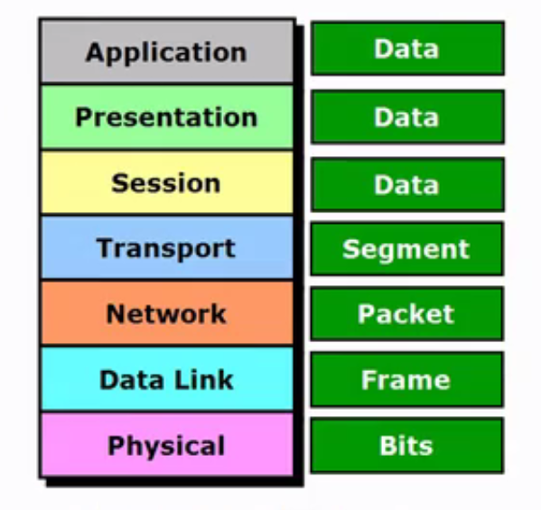
Summary

