Slide 1
Presentation of Data
Presentation of data refers to an exhibition or putting up data in an attractive and useful manner such that it can be easily interpreted. The three main forms of presentation of data are:
1-Textual presentation
2-Data tables
3-Diagrammatic presentation

Slide 2
The Advantages of Tabular Presentation
Ease of representation: A large amount of data can be easily confined in a data table. Evidently, it is the simplest form of data presentation.
Ease of analysis: Data tables are frequently used for statistical analysis like calculation of central tendency, dispersion etc.
Helps in comparison: In a data table, the rows and columns which are required to be compared can be placed next to each other. To point out, this facilitates comparison as it becomes easy to compare each value.
Economical: Construction of a data table is fairly easy and presents the data in a manner which is really easy on the eyes of a reader. Moreover, it saves time as well as space.

Slide 3
Frequency Distribution
A frequency distribution is a representation, either in a graphical or tabular format, that displays the number of observations within a given interval. Frequency tells you how often something happened. The frequency of an observation tells you the number of times the observation occurs in the data. For example, in the following list of numbers, the frequency of the number 9 is 5 (because it occurs 5 times):
1, 2, 3, 4, 6, 9, 9, 8, 5, 1, 1, 9, 9, 0, 6, 9.

Slide 4
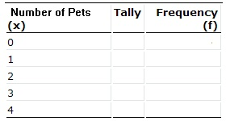
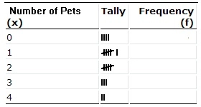
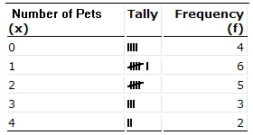
How to make a Frequency Distribution Table: Examples
Example 1
Tally marks are often used to make a frequency distribution table. For example, let’s say you survey a number of households and find out how many pets they own. The results are 3, 0, 1, 4, 4, 1, 2, 0, 2, 2, 0, 2, 0, 1, 3, 1, 2, 1, 1, 3. Looking at that string of numbers boggles the eye; a frequency distribution table will make the data easier to understand.

Slide 5
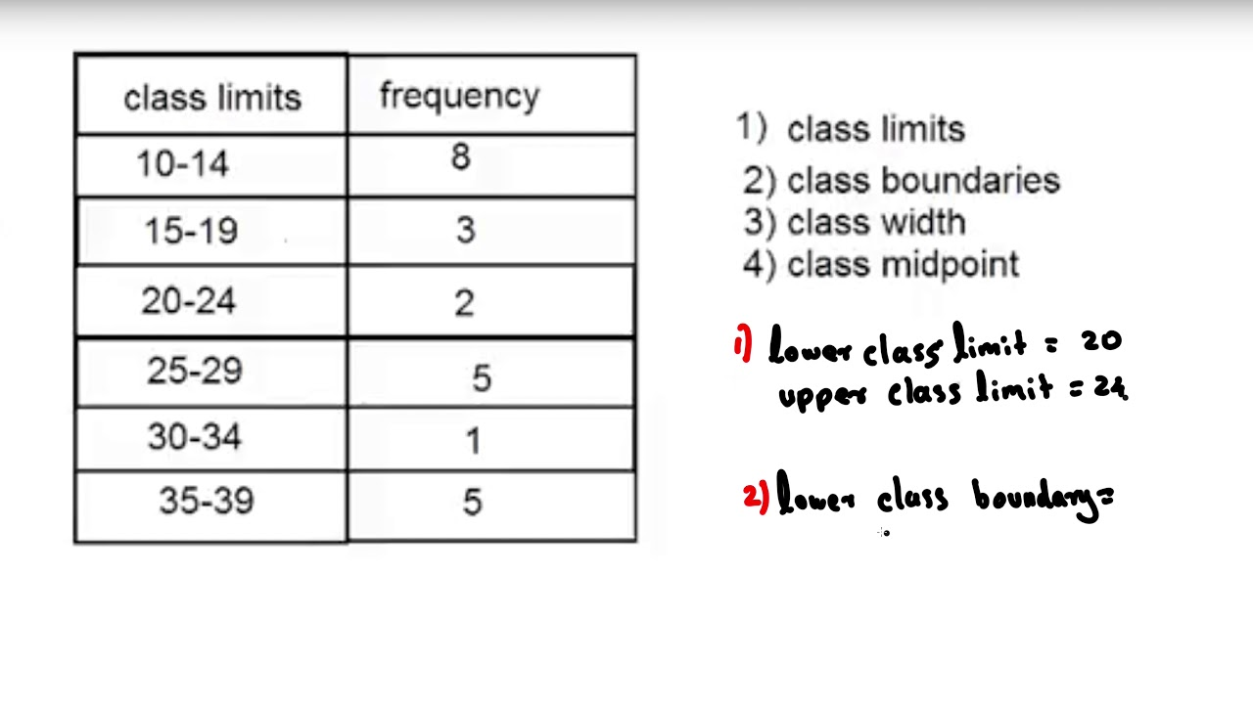
Class limits
class limits may be defined as the minimum value and the maximum value the class interval may contain. The minimum value is known as the lower class limit (LCL) and the maximum value is known as the upper class limit (UCL).

Slide 6
Class limits, class boundaries, class mark
Class limits. There are two for each class. The lower class limit of a class is the smallest data value that can go into the class. The upper class limit of a class is the largest data value that can go into the class. Class limits have the same accuracy as the data values; the same number of decimal places as the data values.
Class boundaries. They are halfway points that separate the classes. The lower class boundary of a given class is obtained by averaging the upper limit of the previous class and the lower limit of the given class. The upper class boundary of a given class is obtained by averaging the upper limit of the class and the lower limit of the next class.
Class marks. They are the midpoints of the classes. They are obtained by averaging the limits

Slide 7
Example

Slide 8
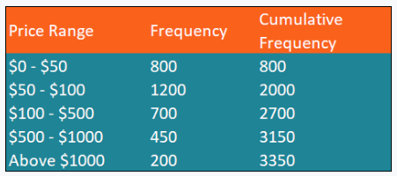
Cumulative frequency distribution
Cumulative frequency distribution is a form of a frequency distribution that represents the sum of a class and all classes below it.
Example:

Slide 9
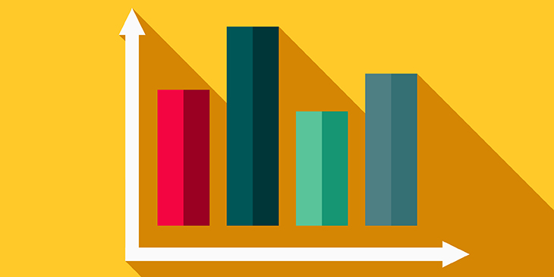
Definition and construction of graphs
a graph can be defined as a pictorial representation or a diagram that represents data or values in an organized manner. The points on the graph often represent the relationship between two or more things.

Slide 10
construction of graphs
Graphs can be constructed in a variety of ways. They can be built from vertices and edges directly in a symbolic form. They can come from built-in curated collections of theoretical or empirical graphs. Special graphs can be generated from parametric specifications.
Step 1: Identify the variables. ...
Step 2: Determine the variable range. ...
Step 3: Determine the scale of the graph. ...
Step 4: Number and label each axis and title the graph.
Step 5: Determine the data points and plot on the graph. ...
Step 6: Draw the graph

Slide 11
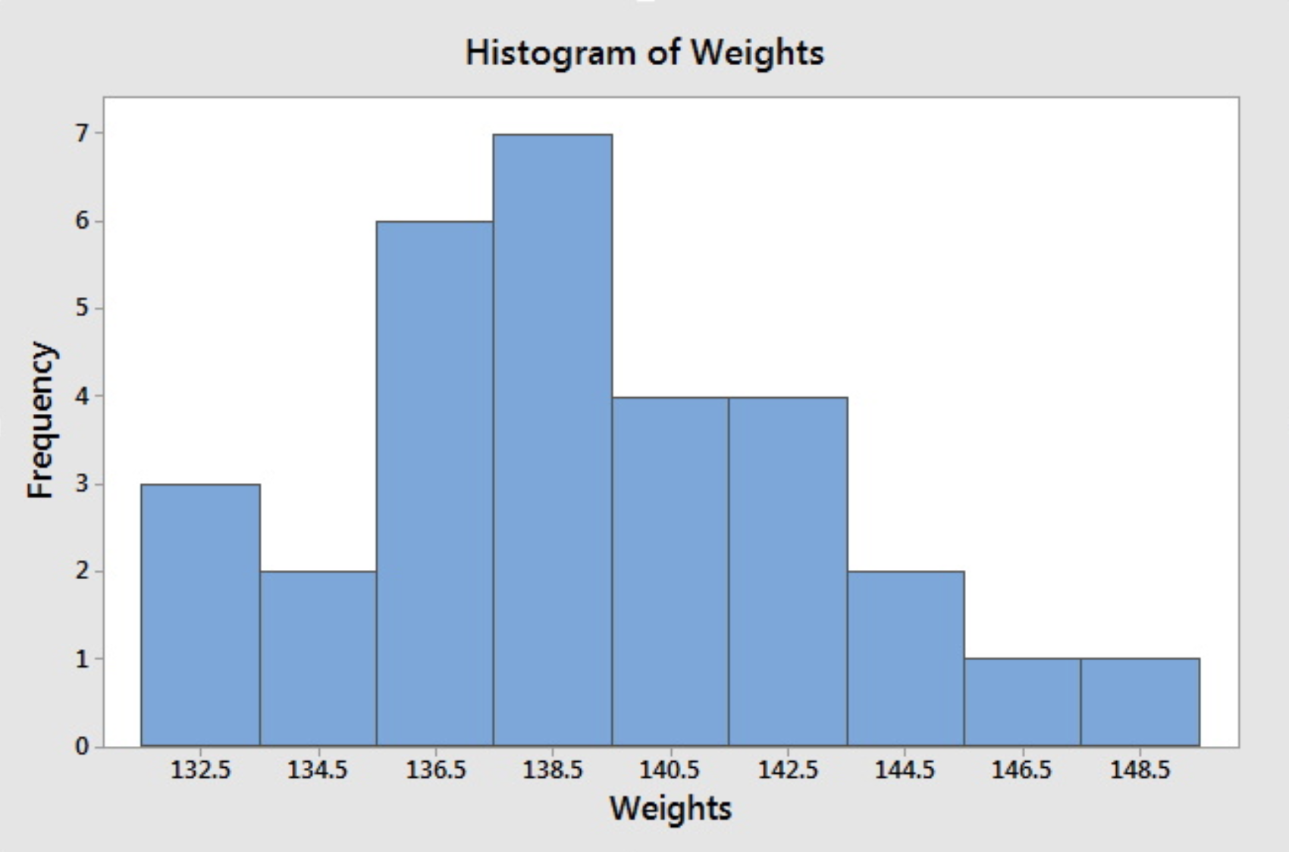
Histogram,
A histogram is an approximate representation of the distribution of numerical data.

Slide 12
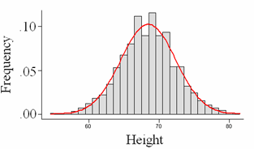
Frequency Curve,
A frequency-curve is a smooth curve for which the total area is taken to be unity.
It is a limiting form of a histogram or frequency polygon. The frequency-curve for a distribution can be obtained by drawing a smooth and free hand curve through the mid-points of the upper sides of the rectangles forming the histogram.

Slide 13
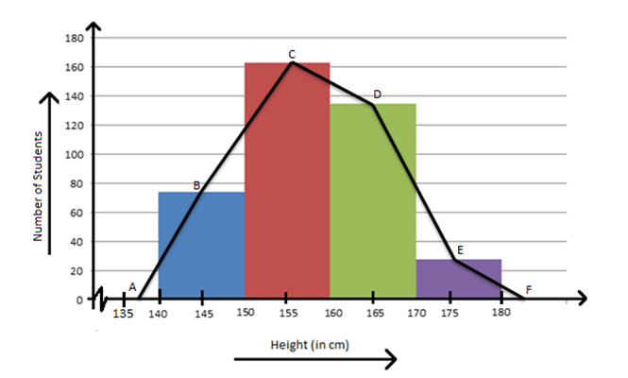
Frequency Polygon
A frequency polygon is a graph constructed by using lines to join the midpoints of each interval, or bin.

Slide 14
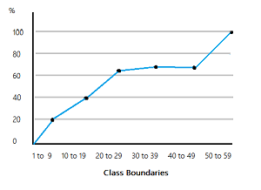
Ogive
A curve that represents the cumulative frequency distribution of grouped data on a graph is called a Cumulative Frequency Curve or an Ogive.

