Slide 1
Organizational Factors:
The Role of Ethical Culture and Relationships

Slide 2
Definition
Corporate culture is also viewed as “the shared beliefs top managers in a company have about how they should manage themselves and other employees, and how they should conduct their business.
The personality of the organization, the shared beliefs that determine how its people behave and solve business problems.
Corporate culture includes values, norms, and artifacts and is exhibited through the behavioral patterns, concepts, documents such as codes of ethics, and rituals that take place in the organization.
It gives the members of the organization meaning as well as the internal rules of behavior.

Slide 3
THE ROLE OF CORPORATE CULTURE IN ETHICAL DECISION MAKING
The role of corporate culture has been associated with success and failure. Some cultures are so strong that to outsiders they come to represent the character of the entire organization.
Corporate culture is often expressed informally—for example, through comments, both direct and indirect, that communicate the wishes of management.
The “tone at the top” is often cited as a determining factor in creating a high-integrity organization.

Slide 4
Ethical Frameworks and Evaluations of Corporate Culture
Two basic dimensions to describe an organization’s culture are:
(1) concern for people—the organization’s efforts to care for its employees’ wellbeing; and
(2) concern for performance—the organization’s efforts to focus on output

Slide 5
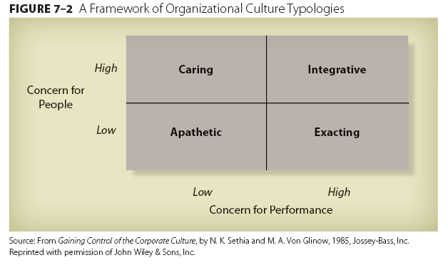

Slide 6
The apathetic culture shows minimal concern for either people or performance
The caring culture exhibits high concern for people but minimal concern for
performance issues. From an ethical standpoint, the caring culture seems very appealing. However, it is difficult to find nationally recognizable companies that maintain little or no concern for performance.
In contrast, the exacting culture shows little concern for people but a high concern for performance; it focuses on the interests of the organization.
The integrative culture combines high concern for people and for performance. An organization becomes integrative when superiors recognize that employees are more than interchangeable parts—that employees have an ineffable quality that helps the firm meet its performance criteria.

Slide 7
cultural audit
Companies can classify their corporate culture and identify its specific values, norms, beliefs, and customs by conducting a cultural audit. A cultural audit is an assessment of the organization’s values. It is usually conducted by outside consultants but may be performed internally as well

Slide 8
Ethics as a Component of Corporate Culture
ethical culture, the ethical component of corporate culture, is a significant factor in ethical decision making. If a firm’s culture encourages or rewards unethical behavior, its employees may well act unethically.
On the other hand, if the organization values ethical behaviors, it will reward them.

Slide 9
Compliance versus Value-based Ethical Cultures
Read from book

Slide 10
Differential Association
Differential association refers to the idea that people learn ethical or unethical behavior while interacting with others who are part of their role-sets or belong to other intimate personal groups

Slide 11
Whistle-Blowing
Read From Book

