Slide 1
Database Systems
Lecture 6: Structured Query Language (SQL) PART 2
By
Rimsha Khan

Slide 2
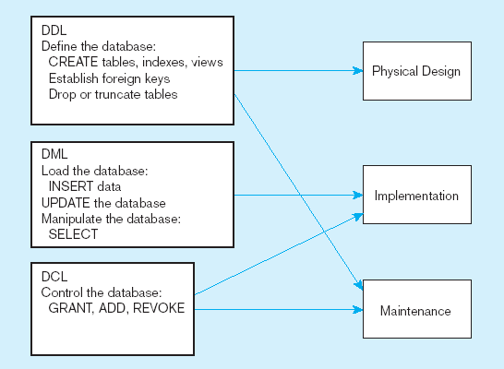
DDL, DML, DCL, and the database development process

Slide 3
Insert Statement
Adds data to a table
Inserting into a table
INSERT INTO CUSTOMER_T VALUES (001, ‘Contemporary Casuals’, ‘1355 S. Himes Blvd.’, ‘Gainesville’, ‘FL’, 32601);
Inserting a record that has some null attributes requires identifying the fields that actually get data
INSERT INTO PRODUCT_T (PRODUCT_ID, PRODUCT_DESCRIPTION,PRODUCT_FINISH, STANDARD_PRICE, PRODUCT_ON_HAND) VALUES (1, ‘End Table’, ‘Cherry’, 175, 8);
Inserting from another table
INSERT INTO CA_CUSTOMER_T SELECT * FROM CUSTOMER_T WHERE STATE = ‘CA’;

Slide 4
Delete Statement
Removes rows from a table
Delete certain rows
DELETE FROM CUSTOMER_T WHERE STATE = ‘HI’;
Delete all rows
DELETE FROM CUSTOMER_T;

Slide 5
Update Statement
Modifies data in existing rows
UPDATE PRODUCT_T SET UNIT_PRICE = 775 WHERE PRODUCT_ID = 7;

Slide 6
SELECT Statement
Used for queries on single or multiple tables
Clauses of the SELECT statement:
SELECT
List the columns (and expressions) that should be returned from the query
FROM
Indicate the table(s) or view(s) from which data will be obtained
WHERE
Indicate the conditions under which a row will be included in the result
GROUP BY
Indicate categorization of results
HAVING
Indicate the conditions under which a category (group) will be included
ORDER BY
Sorts the result according to specified criteria

Slide 7
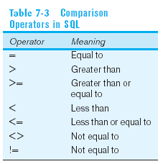
SELECT Example
Find products with standard price less than $275
SELECT PRODUCT_NAME, STANDARD_PRICE
FROM PRODUCT_V
WHERE STANDARD_PRICE < 275;
Comparison Operators in SQL

Slide 8
SELECT Example Using Alias
Alias is an alternative column or table name
SELECT CUST.CUSTOMER AS NAME, CUST.CUSTOMER_ADDRESS
FROM CUSTOMER_V CUST
WHERE NAME = ‘Home Furnishings’;

Slide 9
SELECT Example Using a Function
Using the COUNT aggregate function to find totals
SELECT COUNT(*) FROM ORDER_LINE_V
WHERE ORDER_ID = 1004;

Slide 10
LIKE OPERATOR
the LIKE operator allows you to compare strings using wildcards.
For example, the % wildcard in ‘%Desk’ indicates that all strings that have any number of characters preceding the word “Desk” will be allowed

Slide 11
SELECT Example–Boolean Operators
AND, OR, and NOT Operators for customizing conditions in WHERE clause
SELECT PRODUCT_DESCRIPTION, PRODUCT_FINISH, STANDARD_PRICE
FROM PRODUCT_V
WHERE (PRODUCT_DESCRIPTION LIKE ‘%Desk’
OR PRODUCT_DESCRIPTION LIKE ‘%Table’)
AND UNIT_PRICE > 300;

Slide 12
IN Operator
Note: the IN operator in this example allows you to include rows whose STATE value is either FL, TX, CA, or HI. It is more efficient than separate OR conditions
SELECT CUSTOMER_NAME, CITY, STATE
FROM CUSTOMER_V
WHERE STATE IN (‘FL’, ‘TX’, ‘CA’, ‘HI’);
 | STATE
 | FL
 | TX
 | CA
 | HI
 | PK

Slide 13
SELECT Example – Sorting Results with the ORDER BY Clause
Sort the results first by STATE, and within a state by CUSTOMER_NAME
SELECT CUSTOMER_NAME, CITY, STATE
FROM CUSTOMER_V
WHERE STATE IN (‘FL’, ‘TX’, ‘CA’, ‘HI’)
ORDER BY STATE, CUSTOMER_NAME;

Slide 14
SELECT Example– Categorizing Results Using the GROUP BY Clause
For use with aggregate functions
Scalar aggregate: single value returned from SQL query with aggregate function
Vector aggregate: multiple values returned from SQL query with aggregate function (via GROUP BY)
SELECT CUSTOMER_STATE, COUNT(CUSTOMER_STATE)
FROM CUSTOMER_V
GROUP BY CUSTOMER_STATE;
Note: you can use single-value fields with aggregate functions if they are included in the GROUP BY clause

Slide 15
SELECT Example– Qualifying Results by Categories Using the HAVING Clause
For use with GROUP BY
SELECT CUSTOMER_STATE, COUNT(CUSTOMER_STATE)
FROM CUSTOMER_V
GROUP BY CUSTOMER_STATE
HAVING COUNT(CUSTOMER_STATE) > 1;
Like a WHERE clause, but it operates on groups (categories), not on individual rows. Here, only those groups with total numbers greater than 1 will be included in final result

Slide 16
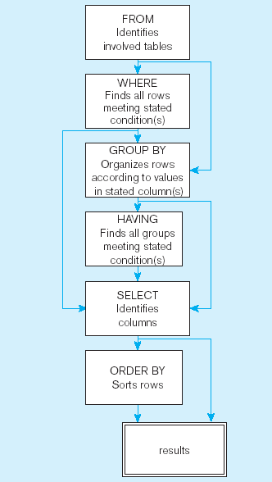
SQL statement processing order

Slide 17
Using and Defining Views
Views provide users controlled access to tables
Base Table–table containing the raw data
Dynamic View
A “virtual table” created dynamically upon request by a user
No data actually stored; instead data from base table made available to user
Based on SQL SELECT statement on base tables or other views
Materialized View
Copy or replication of data
Data actually stored
Must be refreshed periodically to match the corresponding base tables

Slide 18
Sample CREATE VIEW
CREATE VIEW EXPENSIVE_STUFF_V AS
SELECT PRODUCT_ID, PRODUCT_NAME, UNIT_PRICE
FROM PRODUCT_T
WHERE UNIT_PRICE >300;
View has a name
View is based on a SELECT statement

Slide 19
Processing Multiple Tables–Joins
Join–a relational operation that causes two or more tables with a common domain to be combined into a single table or view
The common columns in joined tables are usually the primary key of the dominant table and the foreign key of the dependent table in 1:M relationships

Slide 20
Inner and Outer Joins
List the customer name, ID number, and order number for all customers. Include customer information even for customers that do have an order
SELECT CUSTOMER_T.CUSTOMER_ID, CUSTOMER_NAME, ORDER_ID
FROM CUSTOMER_T, LEFT OUTER JOIN ORDER_T
ON CUSTOMER_T.CUSTOMER_ID = ORDER_T.CUSTOMER_ID;
Unlike INNER join, this will include customer rows with no matching order rows

Slide 21
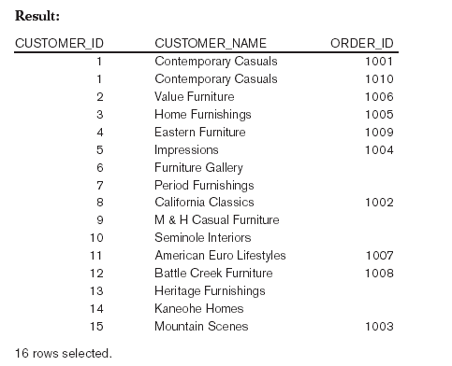
Results
Unlike INNER join, this will include customer rows with no matching order rows

Slide 22
Multiple Table Join Example
Assemble all information necessary to create an invoice for order number 1006
SELECT CUSTOMER_T.CUSTOMER_ID, CUSTOMER_NAME, CUSTOMER_ADDRESS, CITY, SATE, POSTAL_CODE, ORDER_T.ORDER_ID, ORDER_DATE, QUANTITY, PRODUCT_DESCRIPTION, STANDARD_PRICE, (QUANTITY * UNIT_PRICE)
FROM CUSTOMER_T, ORDER_T, ORDER_LINE_T, PRODUCT_T
WHERE CUSTOMER_T.CUSTOMER_ID = ORDER_LINE.CUSTOMER_ID AND ORDER_T.ORDER_ID = ORDER_LINE_T.ORDER_ID
AND ORDER_LINE_T.PRODUCT_ID = PRODUCT_PRODUCT_ID
AND ORDER_T.ORDER_ID = 1006;
Four tables involved in this join
Each pair of tables requires an equality-check condition in the WHERE clause, matching primary keys against foreign keys

Slide 23
Results from a four-table join
From CUSTOMER_T table
From ORDER_T table
From PRODUCT_T table

Slide 24
Processing Multiple Tables Using Subqueries
Subquery–placing an inner query (SELECT statement) inside an outer query
Subqueries can be:
Noncorrelated–executed once for the entire outer query
Correlated–executed once for each row returned by the outer query

Slide 25
Subquery Example
Show all customers who have placed an order
SELECT CUSTOMER_NAME FROM CUSTOMER_T
WHERE CUSTOMER_ID IN
(SELECT DISTINCT CUSTOMER_ID FROM ORDER_T);

Slide 26
Correlated vs. Noncorrelated Subqueries
Noncorrelated subqueries:
Do not depend on data from the outer query
Execute once for the entire outer query
Correlated subqueries:
Make use of data from the outer query
Execute once for each row of the outer query
Notes:
Select E.Name, (Select Sum(Salary) from Salary S Where S.EmpID=E.EmpID) As AverageSalary from Employee E

Slide 27
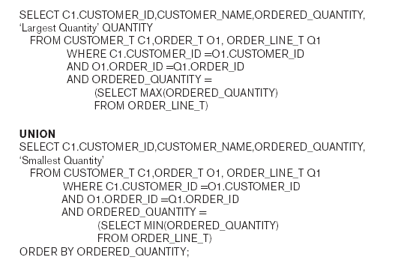
Union Queries
Combine the output (union of multiple queries) together into a single result table
First query
Combine
Second query

Slide 28
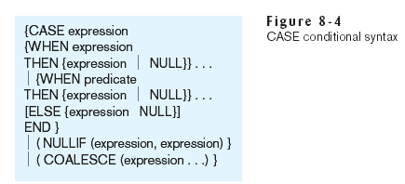
Conditional Expressions Using Case Syntax
This is available with newer versions of SQL, previously not part of the standard

Slide 29
Transaction Integrity
Transaction
A discrete unit of work that must be completely processed or not processed at all
May involve multiple updates
If any update fails, then all other updates must be cancelled

Slide 30
Transaction
SQL commands for transactions
BEGIN TRANSACTION/END TRANSACTION
Marks boundaries of a transaction
COMMIT
Makes all updates permanent
ROLLBACK
Cancels updates since the last COMMIT

Slide 31
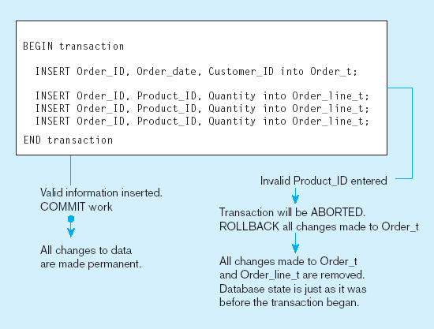
An SQL Transaction sequence (in pseudocode)

Slide 32
Stored Procedures
A prepared SQL code that you can save, so the code can be reused over and over again
CREATE PROCEDURE procedure_name
AS
sql_statement;
EXEC procedure_name;

