Slide 1
Processes in Operations Management
Lecture 6

Slide 2
Process Planning
Process
  Group of related tasks with specific inputs & outputs
Process design
  tasks to be done & how they are coordinated among functions, people, & organizations
Process strategy
  an organization’s overall approach for physically producing goods and services
Process planning
  converts designs into workable instructions for manufacture or delivery

Slide 3
Process Strategy
Vertical integration
  extent to which firm will produce inputs and control outputs of each stage of production process
Capital intensity
  mix of capital (i.e., equipment, automation) and labor resources used in production process
Process flexibility
  ease with which resources can be adjusted in response to changes in demand, technology, products or services, and resource availability
Customer involvement
  role of customer in production process

Slide 4
Outsourcing
Cost
Capacity
Quality
Speed
Reliability
Expertise

Slide 5
Process Selection
Projects
  one-of-a-kind production of a product to customer order
Batch production
  process many different jobs at the same time in groups or batches
Mass production
  produce large volumes of a standard product for a mass market
Continuous production
  used for very-high volume commodity products

Slide 6
Product-Process Matrix

Slide 7
Types of Processes
PROJECT
BATCH
MASS
CONT.
Type of product
Unique
Made-to- order
(customized)
Made-to- stock
(standardized )
Commodity
Type of customer
One-at-a-time
Few individual
customers
Mass
market
Mass
market
Product demand
Infrequent
Fluctuates
Stable
Very stable

Slide 8
Types of Processes
PROJECT
BATCH
MASS
CONT.
Demand volume
Very low
Low to medium
High
Very high
No. of different products
Infinite variety
Many, varied
Few
Very few
Production system
Long-term project
Discrete, job shops
Repetitive, assembly lines
Continuous, process industries

Slide 9
Types of Processes
PROJECT
BATCH
MASS
CONT.
Equipment
Varied
General-purpose
Special-purpose
Highly automated
Primary type of work
Specialized contracts
Fabrication
Assembly
Mixing, treating, refining
Worker skills
Experts, crafts-persons
Wide range of skills
Limited range of skills
Equipment monitors

Slide 10
Types of Processes
PROJECT
BATCH
MASS
CONT.
Advantages
Custom work, latest technology
Flexibility, quality
Efficiency,
speed,
low cost
Highly efficient,
large capacity,
ease of control
Dis-advantages
Non-repetitive, small customer base, expensive
Costly, slow,
difficult to
manage
Capital
investment;
lack of
responsiveness
Difficult to change,
far-reaching errors,
limited variety
Examples
Construction, shipbuilding, spacecraft
Machine shops,
print shops,
bakeries,
education
Automobiles,
televisions,
computers,
fast food
Paint, chemicals, foodstuffs

Slide 11
Process Selection With
Break-Even Analysis
Study cost trade-offs based on demand volume
Cost
  Fixed costs
    constant regardless of the number of units produced
  Variable costs
    vary with the volume of units produced
Revenue
  price at which an item is sold

Slide 12
Process Selection With
Break-Even Analysis
Total revenue
  price times volume sold
Profit
  difference between total revenue and total cost

Slide 13
Process Selection With
Break-Even Analysis
Total cost = fixed cost + total variable cost
    TC = c_{f} + vc_{v}
Total revenue = volume x price
    TR = vp
Profit = total revenue - total cost
    Z = TR – TC = vp - (c_{f} + vc_{v})
c_{f} = fixed cost
V = volume (i.e., number of units produced and sold)
c_{v} = variable cost per unit
p = price per unit

Slide 14
Process Selection With
Break-Even Analysis
TR = TC
vp = c_{f} + vc_{v}
vp - vc_{v} = c_{f}
v(p - c_{v}) = c_{f}
v =
c_{f}
p - c_{v}
Solving for Break-Even Point (Volume)

Slide 15
Break-Even Analysis
Fixed cost = c_{f} = $2,000
Variable cost = c_{v} = $50 per unit
Price = p = $100 per unit
Break-even point is
c_{f}
p - c_{v}
2000
100 - 50
v = = = 40 units

Slide 16
Break-Even Analysis: Graph
Dollars
$3,000 —
$2,000 —
$1,000 —
Total cost line
Total revenue line
40 Units
Break-even point

Slide 17
Process Analysis
Systematic study of all aspects of a process
  make it faster
  more efficient
  less costly
  more responsive
Basic tools
  process flowcharts
  diagrams
  maps

Slide 18
Building a Flowchart
Determine objectives
Define process boundaries
Define units of flow
Choose type of chart
Observe process and collect data
Map out process
Validate chart

Slide 19
Process Flowcharts
Look at manufacture of product or delivery of service from broad perspective
Incorporate
  nonproductive activities (inspection, transportation, delay, storage)
  productive activities (operations)

Slide 20
Process Flowchart Symbols
Operation
Inspection
Transportation
Delay
Storage

Slide 21
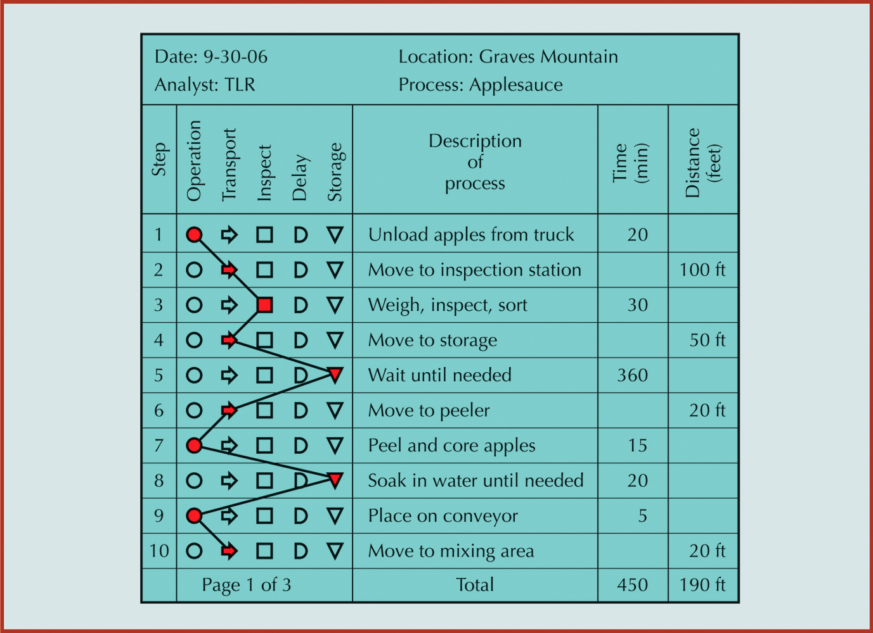
Process Flowchart of Apple Processing

Slide 22
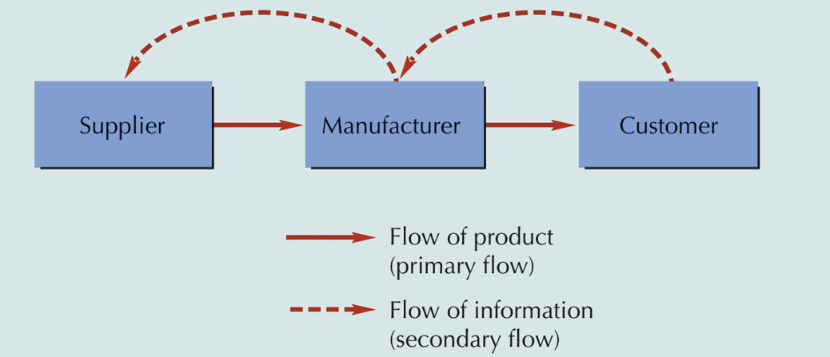
Simple Value Chain Flowchart

Slide 23
Process Innovation
Total redesign of a process for breakthrough improvements
Continuous improvement refines the breakthrough
Breakthrough Improvement
Continuous improvement activities peak; time to reengineer process

Slide 24
Process
Innovation
Strategic
Directives
Baseline Data
Customer
Requirements
Goals for Process Performance
Benchmark
Data
High - level
Process map
Innovative
Ideas
Design
Principles
Detailed
Process Map
Model
Validation
Key
Performance
Measures
Pilot Study
of New Design
Goals
Met?
Full Scale
Implementation
No
Yes

Slide 25
Principles for Redesigning Processes
Remove waste, simplify, and consolidate similar activities
Link processes to create value
Let the swiftest and most capable enterprise execute the process
Flex process for any time, any place, any way
Capture information digitally at the source and propagate it through process

Slide 26
Principles for Redesigning Processes
Provide visibility through fresher and richer information about process status
Fit process with sensors and feedback loops that can prompt action
Add analytic capabilities to the process
Connect, collect, and create knowledge around process through all who touch it
Personalize process with preferences and habits of participants

Slide 27
Techniques for Generating
Innovative Ideas
Vary the entry point to a problem
  in trying to untangle fishing lines, it’s best to start from the fish, not the poles
Draw analogies
  a previous solution to an old problem might work
Change your perspective
  think like a customer
  bring in persons who have no knowledge of process

Slide 28
Techniques for Generating
Innovative Ideas
Try inverse brainstorming
  what would increase cost
  what would displease the customer
Chain forward as far as possible
  if I solve this problem, what is the next problem
Use attribute brainstorming
  how would this process operate if. . .
    our workers were mobile and flexible
    there were no monetary constraints
    we had perfect knowledge

