Slide 1
Chap 5: Analog Transmission
By: Engr. Ghassan Hasnain

Slide 2
Video Link:
https://www.youtube.com/watch?v=1aCWlbE3Meo

Slide 3
Digital to Analog conversion
Digital-to-analog conversion is the process of changing one of the characteristics of an analog signal based on the information in digital data.
Figure shows the relationship between the digital information, the digital-to-analog modulating process, and the resultant analog signal.

Slide 4
Digital to Analog conversion
A sine wave is defined by three characteristics: amplitude, frequency, and phase.
When we vary any one of these characteristics, we create a different version of that wave.
So, by changing one characteristic of a simple electric signal, we can use it to represent digital data.
Any of the three characteristics can be altered in this way, giving us at least three mechanisms for modulating digital data into an analog signal:
Amplitude shift keying (ASK),
Frequency shift keying (FSK), and
Phase shift keying (PSK).

Slide 5
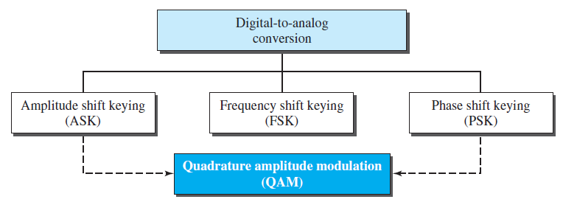
Digital to Analog conversion
In addition, there is a fourth (and better) mechanism that combines changing both the amplitude and phase, called quadrature amplitude modulation (QAM).
QAM is the most efficient of these options and is the mechanism commonly used today.

Slide 6
Data Element & Signal Element
A data element is the smallest piece of information to be exchanged, the bit.
A signal element is the smallest unit of a signal that is constant.

Slide 7
Data Rate vs Signal Rate
The relationship between these two is
where N is the data rate (bps) and r is the number of data elements carried in one signal element.
The value of r in analog transmission is r = log₂ L, where L is the number of different signal elements.
The same terminology is used to simplify the comparisons.

Slide 8
Example:
An analog signal carries 4 bits per signal element. If 1000 signal elements are sent per second, find the bit rate.
Solution
In this case, r = 4, S = 1000, and N is unknown. We can find the value of N from

Slide 9
Carrier Signal
In analog transmission, the sending device produces a high-frequency signal that acts as a base for the information signal.
This base signal is called the carrier signal or carrier frequency.
The receiving device is tuned to the frequency of the carrier signal that it expects from the sender.
Digital information then changes the carrier signal by modifying one or more of its characteristics (amplitude, frequency, or phase).
This kind of modification is called modulation (shift keying).

Slide 10
Amplitude shift keying
In amplitude shift keying, the amplitude of the carrier signal is varied to create signal elements.
Both frequency and phase remain constant while the amplitude changes.

Slide 11
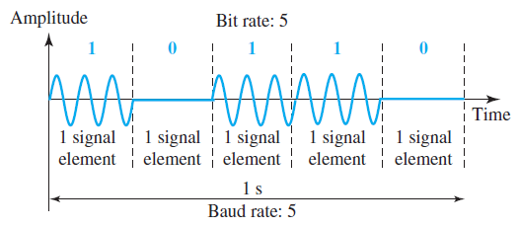
Binary Amplitude shift keying
Although we can have several levels (kinds) of signal elements, each with a different amplitude, ASK is normally implemented using only two levels.
This is referred to as binary amplitude shift keying or on-off keying (OOK).
The peak amplitude of one signal level is 0; the other is the same as the amplitude of the carrier frequency.

Slide 12
Bandwidth for ASK
Although the carrier signal is only one simple sine wave, the process of modulation produces a non-periodic composite signal.
This signal has a continuous set of frequencies.
The bandwidth is proportional to the signal rate (baud rate).
However, there is normally another factor involved, called d, which depends on the modulation and filtering process.
The value of d is between 0 and 1.
This means that the bandwidth can be expressed as shown, where S is the signal rate and the B is the bandwidth.

Slide 13
Bandwidth for ASK
The formula shows that the required bandwidth has a minimum value of S and a maximum value of 2S.
The most important point here is the location of the bandwidth.
The middle of the bandwidth is where fc, the carrier frequency, is located.
This means if we have a band-pass channel available, we can choose our fc so that the modulated signal occupies that bandwidth.
This is in fact the most important advantage of digital-to-analog conversion.
We can shift the resulting bandwidth to match what is available.

Slide 14
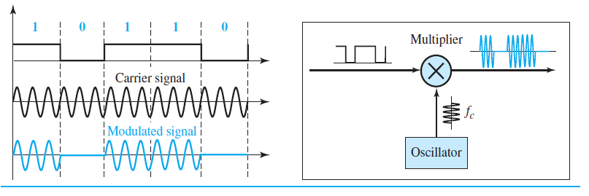
Implementation of BASK

Slide 15
Example:
We have an available bandwidth of 100 kHz which spans from 200 to 300 kHz. What are the carrier frequency and the bit rate if we modulated our data by using ASK with d = 1?
Solution
The middle of the bandwidth is located at 250 kHz. This means that our carrier frequency can be at f_{c} = 250 kHz. We can use the formula for bandwidth to find the bit rate (with d = 1 and r = 1).

Slide 16
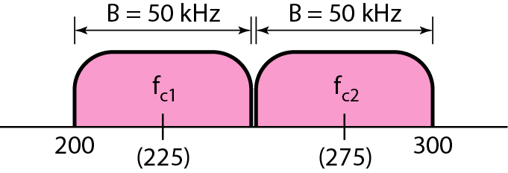
Example:
In data communications, we normally use full-duplex links with communication in both directions. We need to divide the bandwidth into two with two carrier frequencies, as shown in the Figure. The figure shows the positions of two carrier frequencies and the bandwidths. The available bandwidth for each direction is now 50 kHz, which leaves us with a data rate of 25 kbps in each direction.

Slide 17
FSK (Frequency shift keying)
In frequency shift keying, the frequency of the carrier signal is varied to represent data.
The frequency of the modulated signal is constant for the duration of one signal element, but changes for the next signal element if the data element changes.
Both peak amplitude and phase remain constant for all signal elements.

Slide 18
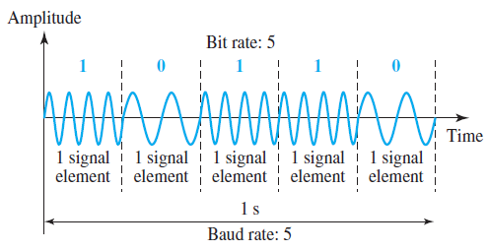
BFSK (Binary Frequency shift keying)
One way to think about binary FSK (or BFSK) is to consider two carrier frequencies.
We can select two carrier frequencies, f1 and f2.
We use the first carrier if the data element is 0; we use the second if the data element is 1.

Slide 19
BFSK (Binary Frequency shift keying)
The middle of one bandwidth is f1 and the middle of the other is f2.
Both f1 and f2 are Δf apart from the midpoint between the two bands.
The difference between the two frequencies is 2Δf.

Slide 20
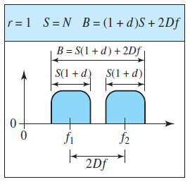
Bandwidth for BFSK
Figure shows the bandwidth of FSK.
Again the carrier signals are only simple sine waves, but the modulation creates a non-periodic composite signal with continuous frequencies.
We can think of FSK as two ASK signals, each with its own carrier frequency ( f1 or f2).
If the difference between the two frequencies is 2Δf, then the required bandwidth is: B= (1 + d) x S + 2Δf

Slide 21
Implementation of BFSK

Slide 22
PSK (Phase shift keying)
In phase shift keying, the phase of the carrier is varied to represent two or more different signal elements.
Both peak amplitude and frequency remain constant as the phase changes.
Today, PSK is more common than ASK or FSK.

Slide 23
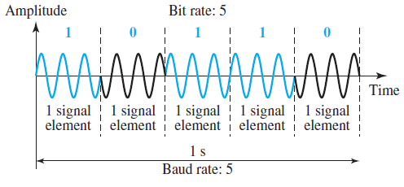
BPSK (Binary Phase shift keying)
The simplest PSK is binary PSK, in which we have only two signal elements, one with a phase of 0°, and the other with a phase of 180°.
Figure gives a conceptual view of PSK.
Binary PSK is as simple as binary ASK with one big advantage—it is less susceptible to noise.

Slide 24
BPSK (Binary Phase shift keying)
In ASK, the criterion for bit detection is the amplitude of the signal; in PSK, it is the phase.
Noise can change the amplitude easier than it can change the phase.
In other words, PSK is less susceptible to noise than ASK.
PSK is superior to FSK because we do not need two carrier signals.
However, PSK needs more sophisticated hardware to be able to distinguish between phases.

Slide 25
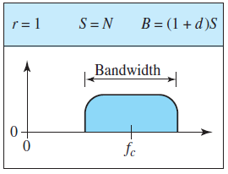
Bandwidth for BPSK
Figure shows the bandwidth for BPSK.
The bandwidth is the same as that for binary ASK, but less than that for BFSK.
No bandwidth is wasted for separating two carrier signals.

Slide 26
Implementation of BPSK
The implementation of BPSK is as simple as that for ASK.
The reason is that the signal element with phase 180° can be seen as the complement of the signal element with phase 0°.
This gives us a clue on how to implement BPSK.
We use the same idea we used for ASK but with a polar NRZ signal instead of a unipolar NRZ signal.
The polar NRZ signal is multiplied by the carrier frequency; the 1 bit (positive voltage) is represented by a phase starting at 0°; the 0 bit (negative voltage) is represented by a phase starting at 180°.

Slide 27
Implementation of BPSK

Slide 28
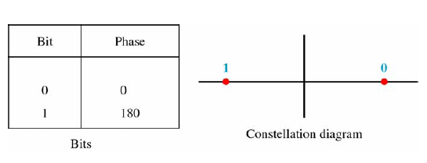
BPSK Constellation
28

Slide 29
QPSK
The simplicity of BPSK enticed designers to use 2 bits at a time in each signal element, thereby decreasing the baud rate and eventually the required bandwidth.
The scheme is called quadrature PSK or QPSK because it uses two separate BPSK modulations; one is in-phase, the other quadrature (out-of-phase).

Slide 30
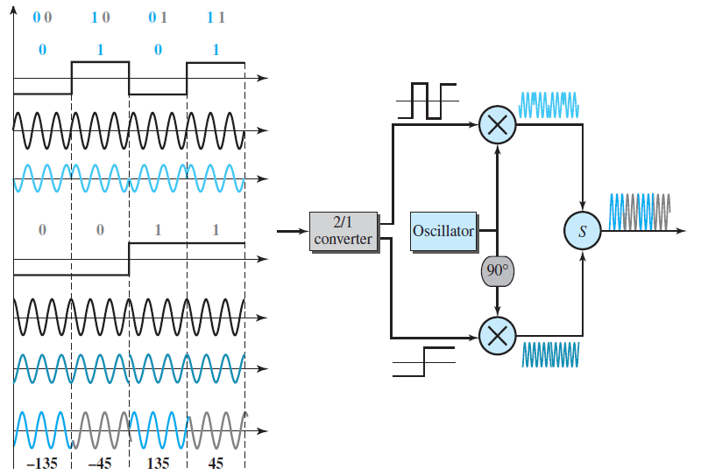
QPSK

Slide 31
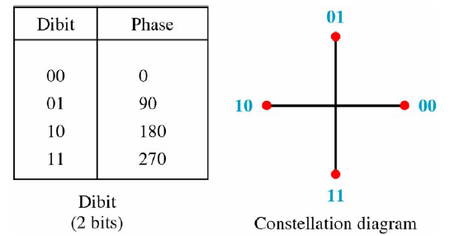
4 PSK Characteristic
31

Slide 32
QAM (Quadrature Amplitude Modulation)
PSK is limited by the ability of the equipment to distinguish small differences in phase.
This factor limits its potential bit rate.
So far, we have been altering only one of the three characteristics of a sine wave at a time.
What if we alter two and combine ASK and PSK?
The idea of using two carriers, one in-phase and the other quadrature, with different amplitude levels for each carrier is the concept behind quadrature amplitude modulation (QAM).
32

Slide 33
Analog to Analog Conversion
33

Slide 34
Analog-to-analog conversion
Analog-to-analog conversion, or analog modulation, is the representation of analog information by an analog signal.
One may ask why we need to modulate an analog signal; it is already analog.
Modulation is needed if the medium is band-pass in nature or if only a band-pass channel is available to us.
An example is radio.
The government assigns a narrow bandwidth to each radio station.
The analog signal produced by each station is a low-pass signal, all in the same range.
To be able to listen to different stations, the low-pass signals need to be shifted, each to a different range.
34

Slide 35
Analog-to-analog conversion
Analog-to-analog conversion can be accomplished in three ways:
Amplitude modulation (AM),
Frequency modulation (FM), and
Phase modulation (PM).
35

Slide 36
AM (Amplitude Modulation)
In AM transmission, the carrier signal is modulated so that its amplitude varies with the changing amplitudes of the modulating signal.
The frequency and phase of the carrier remain the same; only the amplitude changes to follow variations in the information.
The modulating signal is the envelope of the carrier.
AM is normally implemented by using a simple multiplier because the amplitude of the carrier signal needs to be changed according to the amplitude of the modulating signal.
36

Slide 37
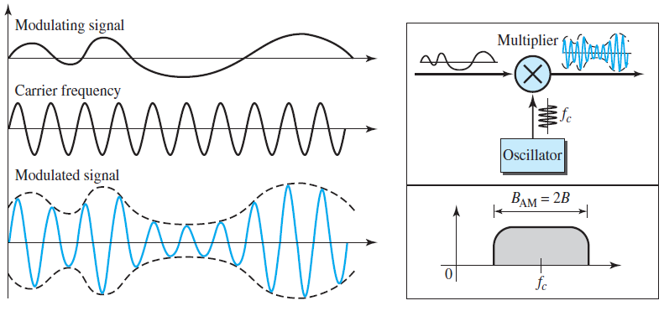
AM (Amplitude Modulation)
37

Slide 38
Bandwidth Allocation for AM
The bandwidth of an audio signal (speech and music) is usually 5 kHz.
Therefore, an AM radio station needs a bandwidth of 10 kHz.
In fact, the Federal Communications Commission (FCC) allows 10 kHz for each AM station.
AM stations are allowed carrier frequencies anywhere between 530 and 1700 kHz (1.7 MHz).
However, each station’s carrier frequency must be separated from those on either side of it by at least 10 kHz (one AM bandwidth) to avoid interference.
If one station uses a carrier frequency of 1100 kHz, the next station’s carrier frequency cannot be lower than 1110 kHz.
38

Slide 39
Bandwidth Allocation for AM
39

Slide 40
FM (Frequency Modulation)
In FM transmission, the frequency of the carrier signal is modulated to follow the changing voltage level (amplitude) of the modulating signal.
The peak amplitude and phase of the carrier signal remain constant, but as the amplitude of the information signal changes, the frequency of the carrier changes correspondingly.
Figure shows the relationships of the modulating signal, the carrier signal, and the resultant FM signal.
FM is normally implemented by using a voltage-controlled oscillator as with FSK.
The frequency of the oscillator changes according to the input voltage which is the amplitude of the modulating signal.
40

Slide 41
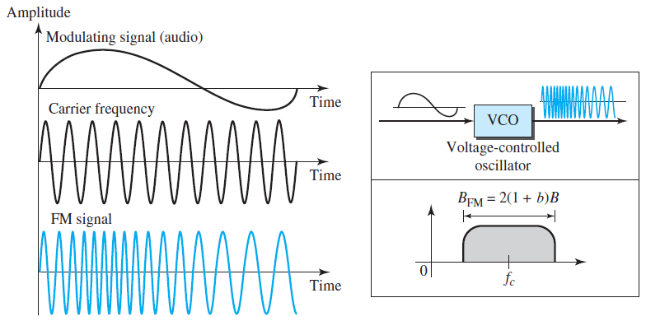
FM (Frequency Modulation)
41

Slide 42
PM (Phase Modulation)
In PM transmission, the phase of the carrier signal is modulated to follow the changing voltage level (amplitude) of the modulating signal.
The peak amplitude and frequency of the carrier signal remain constant, but as the amplitude of the information signal changes, the phase of the carrier changes correspondingly.
Figure shows the relationships of the modulating signal, the carrier signal, and the resultant PM signal.
42

Slide 43
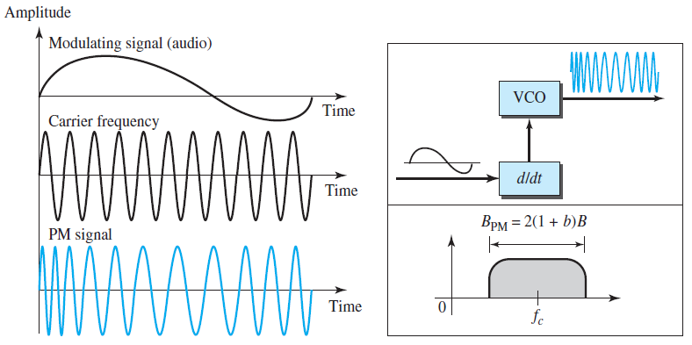
PM (Phase Modulation)
43

Slide 44
Thank you

