Slide 1
Time Value of Money
Simple Interest
Compound Interest

Slide 2
Time Value of Money
That is, the earlier a sum of money is received, the more it is worth, because over time money can earn more money, or interest.
There are three reasons why a dollar tomorrow is worth less than a dollar today

Slide 3
The simple rate of interest:
In the simple interest only the principal earns interest in every period over the life of the amount.
The interest earned at the end of the period on the principal will not earn interest in any of the subsequent periods.

Slide 4
The simple rate of interest:
Consider the Below time line. You deposit $100 at time 0 and assuming the rate of interest is 10% per annum. At the end of period 1, you will have $110 in the account. The breakdown of $110 is as follows:
Principal $100
Interest earned = 0.10 x $100 = $ 10
Total amount = $100 + $10 = $110

Slide 5
The simple rate of interest:
Under the simple rate of interest in the successive period only the principal ($100) will earn the interest. The interest earned i.e. $10 in period 1 will not earn interest in any of the subsequent periods. Therefore, the total amount in the account at the end of the period 2 will be $120.
i.e. $100 + $10 +$10 = $120 computed as follows

Slide 6
Compound rate of interest
In compound rate of interest, the interest earned on the principal during the specified period also earns interest in the subsequent periods.

Slide 7
For example
In the above diagram at the end of period 1, the account will have $110 under both approaches (simple interest and compound interest). But at the end of period 2, the total amount will be $121 under the compound interest approach rather than $120 as we obtained in the simple interest approach.

Slide 8
Since compound rate of interest, interest earned also starts earning interest the total amount becomes $121. The difference of $1 between compound interest and simple interest approach is due to interest of $1 earned in period 2 on $10 interest that was earned in period 2.

Slide 9
Formula for Simple Interest Rate
Interest is the amount of money paid for either borrowing money or earning money on a deposit.
And
Simple Interest is interest that is compounded on the original principal only.

Slide 10
Where,
I = Interest
P = principal (present value)
r = interest rate (% to decimal)
t = time in years

Slide 11
Example 1
Find the simple interest on a $1000 investment made for 3 years at an interest rate of 5% per year.

Slide 12
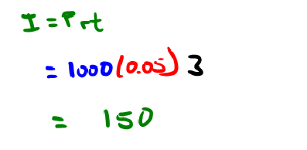
Solution

Slide 13
Future Value with Simple Interest

Slide 14
Example 2
Mike borrowed $1,200 at 10% simple interest per year. How much is due when the loan matures in 9 months?

Slide 15
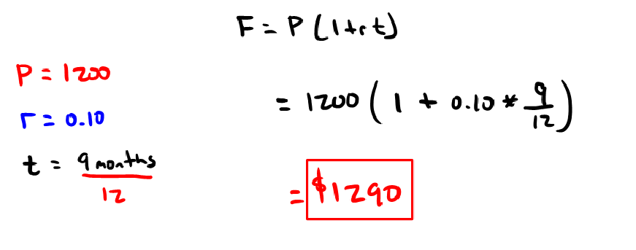
Solution

Slide 16
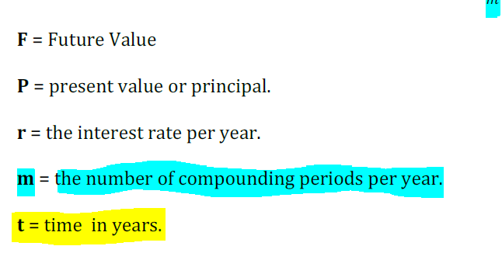
Compound Interest:
Interest that charged or earned on the original principal and also on any previously charge or earned interest.
The principal amount plus accumulated interest.( Most commonly used).
Let an amount P dollars is invested and i% is the interest rate per period, the amount will grow to a future amount of P+Pi= P(1+i) by the end of one period.
By the end of period 2, the amount will grow to P(1+i)(1+i)=P(1+i)²
By the end of period 3, the amount will grow to P(1+i)2(1+i)=P(1+i)³
By the end of period N,the amount will grow to F= P(1+i)^{n}

Slide 17
Example 3
Find the accumulated amount after 5 years if $1700 is invested at 6.25% per year compounded,
Quarterly
Semi-annually

Slide 18
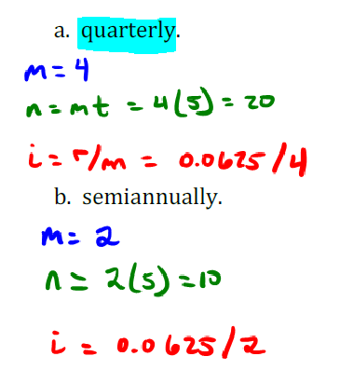
Solution

Slide 19
Present Value with Compound Interest Formula

Slide 20
Example
Kim and Ken find that they will need $15,500 to build an addition to their home in 4 years. How much should they invest now at 3.25% per year compounded quarterly to have the desired funds in 4 years?

Slide 21
Solution

Slide 22
Example
An investor has an option to purchase a tract of land that will be worth $ 10,000 in six years. If the value of the land increases at 8%, how much the investor be willing to pay for this property.

Slide 23
Solution
P = F (1/1+i)^{n.}
P = $10,000 (1/1+0.08)^{6.}
P = $6302

