Slide 1
CSE-880 Advance Database Systems
Lecture 4: Logical Database Design and the Relational Model
By
Rimsha Khan

Slide 2
Agenda
Definition of terms
Properties of relations
Properties of candidate keys
Define first, second, and third normal form
Transformation of E-R and EER diagrams to relations
Entity and relational integrity constraints
Normalization

Slide 3
Relation
Definition: A relation is a named, two-dimensional table of data
Table consists of rows (records) and columns (attribute or field)
Degree of Relation: No of columns
Cardinality of Relation: No of rows

Slide 4
Correspondence with E-R Model
Relations (tables) correspond with entity types
Rows correspond with entity instances
Columns correspond with attributes

Slide 5
Key Fields
Keys are special fields that serve two main purposes:
Primary keys are unique identifiers of the relation in question. Examples include employee numbers, social security numbers, etc. This is how we can guarantee that all rows are unique
Foreign keys are identifiers that enable a dependent relation (on the many side of a relationship) to refer to its parent relation (on the one side of the relationship)
Keys can be simple (a single field) or composite (more than one field)

Slide 6
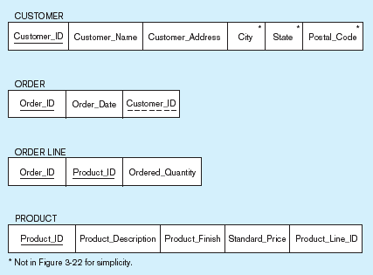
Schema for four relations (Pine Valley Furniture Company)
Primary Key
Foreign Key (implements 1:N relationship between customer and order)
Combined, these are a composite primary key (uniquely identifies the order line)…individually they are foreign keys (implement M:N relationship between order and product)

Slide 7
Transforming ER Diagrams into Relations
Mapping Regular Entities to Relations
Simple attributes: E-R attributes map directly onto the relation
Composite attributes: Use only their simple, component attributes
Multivalued Attribute–Becomes a separate relation with a foreign key taken from the superior entity

Slide 8
Mapping a regular entity
(a) CUSTOMER entity type with simple attributes
(b) CUSTOMER relation

Slide 9
Mapping a composite attribute
(a) CUSTOMER entity type with composite attribute
(b) CUSTOMER relation with address detail

Slide 10
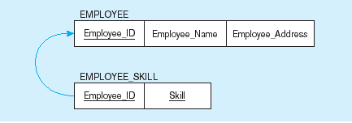
Mapping an entity with a multivalued attribute
(a)
Multivalued attribute becomes a separate relation with foreign key
(b)
One–to–many relationship between original entity and new relation

Slide 11
Transforming ER Diagrams into Relations (cont.)
Mapping Weak Entities
Becomes a separate relation with a foreign key taken from the superior entity
Primary key composed of:
Partial identifier of weak entity
Primary key of identifying relation (strong entity)

Slide 12
Example of mapping a weak entity
a) Weak entity DEPENDENT

Slide 13
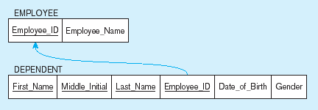
Example of mapping a weak entity (cont.)
b) Relations resulting from weak entity
NOTE: the domain constraint for the foreign key should NOT allow null value if DEPENDENT is a weak entity
Foreign key
Composite primary key

Slide 14
Transforming EER Diagrams into Relations (cont.)
Mapping Binary Relationships
One-to-Many–Primary key on the one side becomes a foreign key on the many side
Many-to-Many–Create a new relation with the primary keys of the two entities as its primary key
One-to-One–Primary key on the mandatory side becomes a foreign key on the optional side

Slide 15
Example of mapping a binary 1:1 relationship
a) In_charge relationship (1:1)
Often in 1:1 relationships, one direction is optional.

Slide 16
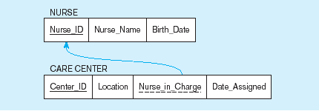
Example of mapping a binary 1:1 relationship (cont.)
b) Resulting relations
Foreign key goes in the relation on the optional side,
Matching the primary key on the mandatory side

Slide 17
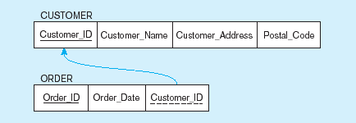
Example of mapping a 1:M relationship
a) Relationship between customers and orders
Note the mandatory one
b) Mapping the relationship
Again, no null value in the foreign key…this is because of the mandatory minimum cardinality
Foreign key

Slide 18
Example of mapping an M:N relationship
a) Completes relationship (M:N)
The Completes relationship will need to become a separate relation

Slide 19
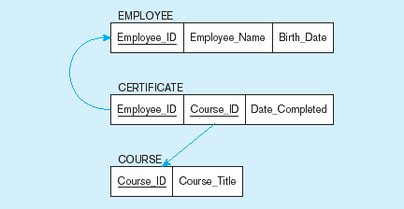
Example of mapping an M:N relationship (cont.)
b) Three resulting relations
Composite primary key
Foreign key
New intersection relation
Foreign key

Slide 20
Transforming EER Diagrams into Relations (cont.)
Mapping Associative Entities
Identifier Not Assigned
Default primary key for the association relation is composed of the primary keys of the two entities (as in M:N relationship)
Identifier Assigned
It is natural and familiar to end-users
Default identifier may not be unique

Slide 21
Example of mapping an associative entity
a) An associative entity

Slide 22
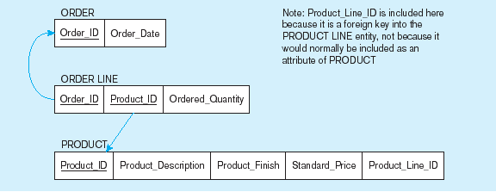
Example of mapping an associative entity (cont.)
b) Three resulting relations
Composite primary key formed from the two foreign keys

Slide 23
Example of mapping an associative entity with
an identifier
a) SHIPMENT associative entity

Slide 24
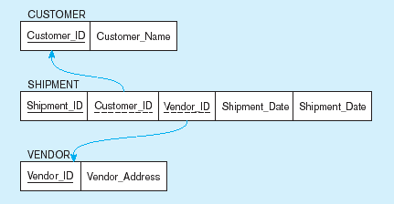
Example of mapping an associative entity with
an identifier (cont.)
b) Three resulting relations
Primary key differs from foreign keys

