Slide 1
Fuel Cell

Slide 2
Video links
https://www.youtube.com/watch?v=RuGwERz0yGg
https://www.youtube.com/watch?v=OmVnIIgDA7o
https://www.youtube.com/watch?v=6oeN9VDFLig
https://www.youtube.com/watch?v=MQG87a8EwzY
https://www.youtube.com/watch?v=5_lDGna9MBM

Slide 3
Discovered German Scientist G H Shoenbein
First developed by William Grove
In 1839, Grove was experimenting on electrolysis (the process by which water is split into hydrogen and oxygen by an electric current), when he observed that combining the same elements could also produce an electric current

Slide 4
1930s -1950s Francis Thomas Bacon, a British scientist, worked on developing alkaline fuel cells.
He demonstrated a working stack in 1958.
The technology was licensed to Pratt and Whitney where it was utilized for the Apollo spacecraft fuel cells.

Slide 5
Fuel Cell
What is a Fuel Cell ?
Electrochemical energy conversion device.
Converts the chemicals hydrogen and oxygen into water.
Generates electricity by a chemical reaction.
Every fuel cell has two electrodes, one positive and one negative, cathode and anode respectively. The reactions that produce electricity take place at the electrodes.

Slide 6
Why we need Fuel Cells ?
Due to energy crisis all over the world.
Due to the issue of global warming.
Due to the unavailability of different renewable sources at each and every place due to geographic condition.
Fuel cell provides an alternate efficient non polluting power source that produces no noise and has no moving parts.
It is expected that by 2050 the global energy demand is going to rise by 2 to 3 times.

Slide 7
Ordinary Combustion process of fuel is
Combustion Products
Fuel
Oxygen
Heat

Slide 8
The process of fuel cell is
Oxidation Products
Fuel
Oxygen
Electricity

Slide 9
Electrical Energy
Chemical Energy
Mechanical Energy
Heat

Slide 10
Fuel cell consists of electrodes, electrolyte & catalyst to facilitate the electrochemical redox reaction.
The basic arrangement in a fuel cell can be represented
as follows:
Fuel
Electrode
Electrolyte
Electrode
Oxidant

Slide 11
Chemical energy of fuel = Electrical energy + Heat energy
Basic energy conversion of a fuel cell can be described as:
The input energy is that produced during reactions at the electrodes.

Slide 12
Performance
One measure of the energy conversion efficiency of a fuel cell is the ratio of the actual voltage at a given current density to the maximum voltage obtained under no load (open circuit) conditions.
Ƞ = On load voltage / theoretical open circuit voltage

Slide 13
PARTS OF A FUEL CELL
Anode
Negative post of the fuel cell.
Conducts the electrons that are freed from the hydrogen molecules so that they can be used in an external circuit.
Etched channels disperse hydrogen gas over the surface of catalyst.
Cathode
Positive post of the fuel cell
Etched channels distribute oxygen to the surface of the catalyst.
Conducts electrons back from the external circuit to the catalyst
Recombine with the hydrogen ions and oxygen to form water.
Electrolyte
Proton exchange membrane.
Specially treated material, only conducts positively charged ions.
Membrane blocks electrons.
Catalyst
Special material that facilitates reaction of oxygen and hydrogen
Usually platinum powder very thinly coated onto carbon paper or cloth.
Rough & porous maximizes surface area exposed to hydrogen or oxygen
The platinum-coated side of the catalyst faces the PEM.

Slide 14
Fuel cell consist of
Anode & Cathode
Materials which have high electron conductivity & zero proton conductivity in the form of porous catalyst (porous catalyst or carbon).
Catalyst
Platinum
Electrolyte
High proton conductivity & zero electron conductivity.

Slide 15
Design, Principle and Operation
The core of each fuel cell consists of an electrolyte and two electrodes.
At the negative anode, a fuel such as hydrogen is being oxidized, while at the positive cathode, oxygen is reduced. Ions are transported through the electrolyte from one side to the other.
Chemistry of fuel cell:
At Anode:- 2H₂ → 4H+ + 4e-
At Cathode:- O₂ + 4H+ + 4e- → 2H₂O Net Reaction: 2H₂ + O₂ → 2H₂O

Slide 16
FUEL CELL OPERATION
Pressurized hydrogen gas (H₂) enters cell on anode side.
Gas is forced through catalyst by pressure.
When H₂ molecule comes contacts platinum catalyst, it splits into two H+ ions and two electrons (e-).
Electrons are conducted through the anode
Make their way through the external circuit (doing useful work such as turning a motor) and return to the cathode side of the fuel cell.
On the cathode side, oxygen gas (O₂) is forced through the catalyst
Forms two oxygen atoms, each with a strong negative charge.
Negative charge attracts the two H+ ions through the membrane,
Combine with an oxygen atom and two electrons from the external circuit to form a water molecule (H O).

Slide 17
2H → 4H⁺ + 4e⁻
The Fuel cell can be represented as:
At anode
2
At Cathode
O₂ + 4H⁺ + 4e⁻ → 2H₂O
Overall Reaction
2H₂ + O₂ → 2H₂O
Large number of these cells are stacked together in series to make a battery called as fuel cell battery or fuel battery.

Slide 18
PEM FUEL CELL SCHEMATIC

Slide 19
PROTON-EXCHANGE MEMBRANE CELL
http://www.news.cornell.edu/releases/Nov03/Fuelcell.institute.deb.html

Slide 21
This electrochemical reaction generates electrons, which flow from the anode to an external load and back to the cathode,
 a final step that both completes the circuit and supplies electric power.
To increase voltage output, several fuel cells are stacked together to form the heart of a clean power generator.

Slide 25
Defining the work term
Electrical work is, in general, described by the relation:
W = EIΔt
where E is the cell voltage and I is the current
In a fuel cell reaction, electrons are transferred from the anode to the cathode, generating a current.
The amount of electricity (IΔt) transferred when the reaction occurs is given by NF, where
N = number of electrons transferred
F = Faraday’s constant = 96,493 coloumbs
So the electrical work can be calculated as:
W = NFE (Work done on the surrounding)

Slide 26
Fuel Cell Efficiency
Since fuel cells use materials that are typically burnt to release their energy, the fuel cell efficiency is described as the ratio of the electrical energy produced to the heat that is produced by burning the fuel.
From the basic definition of efficiency: η = W / Qin
Hydrogen fuel cell: Oxidation half reaction 2H
4H⁺ ⁺ 4e-
4e- 2H₂O
Energy formation (KJ/mole)
-ΔHo = 286 -ΔGo = 237
Reduction half reaction O₂ + 4H⁺ ⁺
The maximum efficiency of the fuel cell would be 83%.

Slide 27
Classification of Losses in an Actual Fuel Cell
Activation Losses: These losses are caused by the slowness of the reaction taking place on the surface of the electrodes. A proportion of the voltage generated is lost in driving the chemical reaction that transfers the electrons.
Ohmic Losses: The voltage drop due to the resistance to the flow of electrons
through the material of the electrodes. This loss varies linearly with current density.
Concentration Losses: Losses that result from the change in concentration of the reactants at the surface of the electrodes as the fuel is used.
Fuel Crossover Losses: Losses that result from the waste of fuel passing through the electrolyte and electron conduction through the electrolyte. This loss is typically small, but can be more important in low temperature cells.

Slide 28
Types of Fuel Cell
Based on the temperature range in which they operate:
Low temperature(25- 100),
Medium temperature (100-500) ,
High temperature(500-1000) &
very high temperature(above 1000)
According to the type of electrolyte :
aqueous, non aqueous, molten or solid.
According to the physical state of the fuel:
Gas(hydrogen, lower hydrocarbons), Liquid(alcohols, hydrazine, higher hydrocarbons), Solid(Metals).

Slide 29
Another Classification :
Primary fuel cell: Reactants are passed through the cell only once & the products of the reaction being discarded. (H₂– O₂ fuel cell )
Secondary fuel cell: Reactants are passed through the cell many times because they are regenerated by different methods.( Nitric oxide – chlorine fuel cell)
Classification based on types of fuel used:
Hydrogen
Fossil Fuel
Ammonia fuel.
Hydrazine fuel.

Slide 30
Hydrogen Oxygen cell
40% KOH solution as electrolyte (Ion exchange membrane).
The membrane is non permeable to the reactant gases, hydrogen and oxygen, which thus prevents them from coming into contact.
The membrane is however , permeable to hydrogen ions which are the current carriers in the electrolyte.
The desired properties of an ideal ion exchange membrane electrolyte are:
High ionic conductivity.
Zero electronic conductivity
Low permeability of fuel and oxidant
Low degree of electro-osmosis.
High resistance to dehydration.
High resistance to its oxidation or hydrolysis and,
Mechanical stability

Slide 31
HYDROGEN FUEL CELL EFFICIENCY
40% efficiency converting methanol to hydrogen in reformer
80% of hydrogen energy content converted to electrical energy
80% efficiency for inverter/motor
Converts electrical to mechanical energy
Overall efficiency of 24-32%

Slide 32
Fossil Fuel Cell
The most interesting fuel cells for the near future are modified hydrogen- oxygen cells, in which a gaseous or liquid hydrocarbon is the source of hydrogen.
Coal may be serve as the primary energy source for fuel cells. Cells based on fossil fuels have three main components.
The fuel processor which converts the fossil fuel into a hydrogen rich gas.
The power section consisting of the actual fuel cell (or combination of cells), and
The inverter for changing the direct current generated by the fuel cell into alternating current to be transmitted to user.

Slide 34
Ammonia as a Fuel
Ammonia gas obtained from the stored liquid is decomposed catalytically into hydrogen and nitrogen.
Part of the hydrogen is burned in air to provide the heat required for the decomposition.
Other hydrogen is supplied to the negative electrode of the hydrogen cell in which potassium hydroxide is used as electrolyte.
The nitrogen produced due to decomposition is an inert gas and plays no roll in the cell.
Advantage - It can be stored in the liquid form.
Disadvantage - Higher vapour pressure and cell operate satisfactory at low temperature.

Slide 35
Hydrazine N₂H₂ as a fuel
For mobile application for vehicle propulsion utilizes the liquid hydrazine as a fuel and hydrogen peroxide or air as the energy source.
Hydrazine is injected as required into the aqueous potassium hydroxide electrolyte to provide the active material at the negative electrode.
The oxygen is either supplied by decomposition or from air.
The electrode is made up of nickel (negative) or silver (positive) as the electrochemical catalyst.
The overall cell reaction is the oxidation of hydrazine to water and nitrogen, but the discharged e.m.f is similar to that of the hydrogen oxygen cell.

Slide 36
OTHER TYPES OF FUEL CELLS
Alkaline fuel cell (AFC)
This is one of the oldest designs. It has been used in the U.S. space program since the 1960s. The AFC is very susceptible to contamination, so it requires pure hydrogen and oxygen. It is also very expensive, so this type of fuel cell is unlikely to be commercialized.
Phosphoric-acid fuel cell (PAFC)
The phosphoric-acid fuel cell has potential for use in small stationary power-generation systems. It operates at a higher temperature than PEM fuel cells, so it has a longer warm-up time. This makes it unsuitable for use in cars.
http://www.howstuffworks.com/fuel-cell.htm/printable

Slide 37
Solid oxide fuel cell (SOFC)
These fuel cells are best suited for large-scale stationary power generators that could provide electricity for factories or towns. This type of fuel cell operates at very high temperatures (around 1,832 F, 1,000 C). This high temperature makes reliability a problem, but it also has an advantage: The steam produced by the fuel cell can be channeled into turbines to generate more electricity. This improves the overall efficiency of the system.
Molten carbonate fuel cell (MCFC)
These fuel cells are also best suited for large stationary power generators. They operate at 1,112 F (600 C), so they also generate steam that can be used to generate more power. They have a lower operating temperature than the SOFC, which means they don't need such exotic materials. This makes the design a little less expensive.

Slide 38
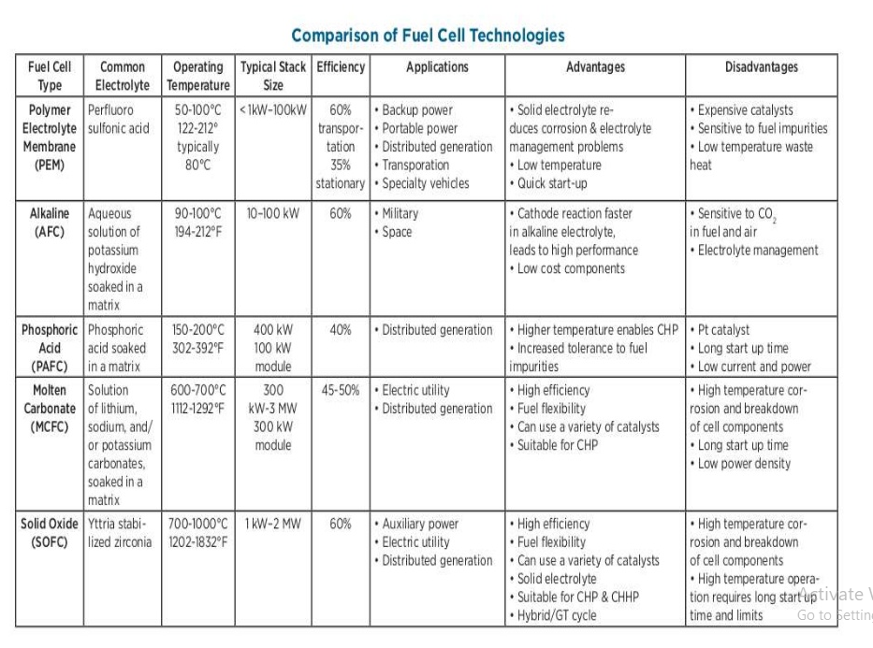

Slide 39
Advantages of Fuel Cells
High efficiency of energy conversion (approaching 70%) from chemical energy to electrical energy.
Low noise pollution & low thermal pollution.
Fuel cell power can reduce expensive transmission lines & minimize transmission loses for a disturbed system.
Fuel cells gives excellent method for efficient use of fossil fuels hence saves fossil fuels.
Fuel cells are less polluting. The chemical process involved in it is clean. It does not produce polluting exhaust. Mostly the byproducts are water & waste heat, which are environmentally acceptable when hydrogen & air are used as reactants.

Slide 40
Advantages of Fuel Cells
6. In case of fossil fuels, when used as
not
reactants, environmentally undesirable NO_{x} are
produced since there is no combustion in the process.
Hydrogen-Oxygen fuel cells produce drinking water of potable quality.
Designing is modular, therefore the parts are exchangeable.
Low maintenance cost.
Fuel cell performance is independent of power plant size. The efficiency does not depend on the size of power plant. It remains same for the plants of MW or kW or W size.

Slide 41
Advantages of Fuel Cells
Fast start up time for low temperature system.
The heat is cogenerated hence increases efficiency of high temperature system.
The demand for variations in power & energy densities is easily met as required. e.g. Laptop, computers requires low power density & high energy density where as automobile requires high power density, high energy density. Both can be powered by fuel cells.
Fuel cells automotive batteries can render electric vehicles, efficient & refillable.

Slide 42
Advantage of Fuel Cell
Fuel cell system are ecofriendly.
High conversion efficiency .
Extremely low emission.
Noise less operations so readily accepted in residential areas.
Availability to use at any location. So less transmission & distribution losses.
No requirements of cooling tower as conventional plants.
Less space require as compared to conventional plants.

Slide 43
Disadvantages of Fuel Cell
Higher Initial Cost.
Lower Service Life.
Fuelling fuel cells is still a major problem since the production, transportation, distribution and storage of hydrogen is difficult.
The technology is not yet fully developed and few products are available.
Fuel cells are currently very expensive to produce, since most units are handmade.

Slide 44
Application
The application of the fuel cell may be discussed in the following areas.
Domestic Power
Central Power Station.
Automotive Vehicles.
Special Application

Slide 45
AUTO POWER EFFICIENCY COMPARISON
System Efficiency
Technology
Fuel Cell Electric Battery Gasoline Engine
24-32%
26%
20%

Slide 46
FUEL CELL ENERGY EXCHANGE
http://hyperphysics.phy-astr.gsu.edu/hbase/thermo/electrol.html

