Slide 1
Lecture 4

Slide 2
Balanced 3 Phase (φ) Systems
A balanced 3 phase (φ) system has
three voltage sources with equal magnitude, but with an angle shift of 120°
equal loads on each phase
equal impedance on the lines connecting the generators to the loads
Bulk power systems are almost exclusively 3φ
Single phase is used primarily only in low voltage, low power settings, such as residential and some commercial

Slide 3
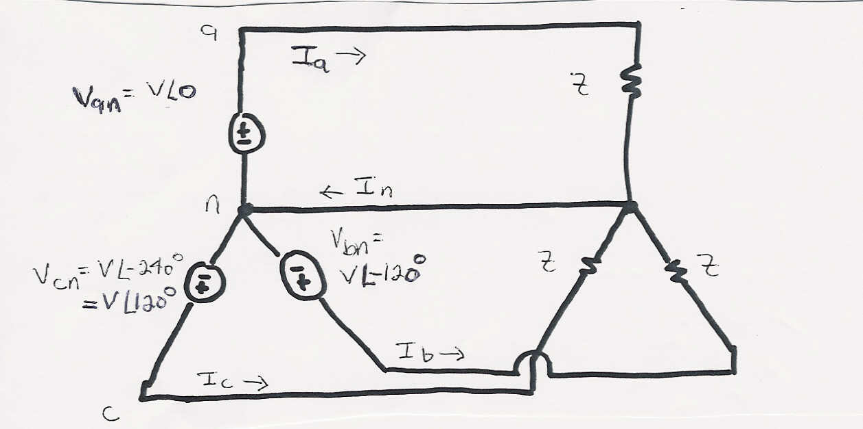
Balanced 3φ -- No Neutral Current

Slide 4
Advantages of 3φ Power
Can transmit more power for same amount of wire (twice as much as single phase)
Torque produced by 3φ machines is constrant
Three phase machines use less material for same power rating
Three phase machines start more easily than single phase machines

Slide 5
Three Phase - Wye Connection
There are two ways to connect 3φ systems
Wye (Y)
Delta (Δ)

Slide 6
Wye Connection Line Voltages
V_{cn}
V_{ab}
V_{ca}
-V_{bn}
V_{an}
V_{bn}
(α = 0 in this case)
V_{bc}
Line to line
voltages are
also balanced

Slide 7
Wye Connection, cont’d
Define voltage/current across/through device to be phase voltage/current
Define voltage/current across/through lines to be line voltage/current

Slide 8
Delta Connection
I_{ca}
I_{c}
I_{b}
I_{ab}
I_{bc}
I_{a}

Slide 9
Three Phase Example
Assume a Δ-connected load is supplied from a 3φ 13.8 kV (L-L) source with Z = 100∠20°Ω

Slide 10
Three Phase Example, cont’d

Slide 11
Delta-Wye Transformation

Slide 12
Delta-Wye Transformation Proof

Slide 13
Delta-Wye Transformation, cont’d

Slide 14
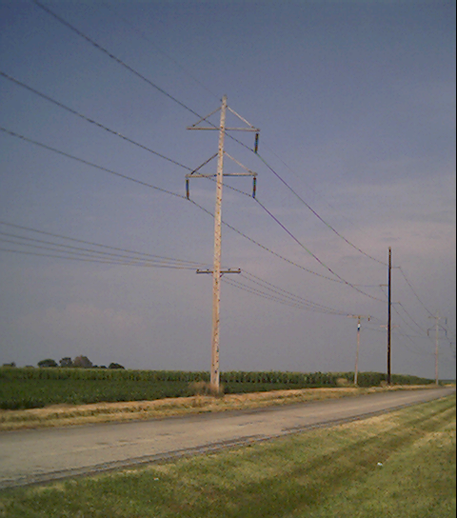
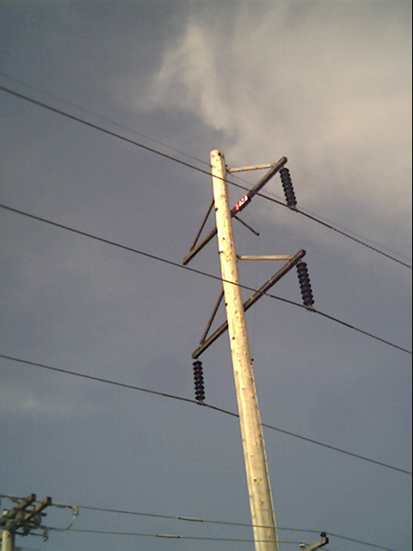
Three Phase Transmission Line

