Slide 1
Market Equilibrium: CAPM and APT

Slide 2
Early Empirical Tests
Tests of the CAPM are based on three implications of the relation between expected return and market beta implied by the model.
Expected returns on all assets are linearly related to their betas, and no other variable has marginal explanatory power.
The beta premium is positive, meaning that the expected return on the market portfolio exceeds the expected return on assets whose returns are uncorrelated with the market return.
In the Sharpe-Lintner version of the model, assets uncorrelated with the market have expected returns equal to the risk-free interest rate, and the beta premium is the expected market return minus the risk-free rate.

Slide 3
1. Tests on Risk Premiums
The early cross-section regression tests focus on the Sharpe-Lintner model’s predictions about the intercept and slope in the relation between expected return and market beta
To regress a cross-section of average asset returns on estimates of asset betas.
The model predicts that the intercept in these regressions is the risk-free interest rate, Rf , and the coefficient on beta is the expected return on the market in excess of the risk-free rate, E(RM) - Rf.

Slide 4
1. Tests on Risk Premiums (…continued)
Two problems in these tests aroused
Estimates of beta for individual assets are imprecise, creating a measurement error problem when they are used to explain average returns
The regression residuals have common sources of variation, such as industry effects in average returns
Positive correlation in the residuals produces downward bias in the usual ordinary least squares estimates of the standard errors of the cross-section regression slopes.

Slide 5
1. Tests on Risk Premiums (…continued)
To improve the accuracy of estimated betas, researchers work with portfolios, rather than individual securities
Grouping, however, shrinks the range of betas and reduces statistical power.
To mitigate this problem, researchers sort securities on beta when forming portfolios; the first portfolio contains securities with the lowest betas, and so on, up to the last portfolio with the highest beta assets.
Estimating month-by-month cross-section regressions of monthly returns on betas - Fama and MacBeth (1973).
Notes:
To improve the accuracy of estimated betas, researchers work with portfolios, rather than individual securities. Since expected returns and market betas combine in the same way in portfolios, if the CAPM explains security returns it also explains portfolio returns. Estimates of beta for diversified portfolios are more precise than estimates for individual securities. Thus, using portfolios in cross-section regressions of average returns on betas reduces the critical errors in variables problem.
Instead of estimating a single cross-section regression of average monthly returns on betas, Fama and MacBeth estimate month-by-month cross-section regressions of monthly returns on betas. The times-series means of the monthly slopes and intercepts, along with the standard errors of the means, are then used to test whether the average premium for beta is positive and whether the average return on assets uncorrelated with the market is equal to the average risk-free interest rate.

Slide 6
1. Tests on Risk Premiums (Conclusion)
The early tests firmly reject the Sharpe-Lintner version of the CAPM
There is a positive relation between beta and average return, but it is too “flat”
The regressions consistently find that
The intercept is greater than the average risk-free rate
The beta coefficient is less than the average excess market return
This relation is also confirmed by time-series tests
Where the intercepts excess asset returns return are positive for assets with low betas and negative for assets with high betas
Notes:
Recall that, in cross-section regressions, the Sharpe-Lintner model predicts that the intercept is the risk-free rate and the coefficient on beta is the expected market return in excess of the risk-free rate, E(RM) - Rf.

Slide 7
2. Testing Whether Market Betas Explain Expected Returns
As CAPM predict that the market portfolio is mean-variance-efficient
This implies that differences in expected return across securities and portfolios are entirely explained by differences in market beta; other variables should add nothing to the explanation of expected return.
Methods can be used
cross-section regressions
Fama and MacBeth (1973)’s month-by-month cross-section regressions
Time-series regressions

Slide 8
2. Testing Whether Market Betas Explain Expected Returns (Conclusion)
The prediction of Sharpe-Lintner CAPM that the premium per unit of beta is the expected market return minus the risk-free interest rate is consistently rejected (Fama & French. 2004)

Slide 9
CAPM Challenges
Assumptions
Risk-free borrowing & lending (Black, 1972), Taxation (Brennan, 1983), International setting (Solnik, 1974)…
Beta
Pama and French (1992) flat and uncertain relationship
Tests to implement
Roll (1977): the CAPM is not testable...
Anomalies
M/B (Statman, 1980), size effect (Banz, 1981), momentum..

Slide 10
“The version of the CAPM developed by Sharpe (1964) and Lintner (1965) has never been an empirical success.”
“The CAPM, like Markowitz’s (1952, 1959) portfolio model on which it is built, is nevertheless a theoretical tour de force. We continue to teach the CAPM as an introduction to the fundamental concepts of portfolio theory and asset pricing, […]. But we also warn students that despite its seductive simplicity, the CAPM’s empirical problems probably invalidate its use in applications”.
Fama and French (2004, p.43)
Notes:
“tour de force”: A performance or achievement that has been accomplished or managed with great skill.

Slide 11
“If betas do not suffice to explain expected returns, the market portfolio is not efficient, and the CAPM is dead in its tracks.”
Fama and French (2004, p.43)

Slide 12
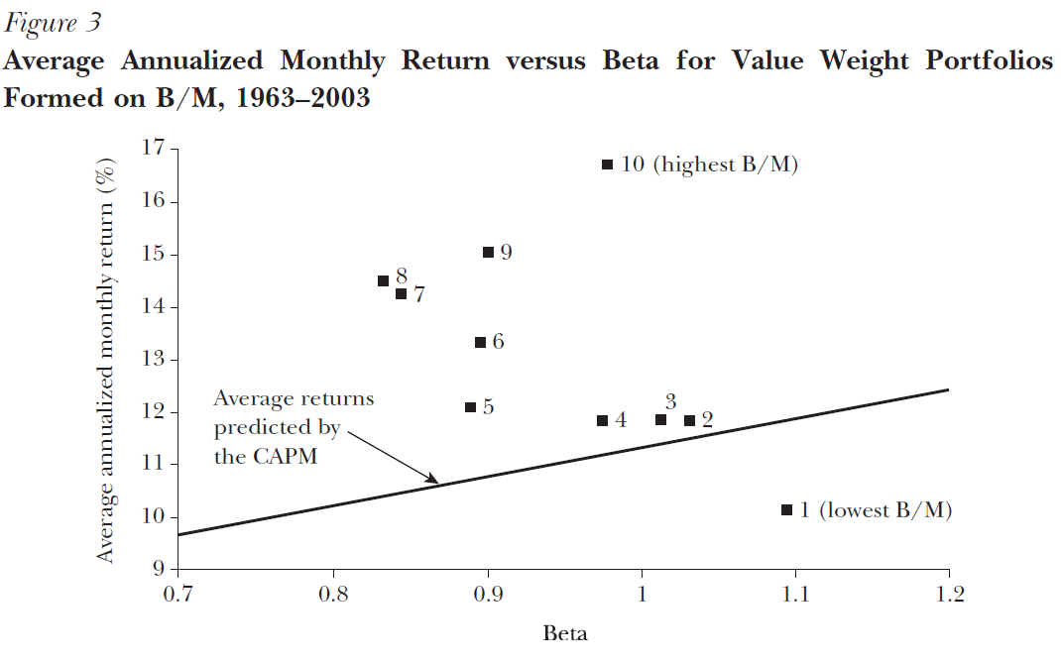
Notes:
Average returns on the B/M portfolios increase almost monotonically, from 10.1 percent per year for the lowest B/M group (portfolio 1) to an impressive
16.7 percent for the highest (portfolio 10). But the positive relation between beta and average return predicted by the CAPM is notably absent.
For example, the portfolio with the lowest book-to-market ratio has the highest beta but the lowest average return.
In short, CAPM is not practical. It should be improved. And there must be some other factors, that could explain the relationship.

Slide 13
Arbitrage Pricing Theory - Ross (1976)
APT offers a testable alternative to the capital asset pricing model
The CAPM predicts that security rates of return will be linearly related to a single common factor—the rate of return on the market portfolio
The APT is based on similar intuition but is much more general - assumes that the rate of return on any security is a linear function of k factors:

Slide 14
APT | Factors
Risk premium, inflation, interest rates... (Roll and Ross, 1980)
Confidence risk, time horizon risk, market risk... (Butmeister, Roll and Ross, 1994)
Size, net income growth, dividend yield, leverage... (Grinhold and Kahn, 1994)

Slide 15
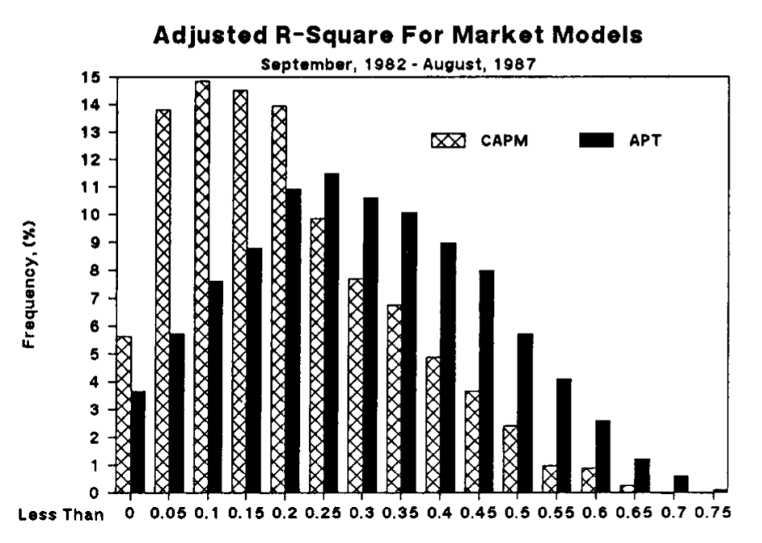
Source : Roll, 1988, p.544
Notes:
As Figure reveals quite clearly, the entire distribution of R-square is displaced to a somewhat higher level for the multiple-factor model (APT), relative to the single factor model (CAPM). The mean R-squares were, 0.179 for the CAPM and 0.244 for the APT. Of the 2030 stocks, 1571 (77.4 percent) had a higher R-square with the multiple-factor model.

Slide 16
“The average explanatory power of well-accepted market models is quite modest, but there are some firms with impressive R²s (in either a single- or a multiple-factor regression), and perhaps a study of these firms would help us understand why the explanatory power is rather limited for the average firm.”
Roll, 1988

