Slide 1
Data Communication & Networks
Chapter 4
Digital Transmission

Slide 2
Introduction
The user data can be in one of two formats:
Analog: Human voice as converted by typical home telephones
Digital: Computer files
The transmitted signals, representing the data, can also be in one of two formats:
Analog or Digital
The conversion of the user data into a transmission signal is called Encoding.
2

Slide 3
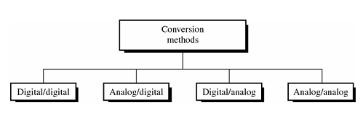
Encoding Techniques
3
In data communications, the user data must be put in a format (signal) suitable for the transmission media (nature, quality, length, etc.)

Slide 4
Encoding: Data-Signal Conversion
4
There are four possible cases:
Digital data, digital signals: We use Line Coding. Less complex and less expensive.
Analog data, digital signals: We use A/D conversion for voice and video.
Digital data, analog signals: We use Digital Modulation for optical fiber and unguided media.
Analog data, analog signals:We use Analog Modulation to transmit base-band signal easily and cheaply.

Slide 5
Analog Signals Carrying Analog and Digital Data

Slide 6
Digital Signals Carrying Analog and Digital Data

Slide 7
Digital Data, Digital Signal
7
Digital signal
Discrete, discontinuous voltage pulses
Each pulse is a signal element
Binary data encoded into signal elements

Slide 8
DIGITAL-TO-DIGITAL CONVERSION
In this section, we see how we can represent digital data by using digital signals. The conversion involves three techniques:
Line coding
Block coding
Scrambling.
Line coding is always needed; block coding and scrambling may or may not be needed.

Slide 9
Line coding is the process of converting digital data to digital signals. We assume that data, in the form of text, numbers, graphical images, audio, or video, are stored in computer memory as sequences of bits.
Figure 4.1 Line coding and decoding

Slide 10
Signal Element Versus Data Element
In data communications, our goal is to send data elements.
A data element is the smallest entity that can represent a piece of information: this is the bit.
In digital data communications, a signal element carries data elements.
A signal element is the shortest unit (timewise) of a digital signal.
In other words, data elements are what we need to send; signal elements are what we can send.
Data elements are being carried; signal elements are the carriers.

Slide 11
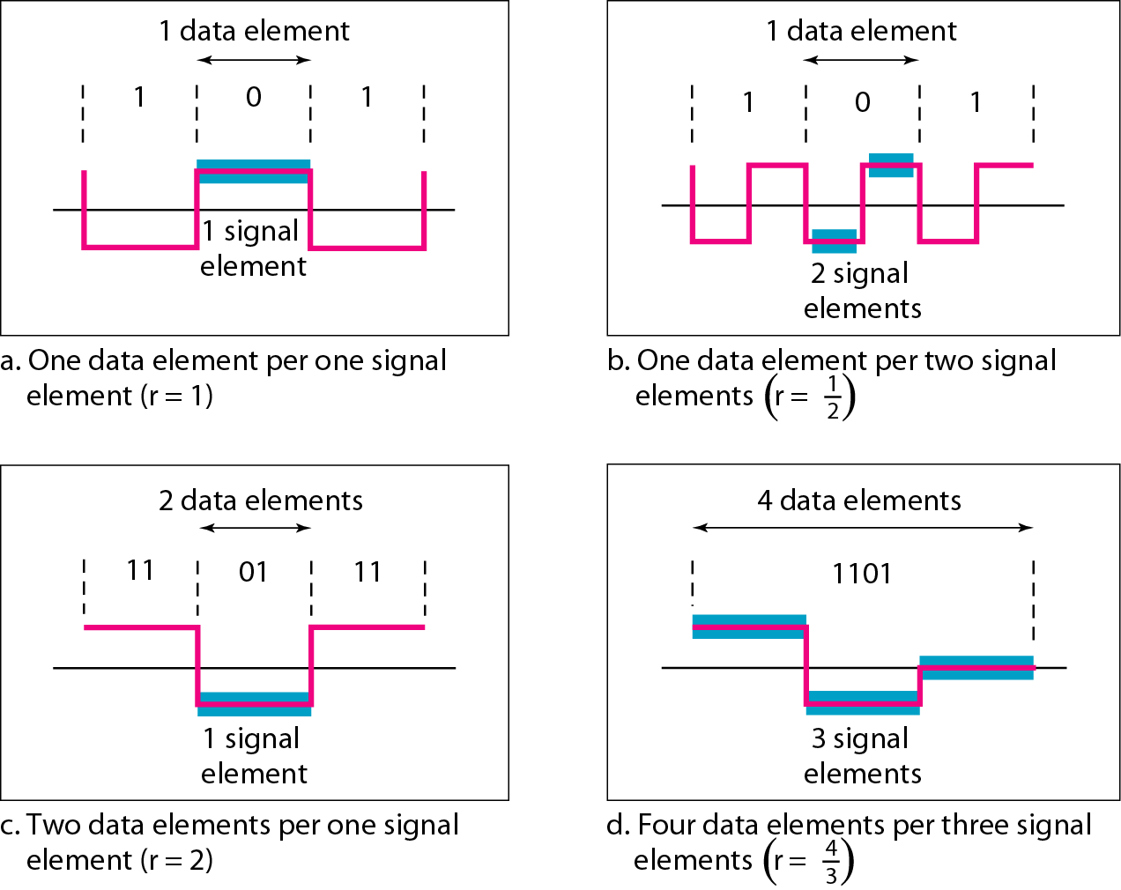
We define a ratio r which is the number of data elements carried by each signal element.
Figure 4.2 shows several situations with different values of r.
Figure 4.2 Signal element versus data element

Slide 12
Data Rate Versus Signal Rate
The data rate defines the number of data elements (bits) sent in 1 s.
The unit is bits per second (bps).
The signal rate is the number of signal elements sent in Is. The unit is the baud.
The data rate is sometimes called the bit rate; the signal rate is sometimes called the pulse rate, the modulation rate, or the baud rate.

Slide 13
Datarate and Signal Rate
We now need to consider the relationship between data rate and signal rate (bit rate and baud rate).
This relationship, of course, depends on the value of r.
It also depends on the data pattern C.
If we have a data pattern of all 1 s or all 0s, the signal rate may be different from a data pattern of alternating 0s and 1 s.

Slide 14
Baseline Wandering
In decoding a digital signal, the receiver calculates a running average of the received signal power.
This average is called the baseline.
The incoming signal power is evaluated against this baseline to determine the value of the data element.
A long string of 0s or 1 s can cause a drift in the baseline (baseline wandering) and make it difficult for the receiver to decode correctly.
A good line coding scheme needs to prevent baseline wandering.

Slide 15
DC Components
When the voltage level in a digital signal is constant for a while, the spectrum creates very low frequencies.
These frequencies around zero, called DC (direct-current) components, present problems for a system that cannot pass low frequencies.
For example, a telephone line cannot pass frequencies below 200 Hz.
Also a long-distance link may use one or more transformers to isolate different parts of the line electrically.
For these systems, we need a scheme with no DC component.

Slide 16
Self-synchronization
To correctly interpret the signals received from the sender, the receiver's bit intervals must correspond exactly to the sender's bit intervals.
If the receiver clock is faster or slower, the bit intervals are not matched and the receiver might misinterpret the signals.

Slide 17
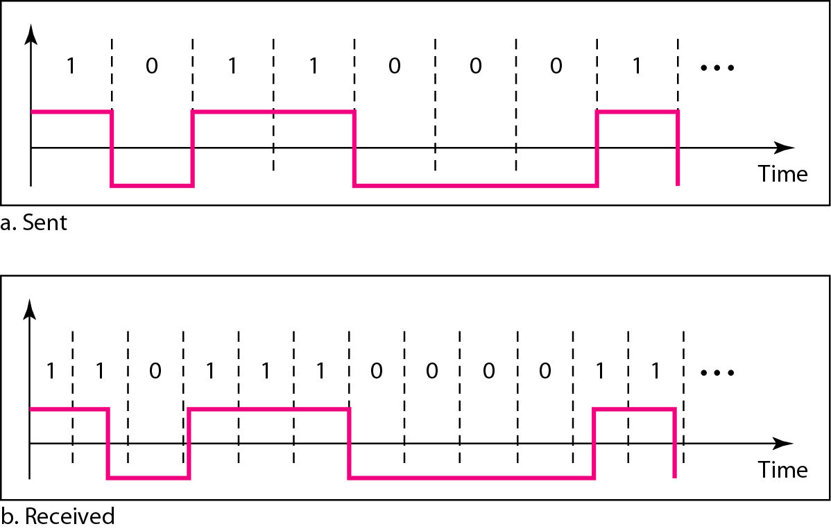
Figure 4.3 Effect of lack of synchronization
A self-synchronizing digital signal includes timing information in the data being transmitted. This can be achieved if there are transitions in the signal that alert the receiver to the beginning, middle, or end of the pulse. If the receiver' s clock is out of synchronization, these points can reset the clock.

Slide 18
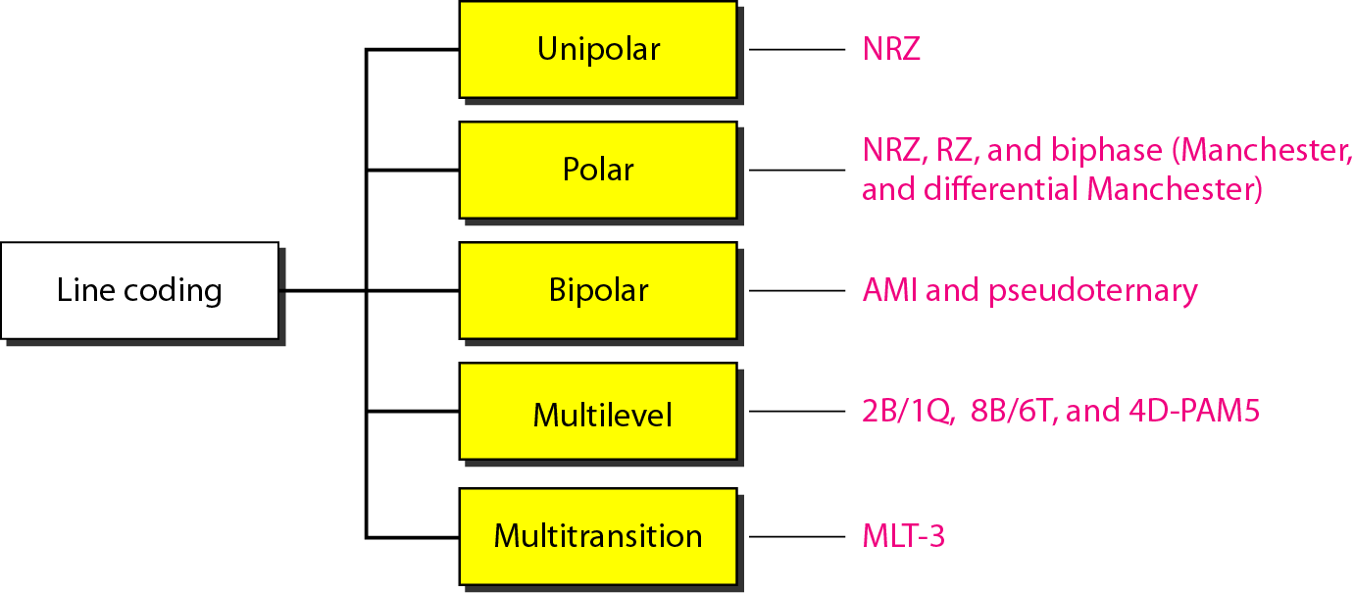
Figure 4.4 Line coding schemes

Slide 19
Unipolar Encoding
Unipolar uses only one signal level (one polarity)
High voltage is binary “1”
No voltage is binary “0”
Unipolar encoding is easy to implement. However:
Not self-synchronized
Has a DC component
19

Slide 20
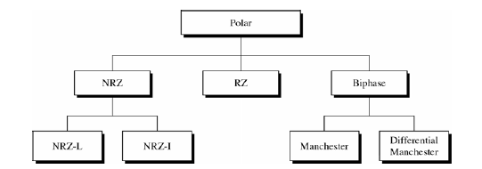
Types of Polar Encoding
Polar encoding uses two signal levels
Positive & Negative Polarities
20

Slide 21
Non-Return to Zero (NRZ) Encoding
NRZ encoding can be of two types:
NRZ-Level (NRZ-L)
“0” is encoded with one polarity, say “+5V”
“1” is encoded with another polarity, say “-5V”
NRZ-Invert (NRZ-I)
“0” is encoded with no change in polarity from previous bit
“1” is encoded with a change in polarity from previous bit
NRZ-I provides better synchronization than NRZL if “1” bits exist in data stream
A stream of many “0” can still cause synch. problems
21

Slide 22
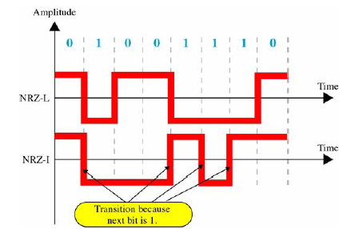
NRZ-L and NRZ-I Encoding
22

Slide 23
Return to Zero (RZ) Encoding
23
We have seen that:
NRZ-L has poor synch. Performance
NRZ-I has better synch. for streams of “1” but faces the same problem for streams of “0”
RZ encoding overcomes this synch. issue by using three voltage levels: Positive, Negative and Zero
“1” is encoded as: (“+V”, Transition “+V ↓ 0V”)
“0” is encoded as: (“ −V”, Transition “−V ↑ 0V”)
RZ is less spectrally efficient than NRZ because it has more transitions i.e. higher freq. components.

Slide 24
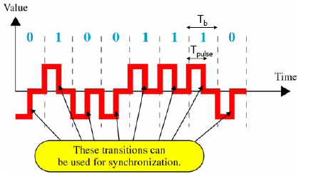
RZ Encoding
24

Slide 25
Manchester Encoding
25
Manchester uses a polarity inversion in the
middle of each bit period
Low to high represents one
High to low represents zero
This transition is used for bit representation as well as synch. purposes.
Manchester achieves the same level of synch. As RZ but with two voltage levels only

Slide 26
Diff. Manchester Encoding
26
Polarity inversion in the middle of each bit period (Tb) is used for synch. only
Transition at start of a bit period represents zero
No transition at start of a bit period represents one
Diff. Manchester requires two signal changes to represent “0” and one signal change to represent “1”

Slide 27
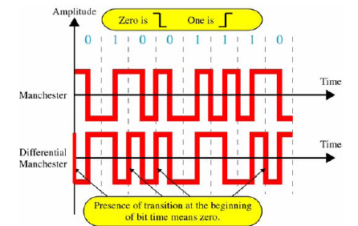
Manchester and Diff. Manchester Encoding
27

Slide 28
Manchester vs. Diff. Manchester
28
Both Manchester and Diff. Manchester encoding rely on signal transition to encode data
Both have better performance in the presence of noise than any encoding scheme that relies on the absolute voltage level to encode data
However, it is easy to lose sense of the polarity of a signal in a complex transmission layout

Slide 29
Biphase Pros and Cons
29
Con
At least one transition per bit time and possibly two
Maximum modulation rate is twice NRZ
Requires more bandwidth
Pros
Synchronization on mid bit transition (self clocking)
No dc component
Error detection

Slide 30
Bipolar Encoding
30
Bipolar encoding uses three voltage levels: Positive, Negative and Zero
“0” is encoded as: (“0V”)
“1” is encoded by alternating between (“+V”) and (“−V”)
If the first “1” is encoded as (“+V”) then the next “1” is encoded as (“−V”), and so on.
This alternation occurs in the case whether these “1”s are consecutive or not
Types of Bipolar Encoding
Alternate Mark Inversion (AMI)
Bipolar n-Zero Substitution (BnZS)
High Density Bipolar 3-Zero (HDB3)

Slide 31
Alternate Mark Inversion (AMI)
31
“Mark” means “1” in telegraphy
AMI means Alternate “1” Inversion
AMI alternates the voltage polarity for successive “1” bits
“0” bits will be represented by “0V”
AMI lacks self-synchronization for long streams of “0”
AMI encoding has no DC component

Slide 32
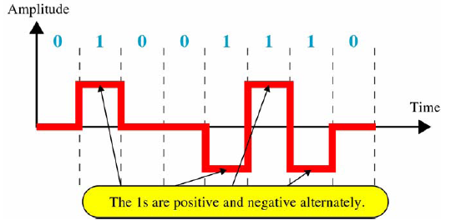
Bipolar AMI Encoding Example
32

Slide 33
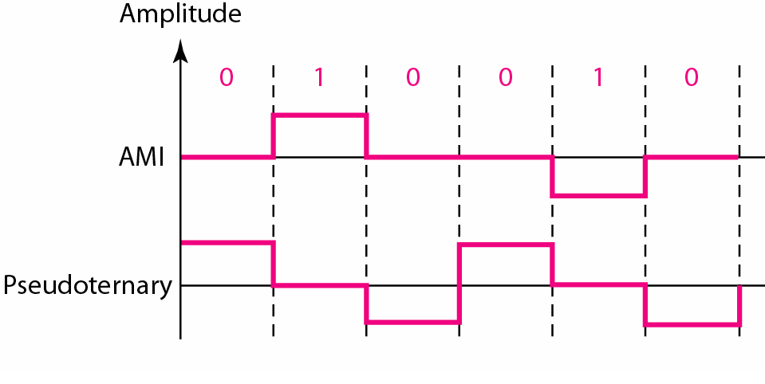
In bipolar encoding (sometimes called multilevel binary), we use three levels: positive, zero, and negative.
Figure 4.9 Bipolar schemes: AMI and pseudoternary
The bipolar scheme was developed as an alternative to NRZ. The bipolar scheme has the same signal rate as NRZ, but there is no DC component.

Slide 34
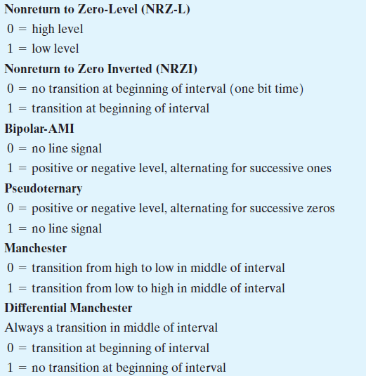

Slide 35
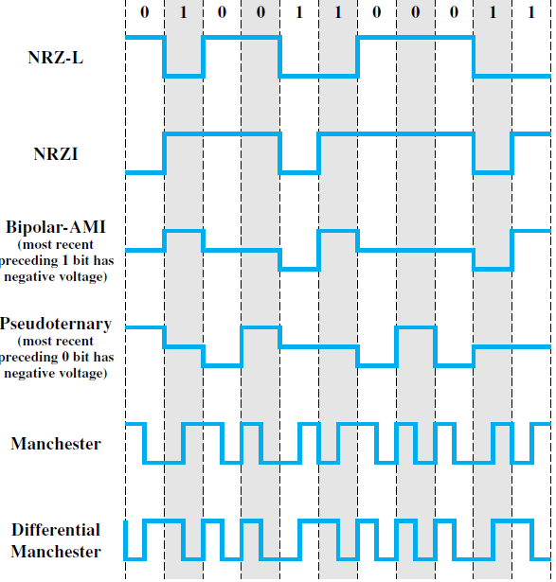

Slide 36
Thank You

