Slide 1
Satellite Communication Systems
Engr. Latif Jan
IQRA National University

Slide 2
Overview
Introduction
Applications
Types of satellites
ISL (Inter Satellite Links)
Routing
Handover
Conclusion
Questions

Slide 3
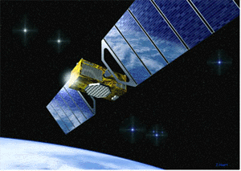
What is a satellite?
A satellite is simply any body that moves around another (usually much larger) one in a mathematically predictable path called an orbit
A communication satellite is a microwave repeater station in space that is used for telecommunication , radio and television signals
The first man made satellite with radio transmitter was launched in 1957
There are about 750 satellite in the space, most of them are used for communication

Slide 4
Communication satellites bring the world to you anywhere and any time…..

Slide 5
Working…
Two Stations on Earth want to communicate through radio broadcast but are too far away to use conventional means ?
The two stations can use a satellite as a relay station for their communication
One Earth Station transmits the signals to the satellite. Up link frequency is the frequency at which Ground Station is communicating with Satellite
The satellite Transponder converts the signal and sends it down to the second earth station. This frequency is called a Downlink frequency

Slide 6
Classical satellite systems
Inter Satellite Link (ISL)
Mobile User Link (MUL or UML)
Gateway Link (GWL)
MUL or UML
GWL
small cells (spotbeams)
base station
or gateway
footprint
ISDN
PSTN
GSM
PSTN: Public Switched
Telephone Network
User data

Slide 7
Advantages & Disadvantages
The advantages of satellite communication over terrestrial communication are…
The coverage area of a satellite is greater than that of a terrestrial system
Transmission cost of a satellite is independent of the distance from the center of the coverage area
Higher Bandwidths are available for use
The disadvantages of satellite communication are…
Cost involved in launching satellites into orbit is too high
Satellite bandwidth is gradually becoming used up
There is a larger propagation delay in satellite communication than in terrestrial communication

Slide 8
Applications…
General applications
Weather forecasting
Radio and TV broadcasting
Military purposes
Satellites for navigation and localization (e.g. GPS)
In context of mobile communication
Global telephone backbones (get rid of large cables)
Connections for communication in remote places or developing areas (for researchers in Antarctica)
Global mobile communication (satellites with lower orbits are needed like LEO’s)

Slide 9
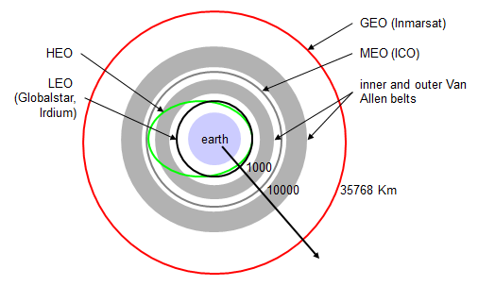
Types of orbits…
GEO: ~ 36000 km from the earth
MEO: 6000 - 20000 km
LEO: 500 - 1500 km
HEO: Highly Elliptical Orbit, elliptical orbits
Difficulties from radiation belts

Slide 10
Geostationary Earth Orbit (GEO)
Objects in Geostationary orbit revolve around the earth at the same speed as the earth rotates
This means GEO satellites remain in the same position relative to the surface of earth
Because of the long distance from earth it gives a large coverage area, almost a fourth of the earth’s surface
But, this distance also cause it to have both a comparatively weak signal and a time delay in the signal, which is bad for point to point communication.
High transmit power needed and launching of satellites to orbit are complex and expensive.
Not useful for global coverage for small mobile phones and data transmission, typically used for radio and TV transmission

Slide 11
Medium Earth Orbit (MEO)
MEO satellites have a larger coverage area than LEO satellites
A MEO satellite’s longer duration of visibility and wider footprint means fewer satellites are needed in a MEO network than a LEO network
A MEO satellite’s distance gives it a longer time delay and weaker signal than a LEO satellite, though not as bad as a GEO satellite

Slide 12
Low Earth Orbit (LEO)
LEO satellites are much closer to the earth than GEO satellites, ranging from 500 to 1,500 km above the surface
LEO satellites don’t stay in fixed position relative to the surface, and are only visible for 15 to 20 minutes each pass
A network of LEO satellites is necessary for LEO satellites to be useful
Handover necessary from one satellite to another
Need for routing

Slide 13
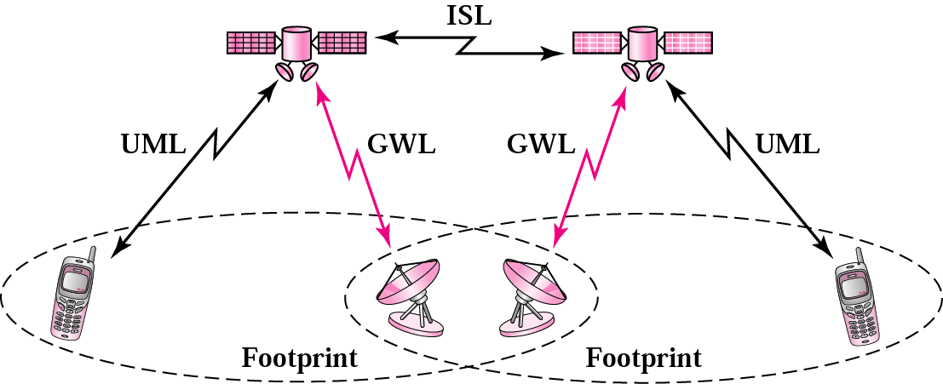
LEOS
ISL Inter Satellite Link
GWL – Gateway Link
UML – User Mobile Link

Slide 14
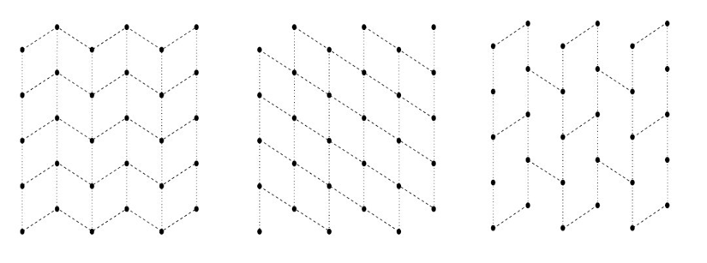
ISL (Inter Satellite Links)
Intra-orbital links: connect consecutive satellites on the same orbits
Inter-orbital links: connect two satellites on different orbits

Slide 15
Routing…
If satellites offer ISL’s
Traffic can be routed between satellites
Only one uplink and one downlink per direction needed for the connection of two mobile phones
Ability of routing within the satellite n/w reduces the number of gateways needed on earth
Else if, satellites do not offer ISL’s
Solution requires two uplinks and two downlinks

Slide 16
Routing Algorithms…
The principle of designing a routing algorithm is to satisfy two goals:
reduce the new call blocking probability, thus increase the system throughput and to achieve this…
a route should be as short as possible in order to minimize the resource usage
a route should avoid going through any congested ISL
reduce the forced termination probability, thus increase the reliability of a connection and to achieve this…
the routing algorithm should provide a larger set of candidate paths such that there is a higher chance of choosing a path for connection

Slide 17
Routing Algorithms…
Minimum Hops Algorithm (MHA)
Minimum Cost Algorithm (MCA)
Mesh Algorithm (MA)
Revised Mesh Algorithm (RMA)
and many more…

Slide 18
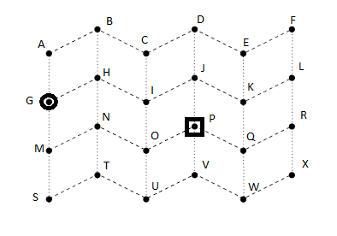
Minimum Hops Algorithm (MHA)
Given a pair of source and destination satellites, the MHA finds a path with minimum number of hops
The MHA can be implemented by the Dijkstra’s shortest algorithm with cost of each edge set to 1
Min-hop: 4
G-H-I-J-P, G-M-N-O-P,….

Slide 19
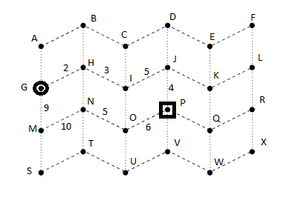
Minimum Cost Algorithm (MCA)
The cost of link is 1/vacancy, where vacancy is # of free channels in the link. The chosen path minimizes the sum of the cost of the ISL’s
G-M-N-O-P
(1/9)+(1/10)+(1/5)+(1/6)=0.57

Slide 20
Handover in satellite systems
More complex, due to motion of satellites
Intra satellite handover
Handover from one spot beam to another
Mobile station still in the footprint of the satellite, but in another cell
Inter satellite handover
Handover from one satellite to another satellite
Mobile station leaves the footprint of one satellite

Slide 21
Handover (Contd…)
Gateway handover
Handover from one gateway to another
Mobile station still in the footprint of a satellite, but satellite moves away from the current gateway
Inter system handover
Handover from the satellite network to a terrestrial cellular network
Mobile station can use a terrestrial network again which might be cheaper, have a lower latency.

Slide 22
Conclusions…
Satellite systems are not aimed to replace terrestrial system but at complementing them
GEO’s are ideal for TV and Radio broadcasting and they do not need handover because of its larger footprint
Lifetime of GEO’s are rather high, about 15 years
LEO’s need a network of satellites and are appropriate for voice communications
In LEO’s handover is frequent and routing is must
MEO’s are in between LEO’s and GEO’s in every aspect

Slide 23
References
Jochen H. Schiller “Mobile communications-second edition”
Ivan Stojmenovic “Handbook of Wireless Networks and Mobile Computing”
Peter T. S. Tam, John C. S. Lui, H. W. Chan, Cliff Cliff N. Sze, and C. N. Sze, “An optimized routing scheme and a channel reservation strategy for a low earth orbit satellite system”
www.google.com/images
http://www.authorstream.com/Presentation/Ravi4000-479427-satellite-communication/
http://www.authorstream.com/Presentation/girishkp-117951-introduction-satellite-communication-satellitemodule-1-science-technology-ppt-powerpoint/

Slide 24
Thank you ☺

