Slide 1
Solar Energy Convertion

Slide 2
Video Links
https://www.youtube.com/watch?v=Rq5Nzv_6v98
https://www.youtube.com/watch?v=UJ8XW9AgUrw
https://www.youtube.com/watch?v=L_q6LRgKpTw
https://www.youtube.com/watch?v=NkVAqwYsiFs

Slide 3
Energy from the Sun
About half the incoming solar energy reaches the Earth's surface.
The Earth receives 174 peta watts (PW) (10¹⁵ watts) of incoming solar radiation at the upper atmosphere. Approximately 30% is reflected back to space while the rest is absorbed by clouds, oceans and land masses.
Earth's land surface, oceans and atmosphere absorb solar radiation, and this raises their temperature. Sunlight absorbed by the oceans and land masses keeps the surface at an average temperature of 14 °C.
By photosynthesis green plants convert solar energy into chemical energy, which produces food, wood and the biomass from which fossil fuels are derived.

Slide 4
The total solar energy absorbed by Earth's atmosphere, oceans and land masses is approximately 3,850,000 exa joules (EJ) (10¹⁸ joules) per year. (70% of incoming sunlight)
Photosynthesis captures approximately 3,000 EJ per year in biomass.
The amount of solar energy reaching the surface of the planet is so vast that in one year it is about twice as much as will ever be obtained from all of the Earth's non- renewable resources of coal, oil, natural gas, and mined uranium combined.

Slide 5
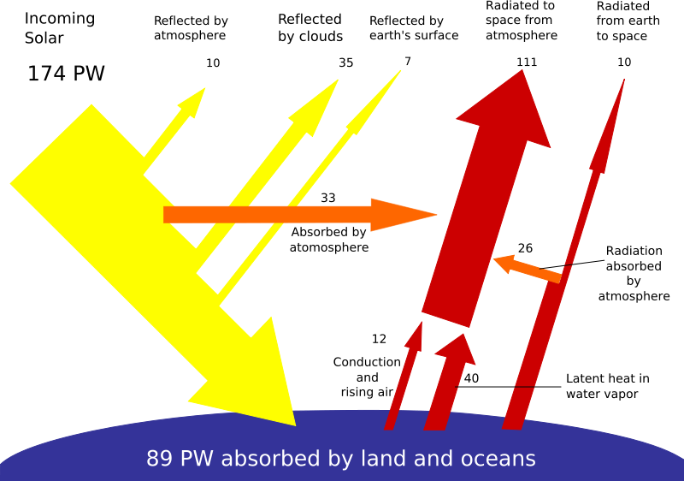
Breakdown of incoming solar energy

Slide 6
Solar Cells Background
1839 - French physicist A. E. Becquerel first recognized the photovoltaic effect.
Photo+voltaic = convert light to electricity
1883 - first solar cell built, by Charles Fritts, coated semiconductor selenium with an extremely thin layer of gold to form the junctions.
1954 - Bell Laboratories, experimenting with semiconductors, accidentally found that silicon doped with certain impurities was very sensitive to light. Daryl Chapin, Calvin Fuller and Gerald Pearson, invented the first practical device for converting sunlight into useful electrical power. Resulted in the production of the first practical solar cells with a sunlight energy conversion efficiency of around 6%.
1958 - First spacecraft to use solar panels was US satellite Vanguard 1

Slide 7
SEMICONDUCTOR
A material whose electrical conductivity is intermediate between that of an
insulator and a conductor, behaves as an insulator at very low temperature.
It has appreciable electricity conductivity at room temperature lower than a conductor.
Commonly used semiconducting materials are Hydrogenated Silicon(a-Si/H), Germanium(G), Cadmium Telluride (Cd/Te), Cadmium Indium Gallium Selenide (CIGS), Gallium Arsenide(G/As), Indium Phosphate(In/P).

Slide 8
TYPES OF SEMICONDUCTORS
INTRINSIC SEMICONDUCTOR :- The conduction of a current in a semiconductor is only due to the electron excited from the valence band to the conduction band.
EXTRINSIC SEMICONDUCTORS :- The conduction of a current in a semiconductor is due to impurities.
DOPING :- The process of intentionally introducing impurities into an extremely
pure semiconductor in order to change its electrical properties is called as doping.
DOPANTS :- The impurities that are added are called dopants.

Slide 9
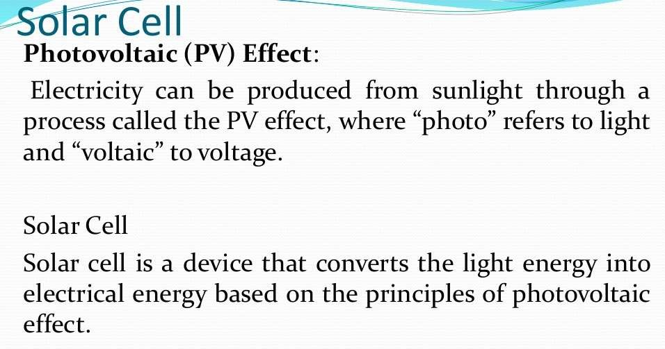

Slide 10
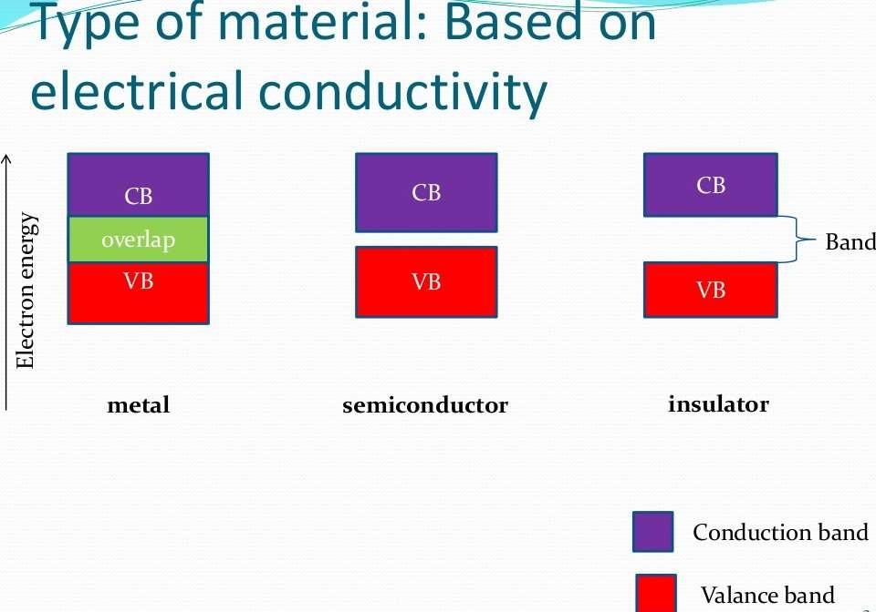

Slide 11

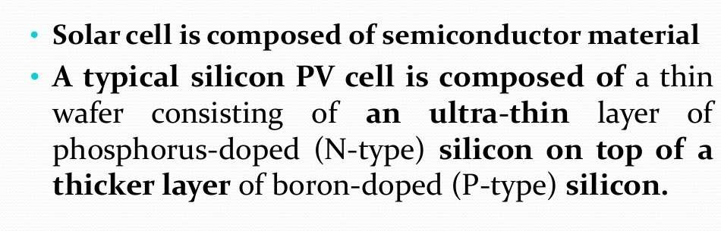

Slide 12
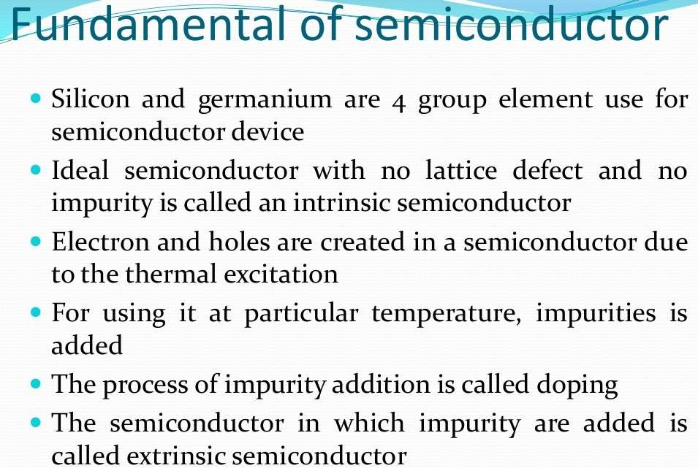

Slide 13
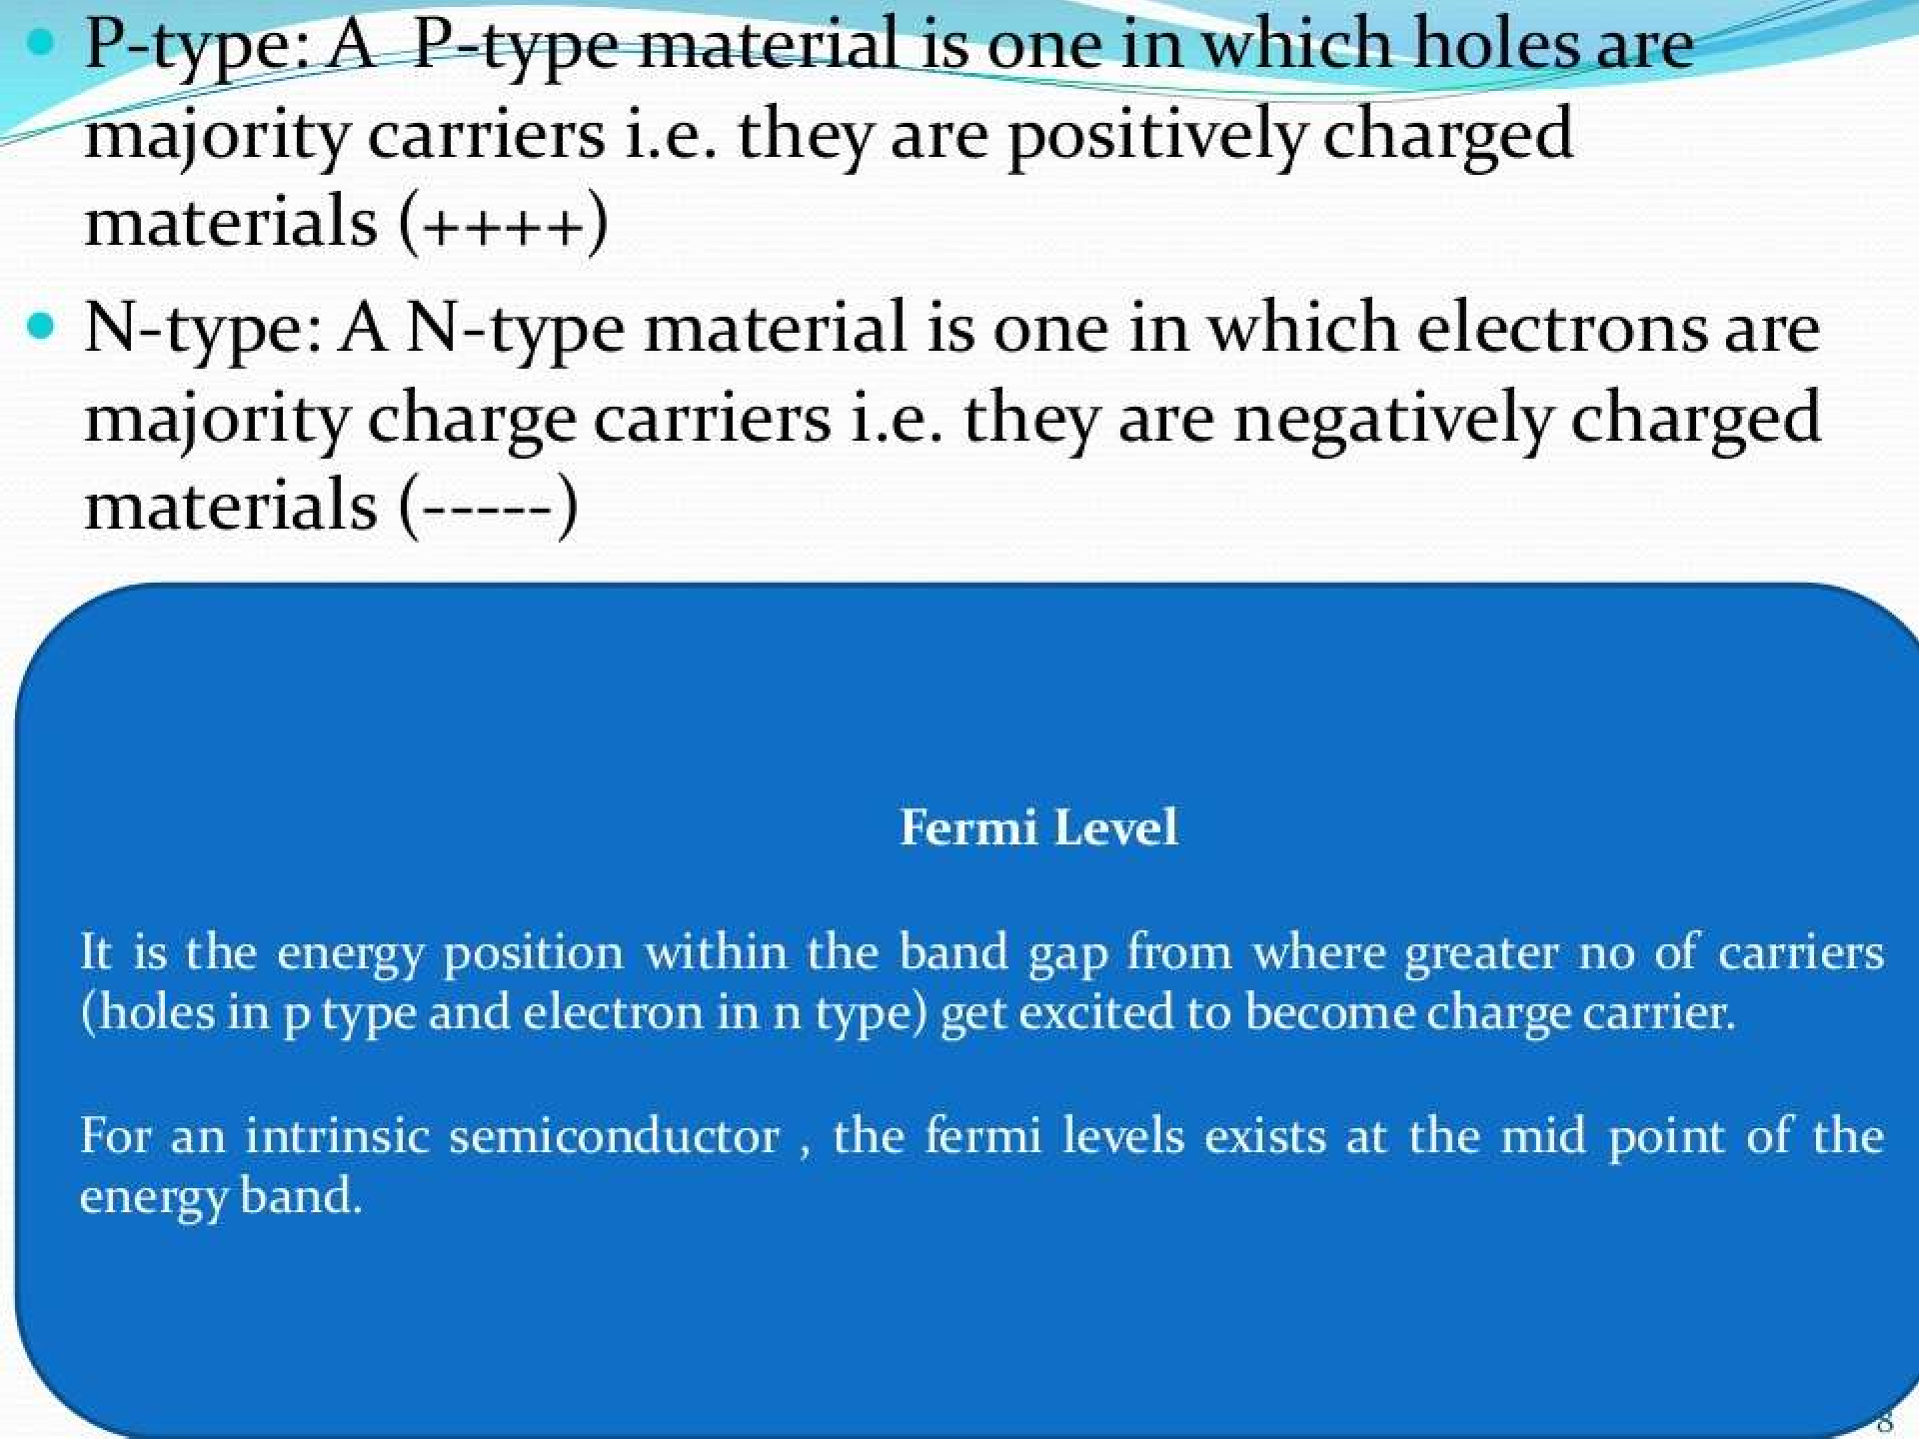

Slide 14
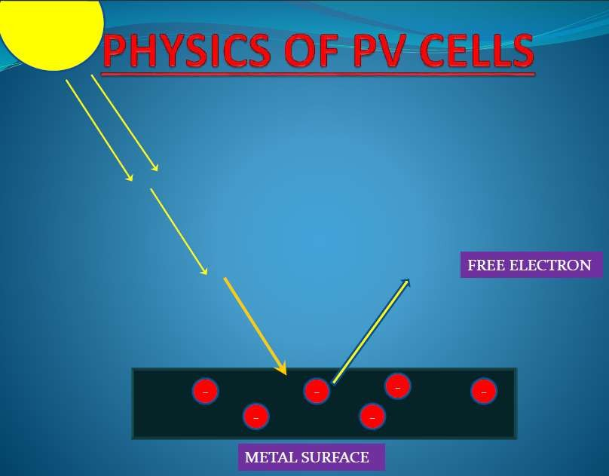

Slide 15
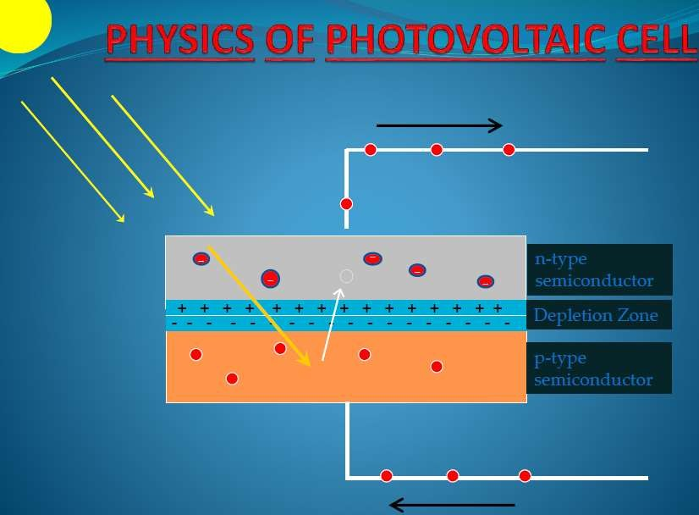

Slide 16
How Solar Cells Work
1. Photons in sunlight hit the solar panel and are absorbed by semiconducting materials, such as silicon
2. Electrons are present in the valance shell get enough energy from the photons that they are knocked loose from their atoms. The electrons jump from the valence band to the conduction band, allowing them to flow in the material to produce electric power
3.The forbidden gap (energy band gap) corresponds to the minimum energy needed to release an electron from the valance band to the conducting band where it can conduct a current.
4. An array of solar cells converts solar energy into a usable amount of direct
current (DC) electricity.

Slide 17
The energy difference between the edges of the two bands is called the band gap energy or band gap, EG, and it is an important material parameter
The band gap of the single crystal silicon is of 1.12eV at room temperature.
An electron volt is equal to the energy, which an electron acquires when it passes through a potential of 1volt in vacuum (1eV = 1.602×10-19J).

Slide 18
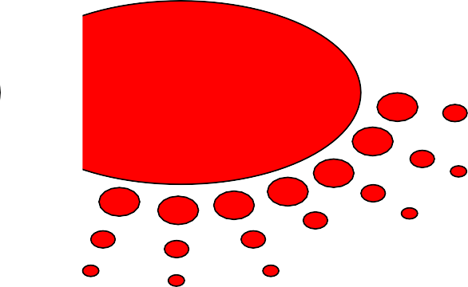

Mechanism of generation
The solar cell is composed of a P-type semiconductor and an N-type semiconductor. Solar light hitting the cell produces two types of charges, negatively charged electrons and positively charged wholes in the semiconductors.
Negatively charged (-) electrons gather around the N-type semiconductor while positively charged (+) wholes gather around the P-type semiconductor. When you connect loads such as a light bulb, electric current flows between the two electrodes.
Electrode
Reflect-Proof Film
N-Type Semiconductor
P-Type Semiconductor
Solar Energy
Electric Current
Load
Electrode
Photo Voltaic cell

Slide 19
RECOMBINATION
When the light is switched off, the system must return to a state of equilibrium and the electron-hole pairs generated by the light must disappear.
With no external source of energy, the electrons and holes wander around until they meet up and recombine.
Any defects or impurities within or at the surface of the semiconductor promote recombination.

Slide 20
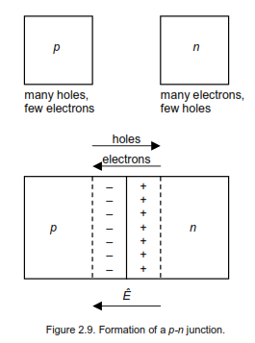
P-N JUNCTIONS
A p-n junction is formed by joining n-type and p-type semiconductor materials, as shown in Fig. 2.9.
When joined, the excess holes in the p-type material flow by diffusion to the n-type material, while electrons flow by diffusion from the n-type material to the p-type material as a result of the carrier concentration gradients across the junction.
The electrons and holes leave behind exposed charges on dopant
atom sites, fixed in the crystal lattice.

Slide 21
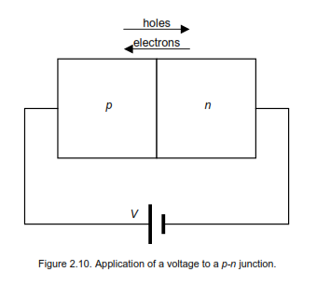
P-N JUNCTIONS
An electric field (E) therefore builds up in the so-called depletion region around the junction to stop the flow. Depending on the materials used, a ‘builtin’ potential (V_{bi}) owing to E will be formed.
If a voltage is applied to the junction, as shown in Fig. 2.10, E will be reduced.

Slide 22
Generation of Charge Carriers
In the operating condition, semiconductor device is not in equilibrium as there is
Flow of current
Voltage applied across the terminals
Application of light on the device.
In the disturbed condition or non-equilibrium condition, the carrier concentration
changes in the device.
The carrier concentration can be increased or decreased depending upon the process happening in the device.
For instance, when solar radiation falls on the surface of the solar cell, the electron hole
(e-h) pairs are generated, resulting in increased in their concentration.

Slide 23
Generation of Charge Carriers
This creation of e-h pair is called Generation
But there is always order restoring process which happens in the reverse direction than that of generation, known as Recombination.
Recombination is a process in which e-h pairs annihilated (or dies out).
When light falls on a solar cell, some of it gets reflected, some of it gets transmitted &
some of it gets absorbed with in the solar cell.

Slide 24
Generation of Charge Carriers
Photons after entering into the semiconductor interacts with the atoms.
Only the photons having the energy more than or equal to the bandgap energy (hυ ≥ E_{g})
can get absorbed in the material.
The photons that are absorbed in the semiconductor material cause excitation of electrons from the Valence band (VB) to Conduction band (CB), resulting in the generation of e-h pairs.
If E_{photon} > E_{g}, the electron get excited to higher energy level than the CB edge (E_{C}).
The energy difference (E_{ph}-E_{g}) is corresponding to Kinetic Energy (K.E) of electrons.
Due to K.E, the electrons undergo several events of scattering & loose energy in the steps
and eventually electron comes down to E_{C} .

Slide 25
Rate of Generation
As the light of energy, more than the Eg, travels in a semiconductor, it gets absorbed.
The light intensity (I) reduces as it travels deeper in the material & can be written as
I = I_{o} e^{-αx}
Where;
I_{o} is the light intensity at the surface of the SC.
α is called the absorption coefficient and it is the function of wavelength of light.
X is the depth of the SC material.
The equation shows that intensity of light decreases or reduces exponentially as it passes
through the SC.

Slide 26
Rate of Generation
As absorption of light is related to the generation of carriers therefore the generation of carriers along the depth of SC should also follow exponential relationship similar to previous equation, and should be a function of distance and wavelength.
If we assume that light is falling continuously then the rate of carrier generation can be
written as
G_{L} = G_{L0} e^{-αx} = dn/dx =dp/dx
Where;
G_{L0} is the generation rate at the surface of SC material.

Slide 27
Absorption Coefficient (α)
How strongly a particular photon get absorbed in a material
It is a material parameter and depends on the wavelength of light
Its value is a determining parameter in deciding the thickness of the material required to absorb most of the solar radiation.
Absorption Length (Lα):
It is the inverse of absorption coefficient and it is defined as the maximum distance a photon can travel in SC without absorption.
L_{α} = 1/α

Slide 28
Absorption Coefficient (α)
α of direct bandgap SC materials is HIGH (>10⁴ cm⁻¹) for most of the λ of solar spectrum.
High value of α represents high absorption possibility because it involves only a photon,
but no phonon for absorption to occur.
High value of α implies that small thickness of SC material is required to capture relevant range of photons (λ), therefor solar cell made from direct bandgap materials can be thinner, thickness being in the range of a few microns.
α of indirect bandgap material varies from high to low. The low value of α is due to the requirement of photon and phonon for absorption to occur, (α ~ 10⁴ cm⁻¹) therefore large thickness of material is required to capture the relevant light.

Slide 29
Absorption Coefficient (α)
The generation of e-h pair in direct & indirect bandgap SC is called Band-to-Band generation.
Other processes (which are not dominant) that can give rise to carrier generation are
  Trap energy levels
  Auger excitation

Slide 30
Recombination of carriers
In this process, the excited electrons fall back from conduction band (CB) to the valence band (VB), reoccupying the empty energy state ( a hole) in the VB, thus e-h pair get destroyed.
It is therefore an equilibrium restoring process.
It is not desirable in SC operation, and should be avoided as much as possible.
The rate of recombination is one of the important solar cell efficiency limiting parameter.

Slide 31
Recombination of carriers
Let the concentration of electrons and holes in equilibrium condition be n₀ & p₀. when light falls on the solar cells, equilibrium is disturbed and non equilibrium concentrations of electrons and holes are n & p. Therefore, excess carrier concentration of electrons and holes under illumination, Δn & Δp, respectively can be written as;
Δn = n – n₀
Δp = p – p₀

Slide 32
Carrier Lifetime (τ)
Generated carriers return to the ground state (recombination) after spending certain time in the excited state.
The average amount of time a carrier spends in the excited state before recombining is known as lifetime of the carrier.
τ_{n} = Δn/R ; τ_{p} = Δp/R
(R is the rate of recombination)
Similar to diffusion coefficient & mobility, carrier lifetime is a material parameter.
The carrier lifetime should be high or low recombination rate is desirable.
A material can have high τ, if it has low structural defects and low undesirable impurity concentration.
τ varies between ns to ms.
Si with τ more than a few tens of μs is considered a good material for solar cell.

Slide 33
Types of Recombination
All of the following can occur in parallel
(1) Band to Band Recombination:
In this process excited electron falls back directlyfrom CB to VB & reoccupy the empty state (hole). In the process it releases its energy in the form of a photon.
(2) Trap Assisted Recombination:
Impurities & structural defects in a material give rise to energy levels within the bandgap.
These energy levels, which are closed gto energy band edges (E_{c} & E_{v}) do not contribute to the recombination of charges.
But the energy levels which lie near the middle of the bandgap or mid-gap energy levels
are very effective & enhance the carrier recombination.

Slide 34
Types of Recombination
Impurities such as Au, Fe & Mn act like a recombination centre in Si.
The mid-gap energy levels are called Trap Levels & therefore this recombination mechanism is called trap assisted recombination.
An electron in the excited state jumps from the CB to mid-gap energy levels (gets trapped); a further jump from the mid-gap energy level to the VB followed by recombination with a hole completes the process. Since both the jumps ( CB to mid-gap & mid-gap to VB) occurs in series, the effectiveness of this recombination process requires equal probability of both the jumps. Probability of a given jump decreases as the energy level difference increase. This in turn requires mid-energy levels to be in the middle of the bandgap.

Slide 35
Types of Recombination
(3) Auger Recombination:
It occurs at high level of carrier concentration (> 10¹⁷ cm⁻³).
In this process, an electron recombining with the hole gives its energy to another electron in the CB instead of giving it in the form of photon.
The second electron, which receives the energy , goes into higher energy levels in the CB, having
higher Kinetic Energy (K.E)
It can also happen in the VB, where recombining electron gives its energy to a hole in the VB
In the Auger process, 3 particles take part in recombination
  electron-electron-hole (CB electron gets excited)
  Electron-hole-hole (VB holes gets excited)

Slide 36
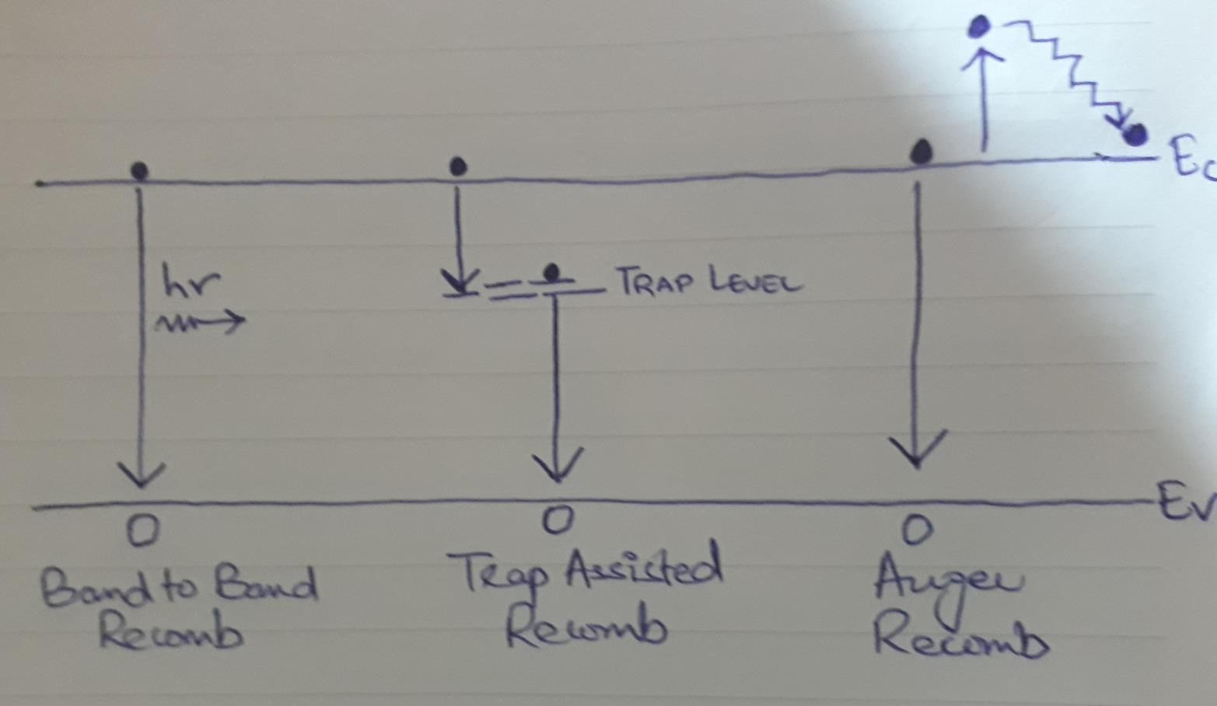
Types of Recombination

Slide 37
Solar Cell Characteristics
Solar cells are compared & characterized with each other with the following parameters
Short circuit current (I_{sc})
Open circuit voltage (V_{oc})
Fill Factor (FF)
Efficiency (η)
I
I
sc _{Pm}
I_{m}
In the following figure, illuminated curve is flipped for convenience, so keep in mind the current axis is exactly a negative x-axis.
V
V_{m}
^{V}oc

Slide 38
Short Circuit Current (I_{sc})
Maximum current that flows in a solar cell when its terminal at P-side and N-side are shorted with each other.
When we put V=0 in the following equation
I_{total} = I_{o} (e^{qV/KT} – 1) – I_{L}
We get
^{I}total ^{= -I}L ^{= I}sc
The short circuit current is nothing but light generated current.
Isc usually represented in terms of mA/cm²

Slide 39

Open Circuit Voltage (V_{oc})
Maximum voltage generated across the terminals of a solar cell when they are kept open i.e. I=0
I_{total} = I_{o} (e^{qV/KT} – 1) – I_{L}
We get,
V = Voc
𝐾𝑇 𝐼_{𝐿}
= ln( + 1 )
𝑞 𝐼_{𝑜}
oc
V_{oc} depends on light generated current and reverse saturation current and is given in terms of mV or V.

Slide 40
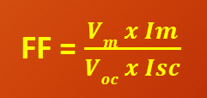
Fill Factor (FF)
It is the ratio of maximum power (P_{m} = V_{m} x I_{m}) that can be extracted from the solar cell to the ideal power (P_{o} = I_{sc} x V_{oc})
𝑽_{𝒎} 𝒙 𝑰 𝒎
FF =
𝑽_{𝒐𝒄} 𝒙 𝑰𝒔𝒄
FF represent the squareness of the solar cell I-V curve and it is represented in
percentage.

Slide 41
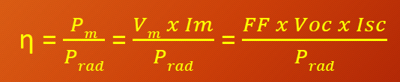
Efficiency (η)
It is the ratio of maximum power (Pm) that can be extracted from the solar cell to the solar radiation power.
𝑃_{𝑚 =} 𝑉_{𝑚} 𝑥 𝐼 𝑚 ₌ 𝐹𝐹 𝑥 𝑉𝑜𝑐 𝑥 𝐼𝑠𝑐
^{𝑃}𝑟𝑎𝑑 ^{𝑃}𝑟𝑎𝑑 ^{𝑃}𝑟𝑎𝑑
η =
As an international standard P_{rad} = 1000 W/m²

Slide 42
Assignment
A solar cell has the following parameters: Voc = 0.6 V; Isc = 30 mA/cm2 and FF = 76%. What will be its efficiency?
Answer → 13.68 %

Slide 43
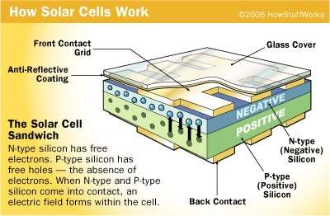

Slide 44
Losses in Solar Cells
A loss in a solar cell refers to loss of photon energy (partial or full), which due to some reason, is not able to deliver an electron out of a solar cell.
This loss could be due to the fundamental reason (limited by material properties) or it could be due to the technological reason (limited by cell processing capabilities).

Slide 45
Fundamental Losses
(1) Loss of Low Energy Photons:
Eph < Eg → No e-h pair generation
Referred as Transmission Loss
23 % for a single P-N junction
(2) Loss Due to Access energy of Photons:
Eph > Eg → Eph – Eg is given off as heat
Referred as Thermalization loss
33 % for a single P-N junction

Slide 46
Fundamental Losses
(3) Voltage Loss:
Occurs due to Auger recombination
voltage loss = Voc/V (bandgap voltage)
Lies in the range 0.65 to 0.72
(4) FF Loss:
Loss due to Parasitic Resistance ( series and shunt)
Ideally FF=1, but in reality I-V curve is given by exponential behavior
In the best case FF= 0.89

Slide 47
Technological Losses
(1) Loss By Reflection:
Incident photons reflected back from the cell’s surface.
It can be minimized by using anti-reflecting coating.
(2) Loss Due to Incomplete Absorption:
Photons have enough energy to get absorbed but can’t get absorbed due to cell thickness.
Its an important consideration now a days as thickness reduction is an important parameter for cost reduction.
It can be minimized by having appropriate light trapping schemes.

Slide 48
Technological Losses
(3) Loss Due to Metal Coverage:
The contact to the front side of cell is made in the form of fingers and bus bars.
This metal contact shadows some light which can be up to 10 %.
It can be minimized by using back contact solar cell or transparent contact.
(4) Recombination Losses:
Not all the generated e-h pairs contribute to the solar cell current & voltage.
Recombination could occur in the bulk of the material or at the surface.
It can be minimized by appropriate surface & bulk passivation techniques .

Slide 49
Solar Cell Design
A solar cell must perform the following 3 functions as efficiently as possible
  Absorption of light
  Separation of generated charge carriers &
  Transport of separated charge carriers to external load without resistive losses.
Solar cell of a given material must be designed to maximize the light to electricity conversion efficiency.
This in turn requires optimization of solar cell parameters I_{sc}, V_{oc} & FF such that higher values of each of these are obtained to get high cell efficiency.
The cell efficiency is written as
η = I_{sc} V_{oc} FF/P_{in}

Slide 50
Minimization of Optical Losses
Solar cell is supposed to absorb all solar radiation falling on it. Any loss of radiation will result in less generation of electron-hole pair which will result in the reduction of I_{L} .
The loss of solar radiation due to optics or optical loss is referred to as the solar radiation which falls on the solar cell, but does not get absorbed due to some reason.
The loss of radiation could be due to the
(1) reflection from the solar cell surface
(2) reflection from metal contact
(3) Transmission through the cell.
The optical loss could be as high as 40% to 50%. These losses should be minimized in order to get high I_{L} .

Slide 51
Minimization of Optical Losses
The optical losses can be minimized by the following design:
Putting anti-reflection coasting on the solar cell surface;
Texturing front surface to reduce reflection;
Minimizing the front metal contact coverage area to reduce contact shading; and
Making solar cell thicker to increase absorption of low energy photons.

Slide 52


































Various type of PV cell
Types and Conversion Efficiency of Solar Cell
Conversion Efficiency of Module
Single crystal
10 - 17%
Crystalline
Silicon Semiconductor
Poly crystalline
10 - 13%
Non-crystalline
Amorphous
7 - 10%
Solar Cell
Compound
Semiconductor
Gallium Arsenide (GaAs)
18 - 30%
Dye-sensitized Type
7 - 8%
Organic Semiconductor
Organic Thin Layer Type
2 - 3%
Electric Energy Output
x 100%
^{Conversion Efficiency =} Energy of Insolation on cell

Slide 53
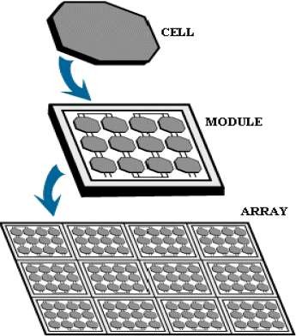
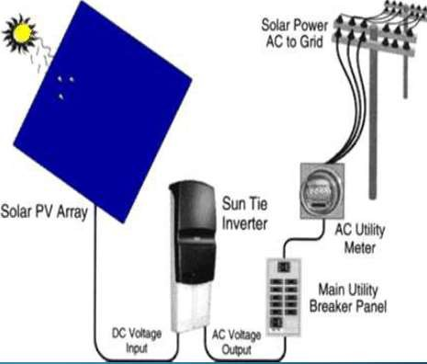
Typical output of a module (~30 cells) is ≈ 15 V, with
1.5 A current

Slide 54
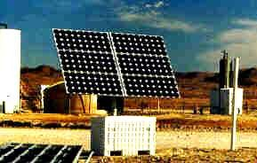
PV System’s Components
Solar Array
Storage Batteries
Charge Controller (Regulator)
Inverter (For AC Systems Only)

Slide 55
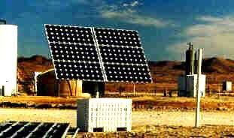
Photovoltaic System
PV
Array
Charge Controller
Battery

Slide 56

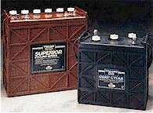
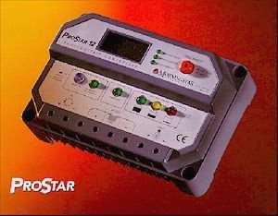

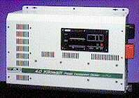

PV System’s Components
Charge Controller
Photovoltaic Array
Battery Bank
Inverter
(AC loads)
Load

Slide 57
Design Strategy
PV Array:
Array are the combination of multiple solar cells
Type Selection
Sizing
Climate & Geographical Location Considerations

Slide 58
Design Strategy
PV Array Types:
Type |  | Efficiency | Cost | Economical Feasibility
Crystalline Silicon (c-Si) |  | High 15-24% | High | Low
Amorphous Silicon (a-Si) | Single Junction | Low 5-10% | Low | Medium
 | Multi- Junction | Medium 7.5-13% | Low | High

Slide 59
Design Strategy
PV Array Sizing:
De-rating Factors
 Aging
 Dirt Accumulation
 Future Growth
Recharging Period
System Voltage
Load Profile
20%
20%
10%

Slide 60
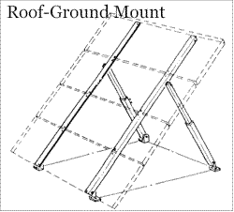
Design Strategy
PV Array Climate & Geographical Location:
Solar Insolation (Radiation)
Effective Sun Hours
Climate
  Temperature & Humidity
Array Orientation
 Direction (Toward South)
 Tilt Angle
  Fixed Angle (Latitude + 10 Degrees)
  Adjustable (Sun Tracking)

Slide 61
Design Strategy
Storage Battery:
Sizing
System Voltage
Load Profile
Backup Time (Autonomy)
7 days
De-rating Factors | Lead-Acid | Ni-Cad
Aging | 25% | 10%
Temp. Compensation | 19% | 14%
Design | 10% | 10%

Slide 62
Design Strategy
Storage Battery:
Environment Considerations
No Temperature Control ⇒ Temp. Compensation
Outdoor Battery Enclosure
Shade Requirement

Slide 63
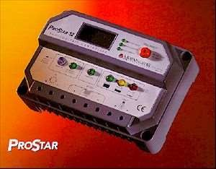
Design Strategy
Charge Regulator:
Type Selection
 Single Stage
 Multistage
Sizing
(Array Rated Currents)
Temperature Compensation
Low Voltage Disconnect

Slide 64

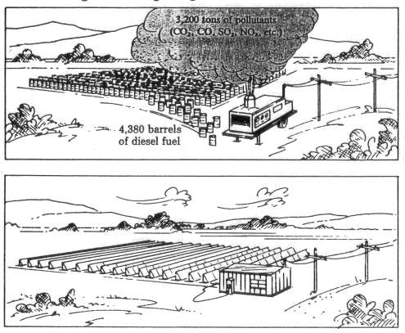
Advantages
$ $ $
Reliable
No Fuels
Low Maintenance
Long-term Savings
No Pollution
No Noise

Slide 65
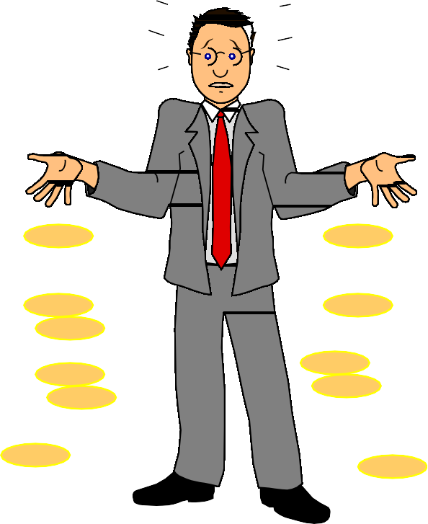
Disadvantages
$
$
High Initial Cost
Specialized Maintenance
 Batteries
 Power Conditioning Equipment
Large Space
$
$
$
$

